Slide 1
Hand pose estimation using point cloud
Clarissa Hamann
Project Plan Presentation
Supervisor: Shile Li

Slide 2
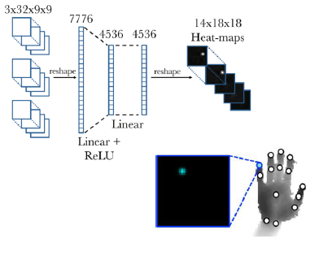
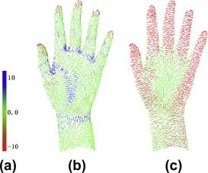
Hand pose estimation using point cloud - Motivation
Depth image
• Structured input
• Compatible to CNN/ResidualNet
• Cannot fully exploit 3D information
• Appearance depends on camera parameters
Point cloud
• Fully usage of 3D information
• Unstructured input
• The order of the input points is not fixed
• Commonly used deep learning elements such as CNN cannot be used
Notes:
CNN: Convolutional Neural Network

Slide 3
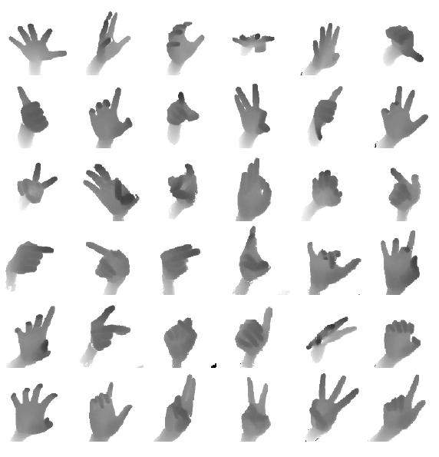
ICVL dataset (Imperial College Vision Lab)
For capturing training and testing data
Captures depth images (lower noise level than structured-light sensors)
For each image 16x3 numbers in .txt file→ 16 joint locations (Palm, Thumb, Index etc.)

Slide 4
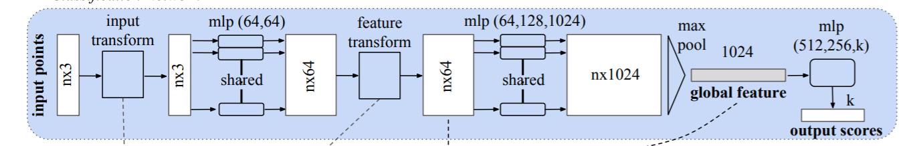
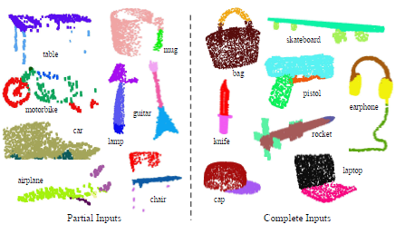
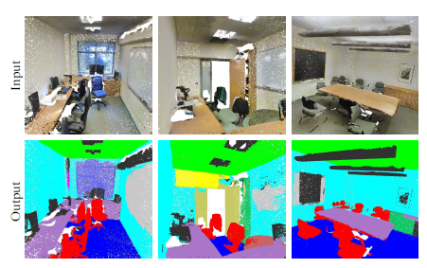
PointNet
Deep learning architecutre capable of reasoning about point clouds
Using Max Pooling
Sucessful for point cloud segmentation task (Part segmentation Semantic Segmenation)
Notes:
Max Pooling: unstructed point cloud, takes only the max value of the feature (one of 1024) → pose coordinates (red points)
part segmentation: network learns to select interesting/informative points; Semantic Segmenation: extended network→ semantic object classes
→ Use this for out task

Slide 5
Project Plan I
Preprocessing
Depth image to point cloud conversion
Point cloud normalizaiton
View point normalization
Centroid point subtraction
Write into h5 files
Conversion to tensorflow format
Notes:
Tensorflow framework for deep learning
→ Point cloud, unoform hand

Slide 6
Project Plan II
Implementation
PointNet based hand pose estimation framwork
Deep Learning
Training with ICVL dataset
Data loading
Data augmentation
Testing with ICVL dataset
Notes:
Augmentation, creat atrififcally more data, to increase size of the data

Slide 7
Time plan
08.11.18 Project Plan Presentation
→ finish Preprocessing
→ starting Implemention
06.12.18 Project Progress Presentation
→ finish Implementation
→ starting Training/Testing
Christmas
→ finish Training/Testing
→ writing report
14.01.19 Final Report Submission
17.01.19 Final Presentation

Slide 8

References
Charles R Qi, Hao Su, Kaichun Mo, and Leonidas J Guibas. Pointnet: Deep learning on point sets
for 3d classication and segmentation. Proc. Computer Vision and Pattern Recognition (CVPR) IEEE, 1(2):4, 2017
Danhang Tang, Hyung Jin Chang, Alykhan Tejani, and Tae-Kyun Kim
Latent regression forest: Structured estimation of 3d articulated hand posture. In Proceedings of the IEEE conference on
computer vision and pattern recognition
pages 3786{3793, 2014

