Slide 1
Controlled Looping
“for” statements

Slide 2
Why???
Looping can be used to perform the same set of statements over and over until a specified condition is met.
Looping makes your program more concise

Slide 3
General form
for(
;
;
)
Initalize
counter
Test counter
Increment counter
{
True
Program statements;
}
Next Program Statement

Slide 4
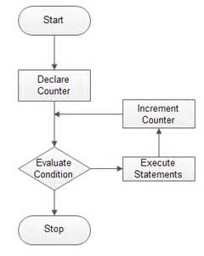

Slide 5
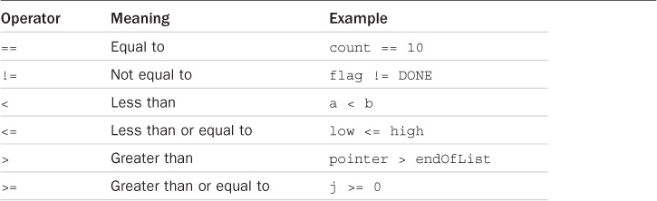
Relational Operators for testing

Slide 6
“for” loop Examples
//list the number 1 to 10 using a “for” loop
int n; //loop counter
for(n = 1; n <= 10; ++n)
{
printf(“%i “, n);
}
Initialize n
Test n
Increment n

Slide 7
“for” loop Examples
//add the numbers 1 to 10 using a “for” loop
int n, //loop counter
sum = 0; //add the numbers to sum
for(n = 1; n <= 10; ++n)
{
sum = sum + n;
}
printf(“Sum = %i\n”, sum);
Sum = 55
Press any key to continue . . .

Slide 8
Sample: Table of values
//Create a table for the number 0 to 5
printf( “A A+2 A+5\n” );
for(n = 0; n < 6; ++n)
printf(“ %i %6i %6i\n”, n, n+2, n+5);
output:
A A+2 A+5
0 2 5
1 3 6
2 4 7
3 5 8
4 6 9
5 7 10

Slide 9
Sample 2
Shortcuts
++a → a = a + 1;
b-- → b = b – 1;
Output:
0 + 8 = 8
1 + 7 = 8
2 + 6 = 8
3 + 5 = 8
4 + 4 = 8
5 + 3 = 8
6 + 2 = 8
7 + 1 = 8
8 + 0 = 8
for(a = 0, b = 8; a <= 8; ++a, b--)
printf(“%i + %i = %i \n”, a, b, a+b);
Initialize 2 variables
Test only 1 variable
Increment 2 variables

Slide 10
Guided Practice
Write the program sequence to do the following
Print the numbers 1 to 20
Print the even numbers 1 to 50
Print the odd numbers 1 to 50
Write the program sequence to do the following
Calculate and print the sum of the numbers 1 to 50
Calculate and print the sum of 15 numbers entered by the user
Calculate and print the average of 20 numbers entered by the user

Slide 11
Guided practice set up
Open compiler
Set up menu
Set up sections with documentation
Test basic structure

Slide 12
/*INFO 2110 Week 4 class code setup
Name
Program description:
1. Write the program sequence to do the following
Print the numbers 1 to 20
Print the even numbers 1 to 50
Print the odd numbers 1 to 50
2. Write the program sequence to do the following
Calculate and print the sum of the numbers 1 to 50
Calculate and print the sum of 15 numbers entered by the user
Calculate and print the average of 20 numbers entered by the user
*/
//Libraries
#include "pch.h" //2017 C++
#include <iostream> //2017 C++
#include <stdio.h> //C

Slide 13
int main()
{
//declare variables - reserve space in memory
//initialize variables - assign numbers to the variables
//calculation and print
//Calculate and print the sum of the numbers 1 to 50
printf("Calculate and print the sum of the numbers 1 to 50: ");
//Calculate and print the sum of 15 numbers entered by the user
printf("Calculate and print the sum of 15 numbers entered by the user: ");
//Calculate and print the average of 20 numbers entered by the user
printf("Calculate and print the average of 20 numbers entered by the user: ");

Slide 14
//output - print the results to the screen
//Print the numbers 1 to 20
printf("Print the numbers 1 to 20");
//Print the even numbers 1 to 50
printf("Print the even numbers 1 to 50: ");
//Print the odd numbers 1 to 50
printf("Print the odd numbers 1 to 50: ");
}

Slide 15
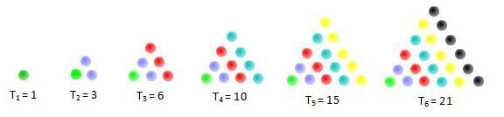
Triangular Numbers
A triangular number or triangle number counts the objects that can form an equilateral triangle.
What is the 4th triangular number?
1 + 2 + 3 + 4 = 10

Slide 16
Sample code for the 8th triangular number
// Program to calculate the eighth triangular number
#include <stdio.h>
int main ()
{
int triangular_number;
triangular_number = 1 + 2 + 3 + 4 + 5 + 6 + 7 + 8;
printf ("The eighth triangular number is %i\n", triangular_number);
return 0;
}

Slide 17
Triangular Numbers
1680
What is the 60th triangular number?
What is the 200th triangular number?
20100

Slide 18
200th Triangular Number
/* Program to calculate the 200th triangular number
Introduction of the for statement */
#include <stdio.h>
int main (void)
{
int n, triangularNumber;
triangularNumber = 0;
for ( n = 1; n <= 200; n = n + 1 )
triangularNumber = triangularNumber + n;
printf ("The 200th triangular number is %i\n", triangularNumber);
return 0;
}

Slide 19
User Input Triangular Number
/* Program to calculate the user’s triangular number*/
#include <stdio.h>
int main (void)
{
int n, num, triangular_number = 0;
printf(“Enter a number: “);
scanf(“%i”, &num);
for ( n = 1; n <= num; n = n + 1 )
triangular_number = triangular_number + n;
printf ("The triangular number is %i\n", triangular_number);
return 0;
}

Slide 20
Table of Triangular Numbers
// Program to generate a table of triangular numbers
#include <stdio.h>
int main (void)
{
int n, triangularNumber;
printf ("TABLE OF TRIANGULAR NUMBERS\n\n");
printf (" n Sum from 1 to n\n");
printf ("--- ---------------\n");
triangularNumber = 0;
for ( n = 1; n <= 10; ++n )
{
triangularNumber = n + triangularNumber;
printf (" %2i %8i\n", n, triangularNumber);
}
return 0;
}

Slide 21
Output
TABLE OF TRIANGULAR NUMBERS
n Sum from 1 to n
--- ---------------
1 1
2 3
3 6
4 10
5 15
6 21
7 28
8 36
9 45
10 55

Slide 22
Sample
Write a program to identify the highest number of 20 numbers entered by the user
int main(void)
{
int big, n, num;
printf(“Enter a number: “); //prompt the user
scanf(“%i”, &big); //get the first number
for(n=1; n<=20; ++n) //generate 20 numbers
{
if(num > big)
big = num;
printf(“Enter a number: “); //prompt the user
scanf(“%i”, &num);
}

Slide 23
sample
Write a program to generate the multiples of 4 up to 100
int main(void)
{
int n, num;
for(n=0; n<=100; n=n+4) //option 1
printf(“%6i”, n);
printf(“\n”);
for(n=1; n<=25; ++n) //option 2
printf(“%6i”, n * 4);
printf(“\n”);
for(n=1; n<=25; ++n) //option 3
{
num = 4 * n;
printf(“%6i”, num);
}
printf(“\n”);

Slide 24
Nested “for” loops

Slide 25
Nested “for” Loops
Code:
for(n=1; n<4; ++n)
{
printf(“\n\n Outer loop #%i\n”, n);
for(k=1; k<3; ++k)
printf(“\t Inner Loop #%i\n”,k);
printf(“End of Outer Loop#%i\n”,n);
}

Slide 26
Output:
Outer loop #1
Inner Loop #1
Inner Loop #2
End of Outer Loop #1
Outer Loop #2
Inner Loop #1
Inner Loop #2
End of Outer Loop #2
Outer Loop #3
Inner Loop #1
Inner Loop #2
End of Outer Loop #3

Slide 27
Sample Code
Write a program to calculate the triangular number for 5 integers entered by the user

Slide 28
Plan
For 5 times
{
Get the number from the user.
Calculate the requested triangular number.
Display the result.
}

Slide 29
#include <stdio.h>
int main (void)
{
int n, number, triangular_number, counter;
for ( counter = 1; counter <= 5; ++counter )
{
printf ("What triangular number do you want? ");
scanf ("%i", &number);
triangular_number = 0; //reset triangular number to zero
for ( n = 1; n <= number; ++n )
triangular_number = triangular_number + n;
printf ("Triangular number %i is %i\n\n", number, triangular_number);
}
return 0;
}

Slide 30
What triangular number do you want? 12
Triangular number 12 is 78
What triangular number do you want? 25
Triangular number 25 is 325
What triangular number do you want? 50
Triangular number 50 is 1275
What triangular number do you want? 75
Triangular number 75 is 2850
What triangular number do you want? 83
Triangular number 83 is 3486

Slide 31
Nested “for” loop Practice
Write a program to generate a solid square
**********
**********
**********
Write a program to generate a solid rectangle
**********
**********
**********
**********
**********

Slide 32
UnGraded Practice
The factorial of an integer n, written n!, is the product of the consecutive integers 1 through n. For example, 5 factorial is calculated as
5! = 5 x 4 x 3 x 2 x 1 = 120
Write a program to generate and print a table of the first 10 factorials.

Slide 33
Write a program that prints the following patterns separately, one below the other. Use "for" loops to generate the pattern. All asterisks "*" should be printed by a single "printf" statement.
*
**
***
****
*****
******
*******
********
*********
**********
_________*
________**
_______***
______****
_____*****
____******
___*******
__********
_*********
**********
**********
_*********
__********
___*******
____******
_____*****
______****
_______***
________**
_________*
**********
*********
********
*******
******
*****
****
***
**
*

Slide 34
