Slide 1
INFO.2110
INTRODUCTION TO
C PROGRAMMING

Slide 2
TONIGHT’S AGENDA
Introduction
Log onto vLab
Log onto email
Open files
Syllabus
Class Meetings
Grading
Assessments

Slide 3
LOG ONTO VLABS
Log in
Email address
Email password

Slide 4
LOG INTO EMAIL
Open browser
UML website: www.uml.edu
Search: email
Open Student email
Locate the email sent by me Nancy_KiernanBell@uml.edu
All files attached to the email will be reviewed during class

Slide 5
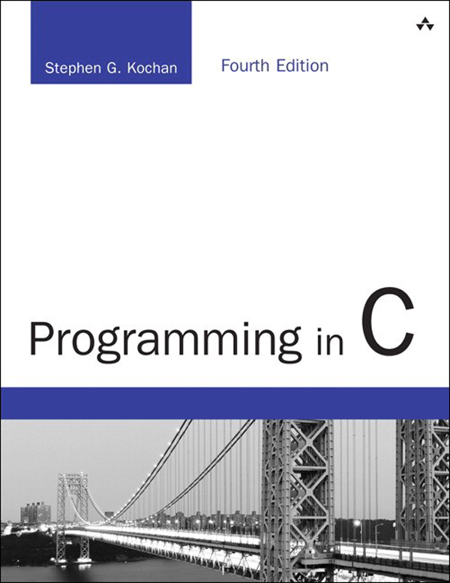
INTRODUCTION
Book – Programming in C by Stephen Kochan (4th Edition)
Compiler – Microsoft Visual C++ 2015 Express

Slide 6
SYLLABUS HIGHLIGHTS
Course Description
This course is designed to provide students with an introduction to the processing of information by the computer, computer logic, memory, input/output processing, and programming in the C language. This course emphasizes the programming problem-solving process, problem organization, algorithms, coding, debugging, documentation and the elements of good programming style. Programming problems will include a wide variety of numeric and non-numeric applications.
No prior programming experience necessary

Slide 7
ATTENDANCE
Attendance is taken each class meeting
Students are required to sign in
Religious Observances
Students should inform the instructor in writing when they will be absent.
All work required can be made up within 1 week without penalty

Slide 8
CLASS MEETINGS
September 11, 18, 25
October 2, 9, 16, 23, 30
November 6, 13, 20, 27
December 4, 11

Slide 9
GRADING
All graded assignments have point value
7 Homework Assignments – 100 points each
2 Exams – 150 points each
Total Possible Points – 1000 points

Slide 10
ASSESSMENTS
7 Homework Assignments
Requirements
On time
Each assignment contains several levels
Lower levels must be completed in order to receive points
2 Exams
Midterm Exam
50 multiple choice questions centered on vocabulary, reading and writing code are worth 2 points each
10 writing questions are worth 5 points each
Final Exam
50 multiple choice questions centered on vocabulary, reading and writing code are worth 2 points each
5 writing questions are worth 10 points each

Slide 11
GRADING
 |  | Points
A | Superior Work: Highest Quality | 950 - 1000 | 4
A- | High Honors Quality | 900 - 949 | 3.7
B+ | High Quality | 880 - 899 | 3.3
B | Basic Honors Quality | 840 - 879 | 3
B- | Below Honors Quality | 800 - 839 | 2.7
C+ | Above Satisfactory Quality | 780 - 799 | 2.3
C | Satisfactory | 740 - 779 | 2
C- | Below Satisfactory Quality | 700 - 739 | 1.7
D+ | Above Minimum Passing | 650 - 699 | 1.3
D | Minimum Passing | 600 - 649 | 1
F | Failed | Below 600 | 0
FX | Failed due to Academic Misconduct (may not be replaced or deleted) |  | 0

Slide 12
CONCEPTS
Ch 1: Fundamentals
Ch2: Compiling and Running your first program
Ch 3: Variables, Data Types, and Arithmetic Expressions
Ch 4: Program Looping
Ch 5: Making Decisions
Ch 6: Working with Arrays
Ch 7 Working with Functions

Slide 13


