Slide 1
Fundamentals
A general overview of the nature of programming in a higher level language

Slide 2
Fundamentals
Programming
High Level Languages
Operating Systems
Compiling Programs
Integrated Development Environments
Language Interpreters

Slide 3
Programming
Merriam-Webster: The action or process of writing computer programs
MacMillian Dictionary: The process of developing and implementing various sets of instructions to enable a computer to do a certain task
Wikipedia: a process that leads from an original formulation of a computing problem to executable computer programs

Slide 4
Programming
Merriam-Webster: The action or process of writing computer programs
MacMillian Dictionary: The process of developing and implementing various sets of instructions to enable a computer to do a certain task
Wikipedia: a process that leads from an original formulation of a computing problem to executable computer programs

Slide 5
The Process
Involves analysis of a problem, generating algorithms, verification of requirements of algorithms including correctness, resources consumption and implementation of the algorithms.

Slide 6
Vocabulary
Software
Compiler
Source Code
Algorithms
Reserve words
Debugging
Machine Code
Hardware
CPU
Mouse
Keyboard
Monitor

Slide 7
Low Level Languages
Binary Numbers, 0s and 1s, corresponded directly to specific machine instructions and locations in the computer’s memory
Assembly Languages allows the programmer to use symbolic names to perform various operations and to refer to specific memory locations in an assembler that translates the program from its symbolic format into the specific machine instructions of the computer

Slide 8
High Level Language
FORTRAN (FORmula TRANslation) allow the programmer to no longer concern themselves with the architecture of the computer. One statement resulted in many different machine instructions being executed.
Standardization of the syntax of a higher level language makes the program to be machine independent.
Compiler – a special program that translates the statements of a program into a form that the computer can understand

Slide 9
Operating Systems
A computer program that controls the entire operation of the computer system
Input devices – keyboard, cd, usb
Output devices – monitor, printer, usb, cd
Manages the computer’s resources
Handles the execution of the programs
UNIX
Developed by Bell Labs
Linux
Mac OS X
Written primarily in C
Microsoft Windows

Slide 10
Compiling Programs
The compiler analyzes a program for syntax
The compiler translates it into machine language
Steps:
Enter the code
Compile the code
Correct errors and recompile
Run the program
https://youtu.be/jTdY0hh5mTM

Slide 11
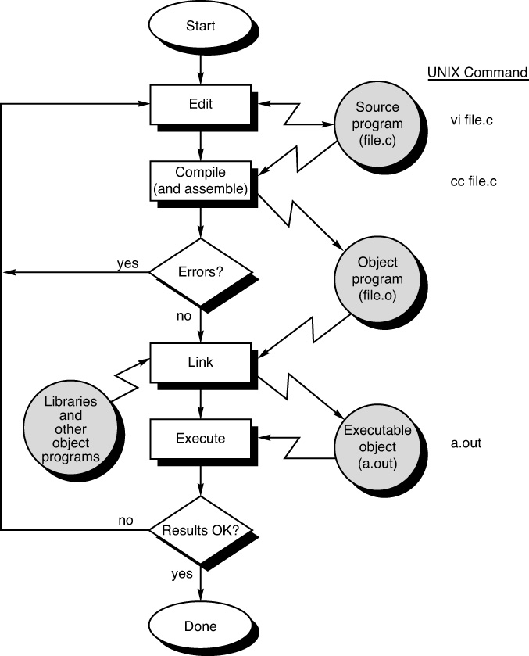

Slide 12
IDE: Integrated Development Environments
Editing, compiling, running, and debugging programs
Windows, Microsoft Visual Studio - Windows-based program that allows you to easily manage, edit, compile, link, run and debugging your program
Mac OS X, Xcode – Apple based programs that allows you to easily manage, edit, compile, link, run and debugging your program
Microsoft Visual C++ Express 2015
How to install the compiler: https://youtu.be/8wZ7_Xefrw8

Slide 13
Language Interpreters
A second method used for analyzing and executing programs
Analyzes and executes the statements at the same time
Allows programs to be more easily debugged
Slower than compilers
BASIC, JavaScript, Unix system’s shell, Python

Slide 14
Helpful Videos
https://youtu.be/jTdY0hh5mTM
https://youtu.be/OVTu4XcmnwE
https://youtu.be/1OukpDfsuXE

