Slide 1
INFO.2110 Week #3

Slide 2
Ch #5 Making Decisions
The if statement
The if-else statement
The switch statement

Slide 3
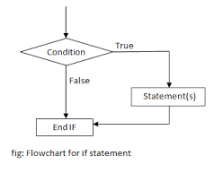
The “if” statement
Video
https://youtu.be/K2RfUgCzZR8

Slide 4
The “if” statement
The “if” statement controls conditional branching, allowing the programmer to control the flow of the program.
The “if” statement asks a question that can be answered True or False, or Yes or No.
The body of an “if” statement is executed if the value of the expression is True.
The ”if” statement is used to stipulate execution of a program statement (or statements if enclosed in braces) based upon specified conditions.

Slide 5
A word about true and false
A TRUE statement is one that evaluates to a non-zero number.
A FALSE statement is one that evaluates to zero.
When a conditional statement is used, the condition will evaluate to 1 if the expression is TRUE and will evaluate to 0 if the expression is FALSE.

Slide 6
Sample Code
if(7)
{
printf(“true\n”);
}
if(0)
{
printf(“false\n”);
}
Note:
there is no semi-colon at the end of the first part of the statement

Slide 7
Relational operators
Operator | Meaning | Example
== | Equal to | num == 10
!= | Not Equal to | response != 0
< | Less than | num < 10
<= | Less than or equal to | num <= 10
> | Greater than | num > 10
>= | Greater than or equal to | num >= 10

Slide 8
“if” statement syntax
if(test condition)
{
program statements;
}

Slide 9
Examples
if ( 5 < 10 )
{
printf( “TRUE \n" );
}
if ( statement is TRUE )
{
Execute these lines of code
}
count = 5;
LIMIT = 1;
if ( count > LIMIT )
{
printf ("Count limit exceeded\n");
}

Slide 10
Sample code
// Program to calculate the absolute value of an integer
int number;
printf ("Type in your number: ");
scanf ("%i", &number);
if ( number < 0 )
{
number = -number;
}
printf ("The absolute value is %i\n", number);
Type in your number: -100
The absolute value is 100
Type in your number: 2000
The absolute value is 2000

Slide 11
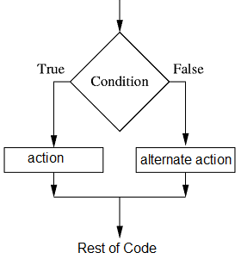
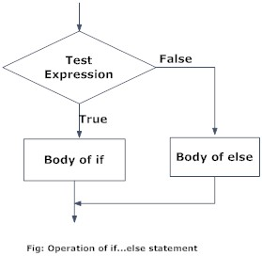
if – else statements
Video - https://youtu.be/SOnpOBvyhDM

Slide 12
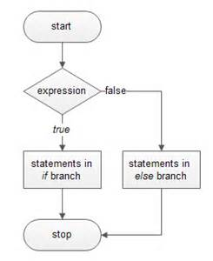
The “if - else” statement

Slide 13
“if – else” statement
Allows the programmer to dictate the action to be taken when the condition is TRUE as well as when the condition is FALSE.
if ( TRUE )
{
/* Execute these statements if TRUE */
}
else
{
/* Execute these statements if FALSE */
}

Slide 14
Using “if” statement only
Using “if - else” statement
int number_to_test, remainder;
printf ("Enter your number to be tested.: ");
scanf ("%i", &number_to_test);
remainder = number_to_test % 2;
if ( remainder == 0 )
printf ("The number is even.\n");
if ( remainder != 0 )
printf ("The number is odd.\n");
int number_to_test, remainder;
printf ("Enter your number to be tested.: ");
scanf ("%i", &number_to_test);
remainder = number_to_test % 2;
if ( remainder == 0 )
printf ("The number is even.\n");
else
printf ("The number is odd.\n");

Slide 15
Compound relational tests with Boolean operators
Boolean operators allow you to create more complex conditional statements.
AND Operator - && OR Operator - ||
p q p &&q p||q
T T T T
T F F T
F T F T
F F F F

Slide 16
Sample code
Test if a grade is between 70 and 79
if ( grade >= 70 && grade <= 79 )
{
++grades_70_to_79;
}
Test if the index is less than 0 or greater than 99
if ( index < 0 || index > 99 )
{
printf ("Error - index out of range\n");
}

Slide 17
Leap year
if ( (rem_4 == 0 && rem_100 != 0) || rem_400 == 0 )
{
printf ("It's a leap year.\n");
}

Slide 18
Leap year code
int year, rem_4, rem_100, rem_400;
printf ("Enter the year to be tested: "); //user enters year
scanf ("%i", &year);
rem_4 = year % 4; //calculations
rem_100 = year % 100;
rem_400 = year % 400;
if ( (rem_4 == 0 && rem_100 != 0) || rem_400 == 0 ) //print results
printf (“%i! It's a leap year.\n“, year);
else
printf (“%i is not a leap year.\n“, year);

Slide 19
Nested “if” statements
Nested – one inside of the other
Nested “if” statements: allows you to have good control over what code gets executed (and NOT executed) in certain scenarios.
used when multiple responses are possible and the outcome for each response is different.
if (x < 0)
sign = -1;
else
{
if (x == 0)
sign = 0;
else if (x > 0)
sign = 1;
}
if (x < 0)
sign = -1;
if (x == 0)
sign = 0;
if (x > 0)
sign = 1;
if (x < 0)
sign = -1;
else if (x == 0)
sign = 0;
else if (x > 0)
sign = 1;

Slide 20
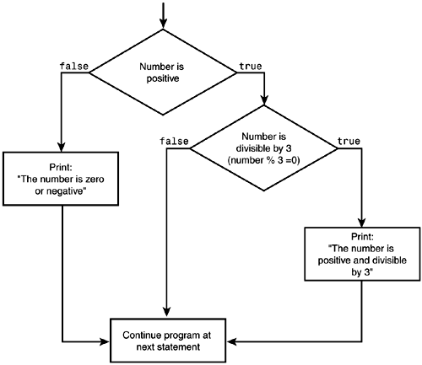
if(number > 0)
{
if(number % 3 == 0)
{
printf(“Positive and divisible by 3\n”);
}
}
else
{
printf(“Zero or negative\n”);
}

Slide 21
char c;
printf ("Enter a single character:\n");
scanf ("%c", &c);
if ( (c >= 'a' && c <= 'z') || (c >= 'A' && c <= 'Z') )
printf ("It's an alphabetic character.\n");
else if ( c >= '0' && c <= '9' )
printf ("It's a digit.\n");
else
printf ("It's a special character.\n");

Slide 22
Math with issues
Math with issues addressed
float value1, value2;
char operator;
printf ("Type in your expression.\n");
scanf ("%f %c %f", &value1, &operator, &value2);
if ( operator == '+' )
printf ("%.2f\n", value1 + value2);
else if ( operator == '-' )
printf ("%.2f\n", value1 - value2);
else if ( operator == '*' )
printf ("%.2f\n", value1 * value2);
else if ( operator == '/' )
printf ("%.2f\n", value1 / value2)
float value1, value2;
char operator;
printf ("Type in your expression.\n");
scanf ("%f %c %f", &value1, &operator, &value2);
if ( operator == '+' )
printf ("%.2f\n", value1 + value2);
else if ( operator == '-' )
printf ("%.2f\n", value1 - value2);
else if ( operator == '*' )
printf ("%.2f\n", value1 * value2);
else if ( operator == '/' )
if ( value2 == 0 )
printf ("Division by zero.\n");
else
printf ("%.2f\n", value1 / value2);
else
printf ("Unknown operator.\n");

Slide 23
Switch statement
a type of selection control mechanism used to allow the value of a variable or expression to change the control flow of program execution via a multiway branch.
The main reasons for using a switch
improving clarity, by reducing otherwise repetitive coding,
offering the potential for faster execution through easier compiler optimization in many cases.

Slide 24
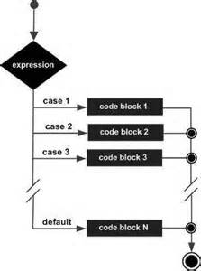
Syntax:
switch(variable)
{
case 1:
program statements
break;
case 2:
program statements;
break;
case 3:
program statements;
break;
default:
program statements;
break;
}

Slide 25
float value1, value2;
char operator;
printf ("Type in your expression.\n");
scanf ("%f %c %f", &value1, &operator, &value2);
switch (operator)
{
case '+':
printf ("%.2f\n", value1 + value2);
break;
case '-':
printf ("%.2f\n", value1 - value2);
break;
case '*':
printf ("%.2f\n", value1 * value2);
break;
case '/':
if ( value2 == 0 )
printf ("Division by zero.\n");
else
printf ("%.2f\n", value1 / value2);
break;
default:
printf ("Unknown operator.\n");
break;
}

Slide 26
Sample code
switch(choice)
{
case 1:
printf(“Addition\n”);
break;
case 2:
printf(“Subtraction\n”);
break;
case 3:
printf(“Multiplication\n”);
break;
case 4:
printf(“Division\n”);
break;
default:
printf(“End of program\n”);
break;
}
Switch statements are used to redirect menu options
ATM, Computer Restaurant Ordering, Phone Systems
Menu
1 – addition
2 – subtraction
3 – multiplication
4 – division
5 – quit

Slide 27
Guided Practice:
Write a program to check for following of a number entered by the user
Divisible by 3
Divisible by 5
Between 1 and 50
Between 51 and 100
Positive, negative or zero
Even or Odd
is less than 1000
Is greater than 500

Slide 28
Graded Homework #2
Write a “Pick-a-Path” story similar to the one presented in the video using “if”, “if-else”, or “switch” statements
Video: https://youtu.be/dllL1h3ZZdI

Slide 29
Homework
Reading: Chapter 4 – “for loops” only
Video: https://youtu.be/Y17-tKQXrxs

Slide 30

QUESTIONS?????

