Slide 1
Intro to C Programming – Part 1
Midterm Exam review

Slide 2
Midterm exam
Tuesday, October 23, 2018
7:00 PM
Bring the following
Pen or pencil
1 page reference sheet
Format
50 multiple choice questions (100 pts)
10 free response questions (50 points)
Topics:
variables
printf statements
scanf statements
calculations
if, if-else, switch statements
for, while, do-while loops

Slide 3
What color are the following components in the Visual Studio C++ compiler?
Comments
Reserve Words
Contents of the print statement
Green
Blue
Red

Slide 4
what symbols are used when creating comments?
//Single line comments
/* multi-line comments */

Slide 5
Rules for naming variables
Must begin with a letter or an under-score
May contain numbers, under-score and letters only
May not contain spaces
Should be descriptive
May not contain special characters
Case-sensitive

Slide 6
Which of the following are invalid variable names? Why?
Valid
Int
Calloc
floating
Reinitialize
Xx
_1312
_
Alpha_beta_routine
z
Invalid Variable names
char – reserve word
6_05 – begins w/number
A$ - contains a special character

Slide 7
ALL variables MUST BE defined before they are used

Slide 8
vocabulary
Syntax
In computer science, the syntax of a computer language is the set of rules that defines the combinations of symbols that are considered to be a correctly structured document or fragment in that language. This applies both to programming languages, where the document represents source code, and markup languages, where the document represents data. The syntax of a language defines its surface form.

Slide 9
vocabulary
Compiler
A compiler is a computer program (or a set of programs) that transforms source code written in a programming language (the source language) into another computer language (the target language), with the latter often having a binary form known as object code. The most common reason for converting source code is to create an executable program.

Slide 10
vocabulary
HARDWARE
Computer hardware (or simply hardware in computing contexts) is the collection of physical elements that constitutes a computer system. Computer hardware is the physical parts or components of a computer, such as the monitor, mouse, keyboard, computer data storage, hard disk drive (HDD), graphic cards, sound cards, memory (RAM), motherboard, and so on, all of which are tangible physical objects

Slide 11
vocabulary
Software
Computer software, or simply software, is that part of a computer system that consists of encoded information or computer instructions, in contrast to the physical hardware from which the system is built.
Computer software includes computer programs, libraries and related non-executable data, such as online documentation or digital media. Computer hardware and software require each other and neither can be realistically used on its own.

Slide 12
vocabulary
Operating System
An operating system (OS) is system software that manages computer hardware and software resources and provides common services for computer programs. The operating system is a component of the system software in a computer system. Application programs usually require an operating system to function.

Slide 13
vocabulary
In computing, an input device is a peripheral (piece of computer hardware equipment) used to provide data and control signals to an information processing system such as a computer or information appliance. Examples of input devices include keyboards, mouse, scanners, digital cameras and joysticks.
Input Devices
An output device is any piece of computer hardware item which utilizes whatever data and commands from your computer to perform a task. The results of data processing carried out by an information processing system which converts the electronically generated information into human-readable form.
Output Devices

Slide 14
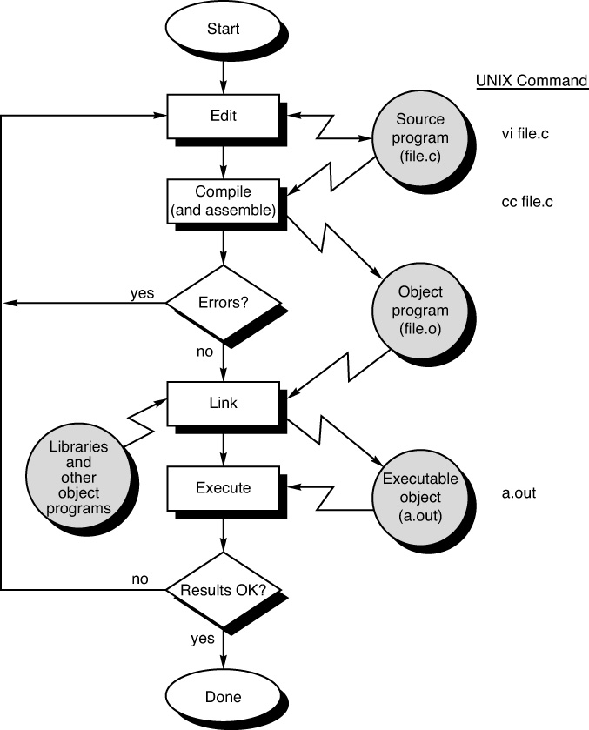
Compiling program steps

Slide 15
Basic Data types
Constants – values and variables that are identified and can not
be changed
Variables
Integer – Positive and negative whole numbers
Float/Double – Positive and negative decimal numbers
Character – single letter
Boolean – A variable that holds only 0 or 1 and evaluates to True or False

Slide 16
Displaying variables
Integers - %i
Float/Double - %f displays 8 places
- %g displays significant digits
- %e display in scientific notation

Slide 17
Math operations
Addition: +
Subtraction: -
Multiplication: *
Division: /
Integers divided by Integers give Integer answers
Integers divided by floats/doubles give float answers
Floats/doubles divided by integers give float answers
Modulus: % (only for integers)
Type Casting: a temporary type change for a calculation

Slide 18
Writing algebraic expressions
3a²b³
3*a*a*b*b*b
4x² +2x - 5
4*x*x+2*x-5

Slide 19
Write an if statement to determine if the grade is passing or failing
if(grade >= 60)
{
++passing;
}
else
{
++failing;
}
if(grade < 60)
{
++failing;
}
else
{
++passing;
}

Slide 20
Write a program to generate and display a table of n and n², for integer values of n ranging from 1 to 10. Be certain to print appropriate column headings
printf(“ N N^2\n”); //column headings
for(n=1; n<=10; ++n) //generate the table contents
{
printf(“%3i %5i\n”, n, n*n);
}

Slide 21
What will the following print?
int x = 5;
if (x > 3)
{
if (x > 4)
printf ("D");
else
printf ("E");
}
else
{
if (x != 0)
printf ("A");
}
printf ("B");
Answer: db

Slide 22
What output might you expect from the following program?
#include <stdio.h>
int main (void)
{
int answer, result;
answer = 100;
result = answer - 10;
printf ("The result is %i\n", result + 5);
return 0;
}
The result is 95

Slide 23
Identify the syntactic errors in the following program.
#include <stdio.h>
int main (Void)
(
INT sum;
/* COMPUTE RESULT
sum = 25 + 37 - 19
/* DISPLAY RESULTS //
printf ("The answer is %i\n" sum);
return 0;
}
Should be a small v
Replace with {
Should be a small int
Close the comment with */
Missing semi-colon
Close the comment with */
Missing comma

Slide 24
Describe the output to the following code
for(x=1; x<100; x=x+7)
{
printf(“%5i”, x);
}
1 8 15 22 29 36 43 50 57 64 71 78 85 93

Slide 25
What output would you expect from the following program?
#include <stdio.h>
int main (void)
{
printf ("Testing...");
printf ("....1");
printf ("...2");
printf ("..3");
printf ("\n");
return 0;
}
Testing…….1…2..3
Press any key to continue…

Slide 26
Write the code to print the following table
TABLE OF TRIANGULAR NUMBERS
n Sum from 1 to n
--- ---------------
1 1
2 3
3 6
4 10
5 15
6 21
7 28
8 36
9 45
10 55
#include<stdio.h>
int main(void)
{
int n, sum = 0;
printf(“TABLE OF TRIANGULAR NUMBERS\n\n\n”);
printf(“n Sum from 1 to n\n”);
printf(“--- ---------------\n”);
for(n=1; n<=10; ++n)
{
sum = sum + n;
printf(“%i %i\n”, n, sum);
}
return 0;
}

Slide 27
Writing code
Write a for loop to generate the even numbers from 1 to 100
for(n=0; n<=100; n=n+2)
Write a for loop to generate the multiples of 3 from 1 to 100
for(n=0; n<=100; n=n+3)
Write a for loop to generate the odd numbers from 100 to 1
for(n=100; n>=1; n=n+2)

Slide 28
Reading code
What is the value of num after the switch?
int value = 1; int num = 100; switch(value) { case 1: num ++; break; case 2: num = num + 2; case 3: num = num + 3; break; case 4: num = num + 4; }
num = 101

Slide 29
Reading code
What is the value of num after the switch?
int value = 1; int num = 100; switch(value) { case 1: num ++; case 2: num = num + 2; case 3: num = num + 3; break; case 4: num = num + 4; }
num = 106

Slide 30
Reading code
int main (void) { int count = 1; while ( count <= 5 )
{ printf ("%i\n", count);
++count; } return 0; }
1
2
3
4
5

Slide 31
Reading code
int main (void) { int count = 1; while ( count <= 5 )
{
++count; printf ("%i\n", count);
} return 0; }
2
3
4
5
6

Slide 32
Reading code
int number = 359, digit; do
{ digit = number % 10; printf ("%i", digit); number = number / 10; }while ( number != 0 );
953

Slide 33
Reading code
The code will print 0 number of 2’s.
Given the code
while(0)
{
printf("%i\n", 2);
}
The code will print ____ number of 2's.

Slide 34
Writing Code
Write a do-while loop to verify the user integer input to be between 50 and 100
do
{
printf(“Enter an integer between 50 and 100 inclusively: “);
scanf(“%i”, &num);
if(num < 50 || num > 100)
printf(“Invalid Entry. Please try again\n”);
}while(num < 50 || num > 100);

Slide 35
Writing Code
Write the code to calculate the sum of the odd numbers from 1 to 100
sum = 0; //reset sum = 0
for(n = 1; n <= 100; n=n+2)
{
sum = sum + n;
}
printf("\n\nThe sum is %i\n", sum);

Slide 36
Midterm EXam practice homework
Write a program to help young children learn their multiplication tables. The program should give the student the option to play or quit. To play, the program will require the student to enter the tables to practice. The tables will display the equations 1 to 10 for that number. The student will give the answer to the equation. If the answer is correct, the program will proceed to the next equation. If the answer is not correct, the student will be given a second chance to answer. If the answer is correct, the program will proceed to the next equation. If the answer is not correct, the program should display the equation with the correct solution.

Slide 37
Midterm EXam practice homework
Sample Output
Multiplication Tables Practice
Menu
1 – play
2 – quit
Please enter your choice: 1
What times table would you like to practice? 5
Ok. Here we go!
What is 1 * 5? 5
What is 2 * 5? 10
What is 3 * 5? 155
Incorrect Try again. 15
What is 4 * 5? 20
What is 5 * 5? 25
What is 6 * 5? 30
What is 7 * 5? 35
What is 8 * 5? 40
What is 9 * 5? 44
Incorrect. Try again. 444
Incorrect. 9 * 5 = 45
What is 10 * 5? 50
Menu
1 – play
2 – quit
Please enter your choice: 2
Have a great day!

Slide 38
videos
Printing - https://youtu.be/oSpmApiUsHw
Comments - https://youtu.be/oX2FpFYXE38
Format printing - https://youtu.be/To7WA4ijQQ0
Variables - https://youtu.be/k1ur8rX-DQQ
Scanf - https://youtu.be/hSHFjPvqFjw
Making Decisions - https://youtu.be/PXwWoL0IG5A
https://youtu.be/FtZ1YgSFqs0
https://youtu.be/KgVzRmUPsdo
https://youtu.be/DZ0ZXipUx-A

Slide 39
video
Switch statement - https://youtu.be/qZRP5hKGHrs
Increment operator - https://youtu.be/nNSn1uVNyiU
For loop - https://youtu.be/FPjLbPu5BsQ
While loop - https://youtu.be/7pAXm7WEA2I
Do-while loop - https://youtu.be/eU6no0EEJM0
Creating a Table - https://youtu.be/Y17-tKQXrxs
Review - https://youtu.be/nXvy5900m3M
https://youtu.be/6uIc4PtB9BM

Slide 40
Midterm exam
Topics:
variables
printf statements
scanf statements
calculations
if, if-else, switch statements
for, while, do-while loops
Tuesday, October 23, 2018
7:00 PM
Bring the following
Pen or pencil
1 page reference sheet
Format
50 multiple choice (100 pts)
10 free response (50 points)

