Slide 1
Week Ten
Acknowledgements: Slides created based off material provided by Dr. Michael Raymer and Dr. Travis Doom

Slide 2
What happens if we call a method from inside itself?
Hi!
Hi!
Hi!
Hi!
Hi!
Hi!
Hi!
Hi!
Hi!
Hi!
Hi!
Hi!
Hi!
Hi!
Hi!
Hi!
Hi!
Hi!
Hi!
Hi!
Hi!
Hi!
Hi!
Hi!
Hi!
Hi!
Hi!
Hi!
Hi!
Hi!
Hi!
Hi!
Hi!
Hi!
Hi!
Hi!
Hi!
Hi!
Hi!
Hi!
Hi!
Hi!
Hi!
Hi!
Hi!
Hi!
Hi!
Hi!
Hi!
Hi!
Hi!
Hi!
Hi!
Hi!
Hi!
Hi!
Hi!
Hi!
Hi!
Hi!
Hi!
Hi!
Hi!
Hi!
Hi!
Hi!
Hi!
Hi!
Hi!
Hi!
Hi!
Hi!
Hi!
Hi!
Hi!
Hi!
Hi!
Hi!
Hi!
Hi!
Hi!
Hi!
Hi!
Hi!
public static void sayHi(){
System.out.println(“Hi!”);
sayHi();
}
Hi!
Hi!
Hi!
Hi!
Hi!
Hi!
Hi!
Hi!
Hi!
Hi!
Hi!
Hi!
Hi!
Hi!
Hi!
Hi!
Hi!
Hi!
Hi!
Hi!
Hi!
Hi!
Hi!
Hi!
Hi!
Hi!
Hi!
Hi!
Hi!
Exception in thread "main" java.lang.StackOverflowError

Slide 3
What just happened?
Recursion!

Slide 4
Recursion
Recursive method: any method that calls itself
Starts with a complicated problem and breaks it down into smaller and smaller problems
aka divide and conquer decomposition
Why use recursion?
Sometimes simpler/easier to understand and maintain
Sometimes more flexible
Sometimes faster
Short answer: it’s another tool in your toolbox

Slide 5
Okay, but how do we avoid a stack overflow error?
An endpoint
Termination condition
A base case!

Slide 6
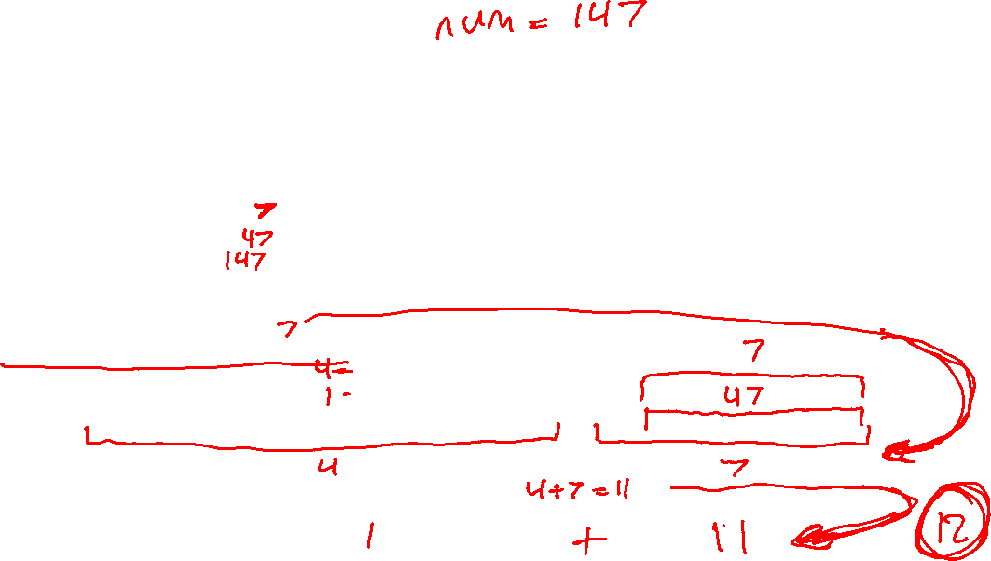

The Base Case
A condition where we no longer make a recursive call
Returns a basic and simple value
Designed to reverse the recursion process to return to the original recursive call
public static int sum(String num){
if (num.length() == 1) {
return Integer.parseInt(num);
} else {
return Integer.parseInt(num.substring(0, 1)) + sum(num.substring(1));
}
}

Slide 7
How to Understand recursion
A few very simple base cases (often just one)
Rules to break down complex cases into simpler cases of the same general problem
Are we done yet? If so, return the results.
If not, simplify the problem (move towards the base case), by constructing a solution from smaller similar problems
If you have an already solved similar but simpler problem, how can that help you solve a more complex problem?
A few very simple base cases (often just one)
Rules to break down complex cases into simpler cases of the same general problem
Are we done yet? If so, return the results.
If not, simplify the problem (move towards the base case), by constructing a solution from smaller similar problems
If you have an already solved similar but simpler problem, how can that help you solve a more complex problem?
A few very simple base cases (often just one)
Rules to break down complex cases into simpler cases of the same general problem
Are we done yet? If so, return the results.
If not, simplify the problem (move towards the base case), by constructing a solution from smaller similar problems
If you have an already solved similar but simpler problem, how can that help you solve a more complex problem?
A few very simple base cases (often just one)
Rules to break down complex cases into simpler cases of the same general problem
Are we done yet? If so, return the results.
If not, simplify the problem (move towards the base case), by constructing a solution from smaller similar problems
If you have an already solved similar but simpler problem, how can that help you solve a more complex problem?

Slide 8
Practice Together
Reverse a word
Input: hello output: olleh
What is our base case?
What small step can we take before making the recursive call?

Slide 9
Your Turn
Write a recursive method that counts how many even numbers are in a String
You can assume the String will only include numbers
Input: “2395832” Output: 3

Slide 10
How About One More?
Write a recursive method that takes in an ArrayList of comparable generic types
The method should find and return the “max” value of the ArrayList
Input: [4, 1, 4, 6, 3, 9, -3, -6, 8] Output: 9
Input: ["hi", "smile", "zoo", "laugh", "kind", "apple“] Output: “zoo”

Slide 11
Let’s Try something a Bit More Difficult
Write a recursive method that takes in a single word and returns every possible permutation of that word in a list
Input: "cat“ Output: [cat, cta, act, atc, tca, tac]
What’s our base case going to be?
How do we break the problem down?
What other structures may we need to use?

Slide 12
What actually happens when A recursive call occurs in a loop?

Slide 13




Recursive Calls In Loops

Slide 14


















