Slide 1
How to Teach Computers to Recognize Natural Language
Dr. Du Pengfei
Digital Manufacturing Division
Smart Virtual System
Jan 2024

Slide 2
Overview
Aim:
To have a deeper understanding of how AI works for Natural Language Processing (NLP)
To get hands on experiences of setting up a typical and creative AI application
Contents:
Basic background knowledge briefing of NLP
Hands on through https://machinelearningforkids.co.uk/#!/about :
First round:
Speech Recognition: Project of Making a Smart Bulb on Scratch 3
Sentiments Analysis: Project of Making Me Happy on Scratch 3
2nd round: is to make chatbot and encourage students to implement more creative projects on top of those achievements.
Format: Individual Learning
Tools needed for each individual learner:
1 pcs laptop with internet access and google chrome browser (GS)
1 mouse (GS)

Slide 3
Contents and Schedule
Journey of Two 1.5-hour Sessions:
Date | P6
21/3; | (15-min) Introduction and Briefing of Speech Recognition (30-min) Scratch Hands-on: Make a Smart Bulb (15-min) Introduction and Briefing of Sentiments Analysis (30-min) Scratch Hands-on: Make Me Happy
28/3; | (15-min) Roboflow sign-up ( https://roboflow.com/ ) (60-min) Scratch Hands-on: Make Chatbots (15-min) Q&A

Slide 4
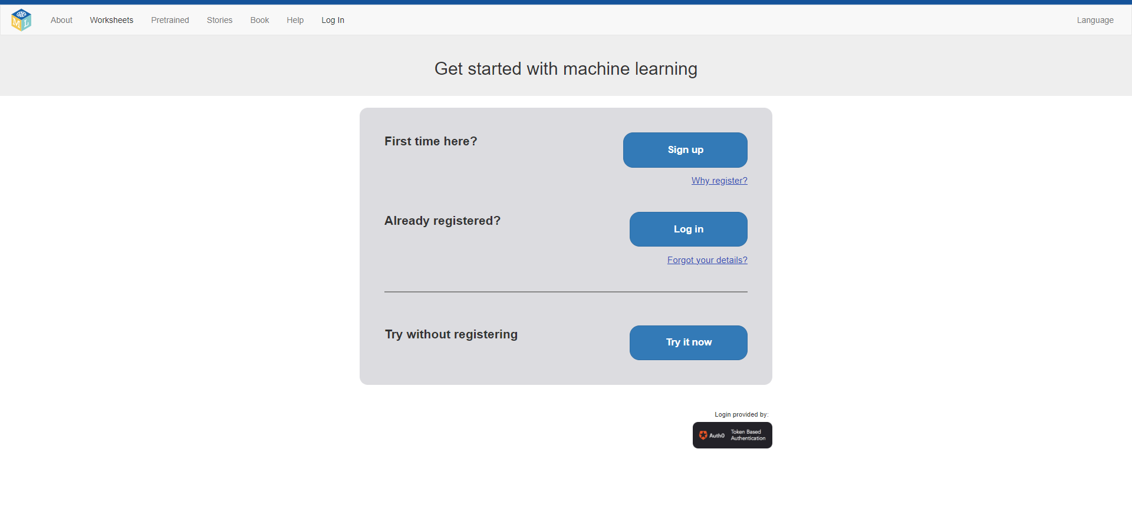
Teachers-Notes: Preparation needed from GSPS teachers
To register a class account in https://machinelearningforkids.co.uk/#!/about beforehand and add students account in.
Step 1:

Slide 5
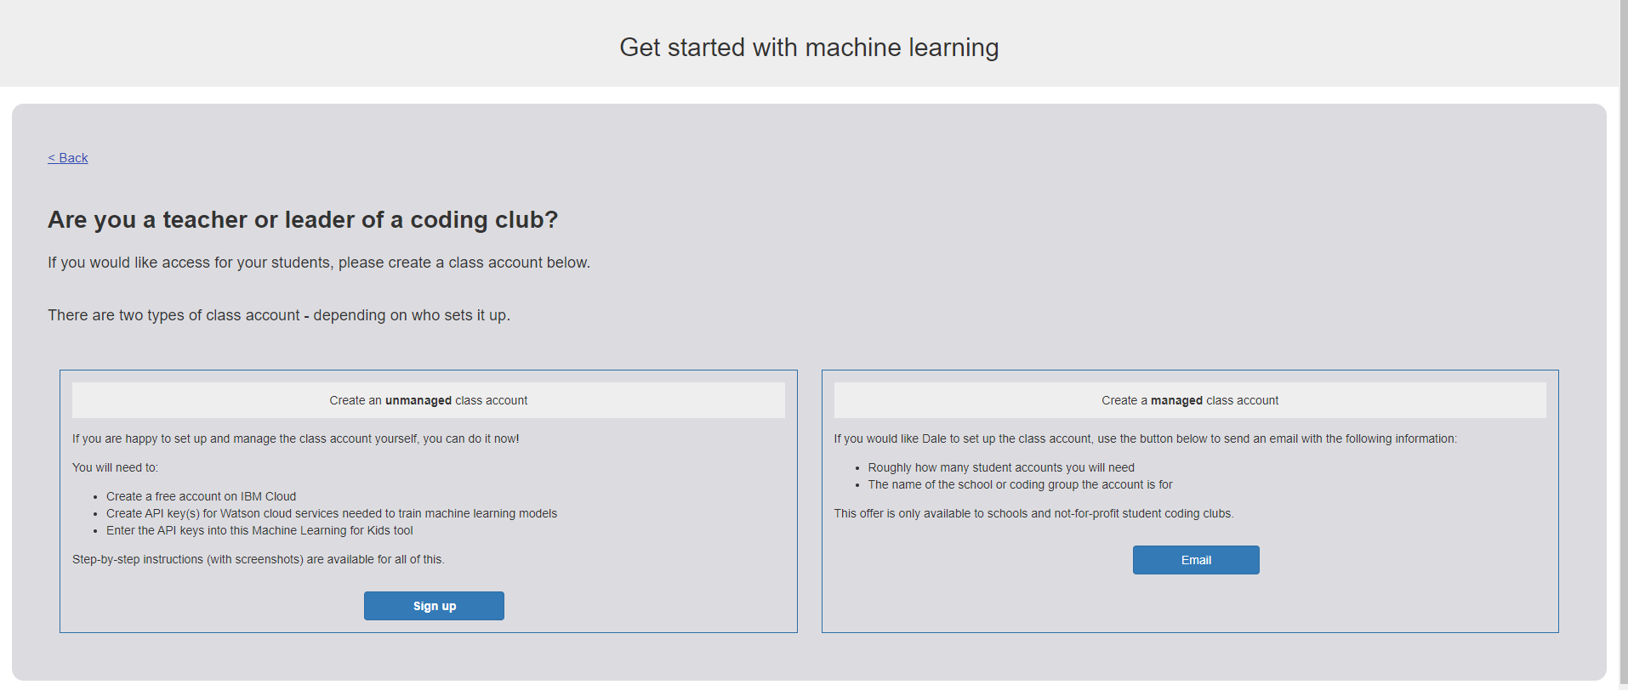
Teachers-Notes: Preparation needed from GSPS teachers
To register a class account in https://machinelearningforkids.co.uk/#!/about beforehand and add students account in.
Step 2:

Slide 6
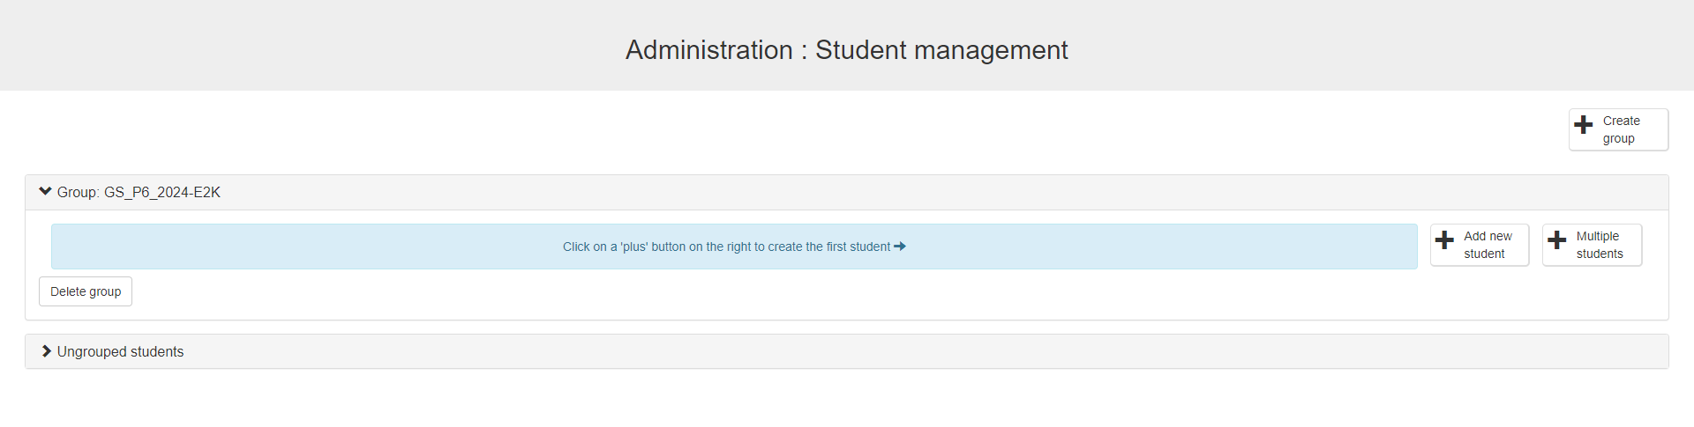
Teachers-Notes: Preparation needed from GSPS teachers
To register a class account in https://machinelearningforkids.co.uk/#!/about beforehand and add students account in.
Step 3:

