Slide 1
Simulating Collisional Dark Matter
Javier Alejandro Acevedo Barroso
ja.acevedo12@uniandes.edu.co

Slide 2
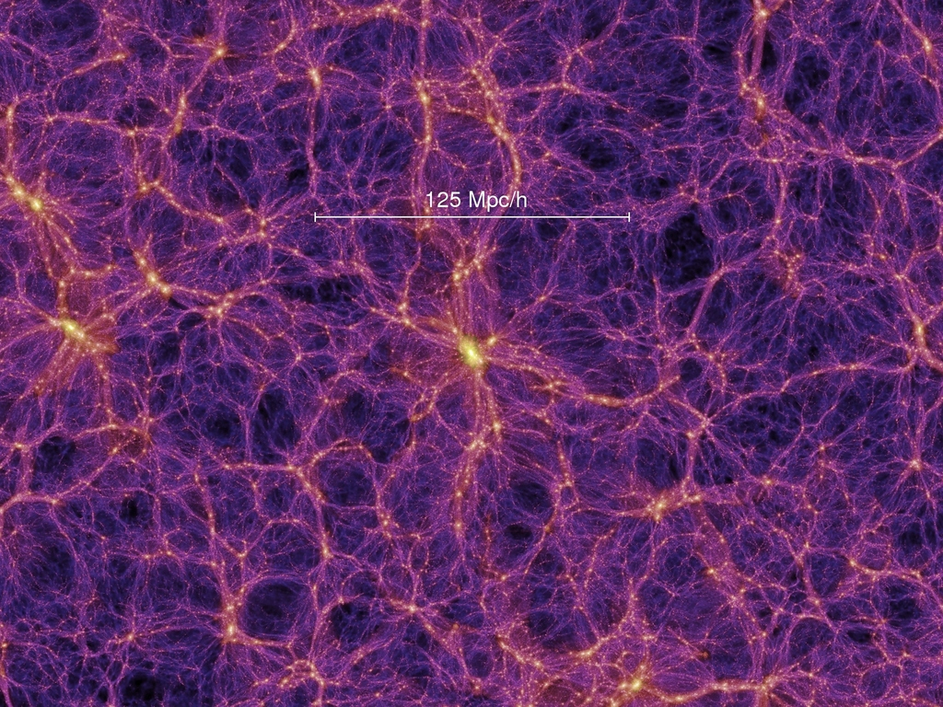
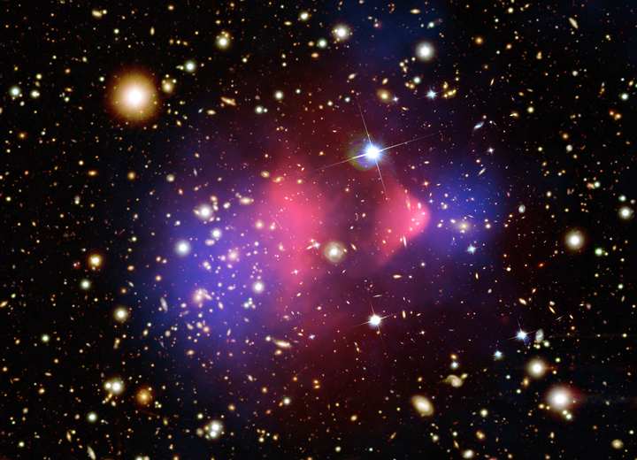
Collisional and Collisionless Dark Matter

Slide 3
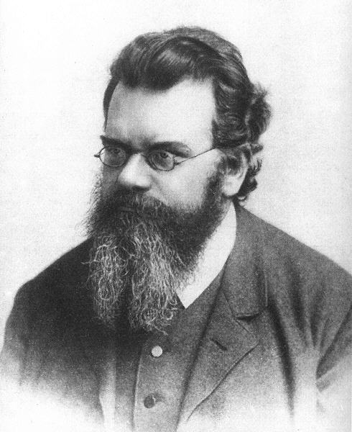


The Boltzmann Equation

Slide 4
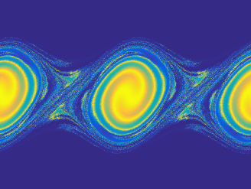
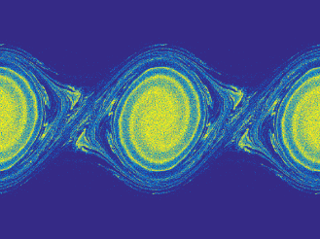
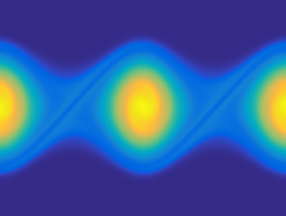
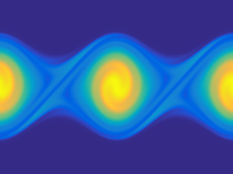
Solving Boltzmann Equation
LB
PM
FV
MM

Slide 5
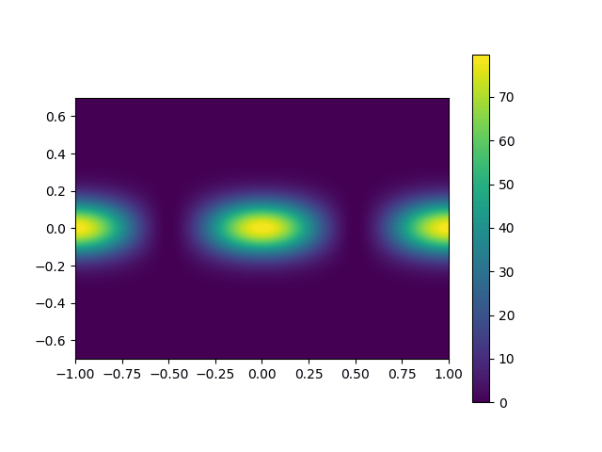
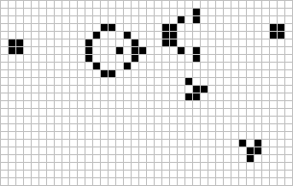
Lattice-Bolztmann and Automatas

Slide 6
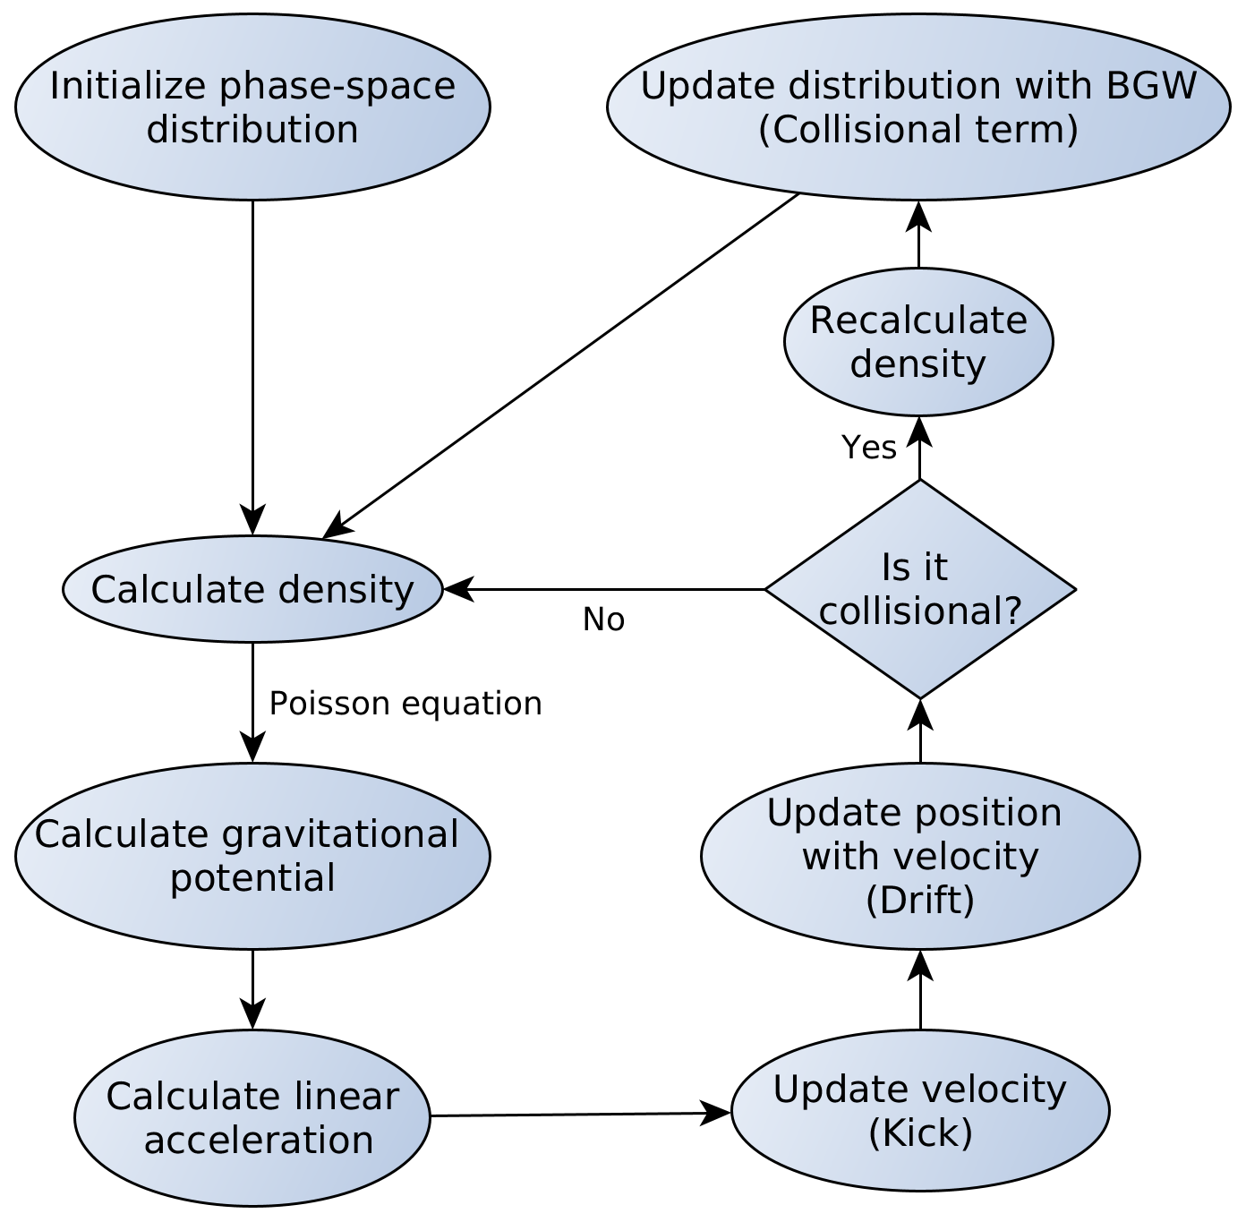
Overview of the Algorithm

Slide 7
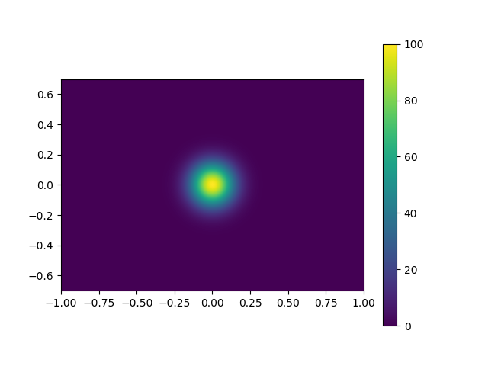

Initial Conditions

Slide 8
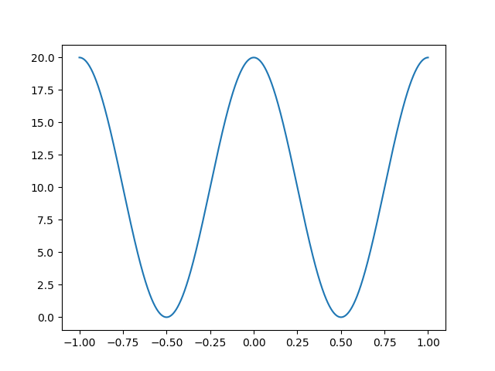
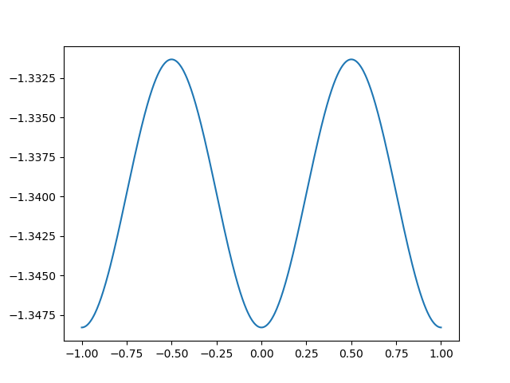
Density and Potential

Slide 9
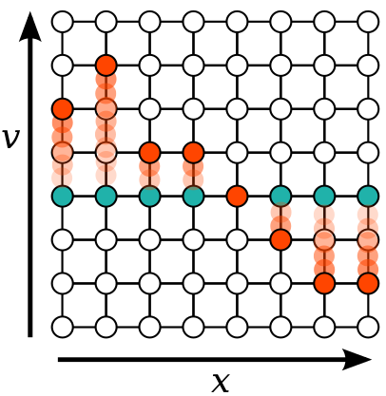
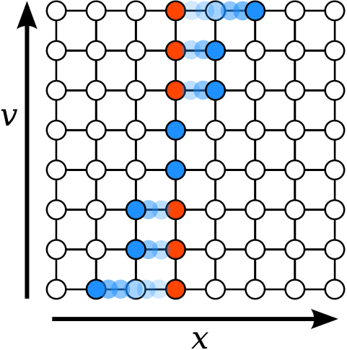
Streaming Step
Kick
Drift

Slide 10
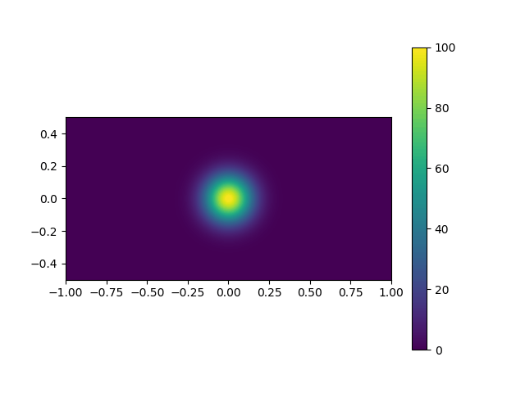
Collisionless examples

Slide 11
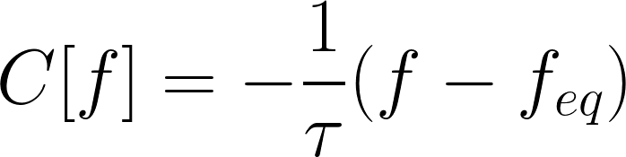
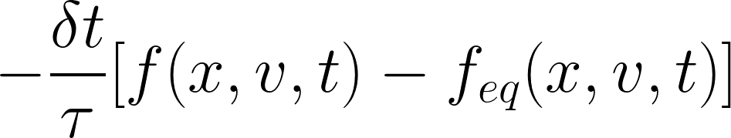
Collisional Term: the BGK Approximation

Slide 12
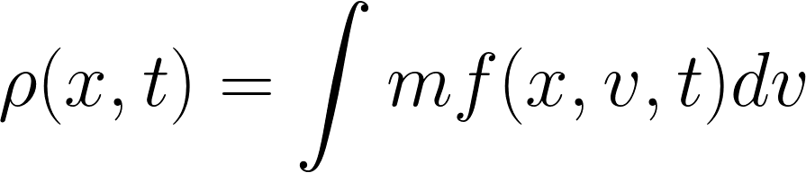
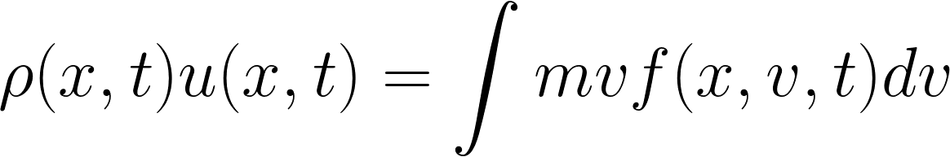
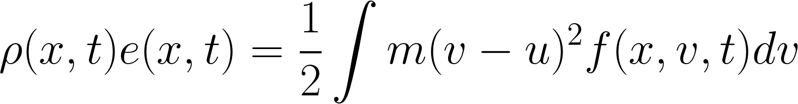
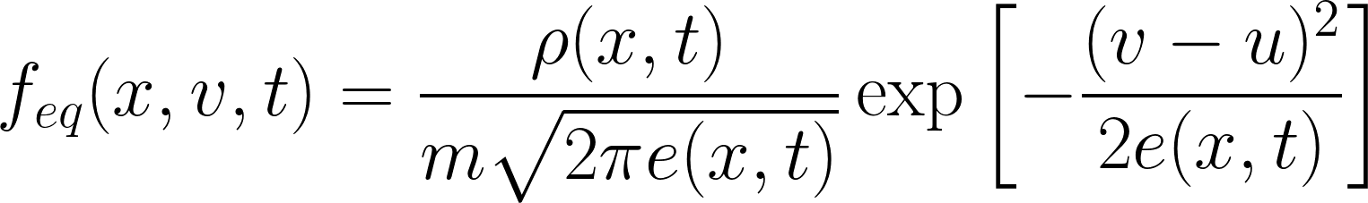
Equilibrium Distribution

Slide 13
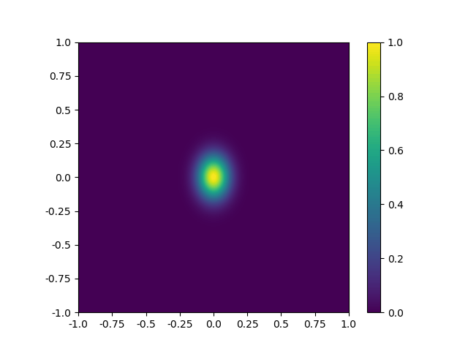
Collisional Examples

Slide 14
Different Taus

Slide 15
Jeans instability

Slide 16
Results on Density

Slide 17
Results on potential and acceleration

Slide 18
Results on phase-space

Slide 19
Gaussian distribution

Slide 20
Results on Density

Slide 21
Results on potential and acceleration

Slide 22
Results on phase-space

Slide 23
2D and 3D implementation

