Slide 1
Infineon Academy Distribution Training
Mastering ModusToolbox™ in Your Development Workflow
Clark Jarvis – Software and Tools Product Marketer
October 2026

Slide 2
Agenda
1
Working Effectively with Version Control & Git
2
Sharing, Importing & Exporting Projects
3
Understanding the ModusToolbox™ BSP Concept
4
Workflows to Develop & Utilize a Custom BSP
5
Middleware Integration — Library Manager & Makefiles
6
ModusToolbox™ AI Assistant extension for VS Code
7
Introduction to the Upcoming ModusToolbox™ SDK
8
Q&A

Slide 3
Session Roadmap
# | Topic | Key Skill
1 | Version Control & Git | Know what to commit, what to ignore, how to collaborate
2 | Project Sharing & Export | Send a working project to anyone — colleague, customer, Infineon
3 | Understanding BSPs | How BSPs bridge your app code and hardware
4 | Custom BSP Workflows | Build a custom BSP for production hardware
5 | Middleware & Library Manager | Add libraries, manage dependencies, understand the Makefile
6 | The ModusToolbox™ SDK | What's coming and why it matters

Slide 4
Working effectively with version control and git

Slide 5
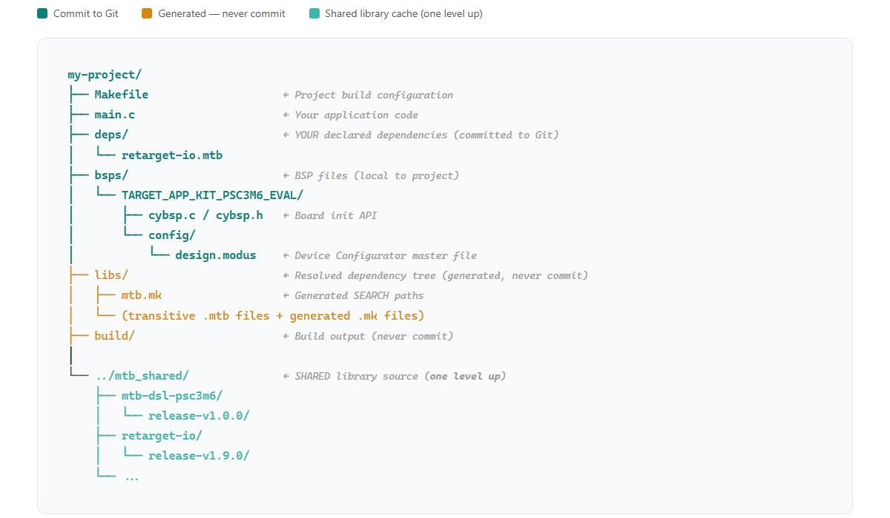
The ModusToolbox™ project structure

Slide 6
The .mtb dependency model
User required library
deps/retarget-io.mtb
Resolution of dependencies
make getlibs
Workspace clone of library
mtb_shared/retarget-io/release-v1.9.0/
URL: https://github.com/Infineon/retarget-io
Version: release-v1.10.0
Path: libs/retarget-io
Parses the .mtb file
  Runs git clone with the specified URL
  and version tag
  Resolves transitive dependencies (each library can have its own deps/)
Generates
  libs/mtb.mk
  SEARCH_* paths
Full library source code, checked out at the pinned version.
Shared across all projects in the workspace.
  Never committed to any project's Git repo.

Slide 7
What are deps/ and libs/ folders?
deps/
libs/
What is inside
.mtb files you declare
Who controls it
You (the developer)
What is represents
What you asked for
Version control
Yes, this should in the git commit
What is inside
resolved .mtb file or generated .mk files
Who controls it
make getlibs (the tool)
What is represents
Everything the build actually needs
Version control
No, this is restored and reconstructed
Text
VS

Slide 8
What to commit, what to ignore?
COMMIT | IGNORE
Makefile | build/
main.c and all source files | mtb_shared/ (regenerated by make getlibs)
deps/*.mtb | libs/ (transitive .mtb + mtb.mk pointing to mtb_shared)
bsps/ (BSP customizations) | .vscode/ (user-specific)
.gitignore itself | .cache/ (clangd / IntelliSense index)
ModusToolbox™ Code Example projects include a starting .gitignore reference file.
This file should be edited based on the user’s workflow

Slide 9
The version-controlled project flow
Clone the project
git clone <project-url>
Gets Makefile, main.c, deps/*.mtb, bsps/ — everything committed to Git
Import into IDE
(optional)
Open VS Code, Eclipse IDE, IAR Embedded Workbench, or Arm uVision
Follow specific steps from respective ModusToolbox™ IDE user guides
Resolve Dependencies
make getlibs (Importing into VS Code or Eclipse will complete this step)
Reads deps/*.mtb → clones libraries to mtb_shared/ → generates libs/mtb.mk
Build
Build application with make build or via IDE
Compiles application + all dependencies into firmware binary
Working Binary
Flash to board with make program or via IDE

Slide 10
Git workflow best practices
Practice | Why
One project per repo (preferred) | Clean history, independent versioning
Commit .mtb files | Reproducible dependency resolution
Never commit mtb_shared/ | It's regenerated; committing bloats the repo enormously
Tag releases | Match your project version to tested BSP/middleware versions
Document BSP + MTB version in README | e.g., "Tested with KIT_PSC3M6_EVAL in ModusToolbox™ 3.9"
Use branches for BSP variants | If supporting multiple boards, branch per target
VS Code include built-in version control tracking, management, and visualization
Eclipse includes additional Views that support version control
ModusToolbox™ (on Windows) include a version of Cygwin Git
  This is what ModusToolbox™ uses by default
  This instance does use different git configurations

Slide 11
Demo / Exercise
Clone a real project and verify dependencies

Slide 12
Exercise - Clone a real project and verify dependencies
Step | Command / Action | Expected Result
1 | Open Modus-Shell
2 | mkdir C:/MTB_Training && cd C:/MTB_Training | Create a workspace directory for the training
3 | git clone https://github.com/ClarkJ-Infineon/mtb-training-blinky | Project cloned into workspace (no mtb_shared/ or libs/ yet)
4 | cd mtb-training-blinky
5 | ls deps/ | See .mtb files for BSP and libraries
6 | make getlibs | Libraries cloned into ../mtb_shared/, libs/mtb.mk generated
7 | make build | Successful build for KIT_PSC3M6_EVAL
8 | Inspect libs/ directory | See transitive .mtb files and mtb.mk with SEARCH paths
9 | Inspect libs/mtb.mk | See the SEARCH_ paths that wire libraries into the build

Slide 13
Sharing, importing and exporting projects

Slide 14
Three typical ways to share a project
Scenario | Method | What controls the outcome | Includes mtb_shared?
Git repo (push/pull) | Cleanest for teams leveraging Git | .gitignore Defines what's tracked vs. excluded | No Recipient runs make getlibs
mtbarchive (CLI or GUI) | MTB-aware archive Includes the right files, excludes generated artifacts | Built-in best practices, tool knows the MTB project structure | No Recipient runs make getlibs
IDE Export / manual ZIP | IDE "Export ModusToolbox™ Application" or zip | User's understanding of what to include — YMMV | No See warning below
Do not include mtb_shared/ in archives. mtb_shared/ is a workspace-level cache shared across all projects.
It contains every library version you've ever resolved, not just the ones your project uses.
Including it unnecessary files (often 200+ MB), creates confusion for the recipient, and may be overwritten anyway if the import process re-runs make getlibs.
Always let the recipient run make getlibs to get exactly what the project needs.

Slide 15
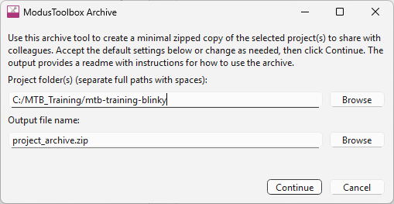
ModusToolbox Archiving and Sharing Utility - mtbarchive
GUI version is accessible via
  Eclipse IDE for ModusToolbox™ Quick Panel
  VS Code ModusToolbox™ Assistant extension
  ModusToolbox™ tools installation directory
CLI version available from Modus-Shell
  mtbarchive -o my_project_archive.zip -f <project-folder>
Why use it over a plain ZIP?
  Knows which artifacts are generated vs. authored
  won't accidentally include 200 MB of libs/
  Produces a clean archive that recipients can open with
  make getlibs → make build
  Ideal for support tickets, customer handoff,
  email/USB sharing

Slide 16
Saving and sharing your work with git
git push
Working
Directory
Staging
Area
Remote Respository
Your local files
Edit freely here
Changes selected for next commit
Local
Repository
Permanent history on your machine
GitHub / GitLab
Shared with team
git add
git commit
git pull
# Check what's changed
git status
# Stage specific files (or all changes)
git add <file>
git add .
# Commit with a descriptive message
git commit -m "Add UART debug output to main loop"
# Push to remote repository
git push origin main
# Pull latest changes from remote
git pull origin main
Best Practices | Why
Commit often, in small logical chunks | Easier to review, revert, and bisect issues
Write descriptive commit messages | Future-you (and teammates) will thank you
Always make build before committing | Don't push broken code
Review git status before committing | Catch unintended files (e.g., build/ artifacts)

Slide 17
Getting a shared project into your IDE
Eclipse IDE for ModusToolbox™:
  Clone or copy the project into your desired workspace folder
  Launch Eclipse IDE and set the workspace to the project's parent folder
  From the Quick Panel → click
  Import Existing Application In-Place
  Select the project folder → Eclipse registers it as a managed MTB project
VS Code (with ModusToolbox™ extension):
  Clone or copy the project to the desired location
  Open VS Code → File → Open Folder... → select the project folder
VS Code (without ModusToolbox™ extension):
  Clone or copy the project to the desired location
  Open Modus-Shell, navigate to the project folder
  Run make vscode — generates .vscode/ settings and a .code-workspace file
  Open the generated .code-workspace file in VS Code
IAR / µVision: Refer to the respective user guides, similar import-in-place workflow applies.
Use make ewarm8 or make uvision5 from Modus-Shell to generate IDE project files.

Slide 18
Demo / Exercise
IDE import and archive / sharing export

Slide 19
Exercise - IDE import and archive / sharing export
Step | Action | Expected Result
1 | Launch ModusToolbox™ Eclipse IDE | When prompted for workspace, set to C:/MTB_Training
2 | From the Quick Panel → Import ModusToolbox™ Application In-Place | Select mtb-training-blinky folder
3 | Project appears in Eclipse Project Explorer | Source files, BSP, and dependencies visible
4 | Build from Eclipse (Quick Panel → Build Application) | Confirm the project builds successfully in the IDE
5 | From Quick Panel → Tools section → launch ModusToolbox™ archiving and sharing | GUI opens with project pre-selected

Slide 20
Understanding the
ModusToolbox™ BSP concept

Slide 21
What is a ModusToolbox™ BSP?
Your Application Code
The BSP answers three questions:
  Which chip — device ID, core type, flash/RAM sizes
  How is it wired — pin assignments, crystal frequencies, debug interface
  How does it boot — startup code, linker scripts, memory map
Portable across boards
Middleware / Peripheral Drivers
Device-family API layer
Board Support Package
Pins, clocks, memory, startup
Silicon (MCU)
PSOC™ Control, PSOC™ Edge, etc…

Slide 22
Anatomy of a Board Support Package
Linker scripts and
startup code
Device resource initialization
Pins, Clocks, Power
Peripheral configuration structures
Board dependent libraries and build recipes
ModusToolbox™ Board Support Package
(BSP)
Software aliases for hardware resources
Secure domain partition resources

Slide 23
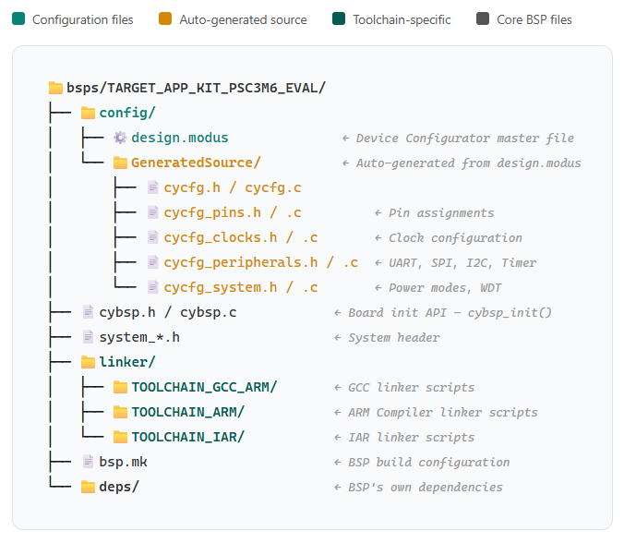
Directory structure of a Board Support Package
The config/GeneratedSource/ files are generated by Device Configurator from design.modus
You edit design.modus in the GUI; the .c/.h files are regenerated automatically

Slide 24
Device Configurator flow
GUI based Configuration
Device Configurator (design.modus)
Auto-generated C files
config/GeneratedSource/
Application Init
cybsp_init()
Configure pins, clocks, peripherals, and power modes with a GUI.
Stored in bsps/TARGET_APP_.../
config/design.modus
cycfg_pins.c / .h
  GPIO pin assignments and drive modes
cycfg_clocks.c / .h
  Clock tree configuration (PLL, dividers)
cycfg_peripherals.c / .h
  UART, SPI, I2C, Timer init structs
cycfg_system.c / .h
  Power modes, WDT, system-level config
One call initializes everything — pins, clocks, peripherals, power
All generated configuration is applied automatically at startup
design.modus is binary XML — always edit via Device Configurator, never manually
Changes to pin assignments, clock speeds, or peripheral configs go here
When you switch BSPs, you get a different design.modus for the new board

Slide 25
Demo
BSP Walkthrough

Slide 26
Workflows to develop and utilize a custom BSP

Slide 27
Why Create a Custom BSP?
Infineon kit BSPs are a starting point…
  They provide a working configuration for the eval board and for the available code examples
  User prototyping on the Infineon kit will likely require BSP modifications — whether to leverage additional device capabilities or to match custom hardware.
Scenario | What Changes
Extending a kit BSP | Enable additional peripherals, change clock speeds, reconfigure pins to use more of the device's capabilities
Customer production board | Different pin assignments, no debug header, custom crystal, different memory layout
Multi-project sharing | Common BSP across a product line, maintained independently from application code

Slide 28
Creating a custom BSP – modify existing BSP in place
Step 1:
(Optional) Copy the current BSP first if you want to preserve it
Is it possible to re-add a new BSP from Infineon GitHub (caution regarding BSP versions)
Step 2:
Open BSP Assistant from Eclipse Quick Panel or VS Code ModusToolbox™ Assistant extension
This modifies the CURRENT BSP in the project — it does not create a new one
Step 3:
Change device (MPN), pins, clocks, peripherals as needed
Step 4:
Save → Device Configurator regenerates configuration
Step 5:
Build and test
Use IDE build or make build → make program

Slide 29
Creating a new custom BSP using standalone BSP Assistant
Step 1:
Launch BSP Assistant from ModusToolbox™ Dashboard (or Windows Start menu)
Select "Create New BSP based on..." an existing Infineon kit BSP or Device Part Number
Step 2:
Save the new BSP to one of two locations:
  Directly into the project's bsps/ folder (e.g., bsps/TARGET_MY_CUSTOM_BOARD/)
  An external location (to be added to the project later)
Step 3:
Open Library Manager in the project
  If saved into bsps/: select and enable the new BSP as the active target
  If saved externally: browse to and add the BSP, then enable it
Step 4:
Edit configuration using Device Configurator
Save → Device Configurator regenerates configuration
Step 5:
Build and test
Use IDE build or make build → make program

Slide 30
Making Your custom BSP available to others
Method | How | Best For
Project-local | BSP lives in bsps/ inside the project | Single project, self-contained
Shared via Git repo | BSP(s) committed to a dedicated repo, cloned locally | Team-wide use, multiple projects, easy distribution
Manifest-published | BSP in its own Git repo, referenced via custom manifest | Organization-wide standard, integrated with Library Manager (power-user)
Project-local (simplest)
  BSP lives in bsp/ directory, committed with project
  Self-contained, no external dependencies
  Version controlled by the project’s own Git history
Shared via Git repo
  Commit custom BSP(s) to dedicated Git repo
  Team members clone the repo to local folder
  For new projects
    Open Project Creator and browse for local BSP folder
    Select folder and continue with application election
  For existing projects
    Use Library Manager to add / enable BSP

Slide 31
Best practices for custom BSPs
Practice | Why
Consider starting from a kit BSP | Ensures correct startup, linker, and configurator files
Modify freely — the BSP is yours | BSPs were moved into the project specifically so users can customize them. The original Infineon BSP can always be restored via Library Manager
Use descriptive naming for custom boards | TARGET_MY_PRODUCT_V2 — makes it clear this targets specific hardware
Version your custom BSP | Use Git tags so projects can pin to a known-good BSP version
Document pin changes in Device Configurator | Use the User Notes feature (recent addition) to annotate pin assignments, clock choices, and design rationale directly in design.modus — stays with the configuration
Test with Device Configurator first | Validate pin/clock config before writing application code

Slide 32
Demo / Exercise
Create your own custom BSP

Slide 33
Exercise - Create your own custom BSP
Step | Action | Expected Result
1 | Copy the kit BSP from your project into a new TARGET_MY_BOARD/ directory | New BSP directory appears in bsps/
2 | Switch to the new BSP: Library Manager (select MY_BOARD → Update) or edit Makefile TARGET=MY_BOARD → make getlibs | Makefile TARGET= updated, libs/mtb.mk regenerated
3 | Open Device Configurator on the new BSP | See the inherited kit configuration
4 | Change one pin assignment (e.g., move USER_LED to a different pin) | Config updates visually
5 | Save the configurator changes | GeneratedSource/ files regenerate

Slide 34
Middleware integration with
Library Manager and Makefiles

Slide 35
Library Manager Overview
What it does:
View all middleware currently in your project
Add new middleware libraries
Update existing libraries to newer versions
Remove libraries you no longer need
How to launch:
Eclipse IDE: Tools → Library Manager (or Quick Panel)
VS Code: ModusToolbox™ Assistant extension → Application tab → Configure Middleware
Command line: make modlibs or make library-manager

Slide 36
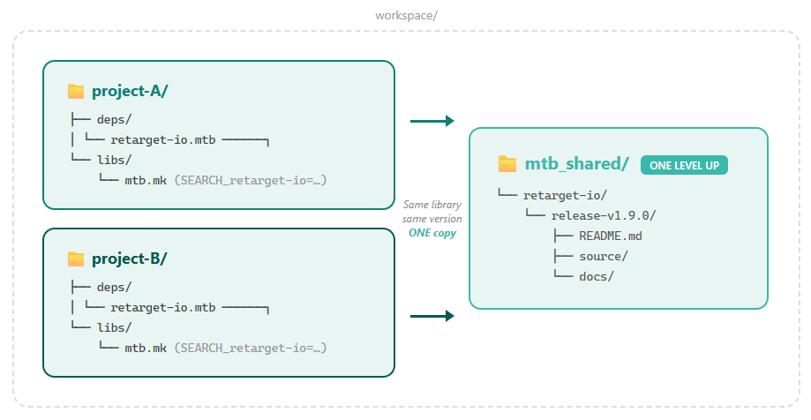
Shared libraries across workspace projects
One copy on disk,
shared across all projects at that version
Multiple versions coexist:
release-v1.8.0/ and
release-v1.9.0/ side by side
libs/mtb.mk contains
SEARCH_* paths that point the build system to mtb_shared/
Pin to release tags in .mtb files for reproducible builds

Slide 37
Adding middleware to project
Step 01
Select library in Library Manager
Click "Add Library"
in the Library Manager UI
Select required middleware
Step 02
Click update in Library Manager
.mtb file created (including dependencies)
make getlibs performed
Library source is added to workspace
Step 03
Project updated
Makefiles (libs/mtb.mk) updated
to include middleware folders and search paths for mtb_shared
Step 04
Build system picks it up
Next make build automatically compiles the new library
No manual Makefile edits to
“include library source”

Slide 38
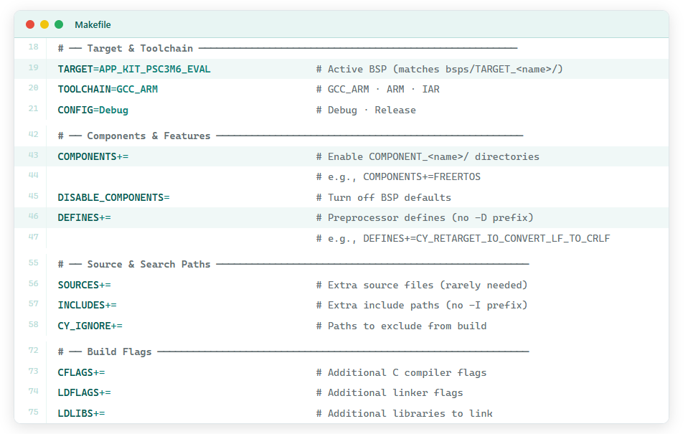
Using Makefiles to integrate and configure middleware
Inclusion of middleware into the build system occurs automatically based on the Library Manager output (make getlibs)
Integration and configuration of middleware may require edits to the Makefile
  COMPONENTS
  DEFINES

Slide 39
How do you know what COMPONENTS and DEFINES to add?
Location | What you'll find | How to access
Library README.md | Quick-start guide, required COMPONENTS and DEFINES, API overview, code snippets | Open mtb_shared/<library>/<version>/README.md in your IDE, or view on the library's GitHub repo
Library docs/ folder | Full API reference (HTML), configuration guide, migration notes | Open mtb_shared/<library>/<version>/docs/ typically contains generated HTML API docs
IDE quick links | Direct access to API documentation for libraries in your project | Eclipse: Quick Panel → Documentation section VS Code: ModusToolbox™ Assistant extension → Documentation links
Library GitHub repo | README (same as above), release notes, code examples list, issue tracker | Reference the library URL in the .mtb file or find it in Library Manager
Code examples | Working, tested projects that demonstrate the library in context | Links in the library README under "Code Examples" or "Related Resources"

Slide 40
Practical workflow — when you add a new library
Add library via Library Manager → click Update
Open mtb_shared/<library>/<version>/README.md ← START HERE
README tells you:
  Required COMPONENTS (add to Makefile)
  Required DEFINES (add to Makefile)
  Required dependency libraries (added automatically via Library Manager)
  Initialization code to add to main.c
For deeper API details → open mtb_shared/<library>/<version>/docs/api_reference.html
For working examples → follow Code Example links in README

Slide 41
Middleware summary and key takeaways
Concept | Key Point
Library Manager | GUI for managing .mtb pointer files — handles make getlibs automatically
README.md & docs/ | Every library ships its own docs — COMPONENTS, DEFINES, dependencies, API reference
COMPONENTS | Makefile variable that toggles optional library features (check library README)
DEFINES | Makefile preprocessor defines to configure library behavior (check library README)
mtb_shared | Shared library storage — one copy per version, shared across projects
Version pinning | Use release tags in .mtb files, not main branch

Slide 42
Demo
Library Manager and
CMSIS-DSP COMPONENT

Slide 43
ModusToolbox™ AI Assistant extension for VS Code

Slide 44
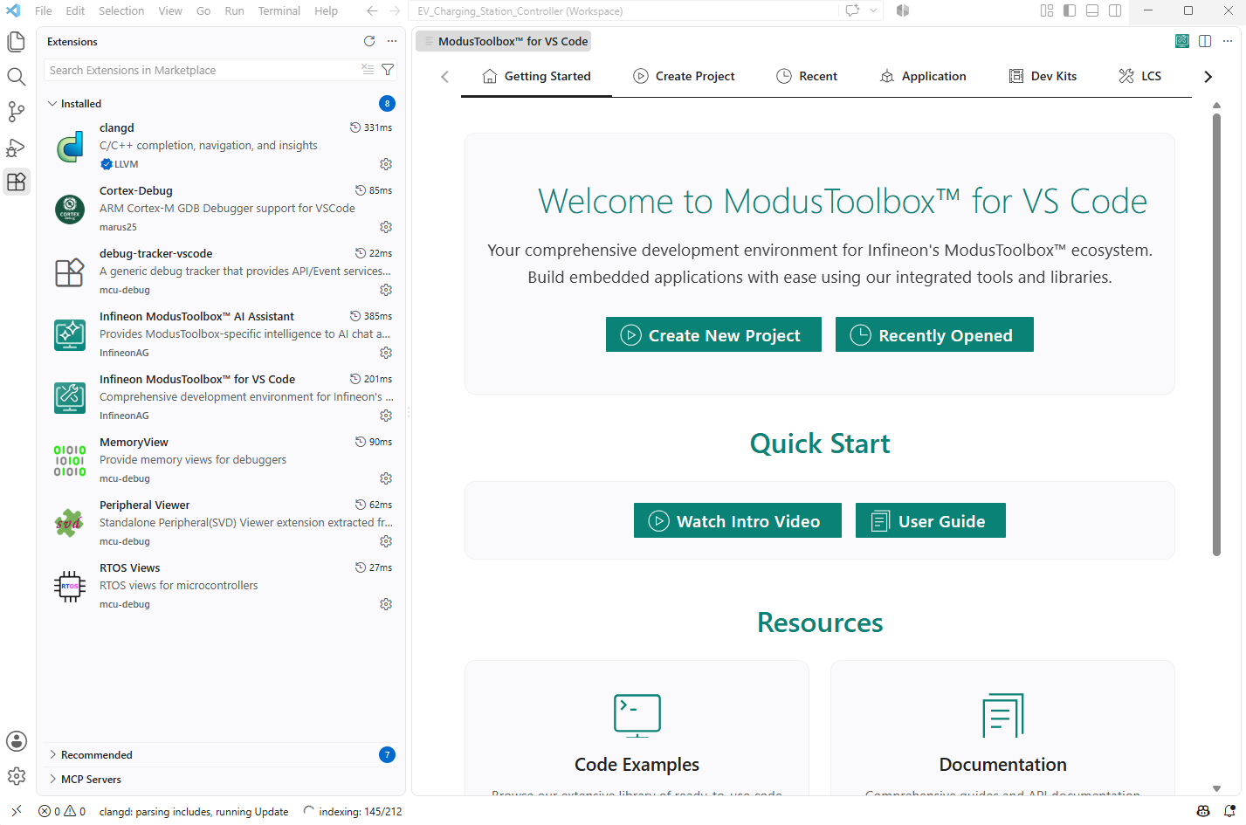
ModusToolbox™ for VS Code
ModusToolbox™ had provided standard VS Code support for 6+ years
Full development workflow: create → configure → build → program → debug
New Infineon supported ModusToolbox™ for VS Code marketplace extension
This recent release bring enhanced enablement and out of box experience to the workflow
Available on the VS Code Marketplace — search "ModusToolbox"
Project Creation | Guided wizard, BSP selection, auto kit detection, multi-core support
Build, Program & Debug | One-click build/program, flash/RAM memory visualization
Code Intelligence | Clangd-powered IntelliSense + inline API doc lookup (Ctrl+Shift+F1)
BSP & Middleware | Search, filter, update BSPs with drag-and-drop
Kit Integration | Connected kit monitoring — status, firmware, BSP mapping
Tool Launcher | Device Configurator, Library Manager, LLVM management, MTB Shell

Slide 45
ModusToolbox™ AI Assistant (Public Preview)
The Problem
AI assistants (Copilot, Cursor, Windsurf) generate code that looks right but:
  Targets the wrong device
  Uses deprecated APIs
  Misses critical init steps
  (clocks, interrupts, DMA channels)
Root cause: They have zero awareness of your hardware, BSP, or project structure
The Solution: Hardware-Aware AI
The ModusToolbox™ AI Assistant gives AI assistants deep context about your workspace:
  MCU - actual device, not a generic Cortex-M
  BSP - pin config, peripherals, clock tree
  Libraries - what's installed, what's available
  Proven recipes - validated peripheral init, connectivity, RTOS patterns
Text

Slide 46
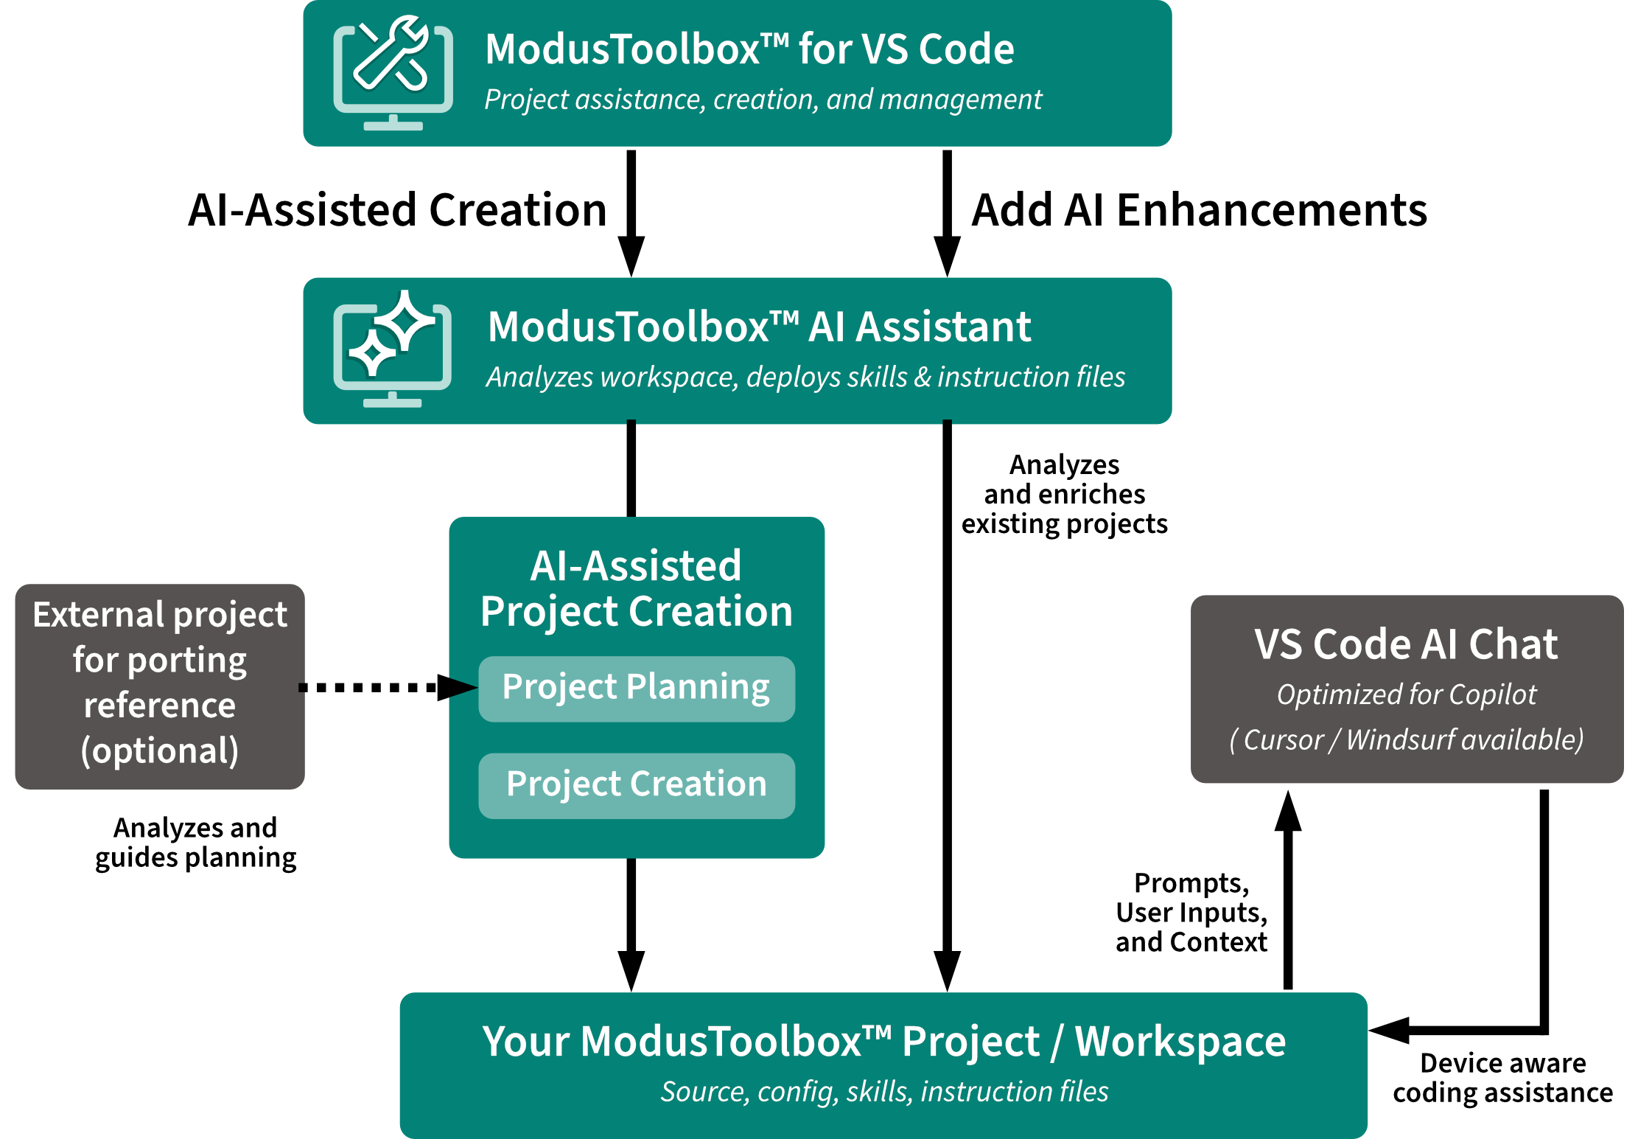
AI-assisted project planning, creation, and enhancement

Slide 47
Feature highlights and key messaging
Example prompts (show or demo)
"Create a FreeRTOS task that reads the BMI270 accelerometer over I2C and prints values over UART"
"Set up BLE peripheral advertising with a custom GATT service"
"What libraries are available for WiFi connectivity?"
"Configure DMA for SPI transfers on this board“
What you get
Code that compiles for your specific device
Correct init sequences (clocks, interrupts, pin mux)
Library recommendations with install commands
Device Configurator integration when config changes are needed
Key messaging
Free to install from VS Code Marketplace
Works with GitHub Copilot (most common), Cursor, or Windsurf
Requires ModusToolbox™ 3.7+ and Python 3.9+
No data sent to Infineon — runs entirely local
Great demo opportunity — install takes 30 seconds, first "wow" in under a minute

Slide 48
Introduction to the upcoming ModusToolbox™ SDK

Slide 49
How the development model is evolving
 | Current Model | SDK Model
Project creation | BSP → CE → download manifests → clone from GitHub | BSP → CE → SDK → copy from local install
Dependencies | .mtb pointers in deps/ Stored in mtb_shared/ via make getlibs | No .mtb, no deps/, no mtb_shared/ libraries in project libs/
Versioning | Each library versioned independently User verifies compatibility | All library versions locked to SDK version
Middleware | Shared, read-only in mtb_shared/ | Local to project, editable directly
Offline | GitHub required for every make getlibs | Fully offline after SDK install
Portability | Recipient must make getlibs to reconstruct | App is self-contained and shareable as-is

Slide 50
What the SDK provides
ModusToolbox™
SDK
BSPs
All supported boards, tested versions
Middleware
PDL, Retarget-IO, Machine Learning,
Motor Control, FreeRTOS, ...
Tools
Device Configurator, Library Manager,
CAPSENSE Configurator, Build system...
Code Examples
Reference projects aligned specifically with
included middleware
Documentation
Release notes, user guides
Predictability — "I'm using SDK v1.2" tells support everything they need to know
Tested together — Infineon validates the full combination before release
Self-contained — applications include all middleware; no external mtb_shared/ dependency
Simpler upgrades — bump one SDK version instead of updating 15 libraries individually

Slide 51
What changes for you and your customers
Workflow | Current | With SDK
Creating a project | BSP → CE → download manifests → clone from GitHub | BSP → CE → SDK → copy from local install
Project structure | deps/ + .mtb files libs/ = transitive pointers mtb_shared/ | deps/ and mtb_shared/ gone libs/ = real source bsps/ → bsp/
Library versions | Add, remove, update individually via Library Manager | Add/remove within SDK Version changes require SDK upgrade
Version control | Commit .mtb pointers mtb_shared/ not committed | Commit middleware source directly App is self-contained
Sharing | Recipient must make getlibs to reconstruct | App includes everything SDK needed only for tools
Middleware ownership | Shared in mtb_shared/ not typically edited | Local and editable in libs/ SDK detects changes on upgrade
What doesn't change:
  Makefile structure and build commands (make build, make program)
  Device Configurator workflow and BSP customization workflow

Slide 52
SDK summary and key takeaways
Point | Detail
SDK = curated bundle | BSPs + middleware + code examples + tools, tested as a set
One version number | Library versions locked to SDK; upgrade SDK to update libraries
Self-contained apps | No deps/, no mtb_shared/ — middleware source lives in project libs/, editable directly
Simplified workflow | BSP → Code Example → SDK; fully offline after install; no make getlibs
Current concepts apply | Makefiles, BSPs, COMPONENTS, Device Configurator all unchanged
Migration supported | Guided tooling to convert existing projects; both models coexist during transition

Slide 53
Q&A

