Slide 1
Datum IndEx as its Target Label (DIET)
Augmentations Include: Random X and Y Flip, Crop, Rotation, Color Jitter, and Gaussian Blur
IRIS image set has 200 and for each and Dysis has 4665. All but the last slide will be IRIS.
Unet
Baseline
Flip and Crop
Intensity+Rotation
All
Batch: 128
Attention Unet
Baseline
Flip and Crop
Intensity+Rotation
All
Batch 128
ResNet 18/50
Baseline
Flip and Crop
All
Batch 64

Slide 2
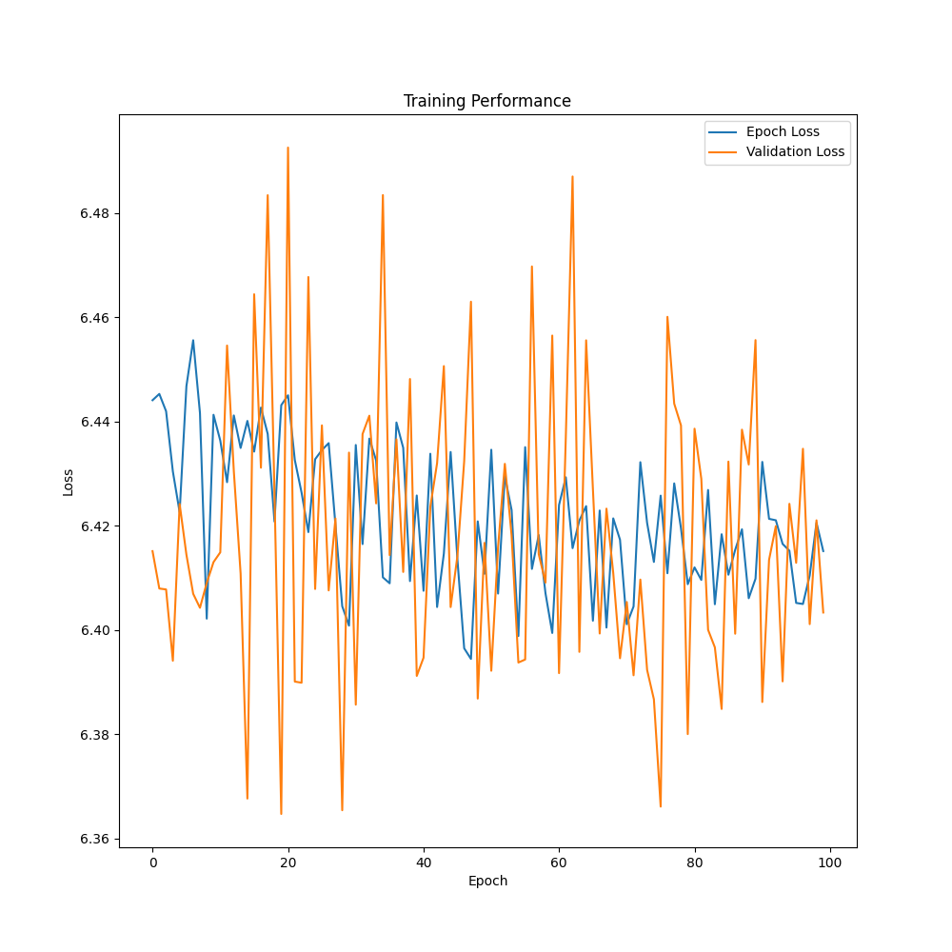
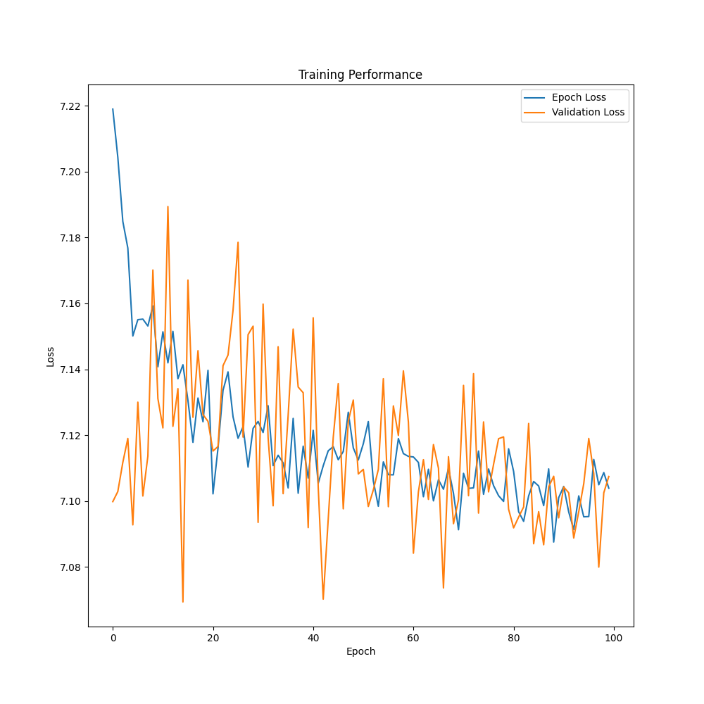
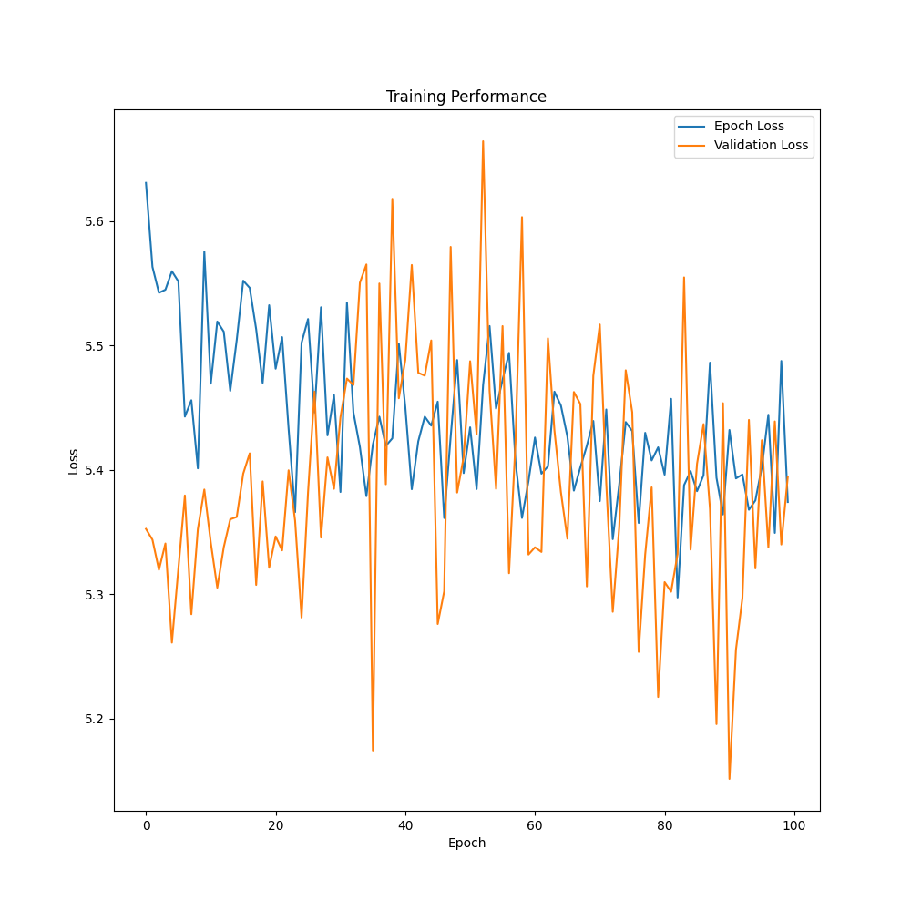
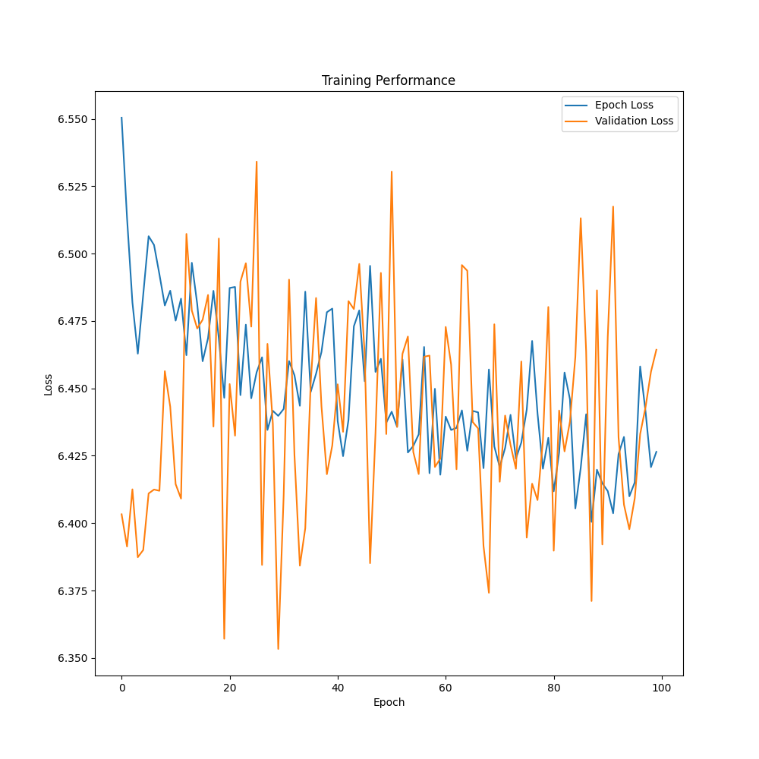
UNet
No Augmentations
Flip and Crop
Rotate, Jitter, Gaussian
All Six

Slide 3
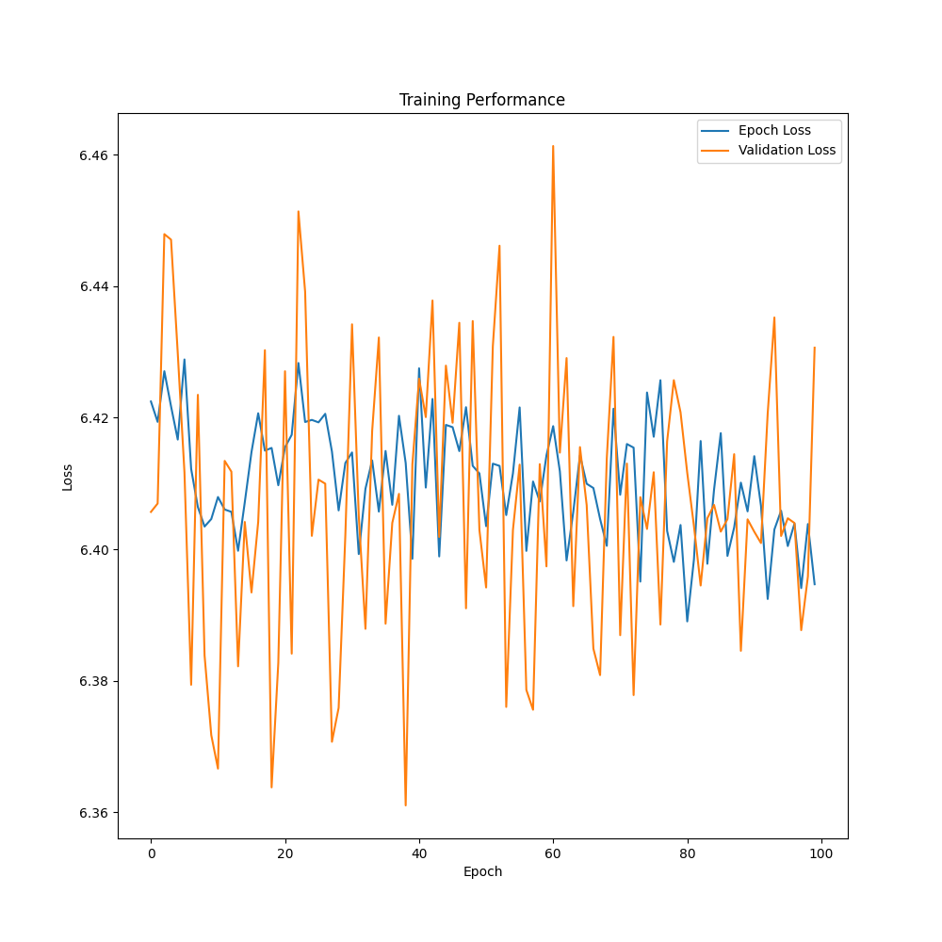
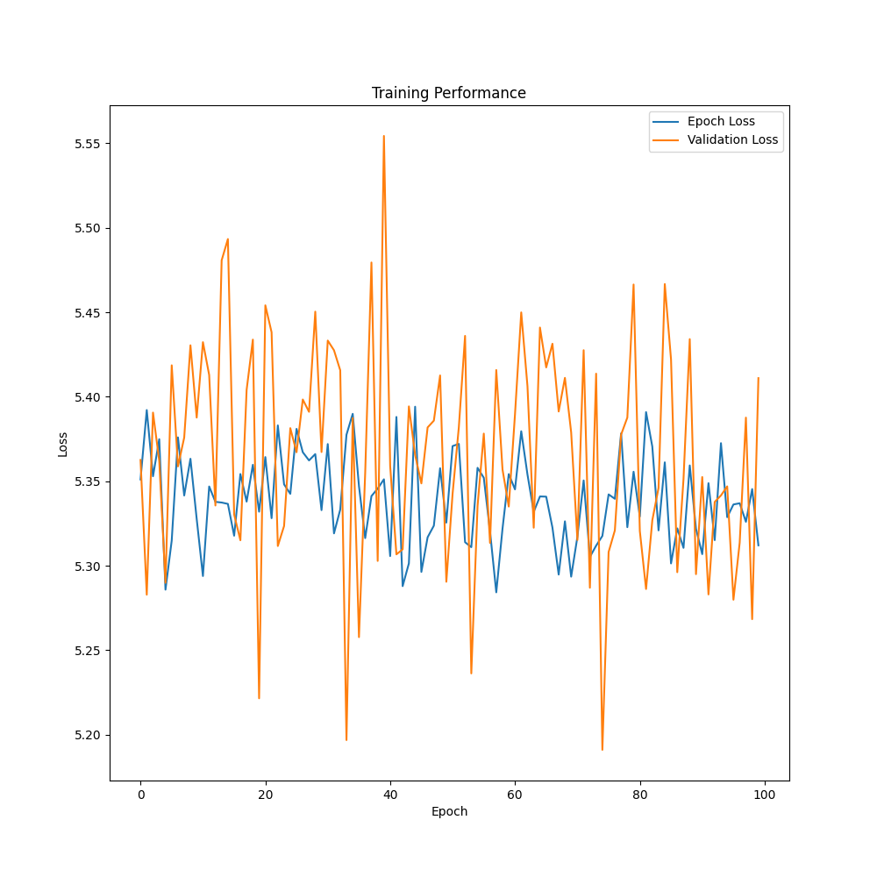
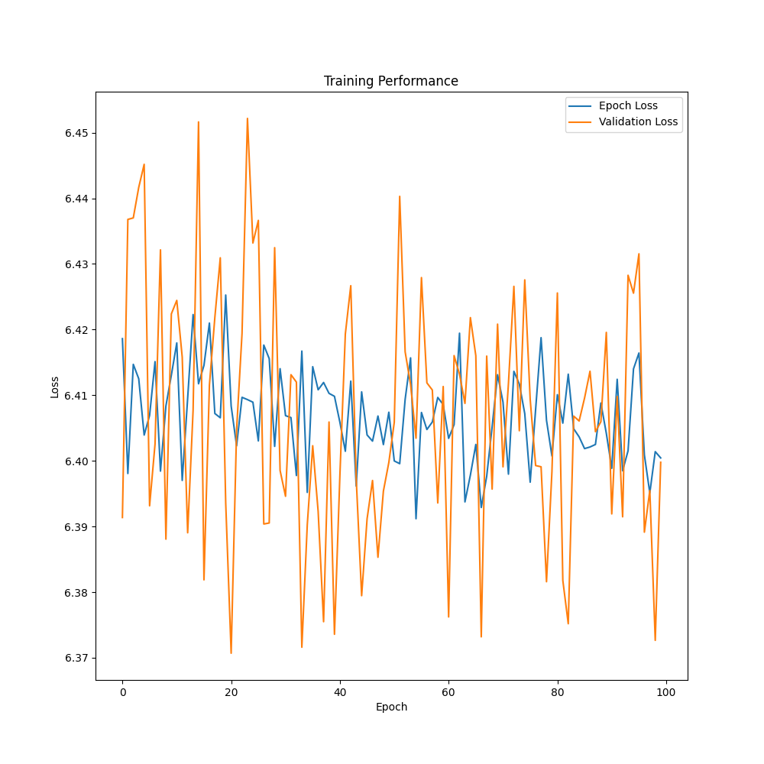
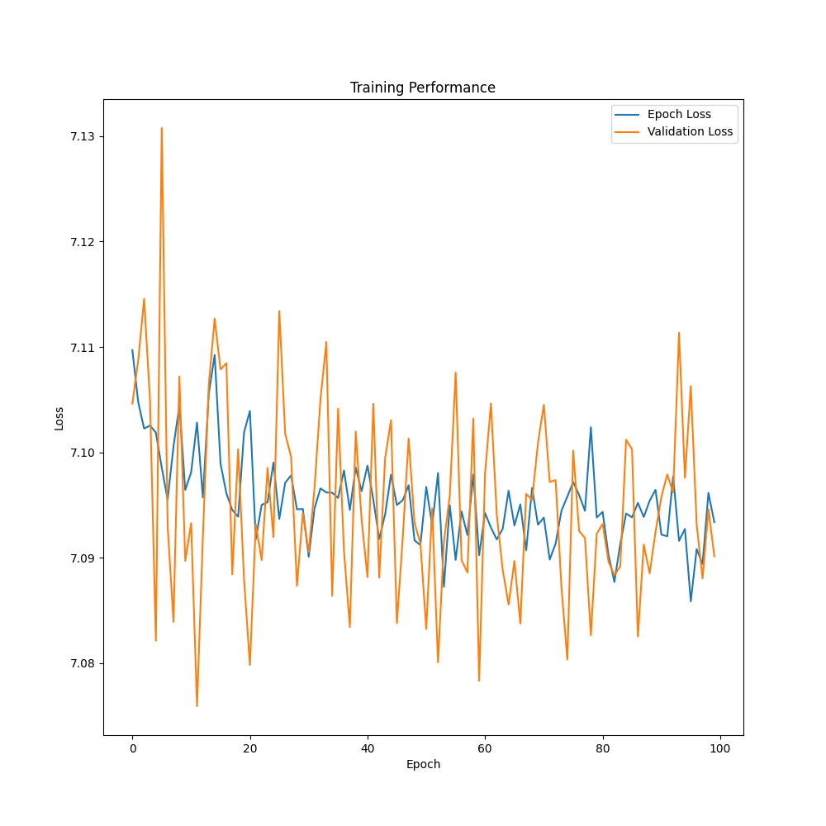
Attention UNet
No Augmentations
Flip and Crop
Rotate, Jitter, Gaussian
All Six

Slide 4
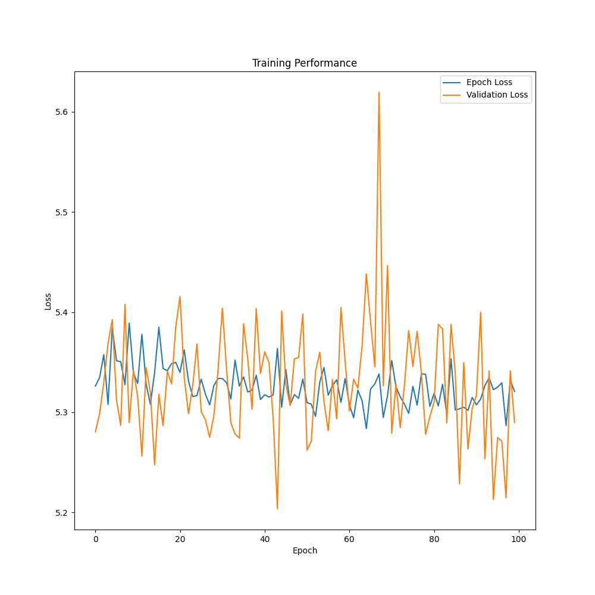
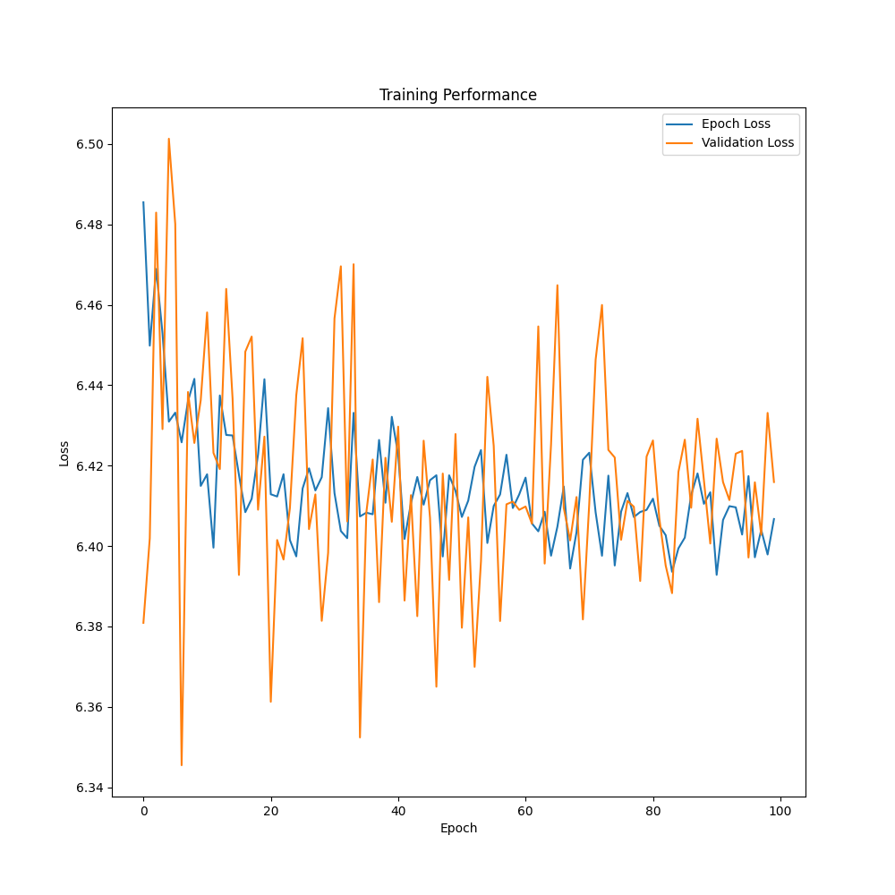
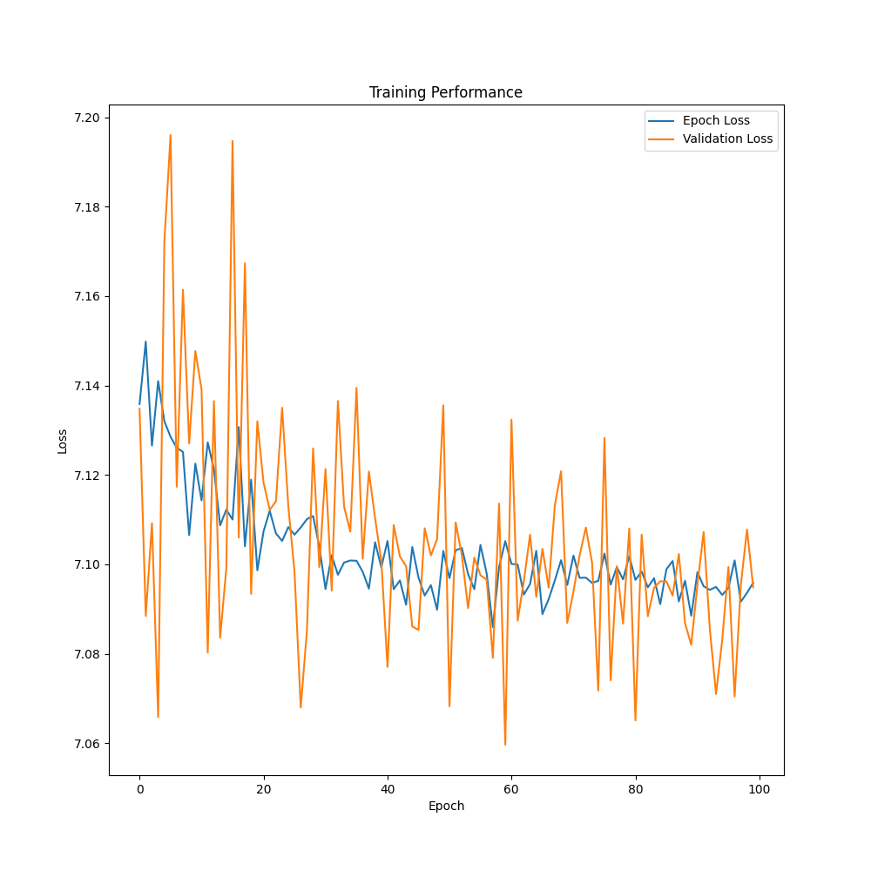
Res18
No Augmentations
Flip and Crop
All Six

Slide 5
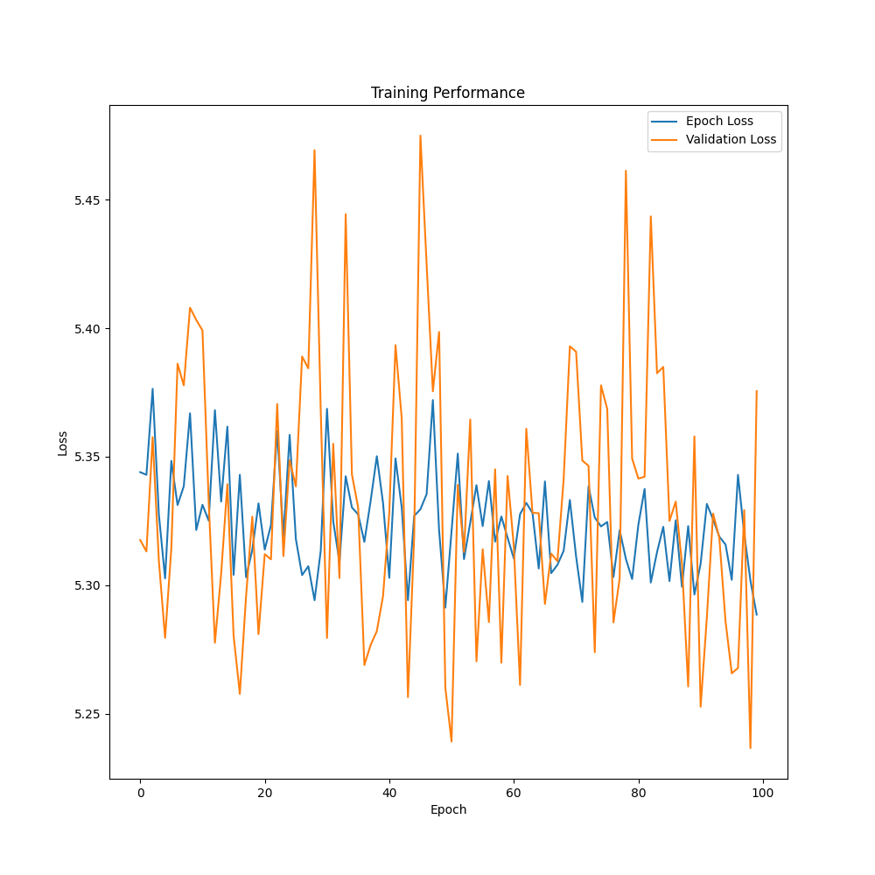
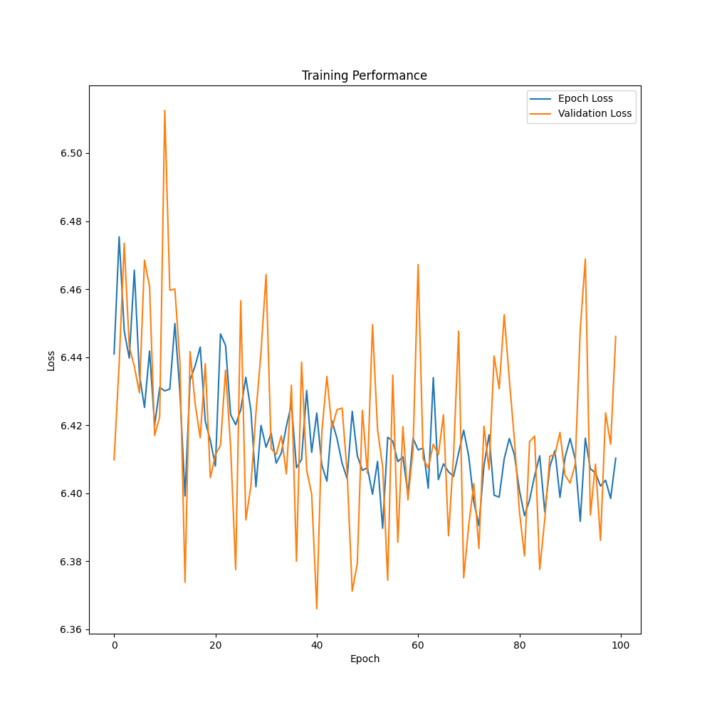
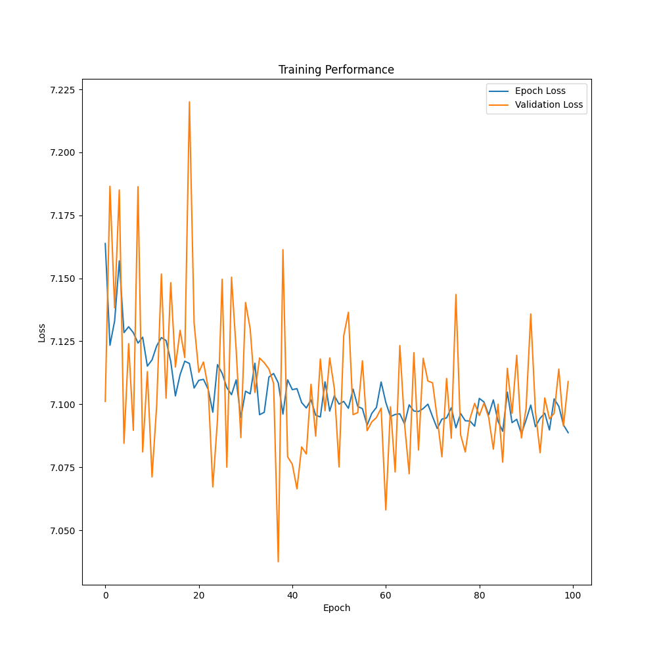
Res50
No Augmentations
Flip and Crop
All Six

Slide 6
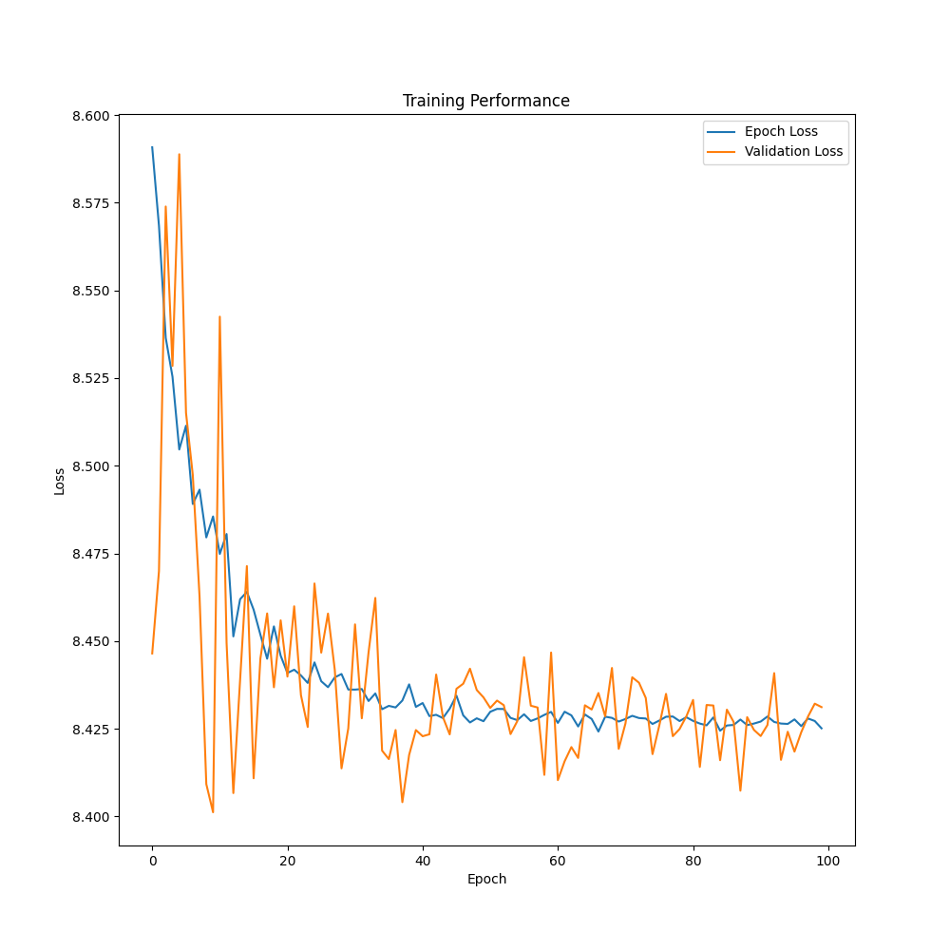
UNet Dysis
No Augmentations

