Slide 1
Alex Clark - Data Portfolio
SICU Spotfire Application
Outpatient Global P&L
Fantasy Football Analysis
Orthopaedics Bundle

Slide 2
SICU Spotfire Application
End users wanted financial data to justify adding a new pharmacist
Wanted to look at pharmacy costs associated with the ICU units
Solution was to build an application
Application must show metrics helpful to end users
Application must have the ability to export data out to excel

Slide 3
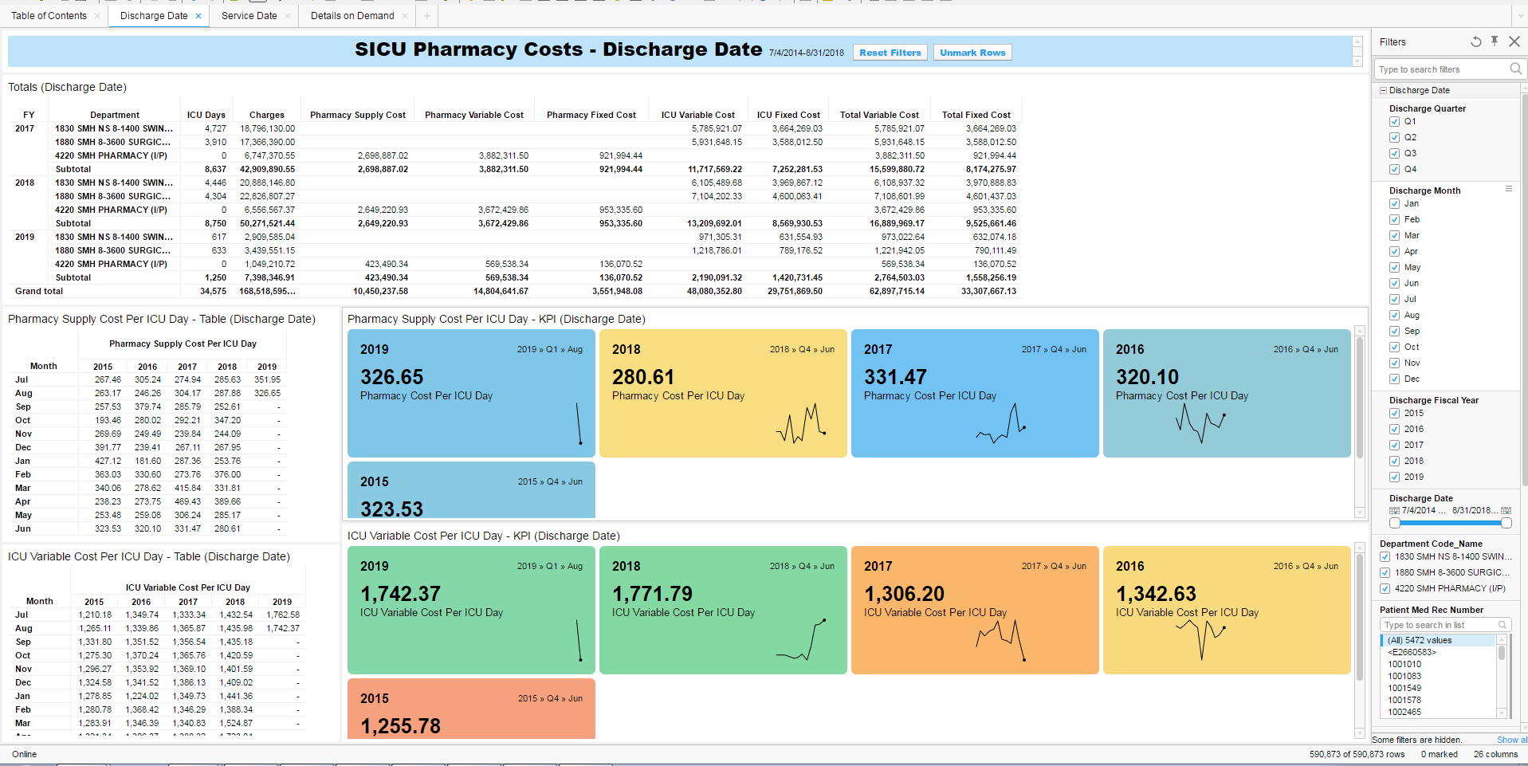
SICU Spotfire Application
Notes:
Initially started out as excel spreadsheet with just table
Added in KPI, key performance metric, that user wanted to see
Details on demand for exporting and own analysis

Slide 4
SICU Spotfire Application

Slide 5
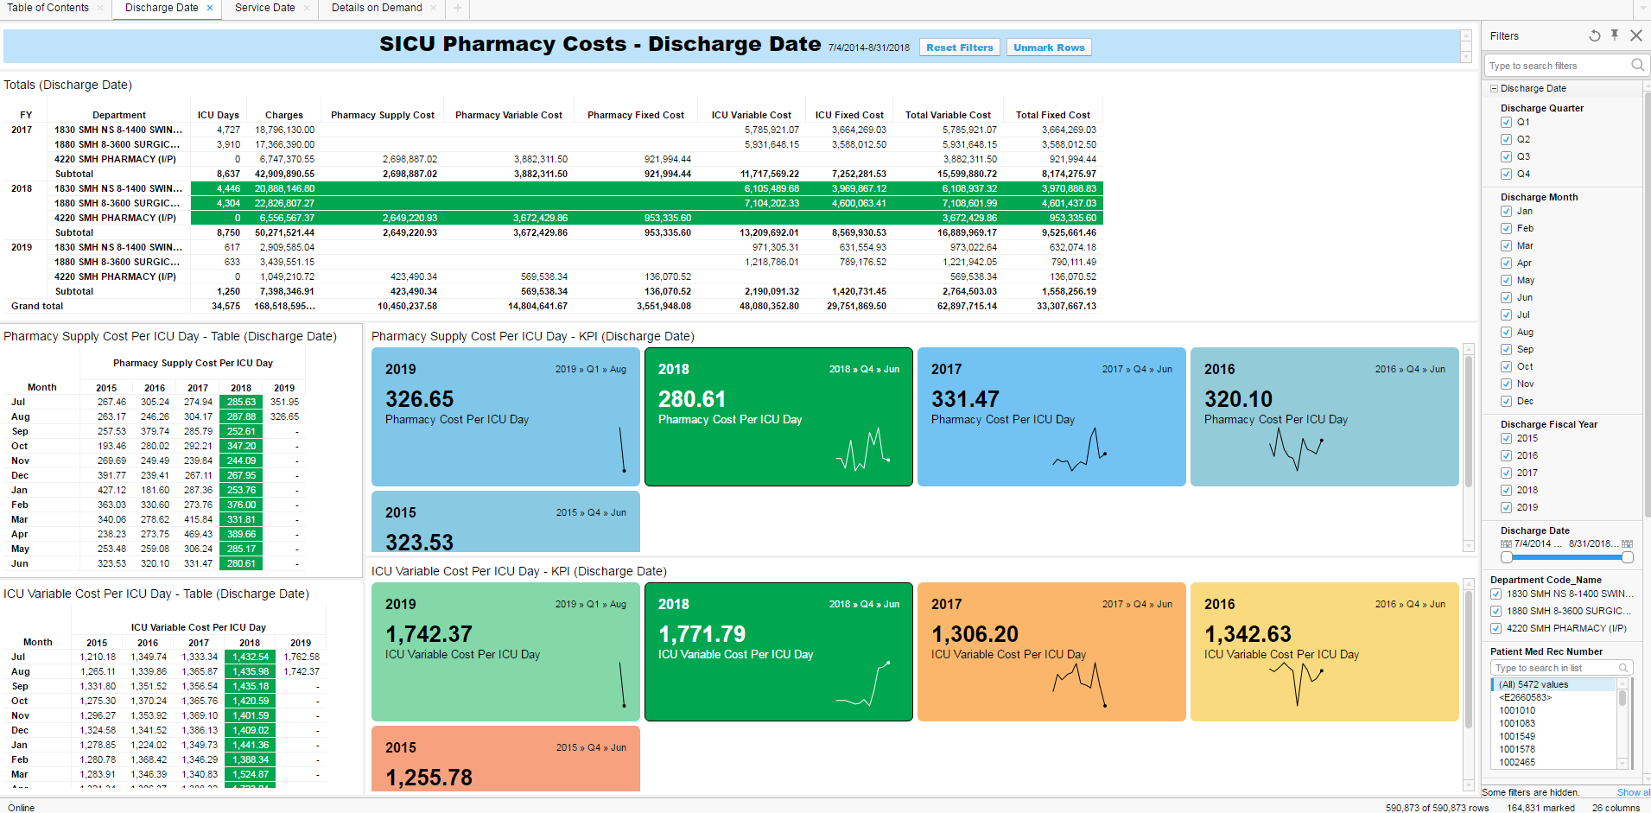
SICU Spotfire Application

Slide 6
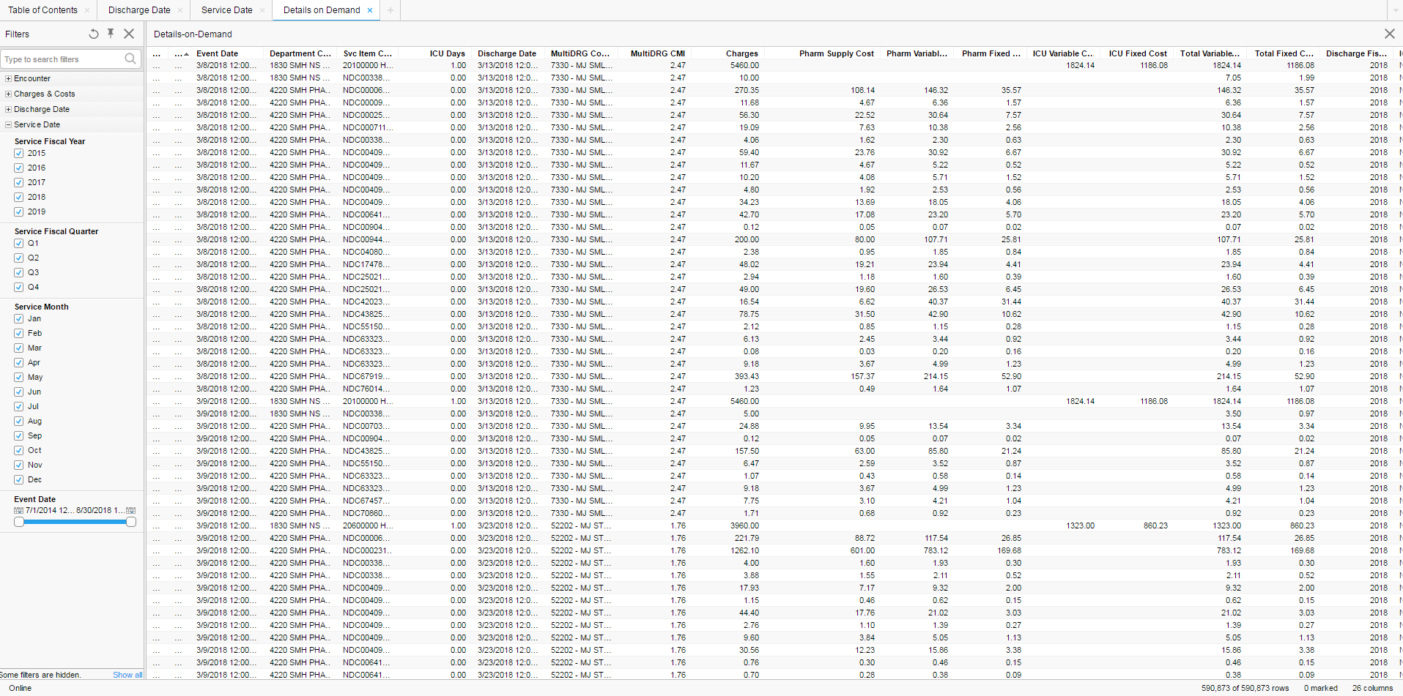
SICU Spotfire Application

Slide 7
Outpatient Global
Combine outpatient hospital billing with outpatient professional billing.
Old process was purely Excel. Old OP Global
Was used to create a paper chiefs report (20 page document for each department)
Took up to 3 weeks to compile and reconcile back to general ledger
New process is done mostly in R. New OP Global Flowchart
New process loads into the chiefs apps, replacement for the paper chiefs
Takes less than a week to compile and reconcile back to general ledger

Slide 8
Fantasy Football Analysis
Final project for data science course
10 years worth of data scraped from my league page
Two objectives:
Would adjusting the scoring of the tight end position increase the positions value?
Is there a correlation to total points scored by each position and where the team ended up in the final standings?
Uploaded datasets to Kaggle (RMFF Data)
Used Python to derive answers - Analysis

Slide 9
Orthopedics Bundle
End user wanted a way to compute the cost of an Orthopedics surgery, from initial visits to post surgery rehab.
To be used to offer a bundle price for patients coming from Canada.
Had to use a complex system within our financial system to track patients across entities and over a course of time.
After the query in our financial system, pulled into Excel
Bucketed visits
Combined visits to summarized table showing where patients touched the most and the costs related
Ortho Bundle

