Slide 1
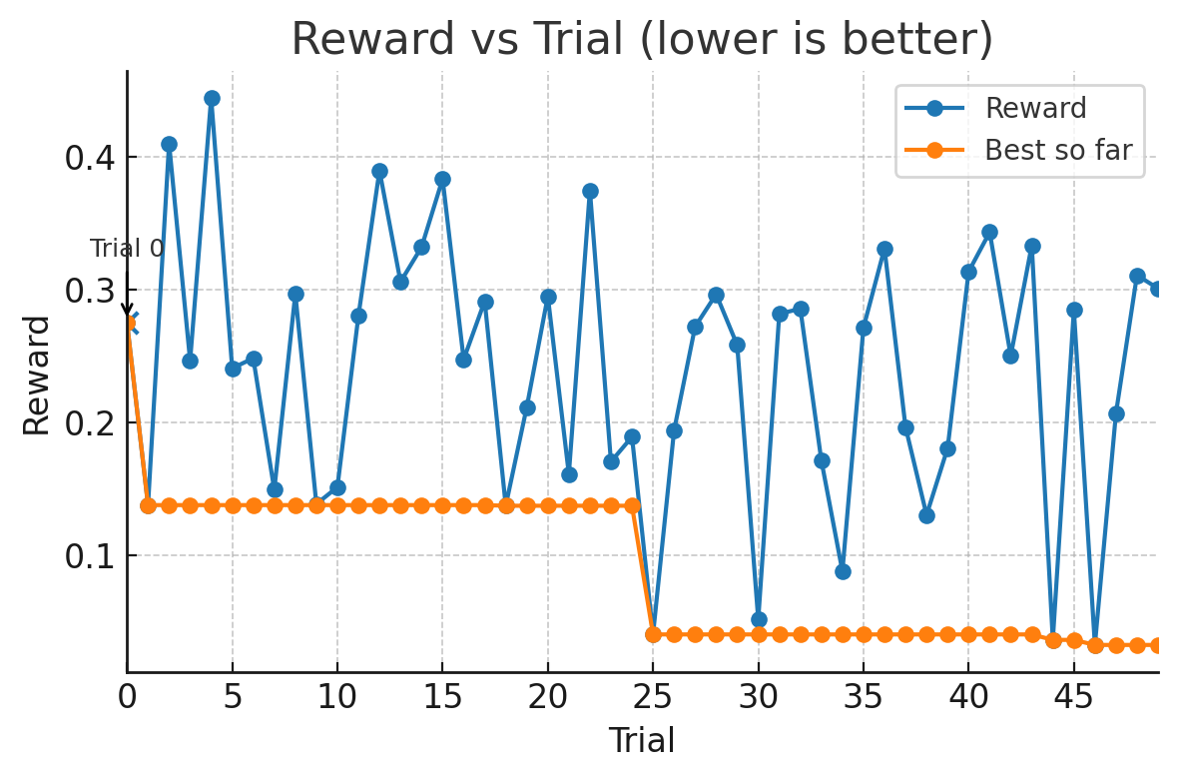
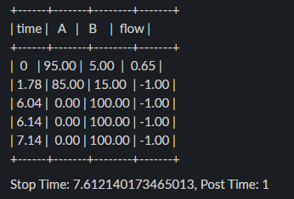
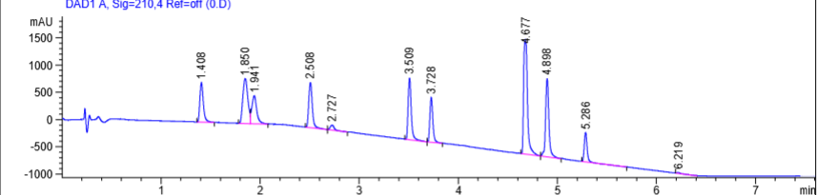
Trial 0 - Sobol
Metric | Value
Separation (Resolution) | 0.889
Last Elution (min) | 5.286
# Peaks | 10
Reward | 0.2750

Slide 2
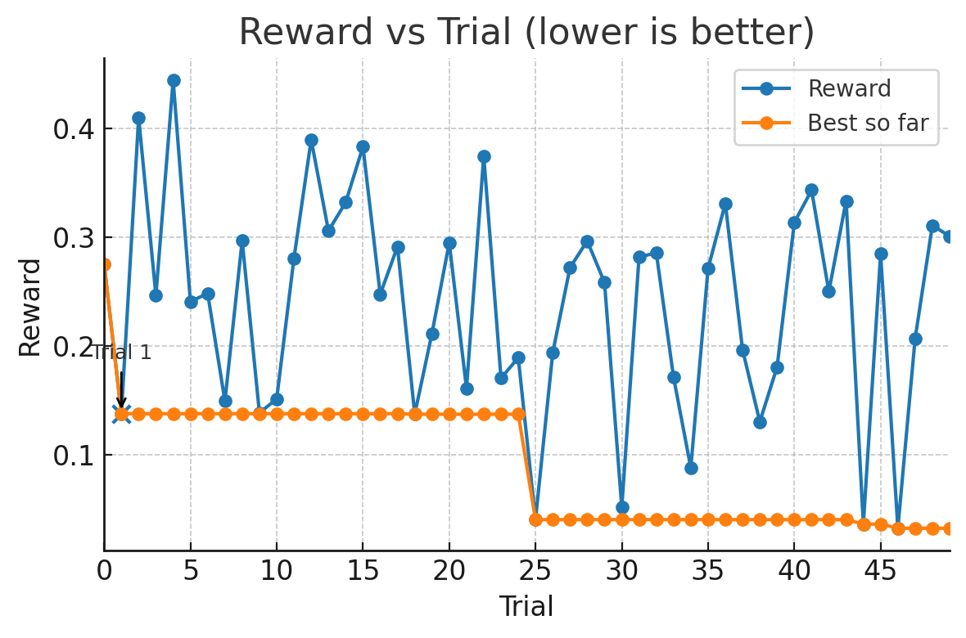
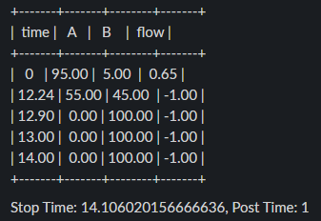
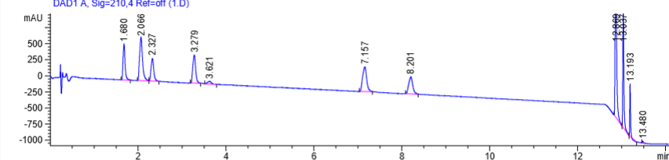
Trial 1 - Sobol
Metric | Value
Separation (Resolution) | 2.138
Last Elution (min) | 13.193
# Peaks | 9
Reward | 0.1380

Slide 3
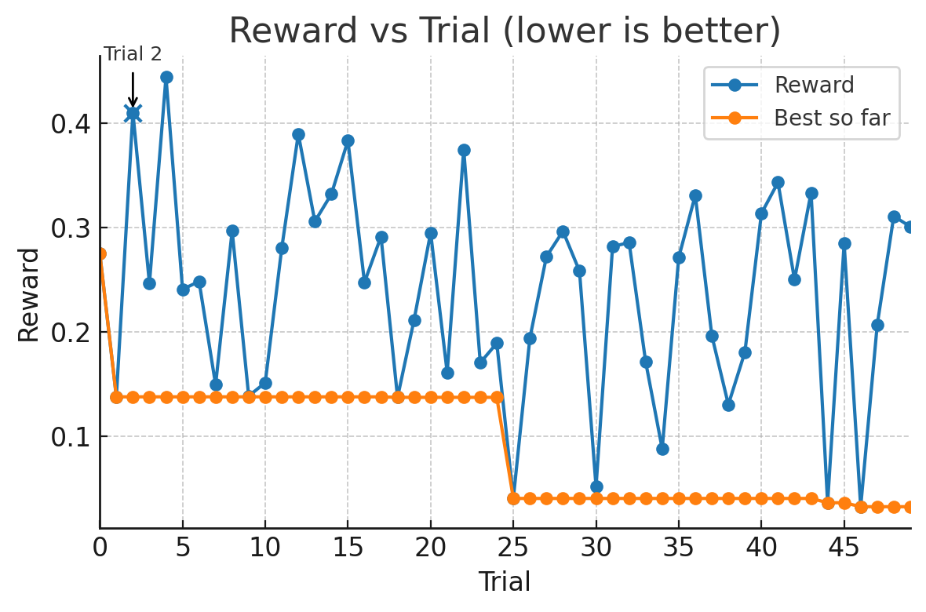
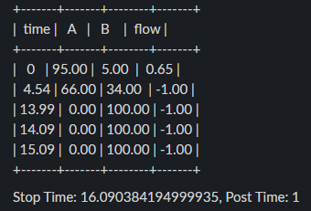
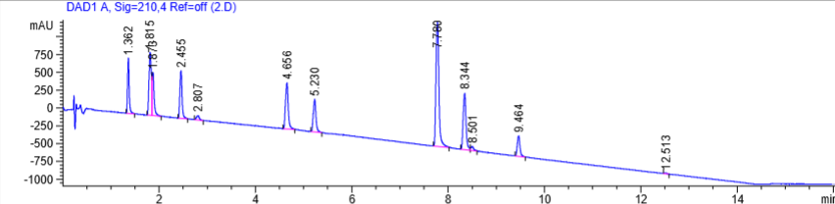
Trial 2 - Sobol
Metric | Value
Separation (Resolution) | 0.649
Last Elution (min) | 9.464
# Peaks | 11
Reward | 0.4098

Slide 4
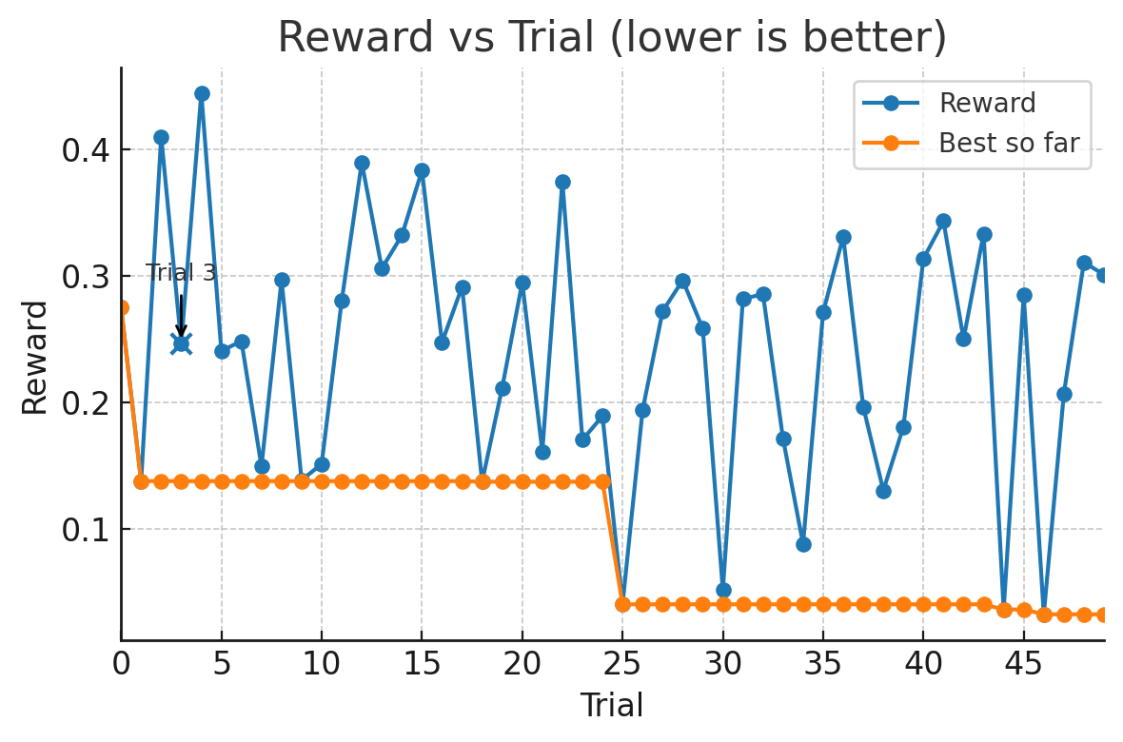
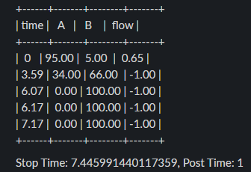
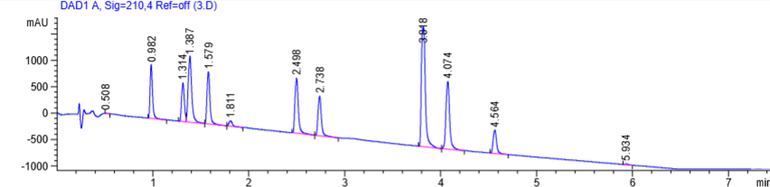
Trial 3 - Sobol
Metric | Value
Separation (Resolution) | 0.996
Last Elution (min) | 4.564
# Peaks | 10
Reward | 0.2465

Slide 5
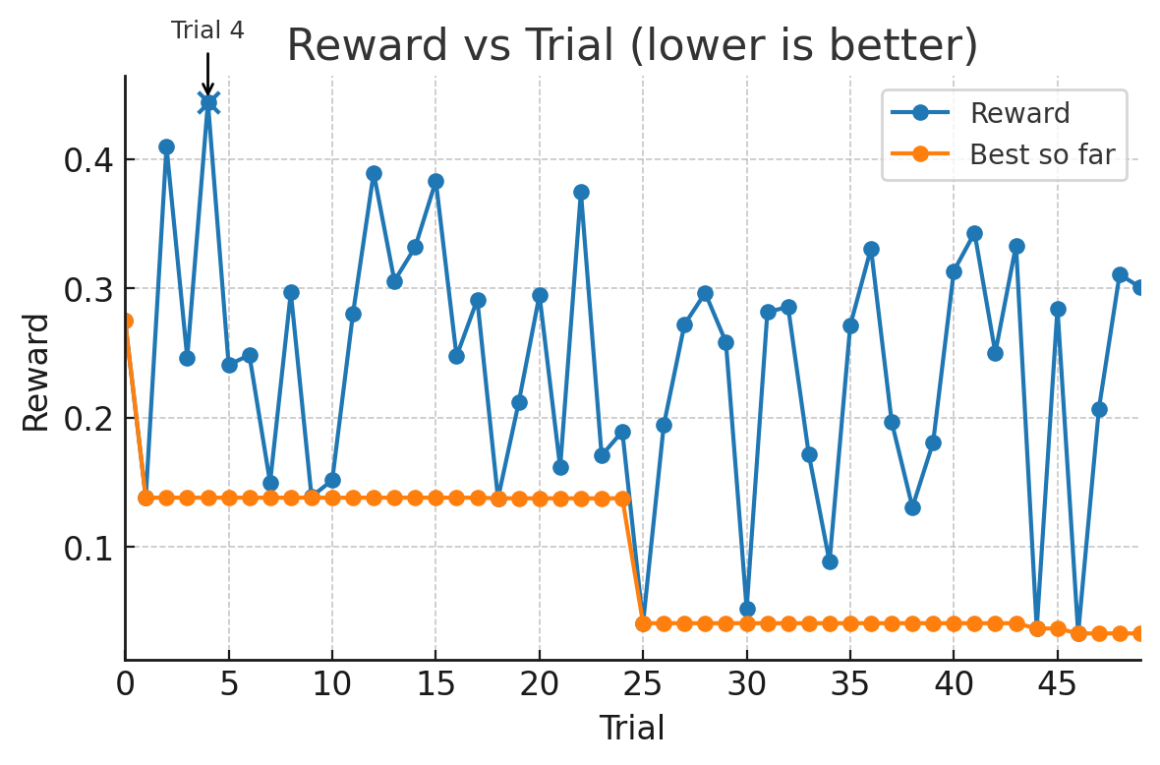
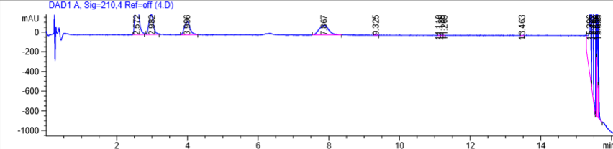
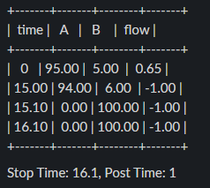
Trial 4 - Sobol
Metric | Value
Separation (Resolution) | 0.787
Last Elution (min) | 15.635
# Peaks | 9
Reward | 0.4440

Slide 6
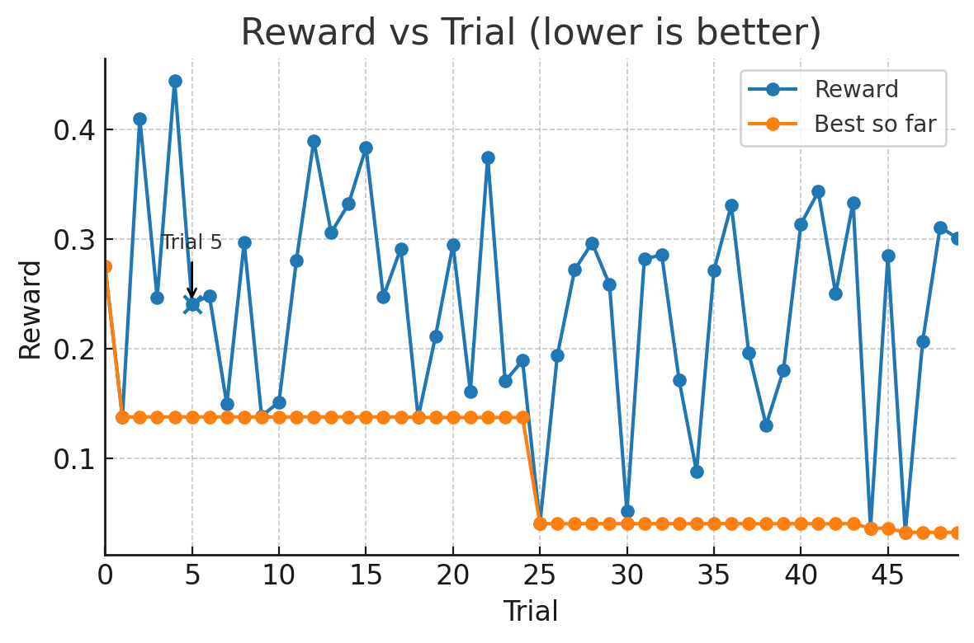
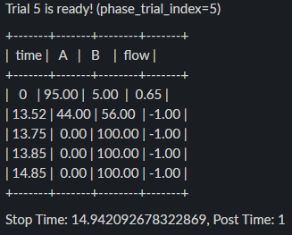
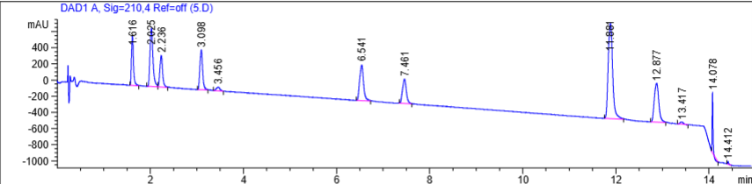
Trial 5 - Sobol
Metric | Value
Separation (Resolution) | 1.725
Last Elution (min) | 14.078
# Peaks | 9
Reward | 0.2408

Slide 7
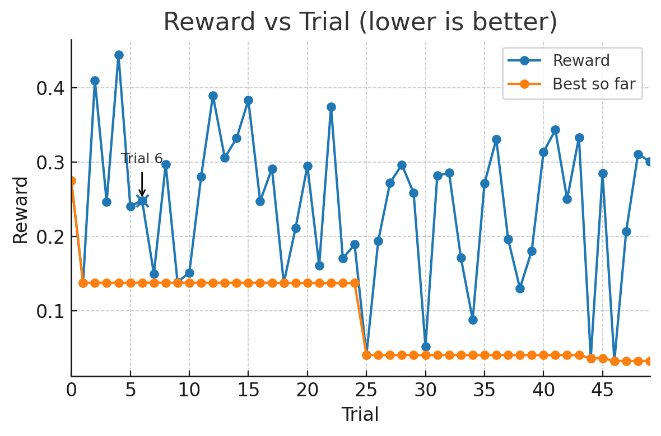
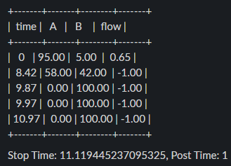
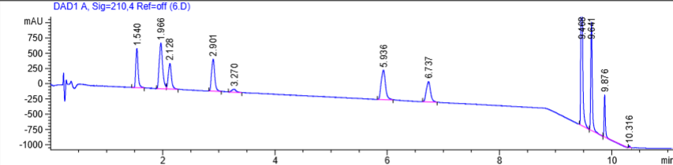
Trial 6 - BoTorch
Metric | Value
Separation (Resolution) | 1.477
Last Elution (min) | 9.876
# Peaks | 9
Reward | 0.2484

Slide 8
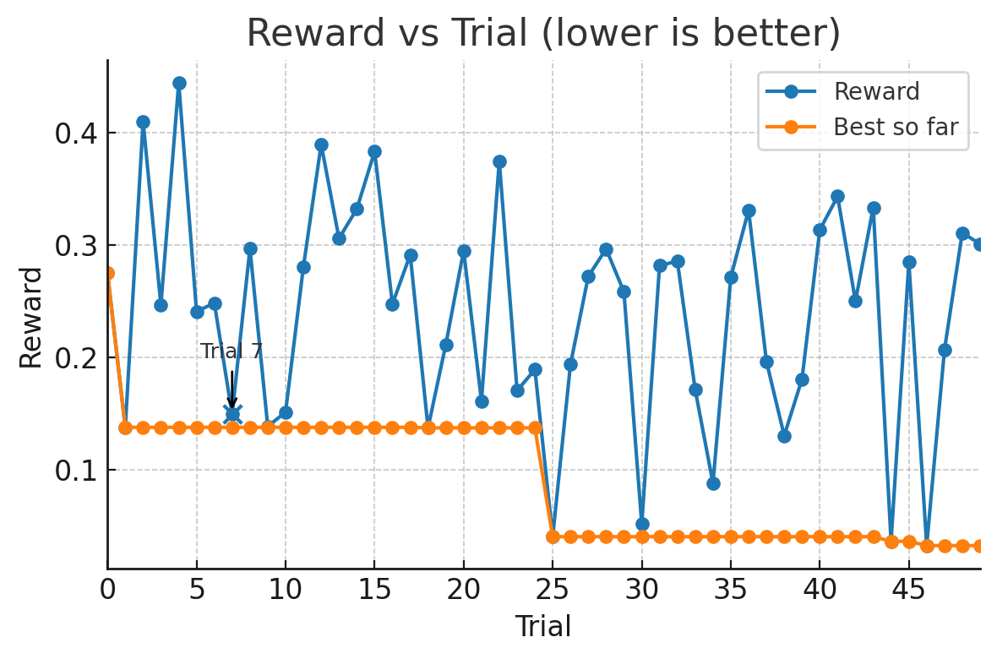
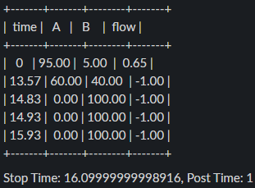
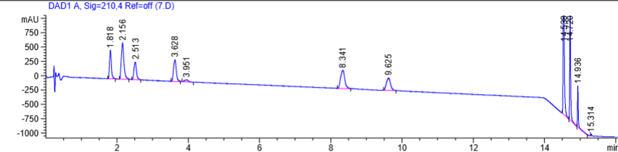
Trial 7 - BoTorch
Metric | Value
Separation (Resolution) | 2.698
Last Elution (min) | 14.936
# Peaks | 9
Reward | 0.1496

Slide 9
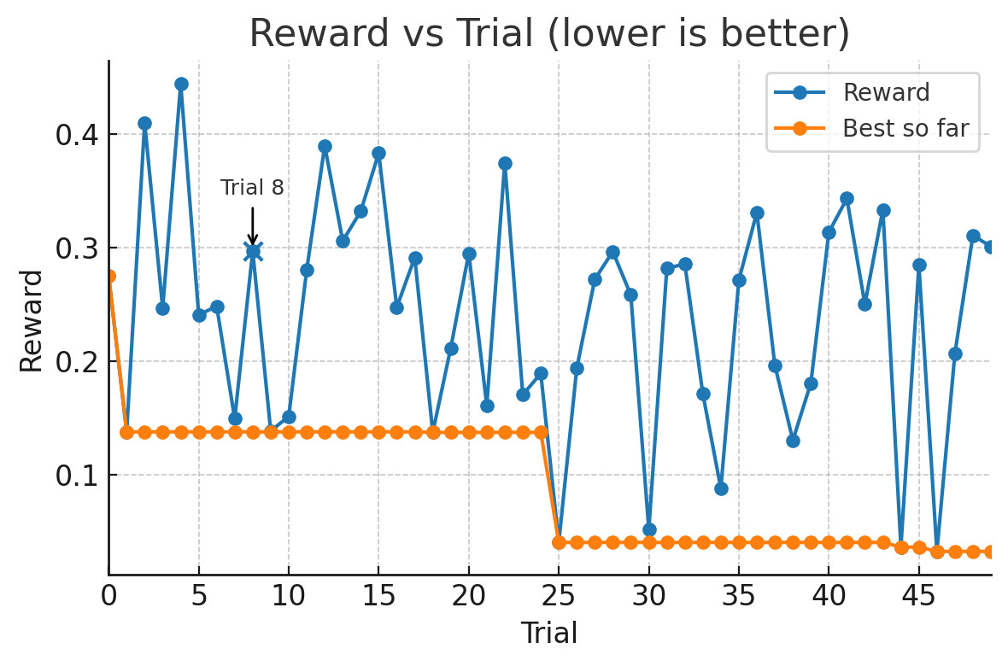
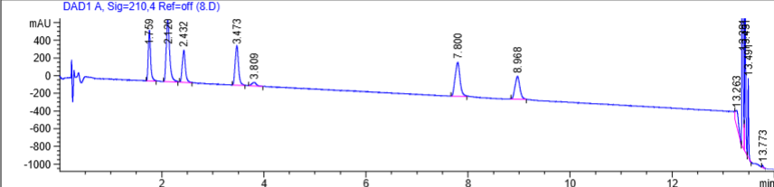
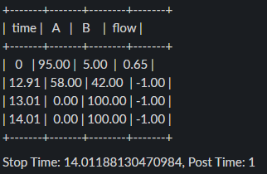
Trial 8 - BoTorch
Metric | Value
Separation (Resolution) | 1.191
Last Elution (min) | 13.491
# Peaks | 10
Reward | 0.2968

Slide 10

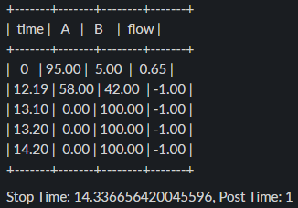
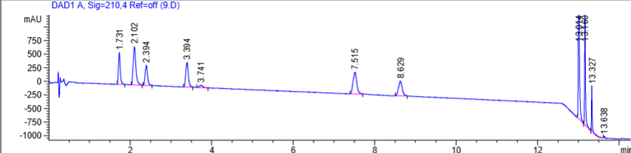
Trial 9 - BoTorch
Metric | Value
Separation (Resolution) | 2.483
Last Elution (min) | 13.327
# Peaks | 9
Reward | 0.1388

Slide 11

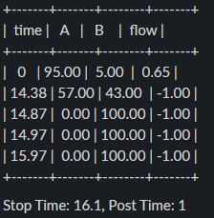
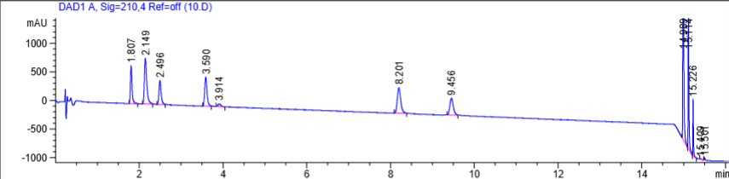
Trial 10 - BoTorch
Metric | Value
Separation (Resolution) | 2.850
Last Elution (min) | 15.226
# Peaks | 9
Reward | 0.1515

Slide 12

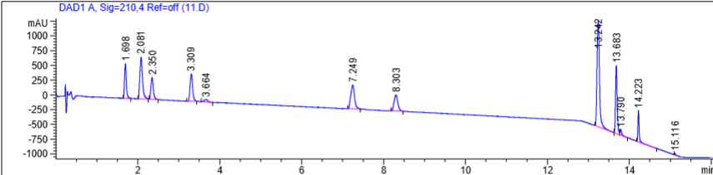
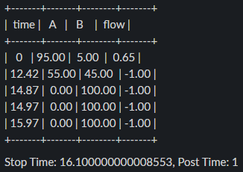
Trial 11 - BoTorch
Metric | Value
Separation (Resolution) | 1.309
Last Elution (min) | 14.223
# Peaks | 10
Reward | 0.2804

Slide 13
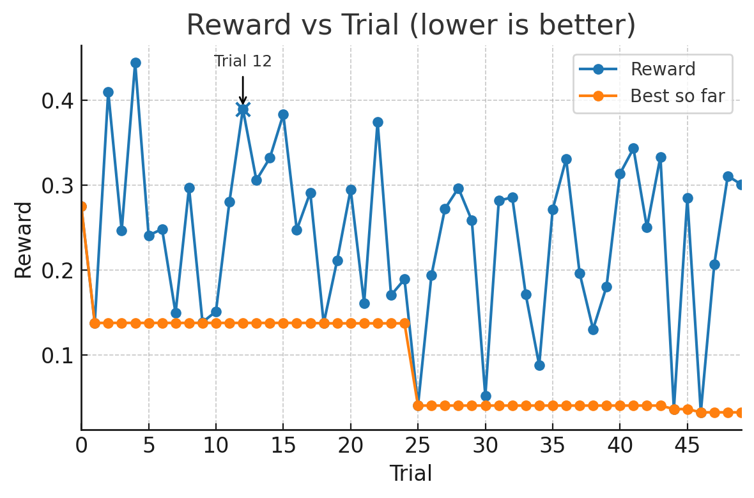
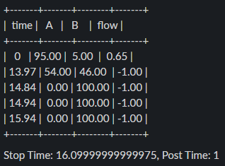
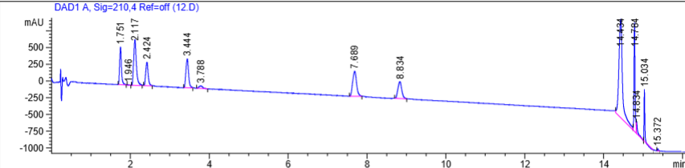
Trial 12 - BoTorch
Metric | Value
Separation (Resolution) | 0.805
Last Elution (min) | 15.034
# Peaks | 10
Reward | 0.3894

Slide 14

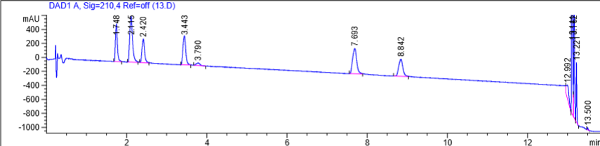
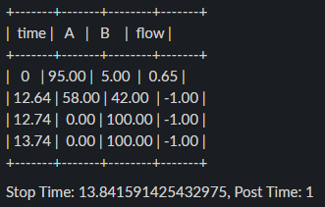
Trial 13 - BoTorch
Metric | Value
Separation (Resolution) | 1.132
Last Elution (min) | 13.221
# Peaks | 10
Reward | 0.3058

Slide 15
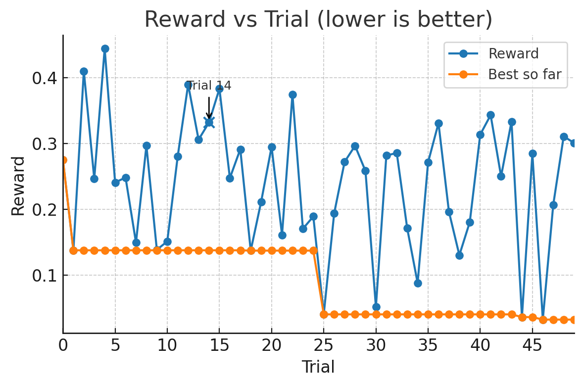
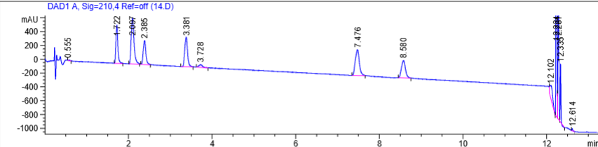
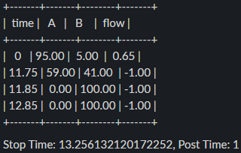
Trial 14 - BoTorch
Metric | Value
Separation (Resolution) | 0.957
Last Elution (min) | 12.335
# Peaks | 10
Reward | 0.3319

Slide 16
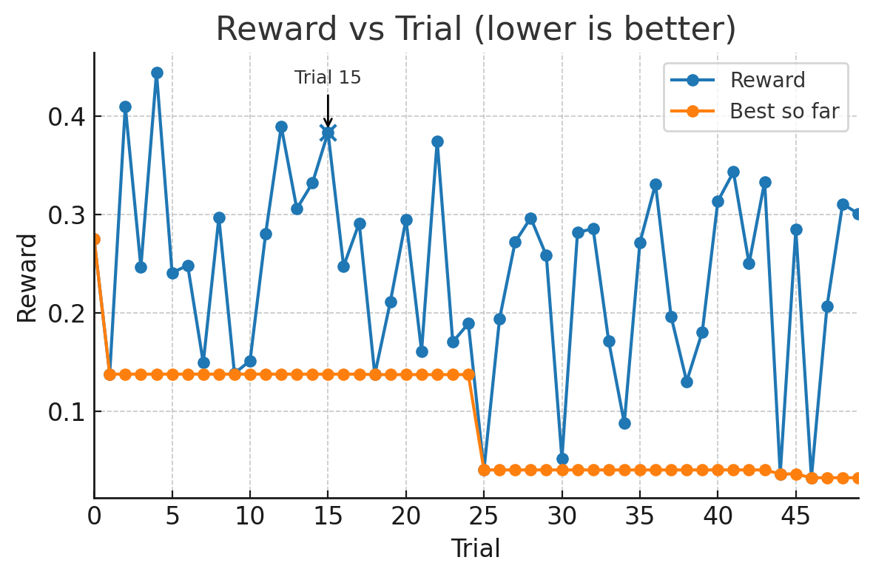
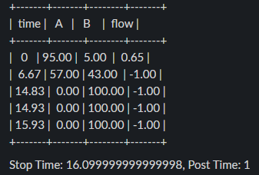
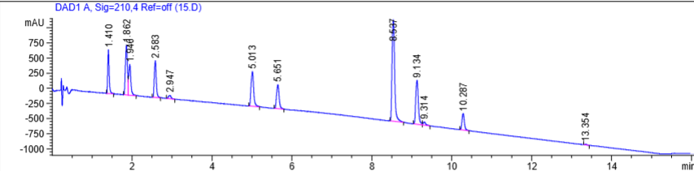
Trial 15 - BoTorch
Metric | Value
Separation (Resolution) | 0.824
Last Elution (min) | 10.287
# Peaks | 11
Reward | 0.3831

Slide 17
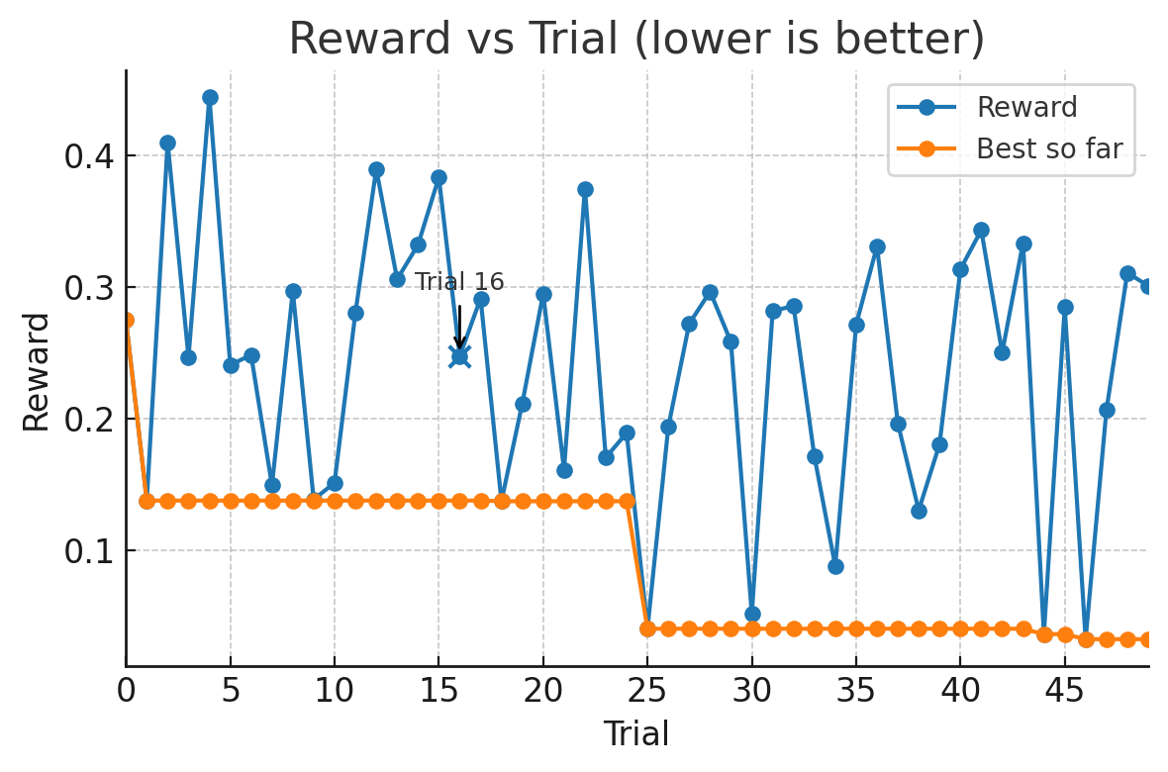
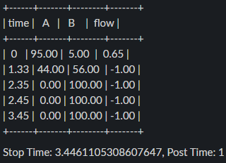
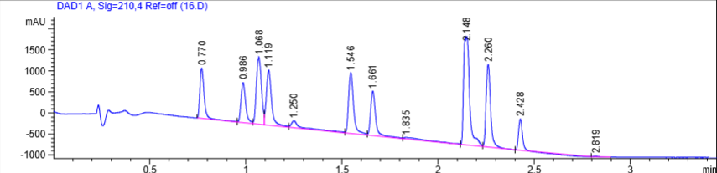
Trial 16 - BoTorch
Metric | Value
Separation (Resolution) | 0.884
Last Elution (min) | 2.428
# Peaks | 10
Reward | 0.2475

Slide 18

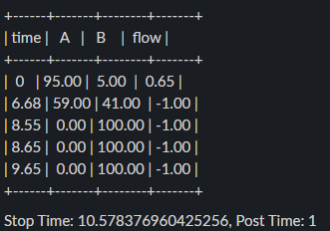
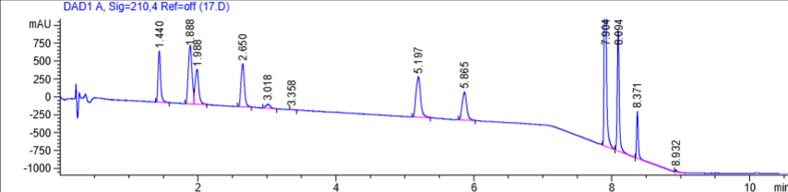
Trial 17 - BoTorch
Metric | Value
Separation (Resolution) | 0.962
Last Elution (min) | 8.371
# Peaks | 10
Reward | 0.2913

Slide 19
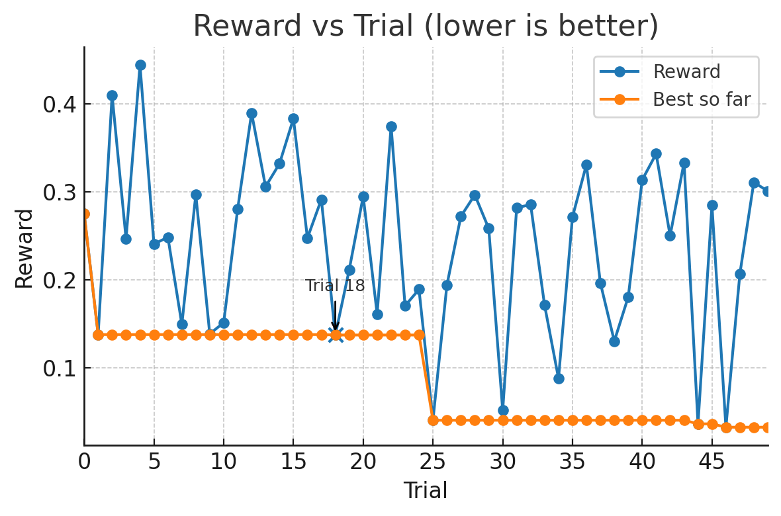


Trial 18 - Sobol
Metric | Value
Separation (Resolution) | 2.251
Last Elution (min) | 13.130
# Peaks | 9
Reward | 0.1375

Slide 20



Trial 19 - Sobol
Metric | Value
Separation (Resolution) | 1.538
Last Elution (min) | 8.927
# Peaks | 9
Reward | 0.2117

Slide 21



Trial 20 - Sobol
Metric | Value
Separation (Resolution) | 0.892
Last Elution (min) | 8.790
# Peaks | 10
Reward | 0.2949

Slide 22



Trial 21 - Sobol
Metric | Value
Separation (Resolution) | 1.475
Last Elution (min) | 6.761
# Peaks | 10
Reward | 0.1613

Slide 23



Trial 22 - Sobol
Metric | Value
Separation (Resolution) | 0.783
Last Elution (min) | 15.748
# Peaks | 10
Reward | 0.3746

Slide 24



Trial 23 - Sobol
Metric | Value
Separation (Resolution) | 1.835
Last Elution (min) | 11.118
# Peaks | 9
Reward | 0.1706

Slide 25



Trial 24 - Sobol
Metric | Value
Separation (Resolution) | 3.957
Last Elution (min) | 16.082
# Peaks | 8
Reward | 0.1893

Slide 26



Trial 25 - Sobol
Metric | Value
Separation (Resolution) | 2.106
Last Elution (min) | 7.336
# Peaks | 10
Reward | 0.0408

Slide 27



Trial 26 - Sobol
Metric | Value
Separation (Resolution) | 1.737
Last Elution (min) | 11.565
# Peaks | 9
Reward | 0.1941

Slide 28



Trial 27 - Sobol
Metric | Value
Separation (Resolution) | 1.351
Last Elution (min) | 11.673
# Peaks | 11
Reward | 0.2721

Slide 29



Trial 28 - Sobol
Metric | Value
Separation (Resolution) | 0.891
Last Elution (min) | 3.574
# Peaks | 11
Reward | 0.2965

Slide 30



Trial 29 - Sobol
Metric | Value
Separation (Resolution) | 1.596
Last Elution (min) | 15.892
# Peaks | 9
Reward | 0.2583

Slide 31



Trial 30 - BoTorch
Metric | Value
Separation (Resolution) | 2.247
Last Elution (min) | 9.367
# Peaks | 10
Reward | 0.0520

Slide 32



Trial 31 - BoTorch
Metric | Value
Separation (Resolution) | 1.215
Last Elution (min) | 9.570
# Peaks | 9
Reward | 0.2817

Slide 33



Trial 32 - BoTorch
Metric | Value
Separation (Resolution) | 0.821
Last Elution (min) | 5.988
# Peaks | 10
Reward | 0.2856

Slide 34



Trial 33 - BoTorch
Metric | Value
Separation (Resolution) | 1.653
Last Elution (min) | 12.254
# Peaks | 10
Reward | 0.1715

Slide 35



Trial 34 - BoTorch
Metric | Value
Separation (Resolution) | 3.774
Last Elution (min) | 6.895
# Peaks | 9
Reward | 0.0883

Slide 36



Trial 35 - BoTorch
Metric | Value
Separation (Resolution) | 0.992
Last Elution (min) | 8.355
# Peaks | 10
Reward | 0.2713

Slide 37



Trial 36 - BoTorch
Metric | Value
Separation (Resolution) | 0.601
Last Elution (min) | 6.146
# Peaks | 10
Reward | 0.3309

Slide 38



Trial 37 - BoTorch
Metric | Value
Separation (Resolution) | 3.242
Last Elution (min) | 17.393
# Peaks | 8
Reward | 0.1966

Slide 39



Trial 38 - BoTorch
Metric | Value
Separation (Resolution) | 1.988
Last Elution (min) | 15.389
# Peaks | 10
Reward | 0.1306

Slide 40



Trial 39 - BoTorch
Metric | Value
Separation (Resolution) | 1.739
Last Elution (min) | 10.028
# Peaks | 9
Reward | 0.1808

Slide 41



Trial 40 - BoTorch
Metric | Value
Separation (Resolution) | 1.017
Last Elution (min) | 14.028
# Peaks | 10
Reward | 0.3135

Slide 42



Trial 41 - BoTorch
Metric | Value
Separation (Resolution) | 0.127
Last Elution (min) | 14.818
# Peaks | 11
Reward | 0.3431

Slide 43



Trial 42 - BoTorch
Metric | Value
Separation (Resolution) | 1.117
Last Elution (min) | 8.833
# Peaks | 10
Reward | 0.2501

Slide 44



Trial 43 - BoTorch
Metric | Value
Separation (Resolution) | 0.214
Last Elution (min) | 15.745
# Peaks | 11
Reward | 0.3333

Slide 45



Trial 44 - BoTorch
Metric | Value
Separation (Resolution) | 2.280
Last Elution (min) | 6.601
# Peaks | 10
Reward | 0.0367

Slide 46



Trial 45 - BoTorch
Metric | Value
Separation (Resolution) | 0.805
Last Elution (min) | 5.472
# Peaks | 10
Reward | 0.2846

Slide 47



Trial 46 - BoTorch
Metric | Value
Separation (Resolution) | 2.164
Last Elution (min) | 5.922
# Peaks | 10
Reward | 0.0329

Slide 48



Trial 47 - BoTorch
Metric | Value
Separation (Resolution) | 1.598
Last Elution (min) | 15.179
# Peaks | 10
Reward | 0.2069

Slide 49



Trial 48 - BoTorch
Metric | Value
Separation (Resolution) | 0.819
Last Elution (min) | 3.558
# Peaks | 11
Reward | 0.3108

Slide 50



Trial 49 - BoTorch
Metric | Value
Separation (Resolution) | 0.736
Last Elution (min) | 5.763
# Peaks | 10
Reward | 0.3008

