Slide 1

SQL
Session 2

Slide 2
Table of Contents
What are type of Aggregate Functions, why do we need them?
Group By Clause
What are type of Joins in SQL, why do we need them
Notes:
In this lesson, we will learn about what an Aggregate function is, five built-in aggregate functions and how they are used in SQL queries.
Then we will learn Group By clauses and their usage with aggregate functions
Besides, if we have time, we will also learn about how to JOIN the tables using SQL's most common join types which are INNER join and LEFT join.

Slide 3
Aggregate Functions

Slide 4
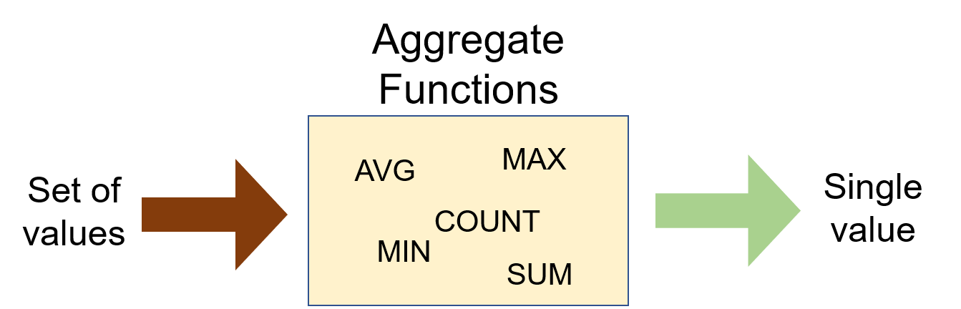
SQL What is an aggregate function?
Aggregate functions are functions that take a collection of values as input and return a single value
Notes:
Aggregate functions are functions that take a collection of values as input and return a single value. SQL has five built-in aggregate functions:
COUNT (Count)
MIN (Minimum)
MAX (Maximum)
SUM (Total)
AVG (Average)

Slide 5
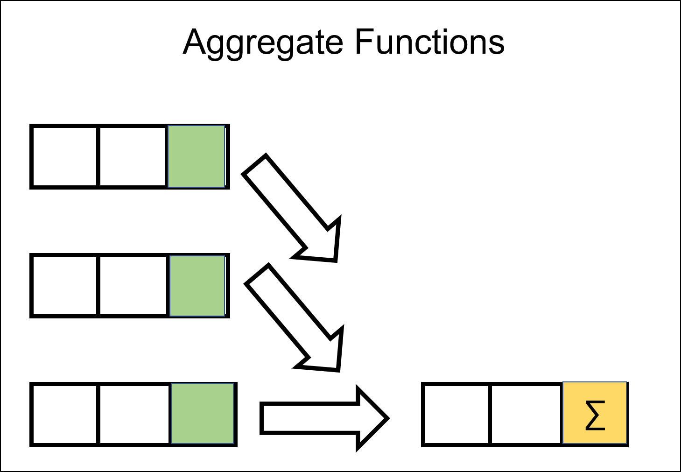
SQL What is an aggregate function?
SUM and AVG → numeric values
MIN, MAX, COUNT → numeric & non-numeric (strings, date, etc.)
We will learn GROUP BY clause and HAVING clause later.
What is NULL?
Notes:
SUM and AVG functions must take only numeric values as input. However, the other functions (MIN, MAX, COUNT) may take non-numeric values (strings, date, etc.) as input other than numeric values.
An aggregate function performs a calculation one or more values and returns a single value. The aggregate function is often used with the GROUP BY clause and HAVING clause of the SELECT statement.
Before we dive into the aggregate functions, we should learn an important concept which is NULL.

Slide 6
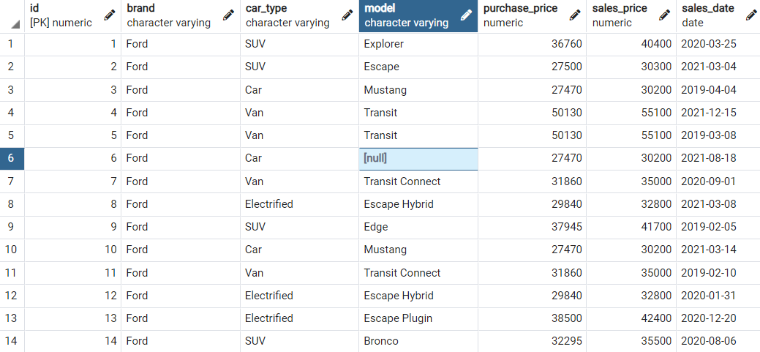
SQL What is NULL?
NULL means no data and is a special value in SQL.
It shows us that a piece of information is unknown or missing or not applicable.
Notes:
For instance, let's assume that we have a song database and we don't know the writers of some of them.
We don't have that information. So, to store these unknown songwriters in a database table, we must use NULL.
If a table has NULL value, then it will be displayed as NULL.

Slide 7

SQL What is NULL?
NULL value represents the unknown value or missing value or not applicable.
NULL is not equal to zero or empty string.
NULL is not equal to itself.
Notes:
It's important to understand what nulls mean and to know how to work with them. They are often ignored in our aggregation functions.
In fact, it is undesirable for the data to be null in the tables, and it is usually tried to get rid of the null expressions in analysis studies.
A field with a NULL value is a field with no value.
If a field in a table is optional, it is possible to insert a new record or update a record without adding a value to this field. Then, the field will be saved with a NULL value.
The following expression returns 0: NULL = NULL, This is because two unknown information cannot be comparable.
Alright, let's start with COUNT function.

Slide 8
COUNT Function
2

Slide 9
SQL COUNT Function
We use COUNT function to count the numbers of records (a.k.a row) in a table.
SELECT COUNT (column_name)
FROM table_name;
Notes:
We use COUNT function to count the numbers of records (a.k.a row) in a table. Here is the syntax of the COUNT function:
Use COUNT keyword immediately after SELECT keyword. Then specify the column on which you want to operate in parentheses

Slide 10
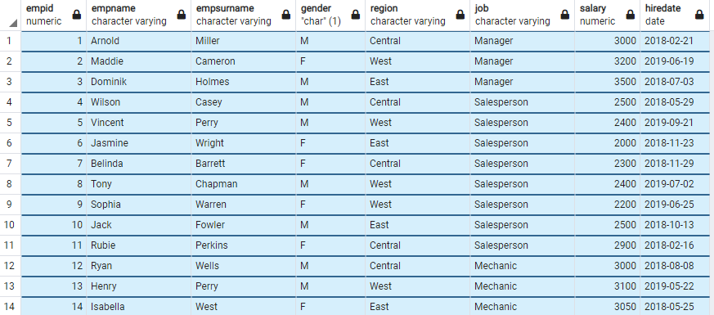

COUNT Function
How many employees does the company have?
SELECT COUNT (*)
FROM employees;
Notes:
Select count(*) from employees;

Slide 11
COUNT Function
There is another special character returning the number of rows in a table. That is * character. Use it inside the COUNT function as COUNT(*).

Slide 12
COUNT Function
An important point for COUNT(*) function is that the result table includes NULL. If you want the number of non-null values, use the syntax: COUNT(column_name).
Notes:
But this way it counts everything in the column, even null data
select count(*)
from Tracks → returns 3503 rows
select count(composer)
from Tracks --> returns 2525 rows
count(.....) removes the null ones
if I want to see how many values are there in the composer field, use this one
select count(*)
from Tracks
where composer is null --> number of null values in composer column--978
(where composer = null --not works like that)
select count(*)
from Tracks
where composer is not null --> number of not null values in composer column --2528

Slide 13
AS (Alias) Keyword
We can customize the column name or table name using AS keyword. AS is used to rename a column or table with an alias.
This is the syntax for aliasing a column name:
column_name [AS] alias_name
---------------------------------------------------------
This is the syntax for aliasing a table name:
table_name [AS] alias_name
Notes:
ALIASES can be used to create a temporary name for columns or tables.
COLUMN ALIASES are used to make column headings in your result set easier to read.
TABLE ALIASES are used to shorten your SQL to make it easier to read or when you are performing join tables

Slide 14

AS (Alias) Keyword
AS keyword is optional. Most programmers specify the AS keyword when aliasing a column name, but not when aliasing a table name.
TIP

Slide 15
COUNT DISTINCT
3

Slide 16
COUNT DISTINCT
In some cases, we may want unique values. In those cases, we use COUNT DISTINCT function.
Syntax
COUNT (DISTINCT column_name)
Notes:
select count (distinct AlbumId)
from Tracks
So we have 347 different albums out of 3503 tracks

Slide 17

COUNT DISTINCT
How many unique fields are there in the employees table?
SELECT COUNT (DISTINCT job)
FROM employees;
Notes:
there are 6 unique or distinct fields in which students may enroll. COUNT(DISTINCT field) returns the number of unique and non-null values in column field.
select field, count(field)
from student_info
group by field

Slide 18
MIN and MAX

Slide 19
MIN Function
MIN function returns the minimum value in the selected column. The MIN function ignores the NULL values.
Syntax
SELECT MIN (column_name)
FROM table_name;
Notes:
The MIN function ignores the NULL values. Thus, it retrieves the non-NULL minimum value in the selected column.

Slide 20
MIN Function
What is the lowest wage in the company?
SELECT MIN (salary)
FROM employees;

Slide 21
MAX Function
MAX function returns the maximum value in the selected column.
Syntax
SELECT MAX (column_name)
FROM table_name;
Notes:
MAX function returns the maximum value in the selected column.
With the MAX function, you can find the highest salary among the employees, the most expensive products, the longest track, the newest dates etc.

Slide 22
MAX Function
What is the last hired employees’s date?
SELECT MAX (hiredate)
FROM employees;
Notes:
The MIN function can also be used with dates. For instance, display the earliest hired employee's date.

Slide 23
SUM and AVG

Slide 24
SUM Function
SUM function returns the sum of a numeric column.
Syntax
SELECT SUM (column_name)
FROM table_name;

Slide 25

SUM Function
What is total amount salary of the employees?
SELECT SUM (salary)
FROM employees;
Notes:
What is total amount salary of the male employees?
SELECT SUM(salary) as male_salary
FROM employees
WHERE gender=’Male’

Slide 26
AVG Function
2

Slide 27
AVG Function
AVG function calculates the average of a numeric column.
Syntax
SELECT MAX (column_name)
FROM table_name;

Slide 28
AVG Function
What is the average salary of the employees?
SELECT AVG (salary)
FROM employees;

Slide 29
GROUP BY Clause
1

Slide 30
GROUP BY Clause
The GROUP BY clause groups the rows into summary rows. It returns one value for each group and is typically used with aggregate functions (COUNT, MAX, MIN, SUM, AVG).
 |  | Gender
 |  | Male
 |  | Male
 |  | Female
 |  | Female
COUNT(Gender)
4
COUNT(Gender)
WHERE Gender = ‘Male’
2
COUNT(Gender)
WHERE Gender = ‘Female’
2
Notes:
There are some cases where we may need to apply the aggregate function not only to a selected group of rows. In the previous parts, we found the total amount of salaries of male and female employees separately. What if want to show them in the same result table grouped by their gender. In such cases, we use GROUP BY statement. In case a WHERE clause is used, the GROUP BY clause should come after the WHERE clause. We specify the column or a list of comma-separated columns right after the GROUP BY. Any nonaggregate expression in the SELECT must be included in the GROUP BY clause.

Slide 31

GROUP BY Clause
Syntax

Slide 32
GROUP BY Clause
GROUP BY returns only one result per group of data.
GROUP BY Clause always follows the WHERE Clause.
GROUP BY Clause always precedes the ORDER BY.
SELECT column1,aggregate_function(column2)
FROM tabel_name
GROUP BY column_1;
Notes:
We've mentioned that the GROUP BY clause is often used with aggregate functions. Now, let's see how it is.

Slide 33
GROUP BY with COUNT Function
2

Slide 34

GROUP BY with COUNT Function
What is the number of employees per gender?
SELECT gender, COUNT (gender)
FROM employees
GROUP BY gender;
Notes:
you remember before, we used with “order by” clause to sort
select *
from employees
order by gender DESC

Slide 35
GROUP BY Clause
The GROUP BY clause groups results before calling the aggregate function. This allows you to apply aggregate function to groups than the entire query.
gender
Male
Male
Male
Male
Male
Male
gender | COUNT(gender)
Male | 6
Female | 4
Female
Female
Female
Female

Slide 36

GROUP BY with COUNT Function
What is the number of employees working as a salesperson broken by gender?
SELECT gender, COUNT (job)
FROM employees
WHERE job='Salesperson'
GROUP BY gender;

Slide 37
GROUP BY Clause
WHERE clause operates on the data before the aggregation.
WHERE clause happens before the GROUP BY clause.
Only the rows that meet the conditions in the WHERE clause are grouped.

Slide 38
GROUP BY with MIN&MAX Functions
3

Slide 39

GROUP BY with MIN&MAX Functions
Let’s find the minimum salaries of each gender group using the MIN function.
SELECT gender, MIN (salary)
FROM employees
GROUP BY gender;

Slide 40

GROUP BY with MIN&MAX Functions
Similarly, we can find the maximum salaries of each group using the MAX function. You may also use the ORDER BY clause to sort the salaries in descending or ascending order. The ORDER BY follows GROUP BY. For instance, sort the maximum salaries in descending order.
SELECT gender, MAX (salary) AS maxsalary
FROM employees
GROUP BY gender
ORDER BY maxsalary DESC;

Slide 41
GROUP BY with SUM&AVG Functions
4

Slide 42

GROUP BY with SUM&AVG Functions
Let’s calculate the total and avarage salaries of each group (gender).
SELECT gender, SUM (salary) AS totalsalary,
AVG (salary) AS avgsalary FROM employees
GROUP BY gender;
Notes:
In the previous part, we have learned how to use MIN and MAX functions with the GROUP BY clause. In this part, we will continue with SUM and AVG functions. Let's go with the same scenario. In this case, we will calculate the total salaries of each group (gender).

Slide 43


Query Time

Slide 44
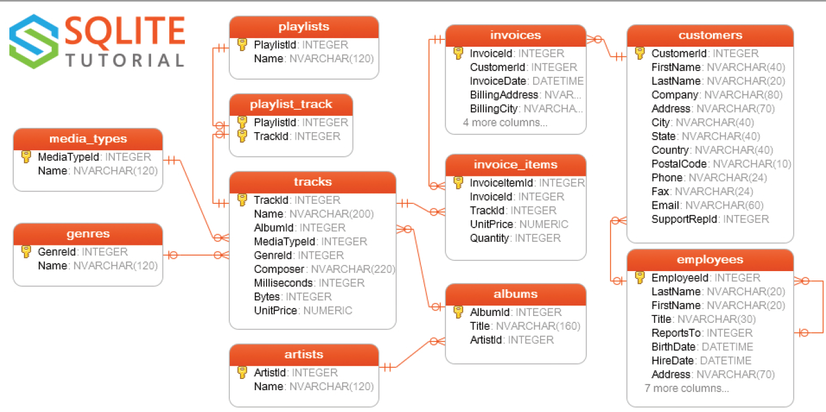
How many invoices are in the digital music store?
Notes:
Answer:
SELECT COUNT(*)
FROM invoices;

Slide 45
How many composers are there in the digital music store?
Notes:
Answer:
SELECT COUNT(DISTINCT Composer)
FROM tracks;

Slide 46
Find the track name having the minimum duration.
Notes:
Answer:
SELECT Name, MIN(Milliseconds)
FROM tracks;

Slide 47
Find the track name having the maximum duration.
Notes:
Answer:
SELECT Name, MAX(Milliseconds)
FROM tracks;

Slide 48
How much money did our store earn?
Notes:
Answer:
SELECT SUM(Total)
FROM invoices;
************
Let’s get further and try to find how much money we had in 2010 or any other year
To encourage students to search themselves on Google, lets discuss

Slide 49
Find the tracks having duration bigger than the average duration.
Notes:
Answer:
SELECT avg(Milliseconds)
FROM tracks;
then use the result in second query
select * from tracks where Milliseconds > 393599.212103911
We will learn subqueries later and you don’t have to run 2 different queries.
You will be able to use the result from one query and use it in the other query

Slide 50
Find the total number of each composer’s track. Your result will include name of the composer and number.
Notes:
Answer:
SELECT Composer, COUNT(*)
FROM tracks
GROUP BY Composer;
SELECT Composer, COUNT(composer)
FROM tracks
GROUP BY Composer;
SELECT Composer, COUNT(composer)
FROM tracks
WHERE Composer IS NOT NULL
GROUP BY Composer;

Slide 51
How many customers do we have from each country? Your result will include name of the country and number.
Notes:
Answer:
SELECT Country, COUNT(*) AS no_of_country
FROM customers
GROUP BY Country
-- ORDER BY no_of_country DESC
-- LIMIT 1;
Country-City tuple
SELECT Country, City, COUNT(*) AS no_of_country
FROM customers
GROUP BY Country, City;
what if you want to bring the table showing the total (average) amounts for per country
SELECT BillingCountry, SUM/AVG(total) as TotalDollars
FROM invoices
GROUP BY BillingCountry

Slide 52
Find the minimum duration of track for each album. Your result will include album id and min duration.
Notes:
Answer:
SELECT AlbumId, MIN(Milliseconds)
FROM tracks
GROUP BY AlbumId;
------------------------------------
SELECT AlbumId, Composer, MIN(Milliseconds)
FROM tracks
GROUP BY AlbumId, Composer;

Slide 53
Find the total amount of invoice for each country. Your result will include country name and total amount.
Notes:
Answer:
SELECT BillingCountry, SUM(Total)
FROM invoices
GROUP BY BillingCountry;

Slide 54
JOINs

Slide 55
Important Concepts
Primary Key (PK):
The primary key is a column in our table that makes each row (aka, record) unique.
Foreign Key (FK):
Foreign key is a column in a table that uniquely identifies each row of another table. That column refers to a primary key of another table. This creates a kind of link between the tables.
Notes:
Now, it’s time to learn what the primary and foreign keys.
Because these are important concepts which we will use as related columns when we do joins.
Primary Key (PK):
The primary key is a column in our table that makes each row (aka, record) unique.
Foreign Key (FK):
Foreign key is a column in a table that uniquely identifies each row of another table. That column refers to a primary key of another table. This creates a kind of link between the tables.
For example,
employee_id in employees table is primary key and it’s foreign key in departments table. We can combine our tables using these keys. Ok. Let’s move on.

Slide 56
Table of Contents
Introduction
JOIN Types
Inner JOIN
Left JOIN
Notes:
From now on, we will learn about how to JOIN the tables using SQL's most common join types which are INNER join and LEFT join.

Slide 57
Introduction
1

Slide 58
Introduction
A JOIN clause is used to combine two or more tables into a single table.
Joins are usually applied based on the keys that define the relationship between those tables or on common fields.

Slide 59
Introduction
In most cases this joins are created using the primary key of one table and the foreign key of the other table we want to join it with.

Slide 60
JOIN Types
2

Slide 61
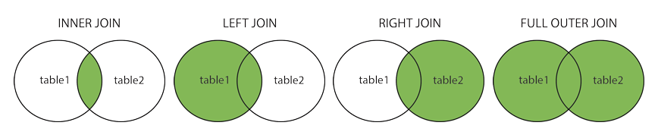
JOIN Types
INNER JOIN: Returns the common records in both tables.
LEFT OUTER JOIN: Returns all records from the left table and matching records from the right table.
RIGHT OUTER JOIN: Returns all records from the right table and matching records from the left table.
FULL OUTER JOIN: Returns all records of both left and right tables.
Notes:
There are basically four types of JOINs: INNER JOIN, LEFT JOIN, RIGHT JOIN and FULL OUTER JOIN. As a special case, a table can join to itself and this type is called SELF JOIN.
Let's make a brief description of JOIN types without going in-depth
In our lessons, we'll focus on INNER join and LEFT join which are commonly used.

Slide 62
INNER JOIN
3

Slide 63

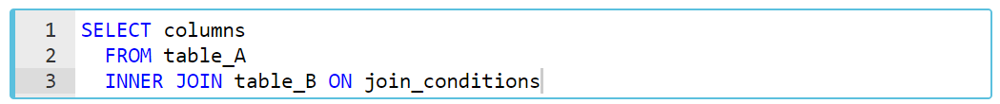
INNER JOIN
INNER JOIN is the most common type of JOINs. The INNER JOIN selects records that have matching values in both tables. INNER keyword is optional for this type of JOIN.
Syntax
join_conditions
table_A. common_field = table_B.common_field
Notes:
INNER JOIN selects all rows from both participating tables to appear in the result if and only if both tables meet the conditions specified in the ON clause. If the join condition evaluates to true (or 1), the columns of rows from both tables are included in the result set.
To understand easily how INNER JOIN works, we can use the visual explanation on the screen. The intersection of the two tables represents the matching rows.
In this syntax,
columns: Column names from table_A or table_B.
table_A, table_B: The names of the joined tables.
join_conditions: It specifies the conditions to evaluate for each pair of joined rows.
The operator in this statement is usually an equal sign (=), so join conditions generally take the form of
table_A. common_field = table_B.common_field
The INNER keyword is optional for this type of JOIN.
TIP;
Note the ON keyword for specifying the INNER JOIN condition.
Multiple join conditions can be written using AND or OR statements.

Slide 64
students
tests
name | exam | score
John | SQL | 75
Mary | AWS | 80
Clark | Python | 60
exam | passing_score
SQL | 70
AWS | 80
Python | 70
Network | 60
Notes:
Let’s do an example. Suppose we have two tables one of them lists the available exams and their passing scores. Other is students who took the some exams and their grades. I want to combine the tables to see the students grades and the passing score of the exams to better understand who passed the exams or failed the exams.

Slide 65
SELECT students.name, students.exam,
students.score, tests.passing_score
FROM students
INNER JOIN tests ON students.exam = tests.exam;
students
tests
name | exam | score
John | SQL | 75
Mary | AWS | 80
Clark | Python | 60
exam | passing_score
SQL | 70
AWS | 80
Python | 70
Network | 60
Notes:
Our common field is exam. So, I will combine the tables on this field.
Please notice that we are using table_name.column_name to specify the the field which we want to bring on SELECT statement.

Slide 66
SELECT students.name, students.exam,
students.score, tests.passing_score
FROM students
INNER JOIN tests ON students.exam = tests.exam;
students
tests
name | exam | score
John | SQL | 75
Mary | AWS | 80
Clark | Python | 60
exam | passing_score
SQL | 70
AWS | 80
Python | 70
Network | 60
Notes:
Since the common field is exam, the matching values and their corresponding rows are combined.

Slide 67
SELECT students.name, students.exam,
students.score, tests.passing_score
FROM students
INNER JOIN tests ON students.exam = tests.exam;
students
tests
name | exam | score
John | SQL | 75
Mary | AWS | 80
Clark | Python | 60
exam | passing_score
SQL | 70
AWS | 80
Python | 70
Network | 60
Notes:
As you see all rows matches except one; exam : Network (Because; Network is not the common field)
Since network doesn’t exist in the students table, we removed it.

Slide 68
SELECT students.name, students.exam,
students.score, tests.passing_score
FROM students
INNER JOIN tests ON students.exam = tests.exam;
students
tests
name | exam | score
John | SQL | 75
Mary | AWS | 80
Clark | Python | 60
exam | passing_score
SQL | 70
AWS | 80
Python | 70
Notes:
We also don’t want the exam column of the tests in our query. So, it won’t be in our result set.

Slide 69
SELECT students.name, students.exam,
students.score, tests.passing_score
FROM students
INNER JOIN tests ON students.exam = tests.exam;
output of the query
name | exam | score
John | SQL | 75
Mary | AWS | 80
Clark | Python | 60
passing_score
70
80
70
Notes:
Here is the result table.

Slide 70
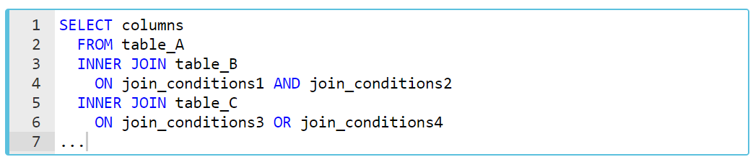
INNER JOIN
Syntax of Join of Multiple Tables
Notes:
In addition, three or more tables can be combined using the INNER JOIN clause. The syntax used to join three or more tables can be like this
For exp; we will use the artists and albums tables from the chinook.db
The following statement returns the album titles and their artist names
SELECT
Title,
Name
FROM
albums
INNER JOIN artists
ON artists.ArtistId = albums.ArtistId;
For exp; we will use the employees and departments tables from the company.db
The following statement returns the emp_id, first_name,last_name,dept_name and dept_id of the employees.
SELECT
employees.emp_id,
employees.first_name,
employees.last_name,
departments.dept_name,
departments.dept_id
FROM employees --e
INNER JOIN departments --d
ON employees.emp_id = departments.emp_id;
***********
SELECT
employees.first_name,
employees.last_name,
-- employees.gender,
employees.salary,
departments.dept_name
FROM employees
JOIN departments
ON employees.emp_id = departments.emp_id
(what if we want to see the female ones → WHERE employees.gender = 'Female';
(3 results)
(what if we want to see the names starting L → WHERE employees.first_name LIKE 'L%';)
(2 results)
(what if we want to see the employees who have a salary higher than 80000 → WHERE employees.salary > 80000;)
(5 results)

Slide 71
Find the genre of each track.
Notes:
Answer:
SELECT tracks.Name, genres.name
FROM tracks
JOIN genres
ON tracks.GenreId = genres.GenreId;
-----------------------------------------------
SELECT t.Name, g.name
FROM tracks t
JOIN genres g
ON t.GenreId = g.GenreId;
---------------------------------
SELECT t.Name as SongName,
g.name as GenreName
FROM tracks t
JOIN genres g
ON t.GenreId = g.GenreId;

Slide 72
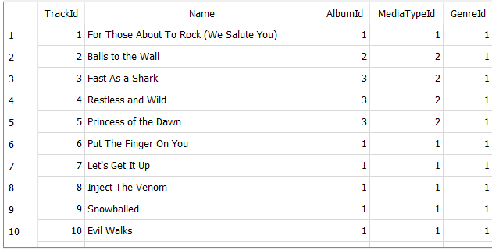
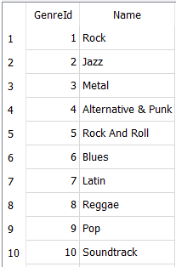
tracks
genres

Slide 73
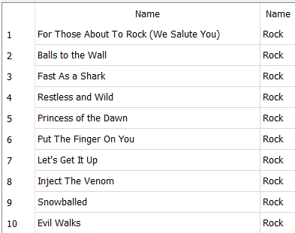
tracks
genres

Slide 74
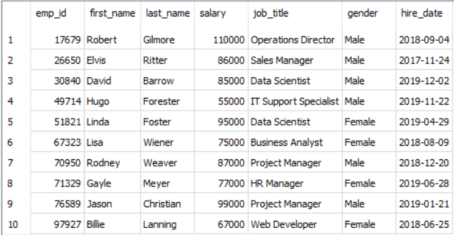
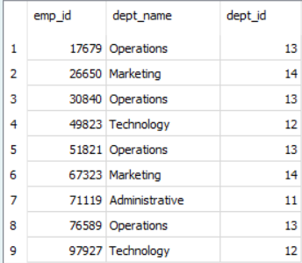
Write a query to return the departments of female employees. Show just first name, last name, salary and department of the employees.
Notes:
SELECT
employees.first_name,
employees.last_name,
-- employees.gender,
employees.salary,
departments.dept_name
FROM employees
JOIN departments
ON employees.emp_id = departments.emp_id
(what if we want to see the female ones → WHERE employees.gender = 'Female';
(3 results)
(what if we want to see the names starting L → WHERE employees.first_name LIKE 'L%';)
(2 results)
(what if we want to see the employees who have a salary higher than 80000 → WHERE employees.salary > 80000;)
(5 results)

Slide 75
Find the customer name of each invoice.
Your result will include Invoice id and customer name.
Notes:
SELECT i.InvoiceId,
c.FirstName,
c.LastName
FROM invoices i
JOIN customers c
ON i.CustomerId = c.CustomerId;
INNER JOIN ile ilgili video on LMS;
https://lms.clarusway.com/mod/hvp/view.php?id=787&forceview=1

Slide 76
LEFT JOIN

Slide 77
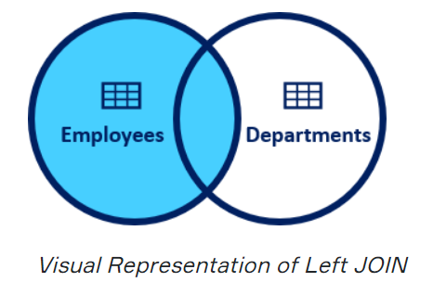
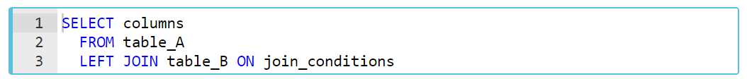
LEFT JOIN
In this JOIN statement, all the records of the left table and the common records of the right table are returned in the query. If no matching rows are found in the right table during the JOIN operation, these values are assigned as NULL.
Syntax
join_conditions
table_A. common_field = table_B.common_field
Notes:
In this syntax,
columns: Column names from table_A or table_B.
table_A, table_B: The names of the joined tables.
join_conditions: It specifies the conditions to evaluate for each pair of joined rows.
LEFT JOIN and LEFT OUTER JOIN keywords are exactly the same. OUTER keyword is optional.
To understand easily how LEFT JOIN works, we can use the visual explanation on the screen. The shaded area represents all rows in the "employees" table and all matching rows in the "departments" table.

Slide 78
students
tests
name | exam | score
John | SQL | 75
Mary | AWS | 80
Clark | Python | 60
exam | passing_score
SQL | 70
AWS | 80
Python | 70
Network | 60
Notes:
Now, let’s see the left join on our previous tables. This time we want all exams are held in the exam center and all students who took exams and their scores.
so we will change the order ..

Slide 79
SELECT tests.exam, tests.passing_score,
students.name, students.score
FROM tests
LEFT JOIN students ON tests.exam = students.exam;
tests
students
exam | passing_score
SQL | 70
AWS | 80
Python | 70
Network | 60
name | exam | score
John | SQL | 75
Mary | AWS | 80
Clark | Python | 60
Notes:
Our common field was exam. So, I will combine the tables on this field.

Slide 80
SELECT tests.exam, tests.passing_score,
students.name, students.score
FROM tests
LEFT JOIN students ON tests.exam = students.exam;
tests
students
exam | passing_score
SQL | 70
AWS | 80
Python | 70
Network | 60
name | exam | score
John | SQL | 75
Mary | AWS | 80
Clark | Python | 60
Notes:
All values from tests table and the matching values from students are returned.

Slide 81
SELECT tests.exam, tests.passing_score,
students.name, students.score
FROM tests
LEFT JOIN students ON tests.exam = students.exam;
tests
students
exam | passing_score
SQL | 70
AWS | 80
Python | 70
Network | 60
name | exam | score
John | SQL | 75
Mary | AWS | 80
Clark | Python | 60
Null | Null | Null
Notes:
Non matching value’s corresponding row return null.

Slide 82
SELECT tests.exam, tests.passing_score,
students.name, students.score
FROM tests
LEFT JOIN students ON tests.exam = students.exam;
tests
students
exam | passing_score
SQL | 70
AWS | 80
Python | 70
Network | 60
name | exam | score
John | SQL | 75
Mary | AWS | 80
Clark | Python | 60
Null | Null | Null
Notes:
Since we want exam, passing_score, name and score columns; exam column from the students table removed.

Slide 83
SELECT tests.exam, tests.passing_score,
students.name, students.score
FROM tests
LEFT JOIN students ON tests.exam = students.exam;
output of the query
exam | passing_score
SQL | 70
AWS | 80
Python | 70
Network | 60
name | score
John | 75
Mary | 80
Clark | 60
Null | Null
Notes:
the output of the queries return like this
For exp; we will use the employees and departments tables from the company.db
The following statement returns the emp_id, first_name,last_name,dept_name and dept_id of the employees.
SELECT
employees.emp_id,
employees.first_name,
employees.last_name,
departments.dept_name,
departments.dept_id
FROM employees --e
LEFT JOIN departments --d
ON employees.emp_id = departments.emp_id;
(10 result)
As a result of the LEFT JOIN operation, all ten rows are returned from the "employees" table and all matching rows in the "departments" table are returned. The rows that do not match with the right table are returned as null.
For exp; write a query to return the departments of all male employees in the "employees" table. Show just first name, last name, department and department ID of the employees.
SELECT
employees.first_name,
employees.last_name,
departments.dept_name,
departments.dept_id
FROM employees
LEFT JOIN departments
ON employees.emp_id = departments.emp_id
WHERE employees.gender = 'Male';
(6 result)

Slide 84
Find the artists’ album info
Notes:
Answer:
SELECT * OR artists.ArtistId, artists.Name, albums.AlbumId
FROM artists
LEFT JOIN albums
ON albums.ArtistId = artists.ArtistId

Slide 85
Subqueries

Slide 86
Introduction
A subquery is a SELECT statement that is nested within another statement. The subquery is also called the inner query or nested query.
Outer query
Inner query

Slide 87
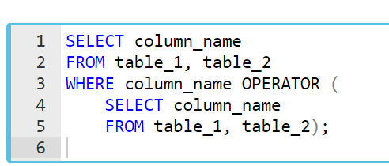
Syntax
Outer query or enclosing query
Inner query, nested query or subquery
Subqueries are nested queries that provide data to the enclosing query.
Subqueries can return individual values or a list of records
Subqueries must be enclosed with parentheses
Notes:
The inner query is executed first before the outer query. The results of the inner query are passed to the outer query.
*****************
There are some rules when using subquery:
A subquery must be enclosed in parentheses.
An ORDER BY clause is not allowed to use in a subquery.
The BETWEEN operator can't be used with a subquery. But you can use BETWEEN within the subquery.

Slide 88
Introduction
A subquery may be used in:
SELECT clause
FROM clause
WHERE clause
Notes:
Actually, there is no general syntax; subqueries are regular queries placed inside parenthesis.
Subqueries can be used in different ways and at different locations inside a query.
A subquery may be used in:
SELECT clause
FROM clause
WHERE clause
But a subquery is usually embedded inside the WHERE clause. You may use comparison operators in WHERE clauses.

Slide 89
Types of Subqueries
There are two main types of subqueries:
Single-row subqueries
Multiple-row subqueries
Notes:
Now, let's start with single-row subqueries.
Q: What is a Subquery?
A: A subquery is a query within another query, also known as nested query or inner query . It is used to restrict or enhance the data to be queried by the main query, thus restricting or enhancing the output of the main query respectively.

Slide 90
Single-row Subqueries
Single-row subqueries return one row with only one column and are typically used with single-row operators such as =, >, >=, <=, <>, != especially in WHERE clause.
Notes:
Mostly they are being used with “WHERE” clauses since it includes some conditions.
comparison operators

Slide 91
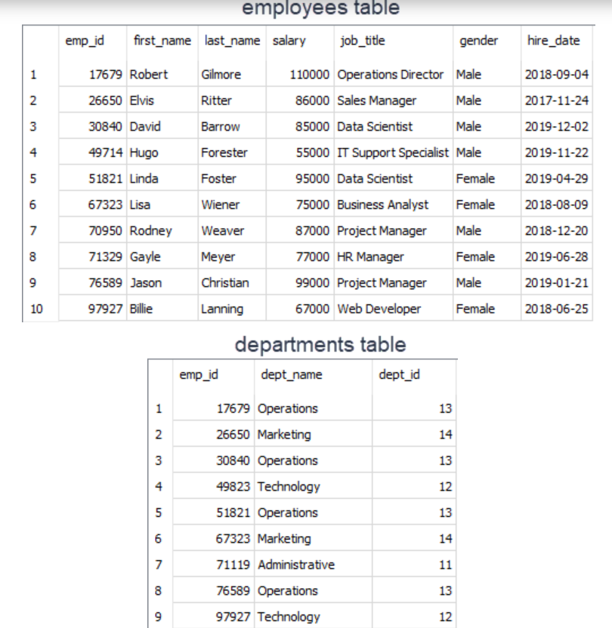
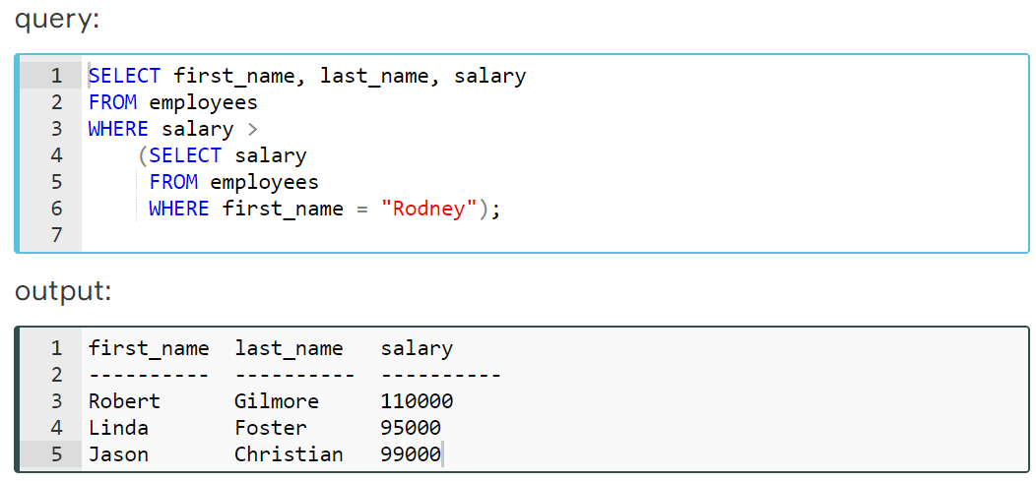
Example
Find the employees who get paid more than Rodney Weaver
Notes:
We'll find the employees who get paid more than Rodney Weaver. Our query should return first name, last name, and salary info of the employees.
Let’s see in detail

Slide 92
Analyze the query-1
1
1
The inner query is executed first and returns 87000 which is the salary of Rodney.
Notes:
First of all, inner query is executed first.
The inner query returns 87000 which is the salary of Rodney.

Slide 93
Analyze the query-2
2
1
1
The inner query is execute first and returns 87000 which is the salary of Rodney.
2
The value 87000 is passed to the outer query, in particular to the WHERE clause.
Notes:
Then 87000 is passed to the outer query, in particular to the WHERE clause. (WHERE salary > 87000)

Slide 94
Analyze the query-3
2
87000
1
1
The inner query is execute first and returns 87000 which is the salary of Rodney.
2
The value 87000 is passed to the outer query, in particular to the WHERE clause.
Notes:
Then 87000 is passed to the outer query, in particular to the WHERE clause. (WHERE salary > 87000)

Slide 95
Analyze the query-4
2
87000
1
1
The inner query is execute first and returns 87000 which is the salary of Rodney.
2
The value 87000 is passed this value to the outer query, in particular to the WHERE clause.
Notes:
In the outer query, WHERE clause filters the employees whose salary is more than 87000 and returns the first name, last name, and salary info of those.

Slide 96
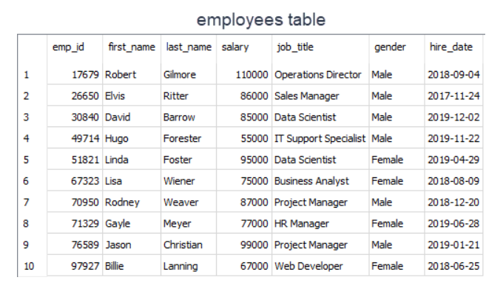
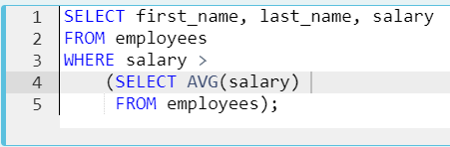
Example
Find out the employees who get paid more than the average salary
Notes:
We can also use aggregated functions since it returns a single row with a single column. Now let' s find out the employees who get paid more than the average salary. Our query should return first name, last name, and salary info of the employees.
EXAMPLE
SELECT first_name, last_name, salary
FROM employees
WHERE salary >
(SELECT AVG(salary)
FROM employees);
Result: 6 rows returned
Let's analyze the query;:
We've used > operator with WHERE clause.
The inner query returns the average salary which is 83600 and passes this single value to the outer query.
Outer query filters those employees and returns those whose salary is more than 83600.
As you see that combining aggregate functions with subqueries, we have more power to answer our analytical questions.

Slide 97
Query Time

Slide 98
Retrieve track id, track name, album id info of the Album title ‘Faceless’. (use : Subquery)
Notes:
Answer:
SELECT trackid,
name,
albumid
FROM tracks
WHERE albumid = (
SELECT albumid
FROM albums
WHERE title = 'Faceless');
Burada SELECT albumid
FROM albums
WHERE title = 'Faceless'
sorgusunu ayrı çalıştır ve tek bir row döndürdüğünü göster.
There are 2 conditions here
Result: 12 rows

Slide 99
Most queries using a join can be rewritten using a subquery (a query nested within another query), and most subqueries can be rewritten as joins.
TIP

Slide 100
Retrieve track id, track name, album id info of the Album title ‘Faceless’. (use : Joins)
Notes:
JOIN kullanarak yapınız.
Answer:
SELECT tracks.TrackId,
tracks.Name,
tracks.AlbumId,
albums.Title
FROM tracks
JOIN albums
ON tracks.AlbumId = albums.AlbumId
WHERE albums.Title = 'Faceless';
Result: 12 rows

Slide 101

Multiple-row Subqueries
Multiple-row subqueries return sets of rows and are used with multiple-row operators such as IN, NOT IN, ANY, ALL.

Slide 102
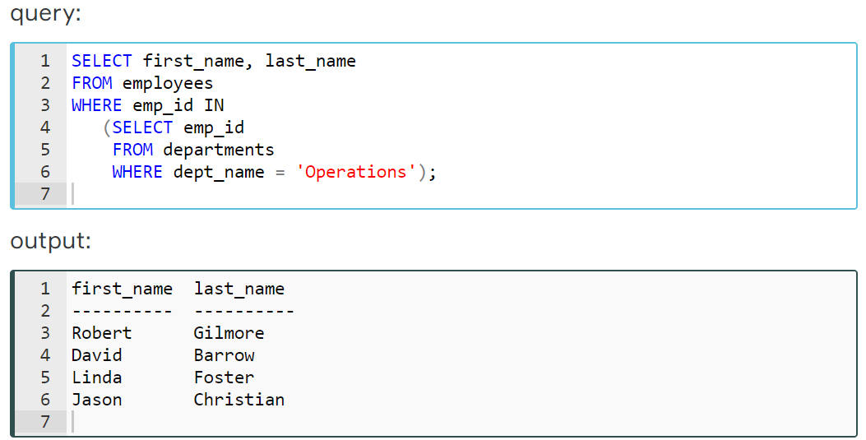
Example
Find the employees (first name, last name from employees table) who work under the Operations department (departments table)
Notes:
As you know that we have added a new table to the company database consisting of one table. Our new table is the departments table. It has three columns and nine rows. Every row represents an employee's department info. Here are our database tables.
Let’s see in detail

Slide 103
Analyze the query-1
1
1
The inner query returns the employees ids who work under the Operations department
Notes:
Let's analyze the query on the screen:
We've used IN operator with WHERE clause.
The inner query returns the employee ids who work under the Operations department.

Slide 104
Analyze the query-2
2
1
1
The inner query returns the employees ids who work under the Operations department
2
Employees ids are passed to the outer query.
Notes:
Then employees ids are passed to the outer query.

Slide 105
Analyze the query-3
2
(17679, 30840, 51821, 76589)
1
1
The inner query returns the employees ids who work under the Operations department
2
Employees ids are passed to the outer query.
Notes:
Then employees ids are passed to the outer query.

Slide 106
Analyze the query-4
(17679, 30840, 51821, 76589)
Outer query filters those employees ids and returns their first name and last name as a result set.
Notes:
Outer query filters those employees ids and returns their first_name and last_name as a result set.
**************
Exp;
How many male employees work under the Operations department?
(Note: Your result table will consist of one column named 'count_male')
SELECT COUNT(gender) as count_male
FROM employees
WHERE gender='Male' AND emp_id IN(select emp_id from departments where dept_name='Operations');
result : 3
*******************************
SELECT COUNT(gender) as count_male
FROM employees
JOIN departments
ON employees.emp_id=departments.emp_id
WHERE employees.gender = 'Male'
AND employees.emp_id IN(
SELECT emp_id
FROM departments
WHERE dept_name='Operations');

Slide 107
Retrieve track id, track name, album id info of the Album title ‘Faceless’ and ‘Let There Be Rock’
Notes:
SUBQUERY kullanarak yapınız.
Answer:
SELECT trackid,
name,
albumid
FROM tracks
WHERE albumid IN (
SELECT AlbumId
FROM albums
WHERE title IN ('Faceless', 'Let There Be Rock')
);
(result 20)
JOIN kullanarak yapınız
SELECT tracks.trackid,
tracks.name,
tracks.albumid
FROM tracks
JOIN albums
ON tracks.AlbumId=albums.AlbumId
WHERE title IN ('Faceless', 'Let There Be Rock');

Slide 108
THANKS!
Any questions?

