Slide 1

SQL
Session 3

Slide 2
Table of Contents
What are type of Joins in SQL, why do we need them
Notes:
In this lesson, we will learn about what an Aggregate function is, five built-in aggregate functions and how they are used in SQL queries.
Then we will learn Group By clauses and their usage with aggregate functions
Besides, if we have time, we will also learn about how to JOIN the tables using SQL's most common join types which are INNER join and LEFT join.

Slide 3
JOINs

Slide 4
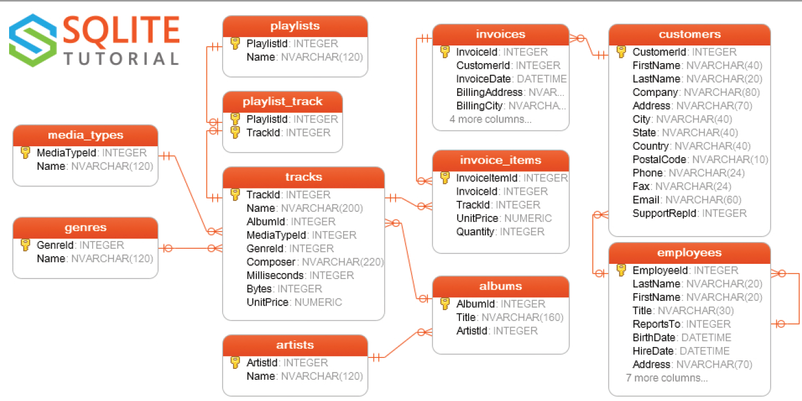
Important Concepts
Primary Key (PK):
The primary key is a column in our table that makes each row (aka, record) unique.
Foreign Key (FK):
Foreign key is a column in a table that uniquely identifies each row of another table. That column refers to a primary key of another table. This creates a kind of link between the tables.
Notes:
Now, it’s time to learn what the primary and foreign keys.
Because these are important concepts which we will use as related columns when we do joins.
Primary Key (PK):
The primary key is a column in our table that makes each row (aka, record) unique.
Foreign Key (FK):
Foreign key is a column in a table that uniquely identifies each row of another table. That column refers to a primary key of another table. This creates a kind of link between the tables.
For example,
employee_id in employees table is primary key and it’s foreign key in departments table. We can combine our tables using these keys. Ok. Let’s move on.

Slide 5
Table of Contents
Introduction
JOIN Types
Inner JOIN
Left JOIN
Notes:
From now on, we will learn about how to JOIN the tables using SQL's most common join types which are INNER join and LEFT join.

Slide 6
Introduction
1

Slide 7
Introduction
A JOIN clause is used to combine two or more tables into a single table.
Joins are usually applied based on the keys that define the relationship between those tables or on common fields.

Slide 8

Introduction
In most cases this joins are created using the primary key of one table and the foreign key of the other table we want to join it with.

Slide 9
JOIN Types
2

Slide 10
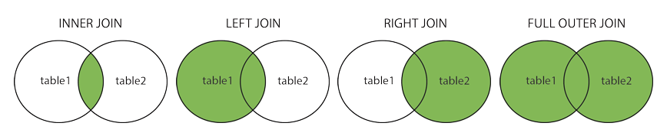
JOIN Types
INNER JOIN: Returns the common records in both tables.
LEFT OUTER JOIN: Returns all records from the left table and matching records from the right table.
RIGHT OUTER JOIN: Returns all records from the right table and matching records from the left table.
FULL OUTER JOIN: Returns all records of both left and right tables.
Notes:
There are basically four types of JOINs: INNER JOIN, LEFT JOIN, RIGHT JOIN and FULL OUTER JOIN. As a special case, a table can join to itself and this type is called SELF JOIN.
Let's make a brief description of JOIN types without going in-depth
In our lessons, we'll focus on INNER join and LEFT join which are commonly used.

Slide 11
INNER JOIN
3

Slide 12
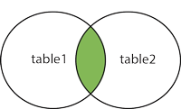
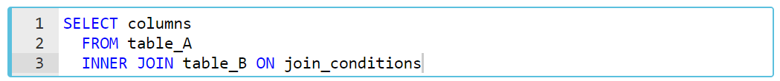
INNER JOIN
INNER JOIN is the most common type of JOINs. The INNER JOIN selects records that have matching values in both tables. INNER keyword is optional for this type of JOIN.
Syntax
join_conditions
table_A. common_field = table_B.common_field
Notes:
INNER JOIN selects all rows from both participating tables to appear in the result if and only if both tables meet the conditions specified in the ON clause. If the join condition evaluates to true (or 1), the columns of rows from both tables are included in the result set.
To understand easily how INNER JOIN works, we can use the visual explanation on the screen. The intersection of the two tables represents the matching rows.
In this syntax,
columns: Column names from table_A or table_B.
table_A, table_B: The names of the joined tables.
join_conditions: It specifies the conditions to evaluate for each pair of joined rows.
The operator in this statement is usually an equal sign (=), so join conditions generally take the form of
table_A. common_field = table_B.common_field
The INNER keyword is optional for this type of JOIN.
TIP;
Note the ON keyword for specifying the INNER JOIN condition.
Multiple join conditions can be written using AND or OR statements.

Slide 13
students
tests
name | exam | score
John | SQL | 75
Mary | AWS | 80
Clark | Python | 60
exam | passing_score
SQL | 70
AWS | 80
Python | 70
Network | 60
Notes:
Let’s do an example. Suppose we have two tables one of them lists the available exams and their passing scores. Other is students who took the some exams and their grades. I want to combine the tables to see the students grades and the passing score of the exams to better understand who passed the exams or failed the exams.

Slide 14
SELECT students.name, students.exam,
students.score, tests.passing_score
FROM students
INNER JOIN tests ON students.exam = tests.exam;
students
tests
name | exam | score
John | SQL | 75
Mary | AWS | 80
Clark | Python | 60
exam | passing_score
SQL | 70
AWS | 80
Python | 70
Network | 60
Notes:
Our common field is exam. So, I will combine the tables on this field.
Please notice that we are using table_name.column_name to specify the the field which we want to bring on SELECT statement.

Slide 15
SELECT students.name, students.exam,
students.score, tests.passing_score
FROM students
INNER JOIN tests ON students.exam = tests.exam;
students
tests
name | exam | score
John | SQL | 75
Mary | AWS | 80
Clark | Python | 60
exam | passing_score
SQL | 70
AWS | 80
Python | 70
Network | 60
Notes:
Since the common field is exam, the matching values and their corresponding rows are combined.

Slide 16
SELECT students.name, students.exam,
students.score, tests.passing_score
FROM students
INNER JOIN tests ON students.exam = tests.exam;
students
tests
name | exam | score
John | SQL | 75
Mary | AWS | 80
Clark | Python | 60
exam | passing_score
SQL | 70
AWS | 80
Python | 70
Network | 60
Notes:
As you see all rows matches except one; exam : Network (Because; Network is not the common field)
Since network doesn’t exist in the students table, we removed it.

Slide 17
SELECT students.name, students.exam,
students.score, tests.passing_score
FROM students
INNER JOIN tests ON students.exam = tests.exam;
students
tests
name | exam | score
John | SQL | 75
Mary | AWS | 80
Clark | Python | 60
exam | passing_score
SQL | 70
AWS | 80
Python | 70
Notes:
We also don’t want the exam column of the tests in our query. So, it won’t be in our result set.

Slide 18
SELECT students.name, students.exam,
students.score, tests.passing_score
FROM students
INNER JOIN tests ON students.exam = tests.exam;
output of the query
name | exam | score
John | SQL | 75
Mary | AWS | 80
Clark | Python | 60
passing_score
70
80
70
Notes:
Here is the result table.

Slide 19
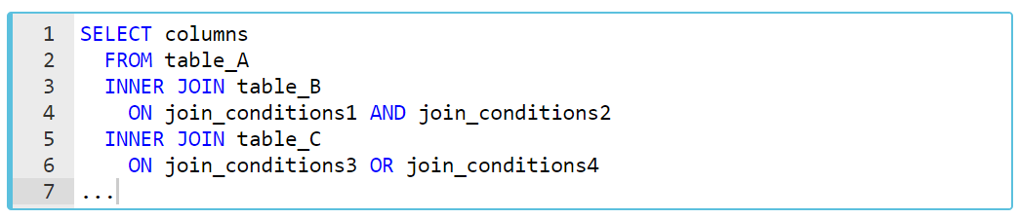
INNER JOIN
Syntax of Join of Multiple Tables
Notes:
In addition, three or more tables can be combined using the INNER JOIN clause. The syntax used to join three or more tables can be like this
For exp; we will use the artists and albums tables from the chinook.db
The following statement returns the album titles and their artist names
SELECT
Title,
Name
FROM
albums
INNER JOIN artists
ON artists.ArtistId = albums.ArtistId;
For exp; we will use the employees and departments tables from the company.db
The following statement returns the emp_id, first_name,last_name,dept_name and dept_id of the employees.
SELECT
employees.emp_id,
employees.first_name,
employees.last_name,
departments.dept_name,
departments.dept_id
FROM employees --e
INNER JOIN departments --d
ON employees.emp_id = departments.emp_id;
***********
SELECT
employees.first_name,
employees.last_name,
-- employees.gender,
employees.salary,
departments.dept_name
FROM employees
JOIN departments
ON employees.emp_id = departments.emp_id
(what if we want to see the female ones → WHERE employees.gender = 'Female';
(3 results)
(what if we want to see the names starting L → WHERE employees.first_name LIKE 'L%';)
(2 results)
(what if we want to see the employees who have a salary higher than 80000 → WHERE employees.salary > 80000;)
(5 results)

Slide 20
Find the genre of each track.
Notes:
Answer:
SELECT tracks.Name, genres.name
FROM tracks
JOIN genres
ON tracks.GenreId = genres.GenreId;
-----------------------------------------------
SELECT t.Name, g.name
FROM tracks t
JOIN genres g
ON t.GenreId = g.GenreId;
---------------------------------
SELECT t.Name as SongName,
g.name as GenreName
FROM tracks t
JOIN genres g
ON t.GenreId = g.GenreId;

Slide 21
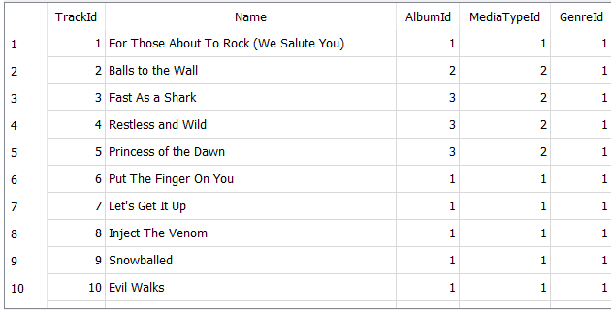
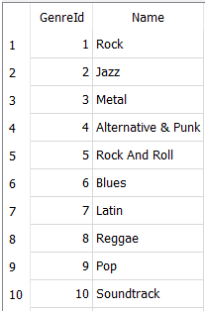
tracks
genres

Slide 22
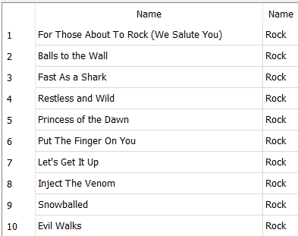
tracks
genres

Slide 23
Find the customer name of each invoice.
Your result will include Invoice id and customer name.
Notes:
SELECT i.InvoiceId,
c.FirstName,
c.LastName
FROM invoices i
JOIN customers c
ON i.CustomerId = c.CustomerId;
INNER JOIN ile ilgili video on LMS;
https://lms.clarusway.com/mod/hvp/view.php?id=787&forceview=1

Slide 24
LEFT JOIN

Slide 25
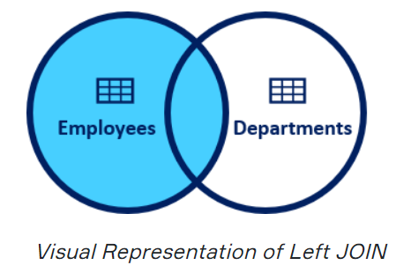
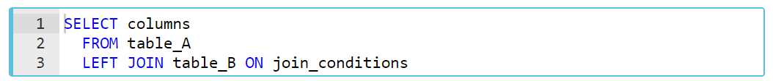
LEFT JOIN
In this JOIN statement, all the records of the left table and the common records of the right table are returned in the query. If no matching rows are found in the right table during the JOIN operation, these values are assigned as NULL.
Syntax
join_conditions
table_A. common_field = table_B.common_field
Notes:
In this syntax,
columns: Column names from table_A or table_B.
table_A, table_B: The names of the joined tables.
join_conditions: It specifies the conditions to evaluate for each pair of joined rows.
LEFT JOIN and LEFT OUTER JOIN keywords are exactly the same. OUTER keyword is optional.
To understand easily how LEFT JOIN works, we can use the visual explanation on the screen. The shaded area represents all rows in the "employees" table and all matching rows in the "departments" table.

Slide 26
students
tests
name | exam | score
John | SQL | 75
Mary | AWS | 80
Clark | Python | 60
exam | passing_score
SQL | 70
AWS | 80
Python | 70
Network | 60
Notes:
Now, let’s see the left join on our previous tables. This time we want all exams are held in the exam center and all students who took exams and their scores.
so we will change the order ..

Slide 27
SELECT tests.exam, tests.passing_score,
students.name, students.score
FROM tests
LEFT JOIN students ON tests.exam = students.exam;
tests
students
exam | passing_score
SQL | 70
AWS | 80
Python | 70
Network | 60
name | exam | score
John | SQL | 75
Mary | AWS | 80
Clark | Python | 60
Notes:
Our common field was exam. So, I will combine the tables on this field.

Slide 28
SELECT tests.exam, tests.passing_score,
students.name, students.score
FROM tests
LEFT JOIN students ON tests.exam = students.exam;
tests
students
exam | passing_score
SQL | 70
AWS | 80
Python | 70
Network | 60
name | exam | score
John | SQL | 75
Mary | AWS | 80
Clark | Python | 60
Notes:
All values from tests table and the matching values from students are returned.

Slide 29
SELECT tests.exam, tests.passing_score,
students.name, students.score
FROM tests
LEFT JOIN students ON tests.exam = students.exam;
tests
students
exam | passing_score
SQL | 70
AWS | 80
Python | 70
Network | 60
name | exam | score
John | SQL | 75
Mary | AWS | 80
Clark | Python | 60
Null | Null | Null
Notes:
Non matching value’s corresponding row return null.

Slide 30
SELECT tests.exam, tests.passing_score,
students.name, students.score
FROM tests
LEFT JOIN students ON tests.exam = students.exam;
tests
students
exam | passing_score
SQL | 70
AWS | 80
Python | 70
Network | 60
name | exam | score
John | SQL | 75
Mary | AWS | 80
Clark | Python | 60
Null | Null | Null
Notes:
Since we want exam, passing_score, name and score columns; exam column from the students table removed.

Slide 31
SELECT tests.exam, tests.passing_score,
students.name, students.score
FROM tests
LEFT JOIN students ON tests.exam = students.exam;
output of the query
exam | passing_score
SQL | 70
AWS | 80
Python | 70
Network | 60
name | score
John | 75
Mary | 80
Clark | 60
Null | Null
Notes:
the output of the queries return like this
For exp; we will use the employees and departments tables from the company.db
The following statement returns the emp_id, first_name,last_name,dept_name and dept_id of the employees.
SELECT
employees.emp_id,
employees.first_name,
employees.last_name,
departments.dept_name,
departments.dept_id
FROM employees --e
LEFT JOIN departments --d
ON employees.emp_id = departments.emp_id;
(10 result)
As a result of the LEFT JOIN operation, all ten rows are returned from the "employees" table and all matching rows in the "departments" table are returned. The rows that do not match with the right table are returned as null.
For exp; write a query to return the departments of all male employees in the "employees" table. Show just first name, last name, department and department ID of the employees.
SELECT
employees.first_name,
employees.last_name,
departments.dept_name,
departments.dept_id
FROM employees
LEFT JOIN departments
ON employees.emp_id = departments.emp_id
WHERE employees.gender = 'Male';
(6 result)

Slide 32
Find the artists’ album info
Notes:
Answer:
SELECT * OR artists.ArtistId, artists.Name, albums.AlbumId
FROM artists
LEFT JOIN albums
ON albums.ArtistId = artists.ArtistId

Slide 33
Subqueries

Slide 34
Introduction
A subquery is a SELECT statement that is nested within another statement. The subquery is also called the inner query or nested query.
Outer query
Inner query

Slide 35
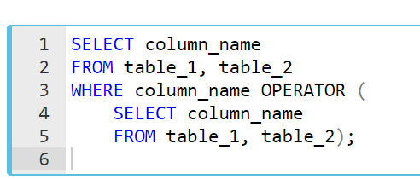
Syntax
Outer query or enclosing query
Inner query, nested query or subquery
Subqueries are nested queries that provide data to the enclosing query.
Subqueries can return individual values or a list of records
Subqueries must be enclosed with parentheses
Notes:
The inner query is executed first before the outer query. The results of the inner query are passed to the outer query.
*****************
There are some rules when using subquery:
A subquery must be enclosed in parentheses.
An ORDER BY clause is not allowed to use in a subquery.
The BETWEEN operator can't be used with a subquery. But you can use BETWEEN within the subquery.

Slide 36
Introduction
A subquery may be used in:
SELECT clause
FROM clause
WHERE clause
Notes:
Actually, there is no general syntax; subqueries are regular queries placed inside parenthesis.
Subqueries can be used in different ways and at different locations inside a query.
A subquery may be used in:
SELECT clause
FROM clause
WHERE clause
But a subquery is usually embedded inside the WHERE clause. You may use comparison operators in WHERE clauses.

Slide 37
Types of Subqueries
There are two main types of subqueries:
Single-row subqueries
Multiple-row subqueries
Notes:
Now, let's start with single-row subqueries.
Q: What is a Subquery?
A: A subquery is a query within another query, also known as nested query or inner query . It is used to restrict or enhance the data to be queried by the main query, thus restricting or enhancing the output of the main query respectively.

Slide 38
Single-row Subqueries
Single-row subqueries return one row with only one column and are typically used with single-row operators such as =, >, >=, <=, <>, != especially in WHERE clause.
Notes:
Mostly they are being used with “WHERE” clauses since it includes some conditions.
comparison operators

Slide 39
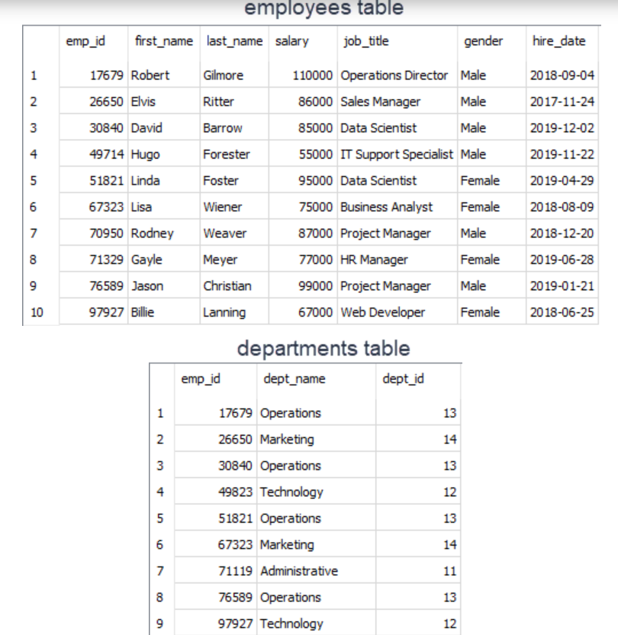
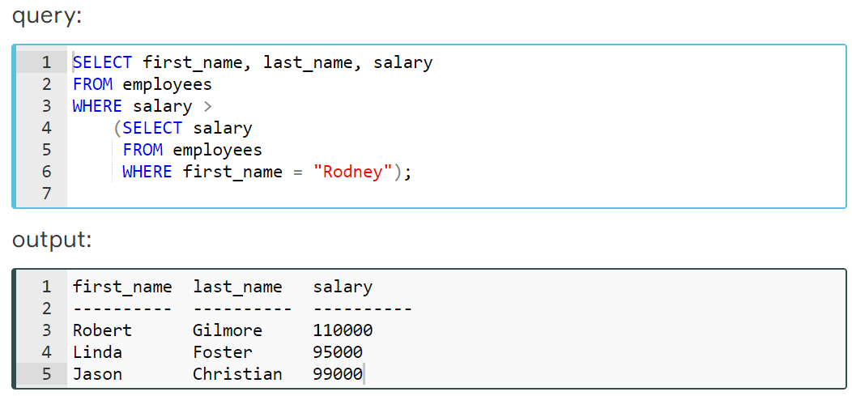
Example
Find the employees who get paid more than Rodney Weaver
Notes:
We'll find the employees who get paid more than Rodney Weaver. Our query should return first name, last name, and salary info of the employees.
Let’s see in detail

Slide 40
Analyze the query-1
1
1
The inner query is executed first and returns 87000 which is the salary of Rodney.
Notes:
First of all, inner query is executed first.
The inner query returns 87000 which is the salary of Rodney.

Slide 41
Analyze the query-2
2
1
1
The inner query is execute first and returns 87000 which is the salary of Rodney.
2
The value 87000 is passed to the outer query, in particular to the WHERE clause.
Notes:
Then 87000 is passed to the outer query, in particular to the WHERE clause. (WHERE salary > 87000)

Slide 42
Analyze the query-3
2
87000
1
1
The inner query is execute first and returns 87000 which is the salary of Rodney.
2
The value 87000 is passed to the outer query, in particular to the WHERE clause.
Notes:
Then 87000 is passed to the outer query, in particular to the WHERE clause. (WHERE salary > 87000)

Slide 43
Analyze the query-4
2
87000
1
1
The inner query is execute first and returns 87000 which is the salary of Rodney.
2
The value 87000 is passed this value to the outer query, in particular to the WHERE clause.
Notes:
In the outer query, WHERE clause filters the employees whose salary is more than 87000 and returns the first name, last name, and salary info of those.

Slide 44
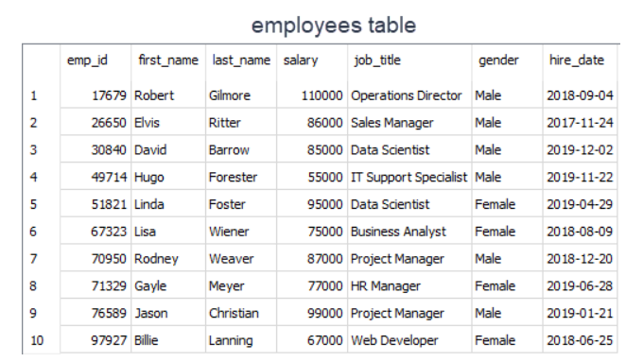
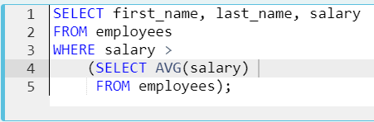
Example
Find out the employees who get paid more than the average salary
Notes:
We can also use aggregated functions since it returns a single row with a single column. Now let' s find out the employees who get paid more than the average salary. Our query should return first name, last name, and salary info of the employees.
EXAMPLE
SELECT first_name, last_name, salary
FROM employees
WHERE salary >
(SELECT AVG(salary)
FROM employees);
Result: 6 rows returned
Let's analyze the query;:
We've used > operator with WHERE clause.
The inner query returns the average salary which is 83600 and passes this single value to the outer query.
Outer query filters those employees and returns those whose salary is more than 83600.
As you see that combining aggregate functions with subqueries, we have more power to answer our analytical questions.

Slide 45


Query Time

Slide 46
Retrieve track id, track name, album id info of the Album title ‘Faceless’. (use : Subquery)
Notes:
Answer:
SELECT trackid,
name,
albumid
FROM tracks
WHERE albumid = (
SELECT albumid
FROM albums
WHERE title = 'Faceless');
Burada SELECT albumid
FROM albums
WHERE title = 'Faceless'
sorgusunu ayrı çalıştır ve tek bir row döndürdüğünü göster.
There are 2 conditions here
Result: 12 rows

Slide 47

Most queries using a join can be rewritten using a subquery (a query nested within another query), and most subqueries can be rewritten as joins.
TIP

Slide 48
Retrieve track id, track name, album id info of the Album title ‘Faceless’. (use : Joins)
Notes:
JOIN kullanarak yapınız.
Answer:
SELECT tracks.TrackId,
tracks.Name,
tracks.AlbumId,
albums.Title
FROM tracks
JOIN albums
ON tracks.AlbumId = albums.AlbumId
WHERE albums.Title = 'Faceless';
Result: 12 rows

Slide 49

Multiple-row Subqueries
Multiple-row subqueries return sets of rows and are used with multiple-row operators such as IN, NOT IN, ANY, ALL.

Slide 50
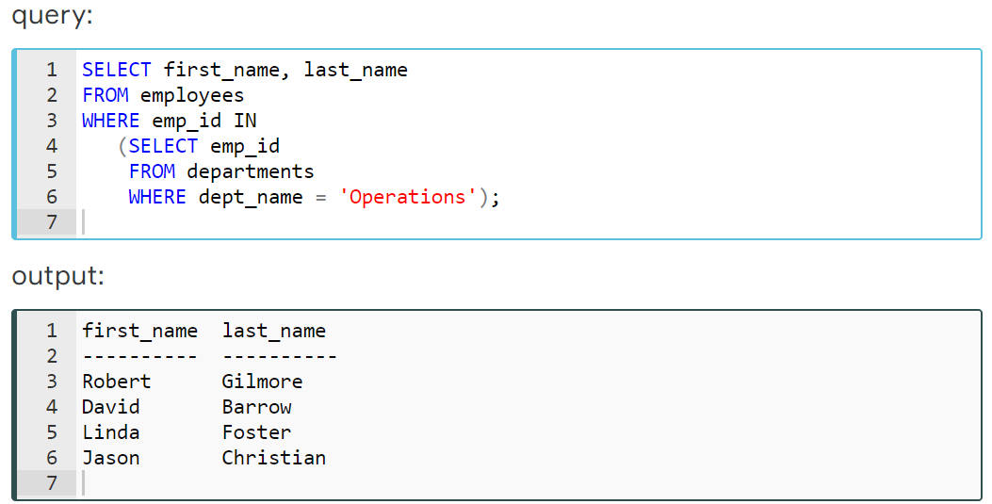
Example
Find the employees (first name, last name from employees table) who work under the Operations department (departments table)
Notes:
As you know that we have added a new table to the company database consisting of one table. Our new table is the departments table. It has three columns and nine rows. Every row represents an employee's department info. Here are our database tables.
Let’s see in detail

Slide 51
Analyze the query-1
1
1
The inner query returns the employees ids who work under the Operations department
Notes:
Let's analyze the query on the screen:
We've used IN operator with WHERE clause.
The inner query returns the employee ids who work under the Operations department.

Slide 52
Analyze the query-2
2
1
1
The inner query returns the employees ids who work under the Operations department
2
Employees ids are passed to the outer query.
Notes:
Then employees ids are passed to the outer query.

Slide 53
Analyze the query-3
2
(17679, 30840, 51821, 76589)
1
1
The inner query returns the employees ids who work under the Operations department
2
Employees ids are passed to the outer query.
Notes:
Then employees ids are passed to the outer query.

Slide 54
Analyze the query-4
(17679, 30840, 51821, 76589)
Outer query filters those employees ids and returns their first name and last name as a result set.
Notes:
Outer query filters those employees ids and returns their first_name and last_name as a result set.
**************
Exp;
How many male employees work under the Operations department?
(Note: Your result table will consist of one column named 'count_male')
SELECT COUNT(gender) as count_male
FROM employees
WHERE gender='Male' AND emp_id IN(select emp_id from departments where dept_name='Operations');
result : 3
*******************************
SELECT COUNT(gender) as count_male
FROM employees
JOIN departments
ON employees.emp_id=departments.emp_id
WHERE employees.gender = 'Male'
AND employees.emp_id IN(
SELECT emp_id
FROM departments
WHERE dept_name='Operations');

Slide 55
Retrieve track id, track name, album id info of the Album title ‘Faceless’ and ‘Let There Be Rock’
Notes:
SUBQUERY kullanarak yapınız.
Answer:
SELECT trackid,
name,
albumid
FROM tracks
WHERE albumid IN (
SELECT AlbumId
FROM albums
WHERE title IN ('Faceless', 'Let There Be Rock')
);
(result 20)
JOIN kullanarak yapınız
SELECT tracks.trackid,
tracks.name,
tracks.albumid
FROM tracks
JOIN albums
ON tracks.AlbumId=albums.AlbumId
WHERE title IN ('Faceless', 'Let There Be Rock');

Slide 56
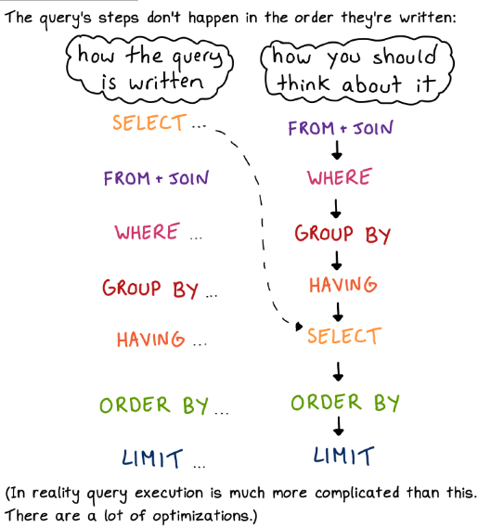
Notes:
Before starting subqueries, you should know how the queries are executed.
It’s different than you write:
starts from the FROM and JOIN statements
then filters it on WHERE clause
then GROUP BY and HAVING
then SELECT the column names accordingly
at this point we have the necessary columns and rows
then it sorts the data on ORDER BY clause
lastly limit the results accordingly

Slide 57
THANKS!
Any questions?

