Slide 1
Odometry

Slide 2
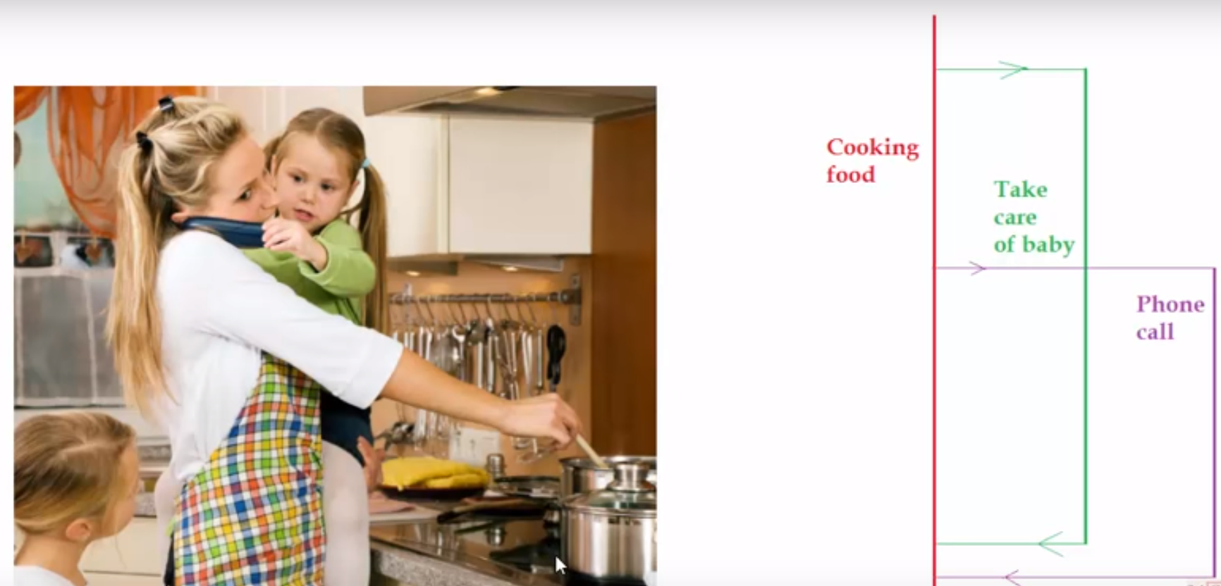

Slide 3
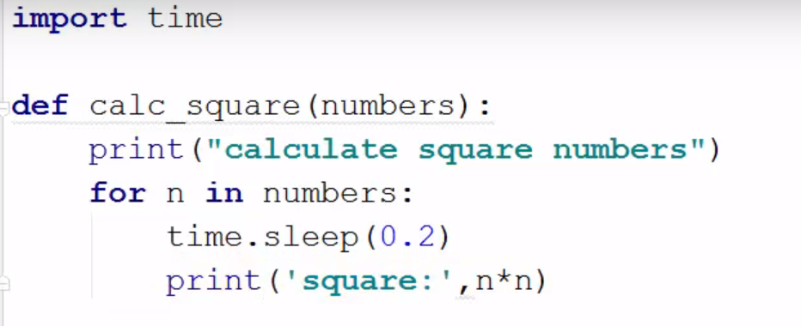

Slide 4
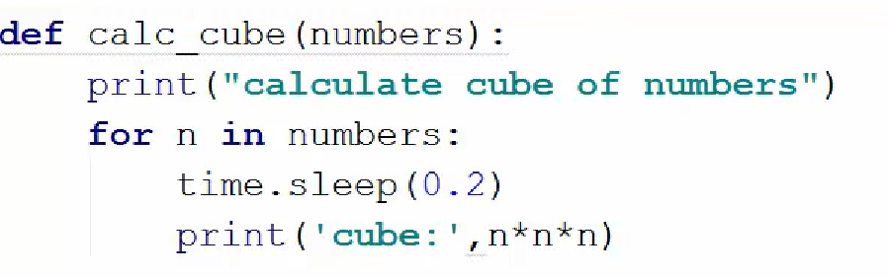

Slide 5
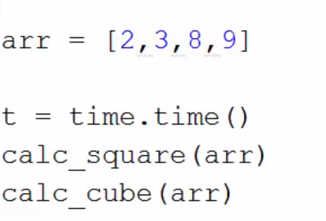

Slide 6
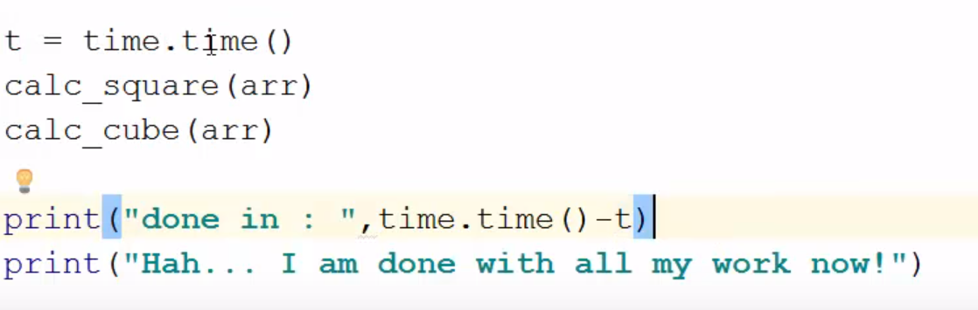

Slide 7
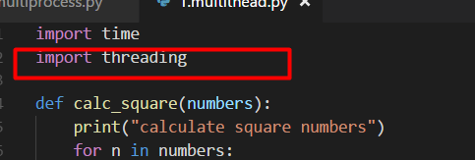

Slide 8


Slide 9


Slide 10


Slide 11
Multiprocessing

Slide 12
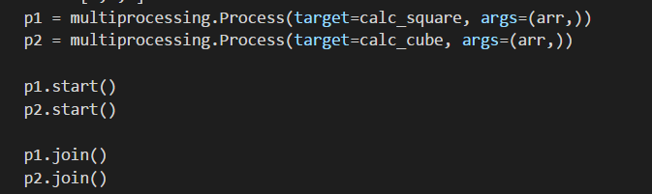

Slide 13
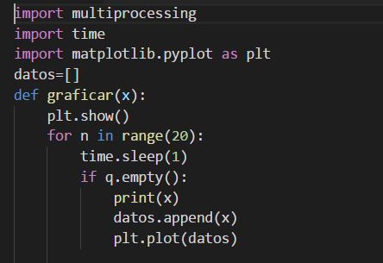

Slide 14
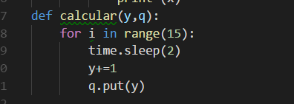

Slide 15
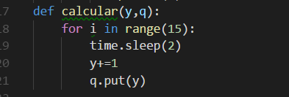

Slide 16
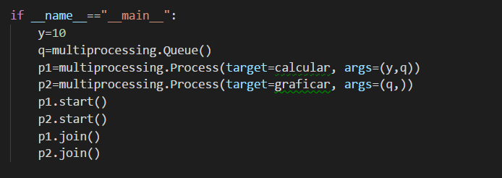

Slide 18
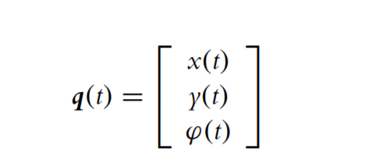

Slide 19
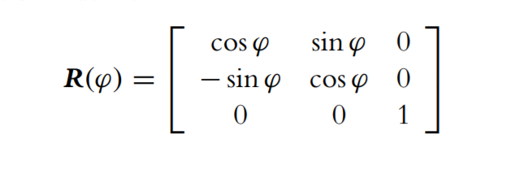
Rotational matrix

Slide 20


Slide 21
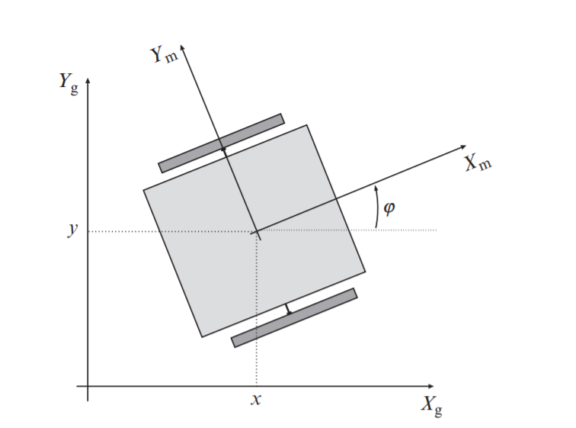

Slide 22
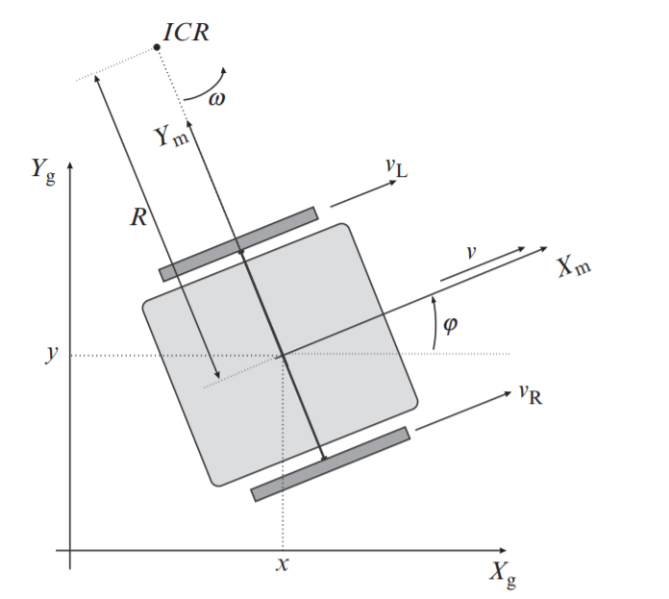

Slide 23
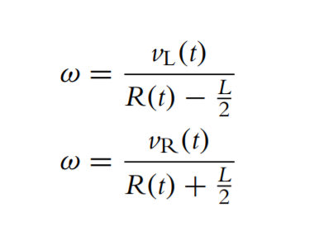

Slide 24
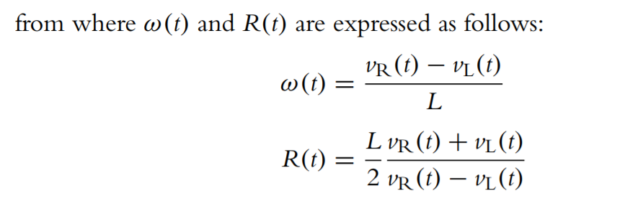

Slide 25
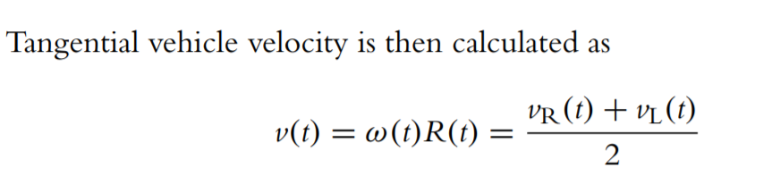

Slide 26
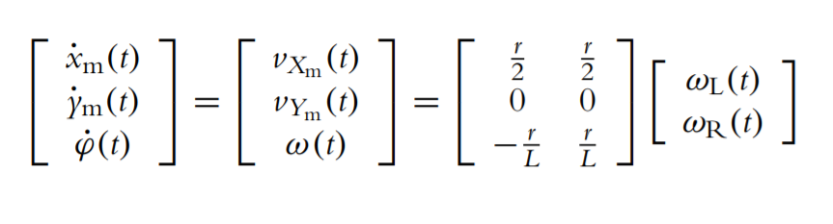
Internal robot kinematics (in local coordinates)

Slide 27
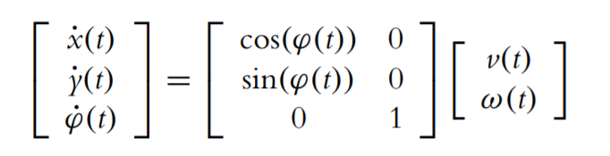
Robot external kinematics (in global coordinates)

Slide 28
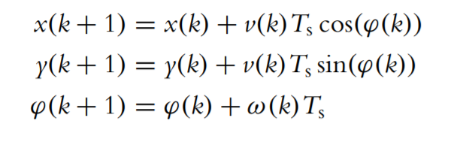
discrete time instants

Slide 29
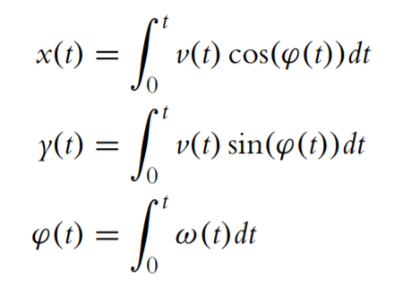
Forward and Inverse Kinematics
A robot pose at some time t is obtained by integration of the kinematic model, which is known as odometry or dead reckoning. Determination of the robot pose for given control variables is called direct (also forward) kinematics:

Slide 30
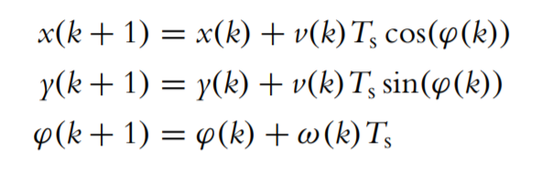
The direct kinematics

Slide 31
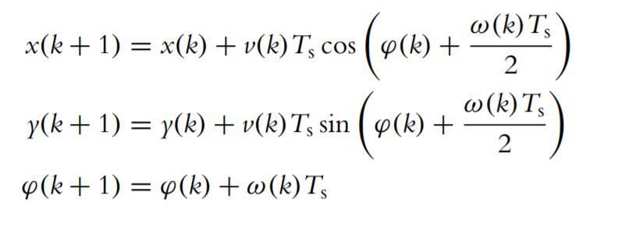
Trapezoidal numerical integration is used a better approximation

Slide 32
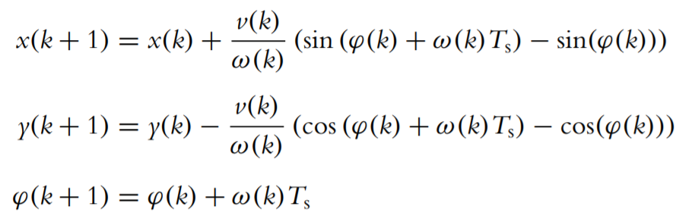
If exact integration is applied the direct kinematics is

Slide 33
where integration in above equation is done inside the sampling time interval where constant velocities v and ω are assumed to obtain increments

Slide 34
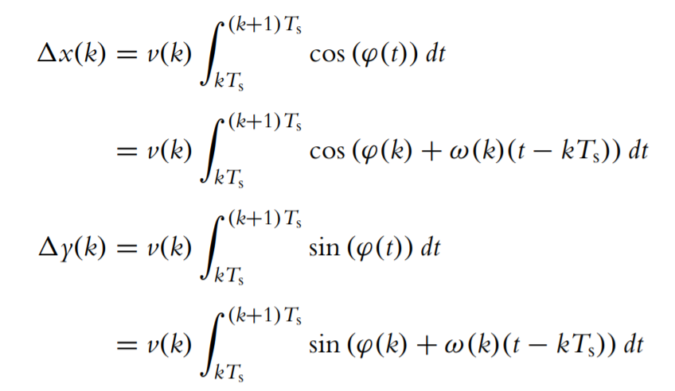

Slide 35

For code implement in Python you must watch this
https://www.youtube.com/watch?v=aE7RQNhwnPQ&t=323s

Slide 36
Inverse Kinematics

Slide 37
The development of the inverse kinematics is a more challenging task than the above cases of direct kinematics. We use inverse kinematics to determine control variables to drive the robot to the desired robot pose or path trajectory

Slide 38
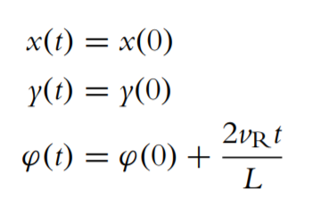
Nonholonomic constraints
Robots are usually subjected to nonholonomic constraints, which means that not all driving directions are possible.
One simple solution to the inverse kinematics problem would be if we allow a differential robot to drive only forward

Slide 39
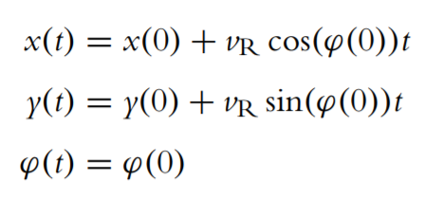
for straight motion equation

Slide 40
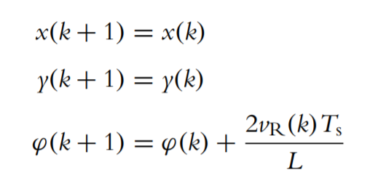
Rotation motion
If we consider a discrete time notation where control speeds vR(k), vL(k) are constant during time interval Ts and changes of the control speeds are only possible at time instants t = kTs then we can write equations for the robot motion.

Slide 41
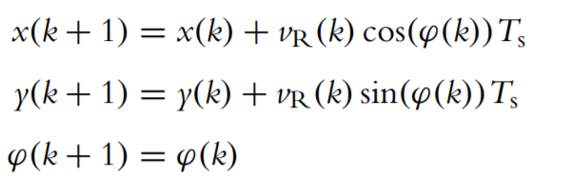
straight motion equation

Slide 42
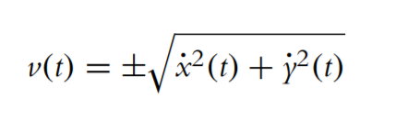
Supposing the robot’s initial pose is on trajectory, and there is a perfect kinematic model and no disturbances, we can calculate required control variables v as follows:

Slide 43

where the sign depends on the desired driving direction (+ for forward and − for reverse). The tangent angle of each point on the path is defined as
where l ∈ {0, 1} defines the desired driving direction (0 for forward and 1 for reverse) and the function arctan2 is the four-quadrant inverse tangent function.

Slide 44
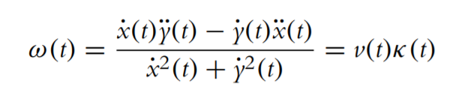
By calculating the time derivative of above equation, the robot’s angular velocity ω(t) is obtained:
where κ(t) is the path curvature

Slide 45


Slide 46
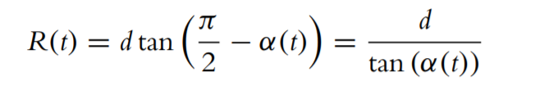
The ICR point is defined by the intersection of both wheel axes. In each moment of time the bicycle circles around ICR with angular velocity ω, radius R, and distance between the wheels d:

Slide 47
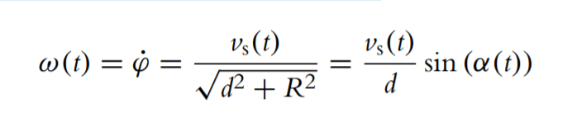
The steering wheel circles around ICR with ω so we can write
where vs(t) = ωs(t)r and r are the rim velocity and the radius of the front wheel, respectively.

Slide 48
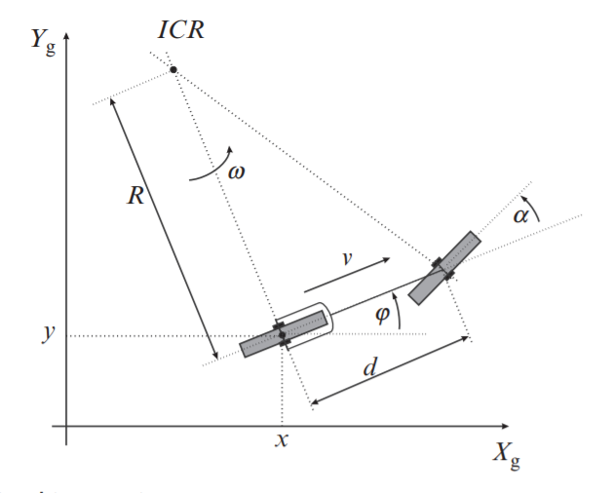

Slide 49
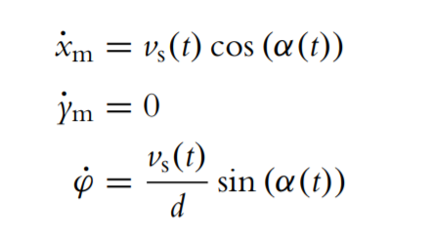
Internal robot kinematics (in robot frame) is

Slide 50
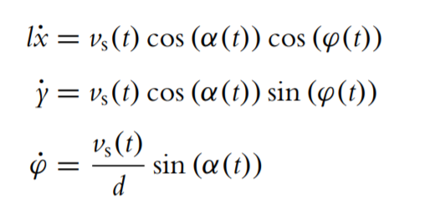
and the external kinematic model is

Slide 51
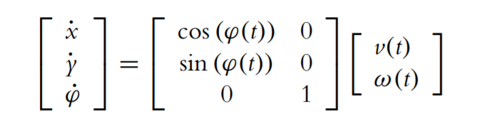
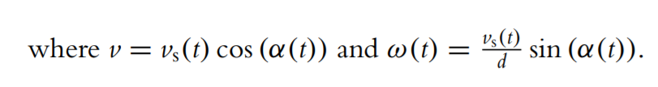
or in compact form

Slide 52
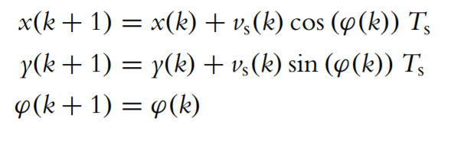
Direct and Inverse Kinematics

Slide 53
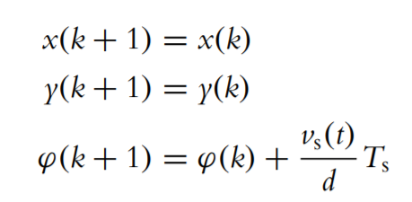
discretization the motion model

Slide 54
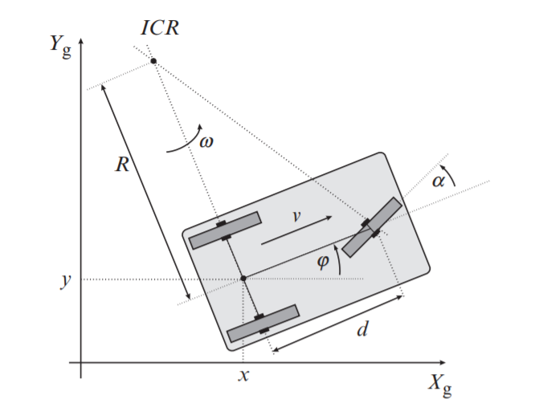
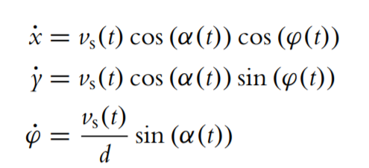
Tricycle Drive
has the same kinematics as bicycle drive.

Slide 55
where v = vs(t) cos(α(t)), ω(t) = (vs(t)/d) sin (α(t)), and vs is the rim velocity of the steering wheel.

Slide 56
Car (Ackermann) Drive

Slide 57
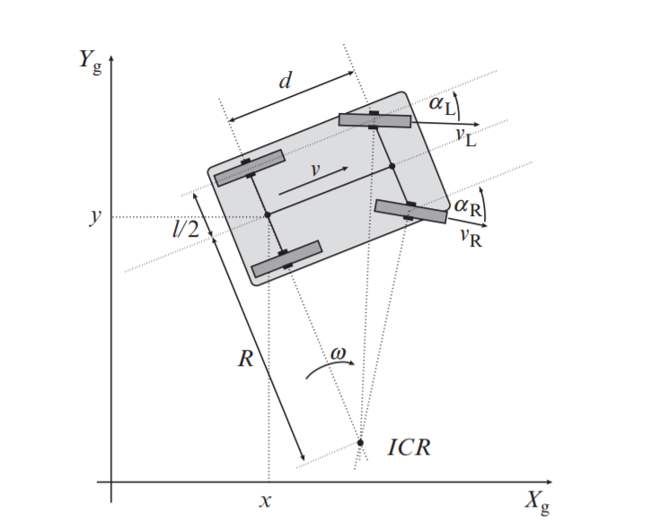

Slide 58
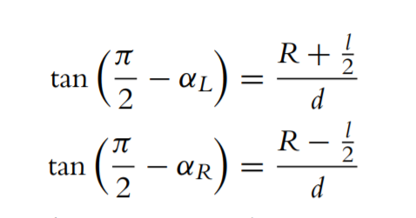
The steering orientations of the front wheels

Slide 59
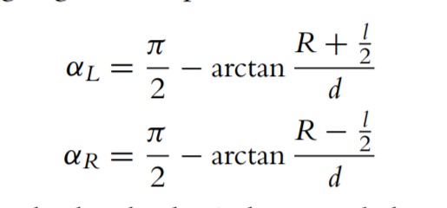
the final steering angles are expressed as

Slide 60
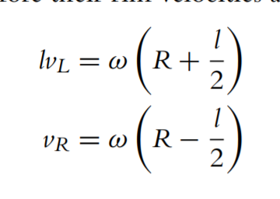
The inner and outer back wheels circle around the ICR with the same angular velocity ω; therefore their rim velocities are

