Slide 1
Power system fault detection and classification using machine learning
MACHINE LEARNING PROJECT
Presented By:
1. SRINIVAS VAJJA – SAGI RAMA KRISHNAM RAJU ENGINEERING COLLEGE - CSE

Slide 2
OUTLINE
Problem Statement (Should not include solution)
Proposed System/Solution
System Development Approach (Technology Used)
Algorithm & Deployment
Result (Output Image)
Conclusion
Future Scope
References

Slide 3
Problem Statement
Design a machine learning model to detect and classify different types of faults in a power distribution system. Using electrical measurement data (e.g., voltage and current phasors), the model should be able to distinguish between normal operating conditions and various fault conditions (such as line-to-ground, line-to-line, or three-phase faults). The objective is to enable rapid and accurate fault identification, which is crucial for maintaining power grid stability and reliability.

Slide 4
Proposed Solution
Develop a machine learning model that classifies power system faults using the dataset provided . The model will process electrical measurements to identify the type of fault rapidly and accurately. This classification will help to automate fault detection and assist in rapid recovery actions, ensuring system reliability.
KEY COMPONENTS:
Data Collection:
Use the dataset for power system faults provided on Kaggle
Data Preprocessing:
Clean and preprocess the collected data to handle missing values, outliers, and inconsistencies.
Machine Learning Algorithm:
Implement a machine learning algorithm, such as a Decision Tree , Snap Logistic Regression, Random Forest , or SVM
Deployment:
Deploy the solution on a scalable and reliable platform, considering factors like server infrastructure, response time and accessibility.
Evaluation:
Assess the model's performance using appropriate metrics such as Mean Absolute Error (MAE), Root Mean Squared Error (RMSE), or other relevant metrics.
Fine-tune the model based on feedback and continuous monitoring of prediction accuracy.
Validate the model using accuracy , precision, recall and F1-Score

Slide 5
System Approach
The "System Approach" section outlines the overall strategy and methodology for developing and implementing the rental bike prediction system. Here's a suggested structure for this section:
System requirements:
IBM Cloud(Mandatory)
IBM Watsonx.ai Studio for development and deployment
IBM Cloud Object Storage for data feeding and dataset handling

Slide 6
Algorithm & Deployment
In the Algorithm section, describe the machine learning algorithm chosen for predicting the types of Faults. Here's an example structure for this section:
Algorithm Selection:
Random Forest Classifier (or SVM based on Performance)
Data Input:
Voltage ,Current , Power Load ,Temperature ,Wind Speed ,Weather Condition ,Maintenance Status ,Component Health, Duration of Fault
Training Process:
Supervised Learning ( Using Labelled Fault-Types)
Prediction Process:
Model was deployed on IBM Watsonx.ai Studio and fed data using Cloud Storage Object with API endpoints for real-time predictions on the Fault-Types
We provide the model with required data for the prediction , once the data is sufficient we can then wait for the model to predict the Fault-Types

Slide 7
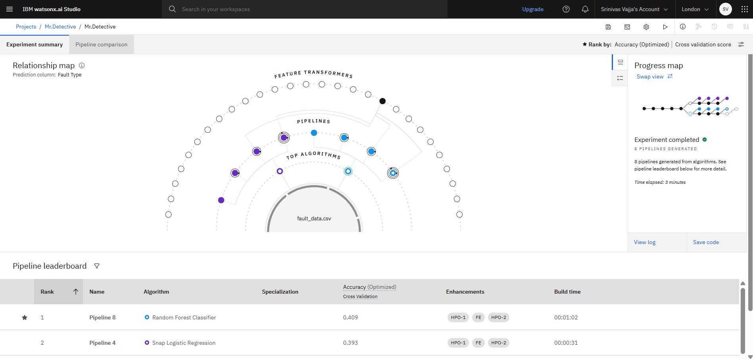
Result

Slide 8
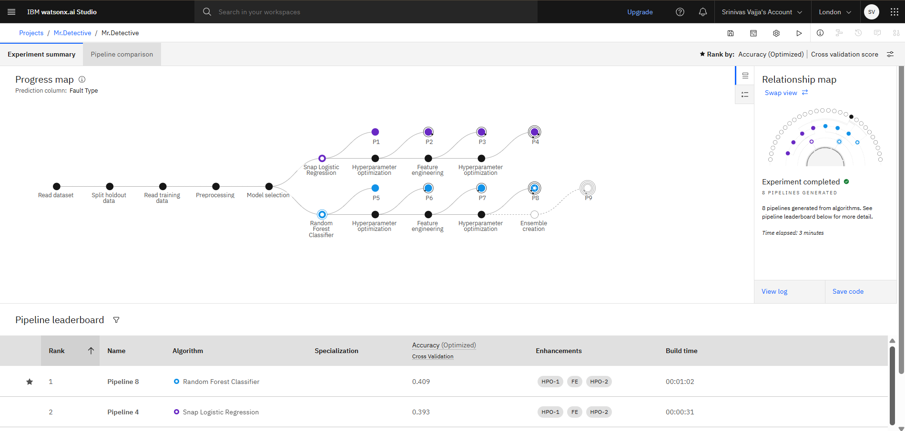
Result

Slide 9
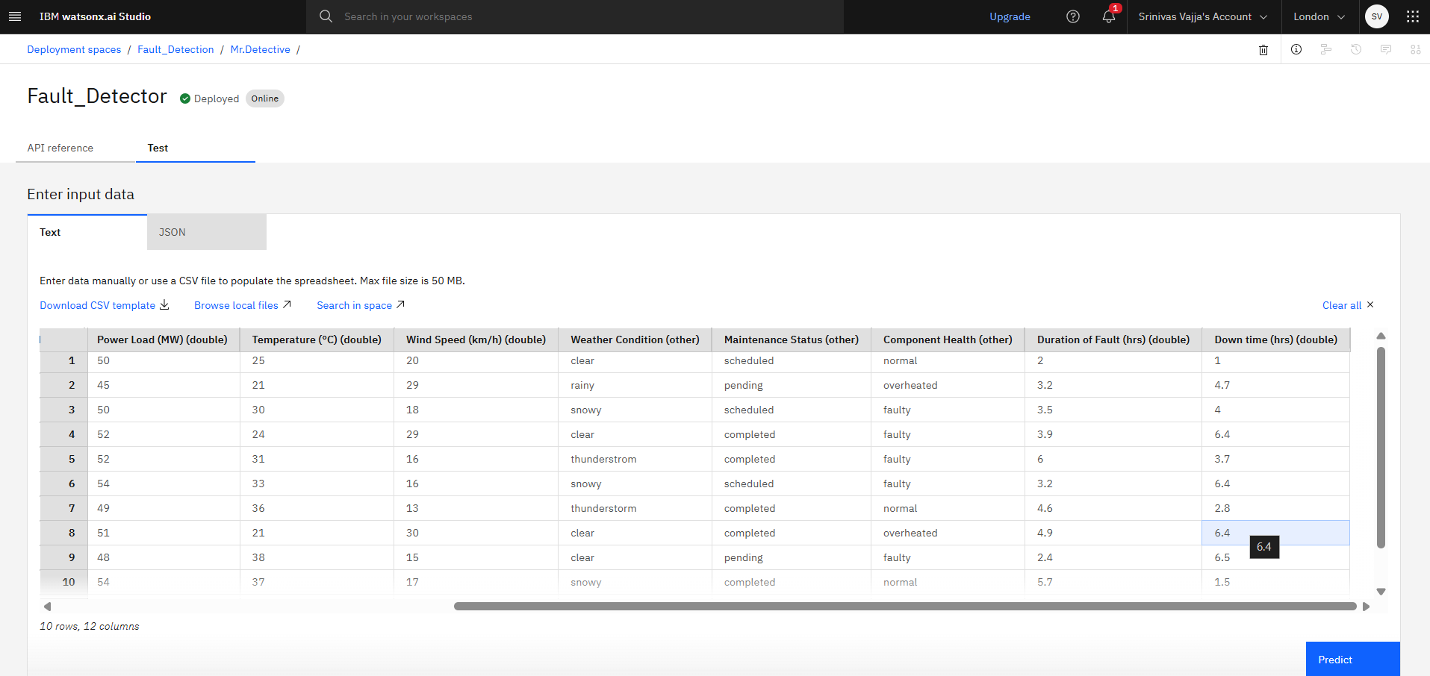
Result

Slide 10
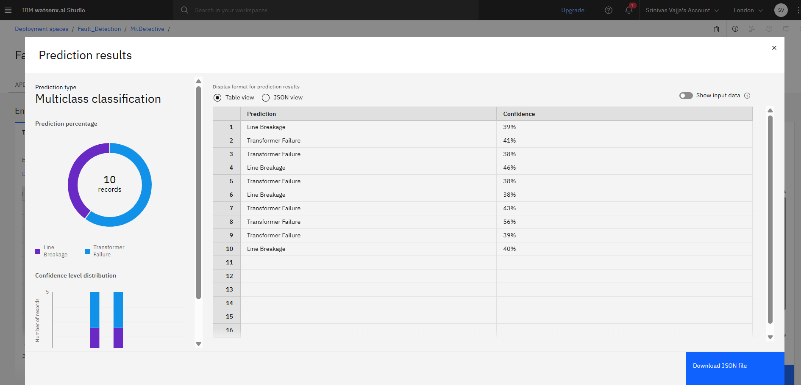
Result

Slide 11
Conclusion
The development of a machine learning-based power system fault classification model has demonstrated that data-driven approaches can significantly improve the speed and accuracy of fault detection in electrical grids. By leveraging a Random Forest Classifier, the system efficiently processed diverse input features—such as voltage, current, power load, environmental conditions, and component health—to identify various fault types. Deployment on IBM Watsonx.ai Studio provided a scalable and reliable infrastructure for real-time predictions, ensuring quick and informed decision-making. This model not only reduces downtime but also supports utilities in maintaining system reliability, safety, and operational efficiency.

Slide 12
GITHUB link
https://github.com/ClashingUniverse/IBM-ML-Project-

Slide 13
Future scope
In the future, this model can be expanded to incorporate real-time data from IoT-enabled devices, such as smart meters and phasor measurement units, enabling more responsive and accurate fault detection across wider grid networks. Beyond classification, the system could evolve into a predictive maintenance tool, forecasting potential component failures before they occur and allowing utilities to take proactive measures. Advanced deep learning techniques, such as LSTM networks or Graph Neural Networks, may further enhance the model’s ability to capture temporal patterns and grid topology for even greater accuracy. Additionally, integrating continuous learning pipelines will allow the model to adapt automatically as new fault data becomes available, ensuring it stays relevant in changing grid conditions

Slide 14
References
Dataset:- https://www.kaggle.com/datasets/ziya07/power-system-faults-dataset
IBM Cloud:- https://www.ibm.com/cloud
Fault-Detection using ML:- https://ieeexplore.ieee.org/document/10306740
Fault-Detection using ML:- https://www.sciencedirect.com/science/article/pii/S2352484724007807

Slide 15
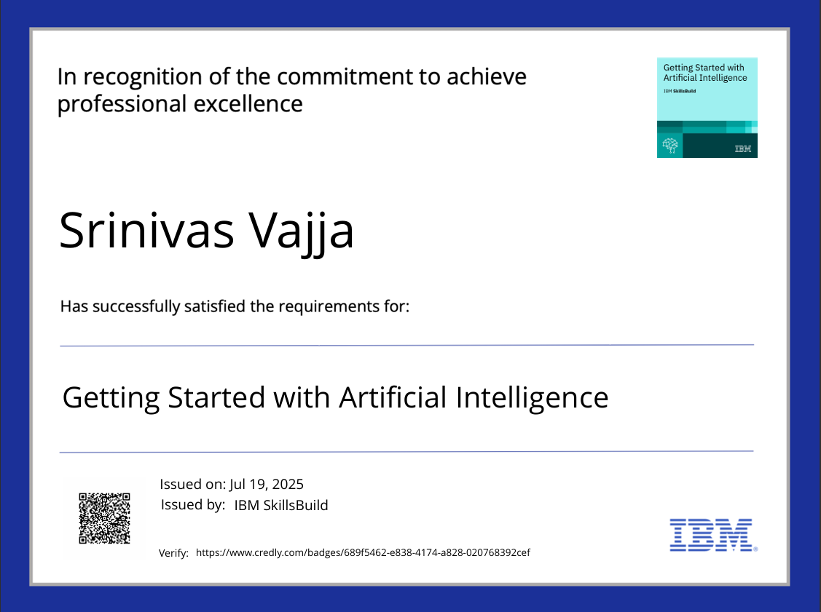
IBM Certifications

Slide 16
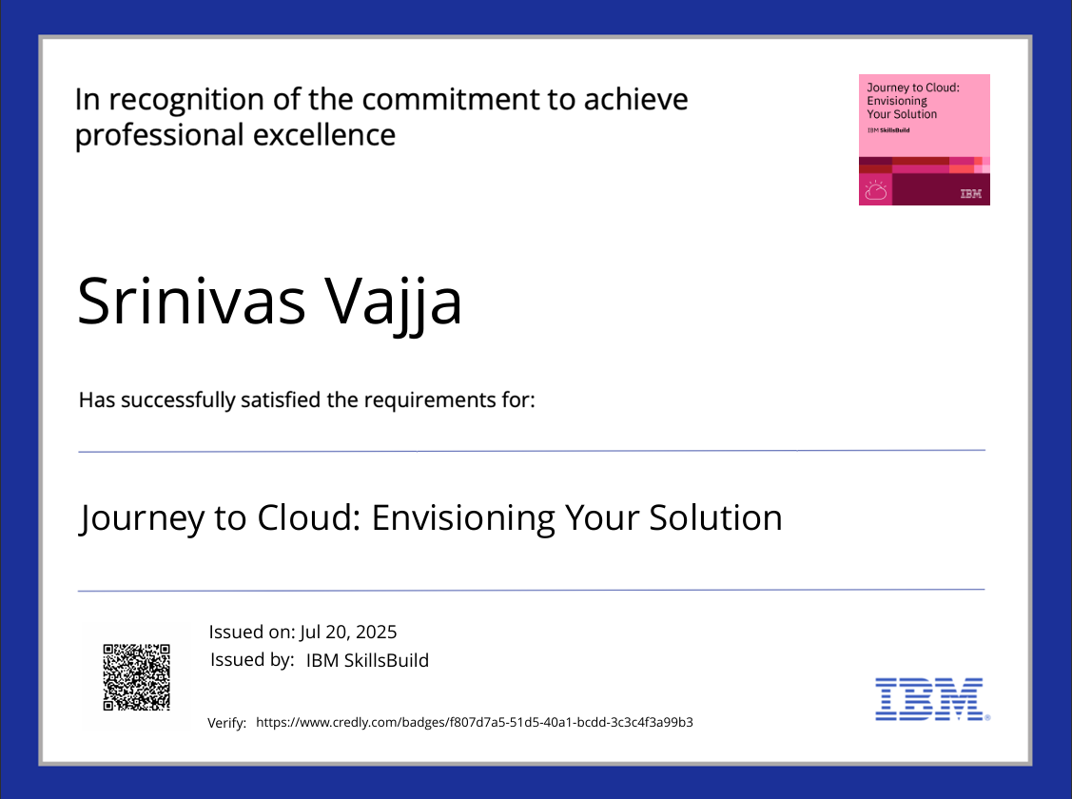
IBM Certifications

Slide 17
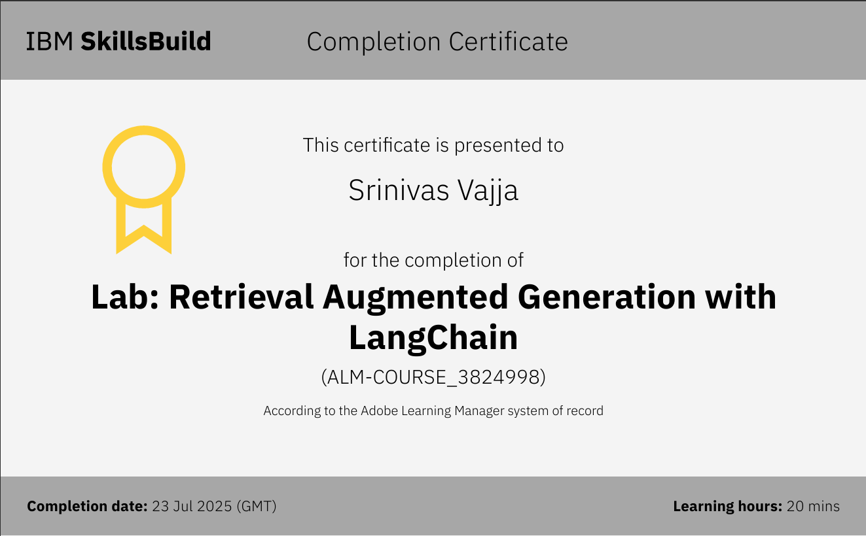
IBM Certifications

Slide 18
THANK YOU

