Slide 1
CSCI 6070 Database Systems CLASS PROJECT Apps and Data - A study of IMDb dataset
SHASHANK PALUSA
VENKATA GANESH GUTTLAPALLI
KUNDHANA REDDY AAVULA BALA
THANEESH REDDY VELURU
KRISHNA CHAITANYA KANDIMALLA

Slide 2
☻Database Platform- Oracle Sqldeveloper
Oracle SQL developer is used for importing data and run the queries
☻Application Platform- Eclipse IDE
Java with Eclipse is used on the Application side for MVC architecture and the design of command prompt application.

Slide 3
TSV : Tab Separated values
CSV : Comma- Separated Values
Our given Dataset is in TSV layout having null values and distinct values.
While uploading data, errors will arise to do away with those we use python code and converted to CSV files.

Slide 4
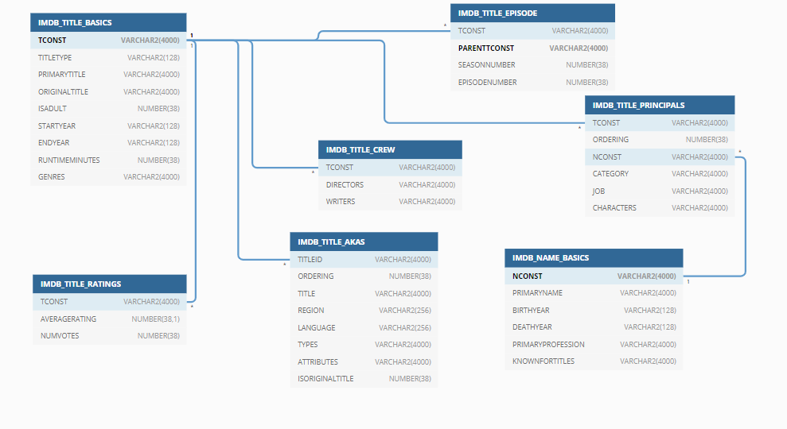
DATABASE SCHEMA
Notes:
It is designed through the inputs necessary for developing queries.
The primary keys required are TCONST,NCONST,PARENTCONST as highlighted above.
The entire schema is designed to show the relationship between each table used to design queries and how we can join or combine one table to another.
A primary key-foreign key relationship defines a one-to-many relationship between two tables in a relational database.
Primary key uniquely identifies a record in the table where as the Foreign key is a field in the table that is primary key in another table.

Slide 5
☻Design of the Queries
Tables
The collection of the related data in a structured format within the database
We have seven Tables with data sets loaded in it in this project.
With the help of these tables the queries were designed
Database Schema
With the help of the database schema we tried to design the queries for the given questions in the project.
The Database schema helps us to logically group tables so we can have an easy understanding of the data and design the required queries.

Slide 6
The Major Queries for the project were designed using these clauses and operators
View
Group by
Order by
Set Operators
Nested Queries
Aggregate Functions

Slide 7
VIEW :
A view is simply the representation of a SQL statement that is stored in memory so that it can be easily reused.
We can also say that views are nothing but virtual tables which are used to fetch records from one or more tables.
GROUP BY :
The GROUP BY clause is a SQL command that Is used to group rows that have same values.
ORDER BY :
The ORDER BY keyword is used to sort the result-set in ascending or descending order.
It sorts the records in ascending order by default, to sort it in descending order we must use the “DESC” keyword in the statement.
SET OPERATORS :
Set operations allow the results of multiple queries to be combined into a single result set.
They Include UNION, INTERSECT and EXCEPT.

Slide 8
NESTED QUERY :
A nested query or inner query or sub query is a query within another SQL query and embedded within the WHERE clause.
It is used to return data that will be used in main query as a condition to further restrict the data to be retrieved.
AGGREGATE FUNCTIONS : Aggregate Functions a single result row based on the group of rows.
For the Project we have combined several statements and clauses which are listed above and designed our query to get the required output.
Following is an example query of how we designed the query in the project to get the required output from the tables:

Slide 9
Show the information of movies (Title, Region, Language, Year, Rating, Votes) which have average rating greater than 7 and number of votes greater than 1000.
Query Statement :
SELECTita.title Title,ita.region Region,ita.language Language, itb.startyearYear,itr.averagerating Rating,itr.numvotes Votes
FROM
imdb_title_akas ita,imdb_title_basics itb,imdb_title_ratings itr
WHERE
1 = 1
AND ita.titleid = itb.tconstAND itb.tconst = itr.tconstAND ita.titleid=itr.tconstAND itr.averagerating > 7AND itr.numvotes>1000;

Slide 10
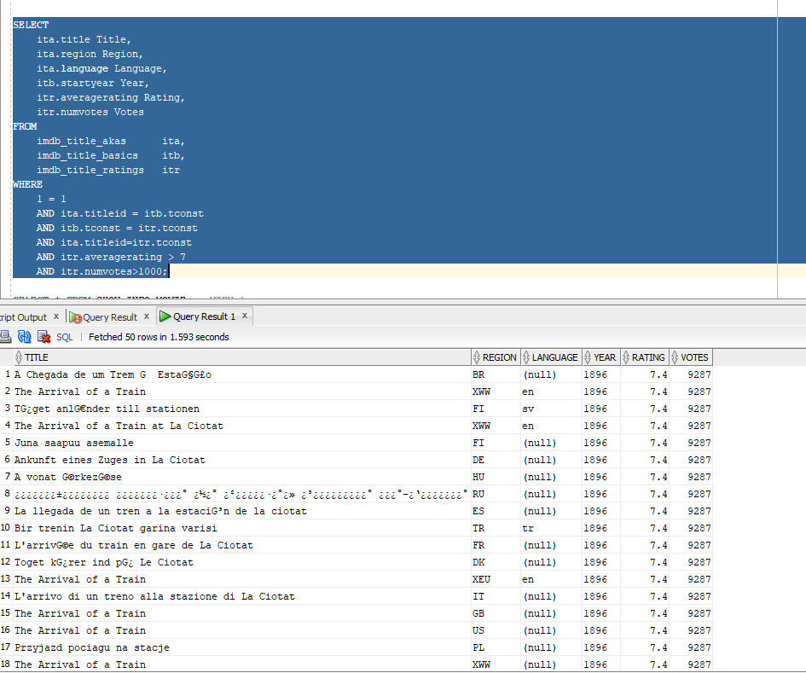

Slide 11
MVC- MODEL VIEW CONTROLLER
Files created to implement command-prompt application are:
Movie.java - Explains creating Models that can organize and represent data in database application
Moviecontroller.java – we created connection and controls to get data from database
MovieView.java – has views to present data
MovieDb.java – MovieController main class has 7 functions and when we call 7 functions an object is created for MovieController
Notes:
Resultset library is used to store database info
Getcount to get rows retrieved from database
Movie object stores rows info from database

Slide 12
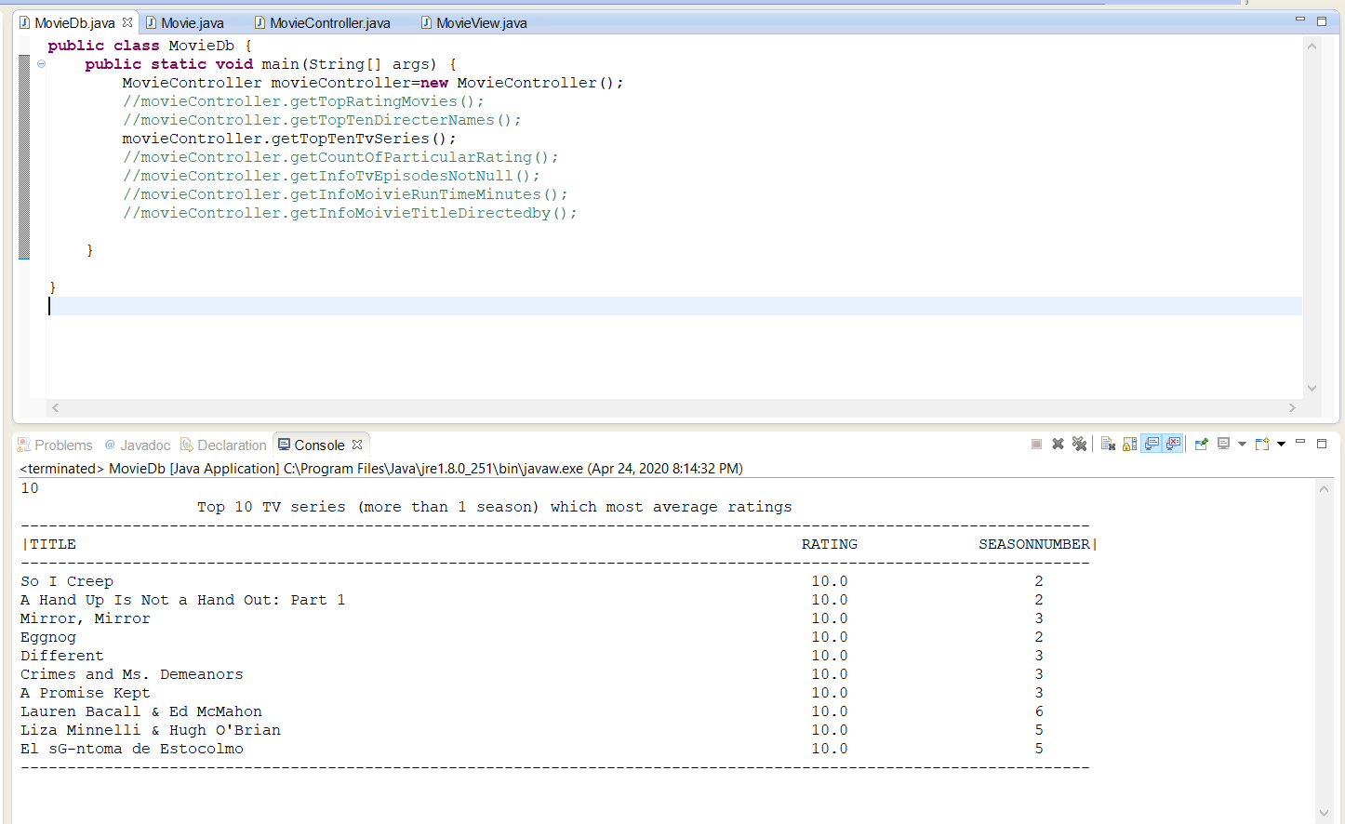

Slide 13
ISSUES OCCURRED:
While using oracle database we faced an issue connecting to database it says error as oracle driver was missing so downloaded the Oracle-JDBC driver jar file from oracle website and imported this file into our project .Thus connection between java and oracle database was successfully established.
We developed a command prompt application and had an alignment issue.
So, we used System.out.printf instead of System.out.println

Slide 14
☻ ANY TECHS USED?
Used Python 3.6.4 to remove null values while converting files in tsv to csv format

Slide 15
LIVE DEMO ☻
QUESTIONS ?
THANK YOU !

