Slide 1
Sociophonetic study of NURSE vowels in Nigerian English
Oluwasegun Amoniyan

Slide 2
Motivation for the study
NURSE vowel means vowels that are produced in similarity or variation to the mid-central vowel [ɜ] as [nɜs]
The existing literature contains information about `NURSE vowel` production, particularly in the English inner circle. However, their findings often overgeneralize other Englishes without providing supporting evidence. This study will investigate the phenomenon in the outer circle of English and provide a balanced description of the variation that characterizes the NURSE vowel.

Slide 3
Background and Review
Background
NURSE vowels have received scholarly attention in different varieties (especially in the inner circle) of English (e.g., American English, British English, New Zealand English). Their results are similar.
Review
Studies of NURSE vowel variation across several English varieties in monolingual or bilingual contexts show merging (as a centralized vowel) or maintaining a three-way contrast realized as [ɪ], [ɛ], and [ʌ], with the varied presence of rhotacization. These realizations are influenced by social (e.g. gender, age) and linguistic factors (e.g., speech style) (Li et. al., 2021; Maclagan et. al., 2017; Mayr, 2010; Mesthrie & Chevalier, 2014; Watson & Clark, 2013).

Slide 4
Research gap
However, very little is known about NURSE vowel variation in New Englishes like Nigerian English (NE), which exists in a rich multilingual context with regional varieties (i.e., Hausa, Igbo, Yoruba) and over 250 ethnic groups. This study bridges the gap in the knowledge of NURSE vowel production in Englishes.
What are NURSE vowel productions in NE?
What possible factors determine variation in NURSE vowel production in NE?
To what extent do phonetic features describe vowel identity of NURSE vowels?

Slide 5
Research Hypothesis
The production of NURSE vowels in Nigerian English may vary across linguistic (vowel production and phonological context), ethnicity (Hausa, Igbo, and Yoruba), and sociolinguistic (age, gender, profession) factors. This hypothesis explains the effect of multilingual and diverse socio-cultural spaces on NURSE vowel production in Nigerian English. Specifically:
NURSE vowel may have variant production in NE
Phonological context may affect NURSE vowel production in NE
Nigeria has over 200 ethnic groups and three major (Hausa, Igbo, and Yoruba); I hypothesize that ethnicity may determine NURSE vowel production in NE
Sociolinguistic factors may determine how NURSE vowels are produced in NE These factors may contribute to the variation in the production of NURSE vowels than in monolingual speech context.

Slide 6
Methodology

Slide 7
Data ICE-Nigeria
The data for this study were drawn from the International Corpus of English Nigeria (ICE-Nig). The corpus contains 1,010,382 collections, with 609,586 spoken words and 400,796 written words (Wunder et al., 2010). The sound and text files were downloaded and uploaded to WebMAUS for forced alignment. The forced-aligned speech samples were manually adjusted on the fourth tier on Praat.
16 sound files (10 - bnews)
two speech styles (broadcast talk and broadcast news)
All speakers in this study used NE as second language users participants
Vary by gender (male vs female), ethnicity, speech style, Profession, and age
inputfile bnew_01 bnew_02 bnew_03 bnew_04 bnew_05 bnew_06 bnew_07 bnew_08 bnew_09 bnew_10 9 10 6 8 11 24 9 16 13 19 btal_01 btal_04 btal_21 btal_22 btal_33 btal_36 16 14 35 22 15 19

Slide 8
Fast Track
Fast Track reports 5 formant levels (f1, f2, f3, f4, f5), with the lowest as 4700Hz and the highest as 7550Hz. The algorithm generates 20 formant for undistorted formants and selects a winner after comparison with other possible formant outputs. Unlike previous studies of NURSE vowels that implemented midpoint and three-point vowel measurement, Fast Track would enable me account for formant trajectories. This algorithm has better formant representation than midpoint and three-point vowel measurement. Samples
segment info nurse aggregate nurse social
Data Wrangling
remove uninformative columns
adding and renaming some columns
categorization of age group, profession
joining data frames

Slide 9
Vowel normalization
Bark difference metrics
to eliminate physiological differences among speakers
to preserve socio-linguistic/dialectal/cross-linguistic differences in vowel quality
to preserve phonological distinctions among vowels navigate

Slide 10
Statistical Analysis
The raw files were analyzed using Mixed effects regression with tidyverse and lme4 to account for linguistic, ethnic and social variables that determine (or may contribute to) variation in Nigerian English NURSE vowels.

Slide 11
Analysis

Slide 12
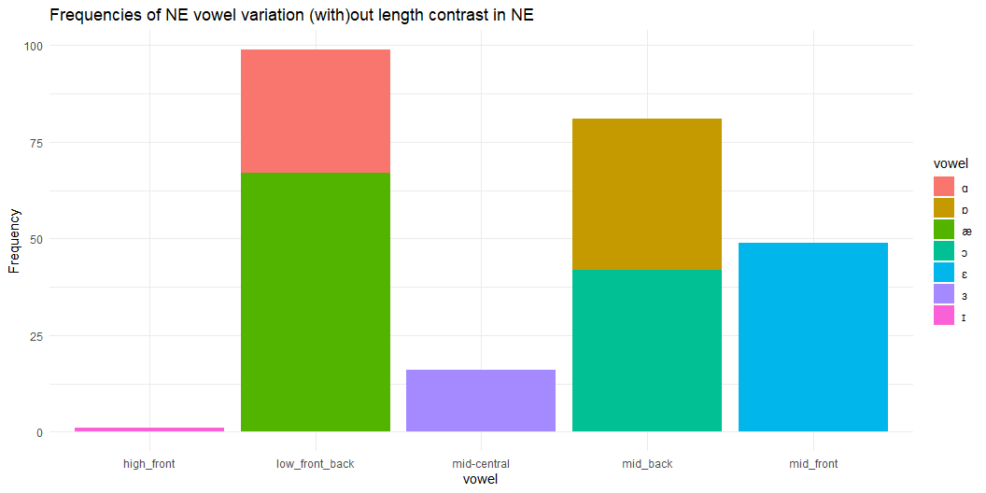
NURSE vowel productions in NE

Slide 13
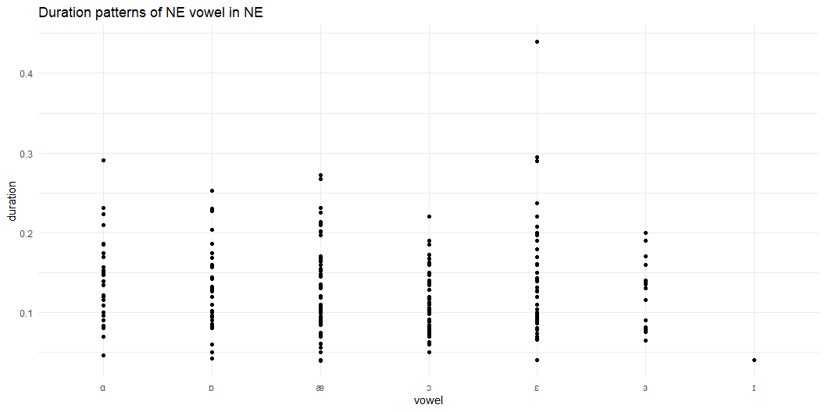
Duration patterns for NURSE vowels in NE
This tests if there is a merger by duration (not by vowel space as largely reported in the literature)

Slide 14
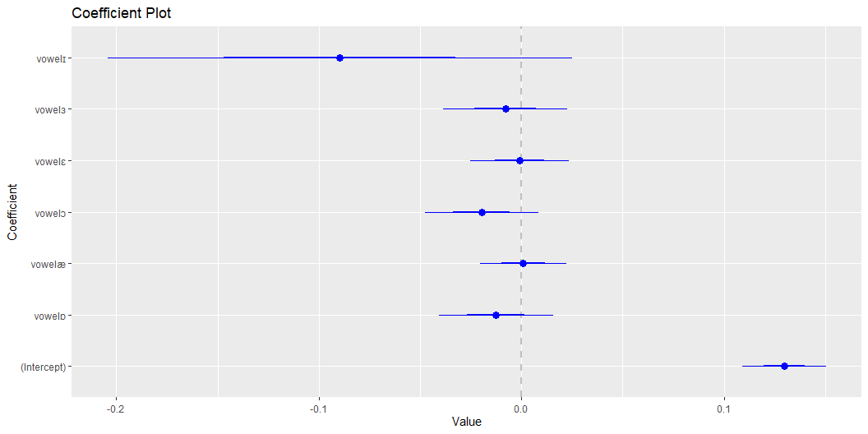
The duration distinguishes tense from lax vowels. The average duration of vowel production in a NURSE context in Nigerian English is 13ms (0.126) for [æ] and 14ms (0.14) for [ɑ]. Similarly, the mean duration of the vowels [ɒ], [ɔ], [ɛ], and [ɜ] range from 11ms (0.113) to 13ms (0.130). Segment info (Is duration significant?)
Regression analysis of duration
Duration does not significantly determine variance in NURSE vowel. The model, the results show that the realization of the NURSE vowel as a low back vowel ([ɑ]) was statistically significantly different in duration from other NURSE vowels (intercept = 0.13, 95%, t(237) = 12.54, p < .001). Meanwhile, the average duration for [æ] was 8ms longer than [a:], though the relationship was not statistically significant (p>0.05). This may indicate that duration is unreliable for differentiating NURSE vowels in NE. Rather, vowel height may help to differentiate NURSE vowel phoneme.

Slide 15
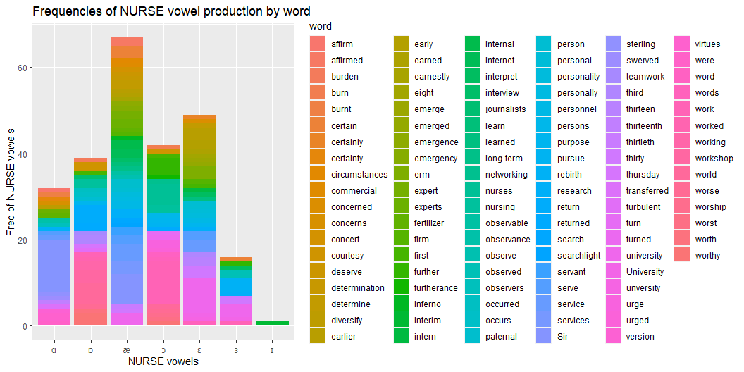
Phonological effect on NURSE vowel
One of the hypotheses for the study identifies the effect of phonological environment on NURSE vowel production in NE. To attempt this task, we need to create a column nurse_determinant where we assign numeric to each level of the nurse_vowel_space for Poisson analysis. The column has three levels: NURSE vowels realized as front_vowel, back_vowel, and central_vowel. The numeric [front_vowel = 0; back_vowel = 1, central_vowel = 2]. This model will reveal whether there is any relationship between vowel space and words in NE.

Slide 16
`Phonological environment` determines NURSE vowel production in NE. The random effect for `word` indicates that the influence of `word` on vowel production varies. The SD (0.28) estimates the degree of variability among words. Furthermore, the fixed effect estimate for the intercept (-0.58) indicates the NURSE vowel productions when no word-specific factor is present. This support the evidence that the production of vowels in NE is determined by the `phonological environment` that NE speakers utter, with various words having variable impacts on vowel identity. This is novel and may not be general across Englishes.

Slide 17
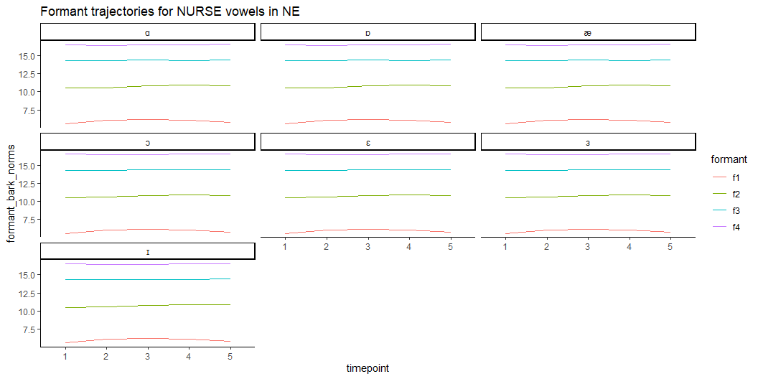
NURSE vowel formant trajectories

Slide 18
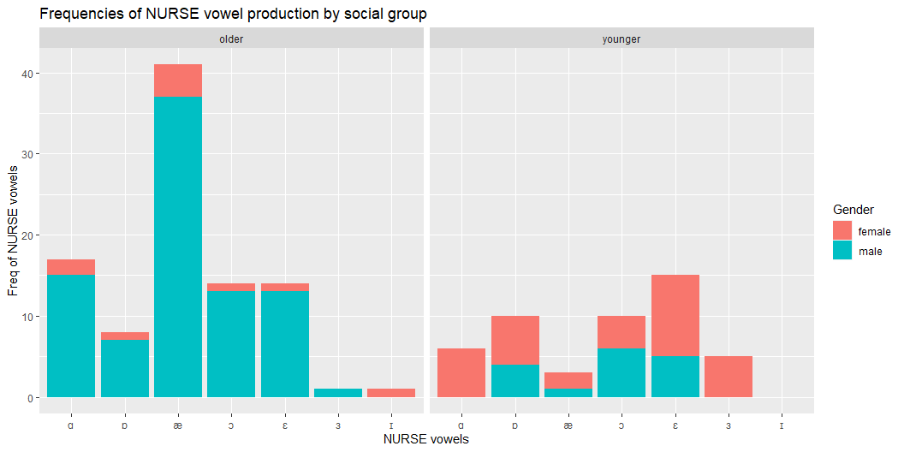
NURSE vowel production in NE by age and gender

Slide 19
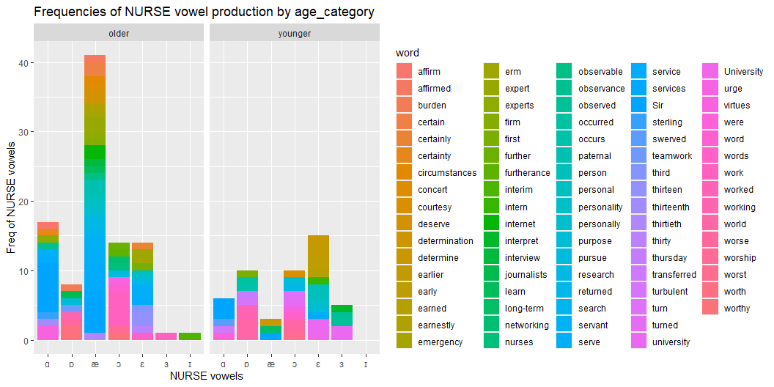
NURSE vowel determinant by age and gender

Slide 20
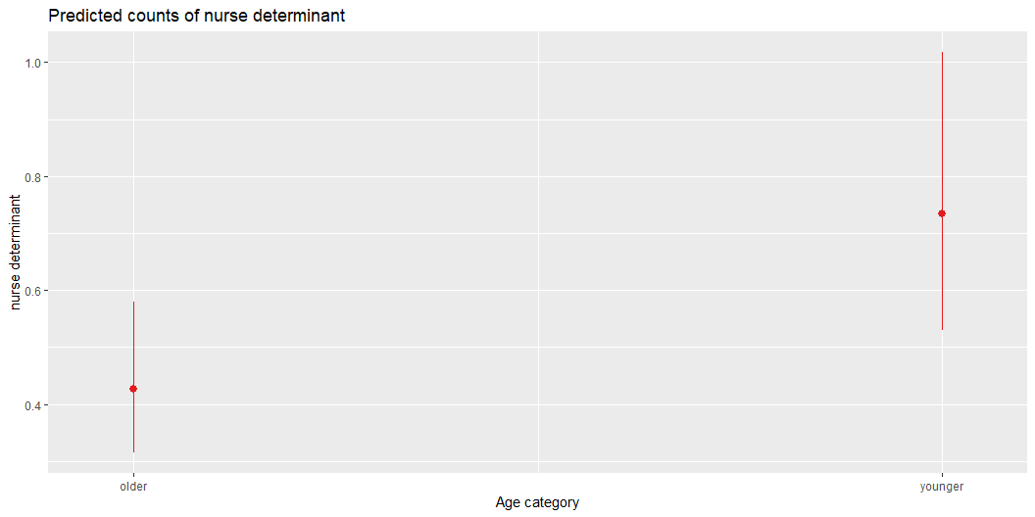
Age(sign), gender(not sig, no conv)

Slide 21
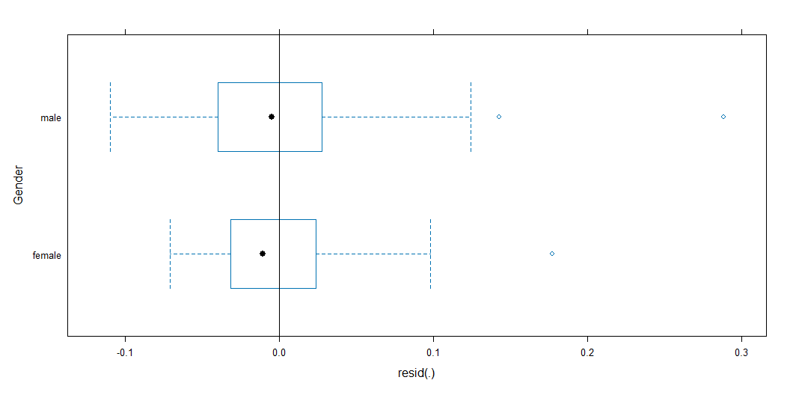
Duration patterns of NURSE vowel production in NE by age and gender
Sign by gender (alone)

Slide 22
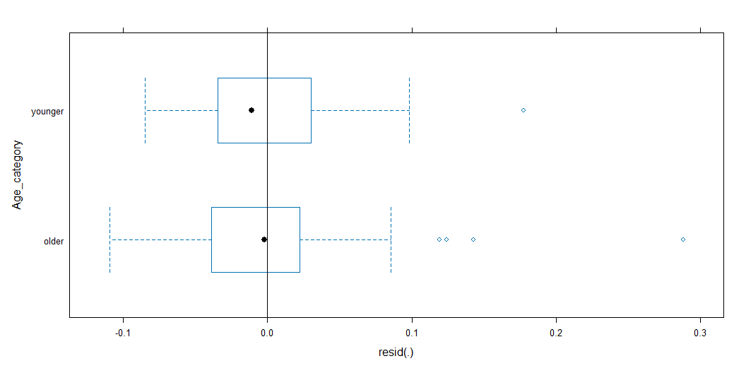

Slide 23
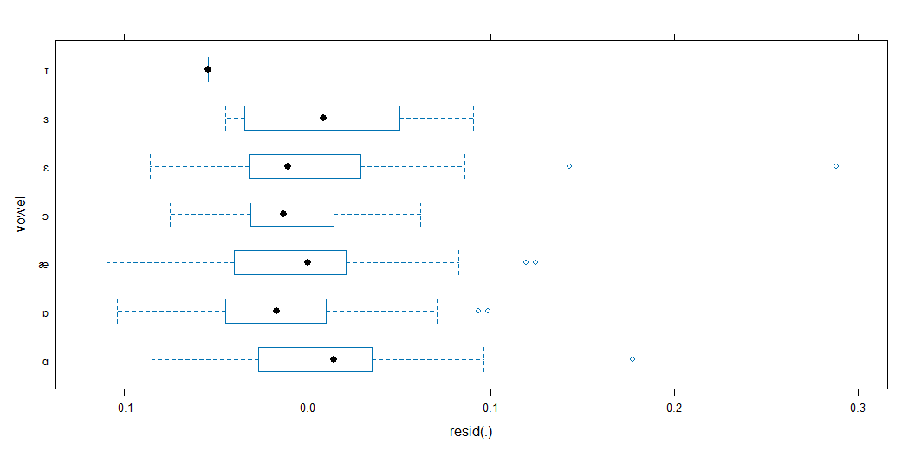

Slide 24
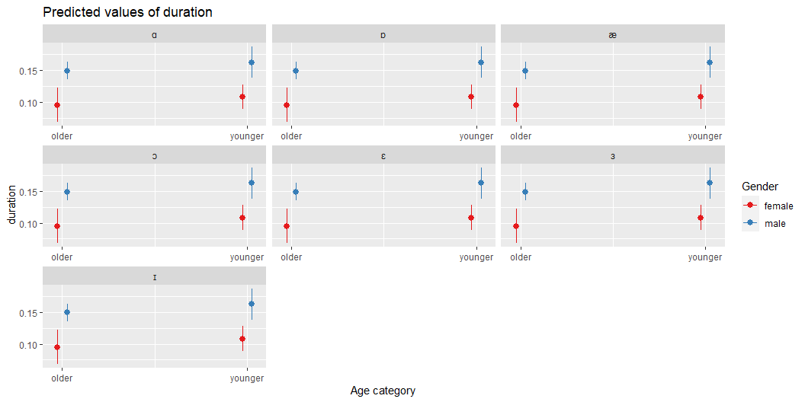

Slide 25
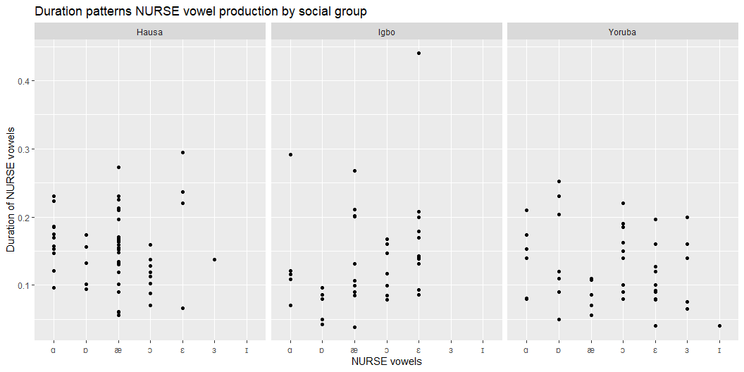
NURSE vowel production by ethnicity

Slide 26
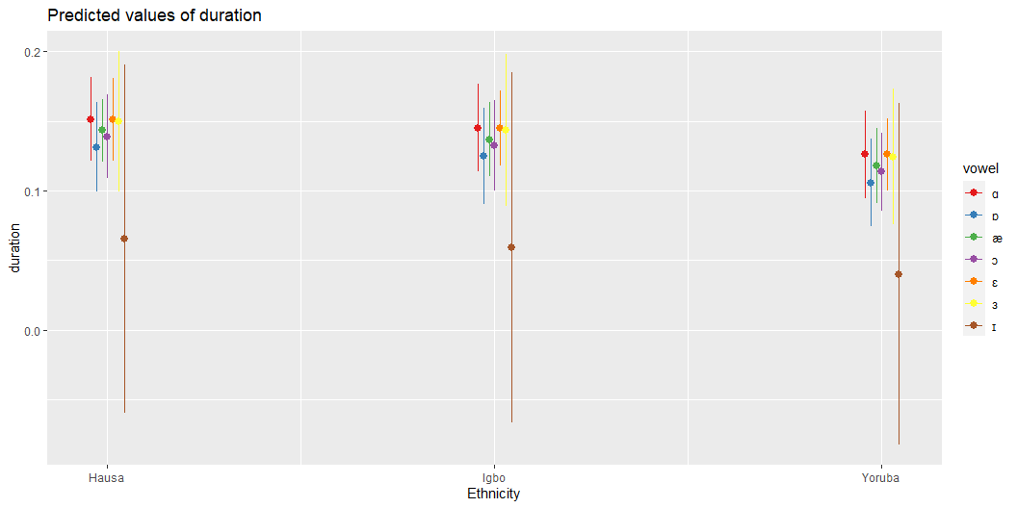

Slide 27
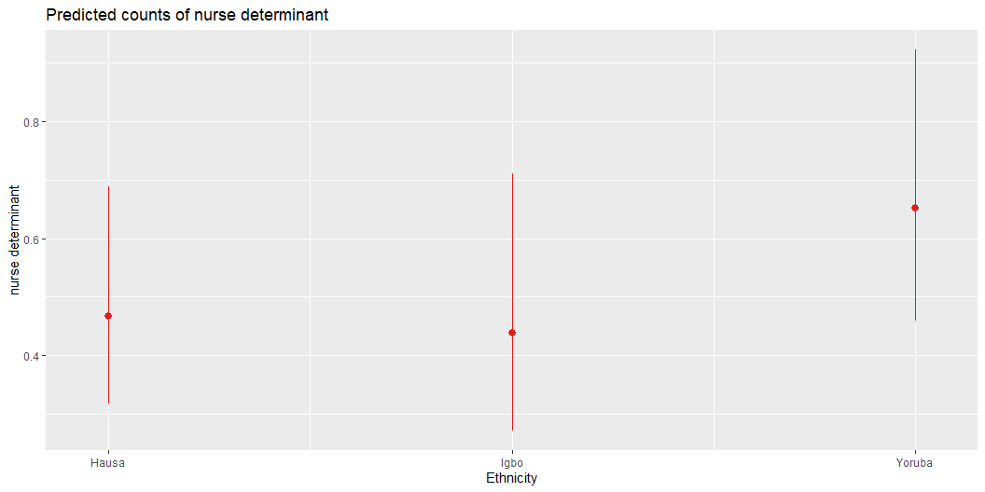
NURSE vowel determinant by ethnicity

Slide 28
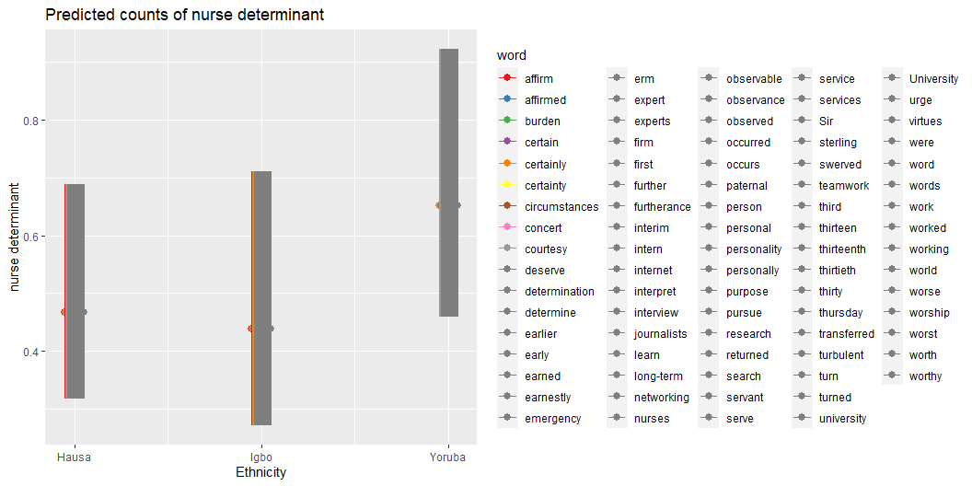

Slide 29
Discussion and future work
Evidently, there are variations in NURSE vowels other than categorical or gradient r-presence. If we included other speech styles later, the variation might exceed what we observed.
My findings are similar to those of previous studies, which found that gender, age, style/register/community of practice, and geographical location could affect NURSE vowel production. (Li et. al., 2021; Maclagan et. al., 2017; Mayr, 2010; Mesthrie & Chevalier, 2014; Watson & Clark, 2013)
My analysis is limited (just 246 data points), so I will add more speech samples before generalization.
As my interest in sociophonetics grows, I will continue to learn R packages and skills in data science for data management, presentation, and accessibility.

Slide 30
References
Li, Z., Gut, U., & Schützler, O. (2021). nurse Vowels in Scottish Standard English: Still Distinct or Merged? Journal of English Linguistics, 49(3), 305-330.
Maclagan, M., Watson, C. I., Harlow, R., King, J., & Keegan, P. (2017). Investigating the sound change in the New Zealand English nurse vowel/ᴈ. Australian Journal of Linguistics, 37(4), 465-485.
Mayr, R. (2010). What exactly is a front-rounded vowel? An acoustic and articulatory
investigation of the NURSE vowel in South Wales English. Journal of the International Phonetic Association, 40(1), 93-112.
Mesthrie, R., & Chevalier, A. (2014). Sociophonetics and the Indian diaspora: The NURSE vowel and other selected features in South African Indian English. In English in the Indian diaspora (pp. 85-104). John Benjamins.

