Slide 1
A PROJECT TOPIC ON ASSESSMENT AND DIGITALIZATION OF THREATENED MEDICINAL PLANTS IN SELECTED LOCATIONS IN SOUTH-WESTERN NIGERIA Presented by NAME:FAGBAMILA MOROJUREREOLUWA MATRIC NO: ND/COM/23/3595 SUBMITTED TO DEPARTMENT OF COMPUTER SCIENCE, FEDERAL COLLEGE OF FORESTRY, IBADAN OYO-STATE NIGERIA IN PARTIAL FULFILMENT OF THE REQUIREMENT FOR THE AWARD OF NATIONAL DIPLOMA IN COMPUTER SCIENCE.

Slide 2
INTRODUCTION
Man and plants have been in close relationship throughout the development of all civilizations. The use of plants in traditional medicine is gaining more priority worldwide (Farnsworth 1988) therefore making medicinal plants to be of immense economic importance and widely consumed globally, especially by rural populations in developing tropical regions (Akinyemi, 2000). Anokbongoo (1992) reported that there is always a correlation between village uses of a plant and its activity in biological screening system. Zahoor et al. (2012) elucidated that the burgeoning world population and the concom anthropogenic activities are rapidly eroding natural ecosystems, resulting in loss of natural habitat for a great number of medicinal herbs and trees, which play important roles in the primary health care of rural populations globally.

Slide 3
STATEMENT OF THE PROBLEM
As medicinal plants receive increased scientific and commercial attention, there is increasing pressure on the wild plant populations from which most medicinal plants are harvested. Overharvesting has placed many medicinal species at risk of extinction.

Slide 4
AIM AND OBJECTIVES OF THE STUDY
The aim of the research work is to develop a software that can keep record of endanger species of medicinal plants in southwestern of Nigeria
The main objectives of the research include:
a. Design and develop of database system that would serve as herb database.
b. provides easy identification and recognition of extinct herbal plant.

Slide 5
RESEARCH METHODOLOGY
A waterfall model under the software development life cycle (SDLC) is the methodology used to produce this system. It is used by system developers to produce or alter information systems or software. It divides the development process into several stages or processes. After the completion of one stage, it will logically move to another stage. Sometimes moving back to the previous stage is necessary due to failure that occurs in current stage.

Slide 6
WATERFALL MODEL
The waterfall model is the first model in software development history. It is also referred to as the (Linear sequential life cycle model) this model is simple to understand and use. In the waterfall model, each phase is completed before moving to the next phase. The waterfall model is the first and earliest approach used in SDLC for the development of software products in this model that do not overlap.

Slide 7
WATERFALL MODEL DESIGN
The waterfall approach was the first approach in the software development life cycle and was widely used in the development of software products and for the success of the project.
System design methods are a discipline within the software development industry which seeks to provide a framework for activity and the capture, storage, transformation and dissemination of information so as to enable the economic development of computer systems that are fit for purpose.

Slide 8
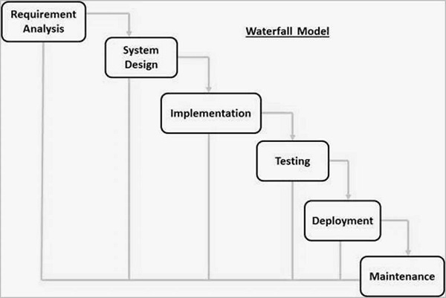

Slide 9
The sequential phases in waterfall model are:
Requirement Gathering and analysis − All possible requirements of the system to be developed are captured in this phase and documented in a requirement specification document.
System Design − The requirement specifications from first phase are studied in this phase and the system design is prepared. This system design helps in specifying hardware and system requirements and helps in defining the overall system architecture.
Implementation − With inputs from the system design, the system is first developed in small programs called units, which are integrated in the next phase. Each unit is developed and tested for its functionality, which is referred to as Unit Testing.

Slide 10
Integration and Testing − All the units developed in the implementation phase are integrated into a system after testing of each unit. Post integration the entire system is tested for any faults and failures.
Deployment of system − Once the functional and non-functional testing is done; the product is deployed in the customer environment or released into the market.
Maintenance − There are some issues which come up in the client environment. To fix those issues, patches are released. Also to enhance the product some better versions are released. Maintenance is done to deliver these changes in the customer environment.

Slide 11
Thanks for Listening

