Slide 1
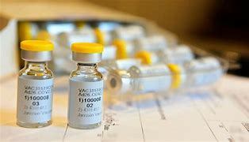
A REPORT WRITING ON
by:
FAGBAMILA MOROJUREREOLUWA

Slide 2
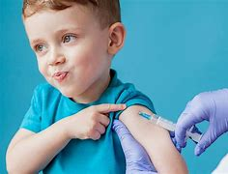
How Vaccines Work
Vaccines are one of the most effective tools in preventing infectious diseases, saving millions of lives globally each year. The way vaccines work is rooted in the body's immune system and its ability to recognize and defend against harmful pathogens. This report provides a comprehensive explanation of how vaccines function, their components, types, and the process of immunization.
The Immune System and Its Role
To understand how vaccines work, it's important to first know how the immune system defends the body:
Innate Immunity: The body's first line of defense, which includes physical barriers like the skin and mucous membranes, and cells that attack invaders non-specifically.
Adaptive Immunity: This is the body's more sophisticated response, which involves the production of antibodies and the activation of T-cells to specifically target and neutralize pathogens (bacteria, viruses, etc.). The adaptive immune system can "remember" past infections, which is key to how vaccines work.

Slide 3
What Are Vaccines?
A vaccine is a biological preparation that provides acquired immunity to a particular disease. It contains one or more antigens, which are substances that trigger an immune response in the body. Antigens are usually parts of pathogens such as proteins or sugars found on their surface.

Slide 4
. How Vaccines Stimulate the Immune System
When a vaccine is administered, it introduces a harmless part of a pathogen (the antigen) into the body. This can be a:
Dead or Inactivated Pathogen: The pathogen has been killed or inactivated so that it cannot cause disease but still contains the antigens needed to trigger the immune response.
Weakened (Live Attenuated) Pathogen: The pathogen is live but weakened so that it cannot cause illness in healthy individuals, yet it can still stimulate the immune system.
Protein Subunit or Piece of the Pathogen: Only a fragment of the pathogen, such as a protein or sugar that the immune system can recognize, is used.
mRNA: In newer types of vaccines (e.g., COVID-19 vaccines), messenger RNA (mRNA) is used to instruct cells to produce the antigen, prompting an immune response without introducing any pathogen.
Viral Vector: This uses a harmless virus to deliver genetic material that encodes the pathogen’s antigen to stimulate immunity.

Slide 5
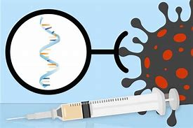
Once the body recognizes the foreign antigen, it triggers an immune response:
B-cells: These cells produce antibodies, which are proteins that specifically recognize and neutralize the pathogen.
T-cells: These include helper T-cells (which coordinate the immune response) and cytotoxic T-cells (which destroy infected cells).

Slide 6
Countries | Covid-19 Rates
Israel | 121.63%
United Arab Emirates | 115.75%
United Kingdom | 82.52%
United States | 80.93%
Hungary | 34.65
Serbia | 59.10

Slide 7
Memory Cells: The Key to Immunity
A key feature of the immune system is its ability to "remember" past infections. Once the immune system encounters the antigen from the vaccine, it creates memory B-cells and T-cells. These memory cells "remember" how to respond quickly and efficiently if the body encounters the same pathogen again in the future. This is the basis of immunological memory, which makes the body capable of rapidly fighting off future infections.

Slide 8
The Types of Vaccines
Vaccines are classified based on how they are made and what they contain. Here are the main types:
Inactivated or Killed Vaccines: These vaccines contain viruses or bacteria that have been killed or inactivated so they cannot cause disease. Examples include the polio vaccine (IPV) and the hepatitis A vaccine.
Live Attenuated Vaccines: These contain live viruses or bacteria that have been weakened so that they do not cause disease in healthy individuals. Examples include the measles, mumps, rubella (MMR) vaccine and the yellow fever vaccine.
Subunit, Recombinant, and Conjugate Vaccines: These use only parts of the virus or bacteria (such as proteins or sugars) that trigger the immune system to respond. Examples include the HPV vaccine and the Hib vaccine.
MRNA Vaccines: This new type of vaccine uses messenger RNA to instruct cells to produce a protein found on the pathogen’s surface. The immune system then learns to recognize and respond to that protein. Examples include the Pfizer-BioNTech and Moderna COVID-19 vaccines.
Toxoid Vaccines: These vaccines contain inactivated toxins (toxoids) produced by the bacteria. The immune system responds to these toxoids to prevent the effects of the toxins in case of future exposure. Examples include the diphtheria and tetanus vaccines.

Slide 9
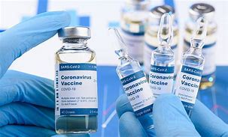
Conclusion
Vaccines are an essential and effective public health tool that work by training the immune system to recognize and fight off specific pathogens. Through various methods, including inactivated pathogens, live attenuated viruses, mRNA, and subunits, vaccines help individuals develop immunity without causing the disease itself. Their widespread use has led to significant reductions in mortality and morbidity from infectious diseases, making them one of the greatest medical achievements in history.

