Slide 1
Maze Generator and Maze Solving Algorithm
Davis Ranney, BS Computer Engineering

Slide 2
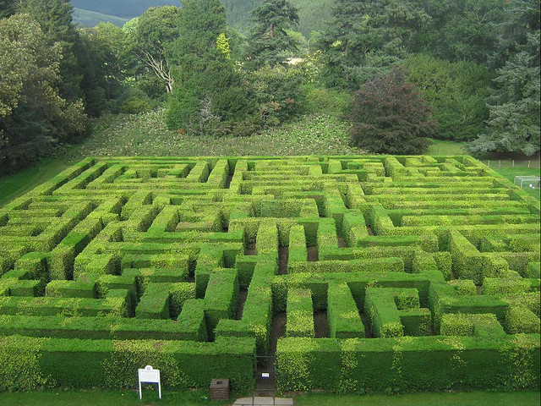
Mazes are an Everyday Challenge
Problem: Demonstrate an algorithm to solve a maze and find the fastest solution
Approach
Use recursion to solve a maze as efficiently as a human would
Generate the mazes to test and demonstrate the algorithm
Source: inklestudios.com

Slide 3
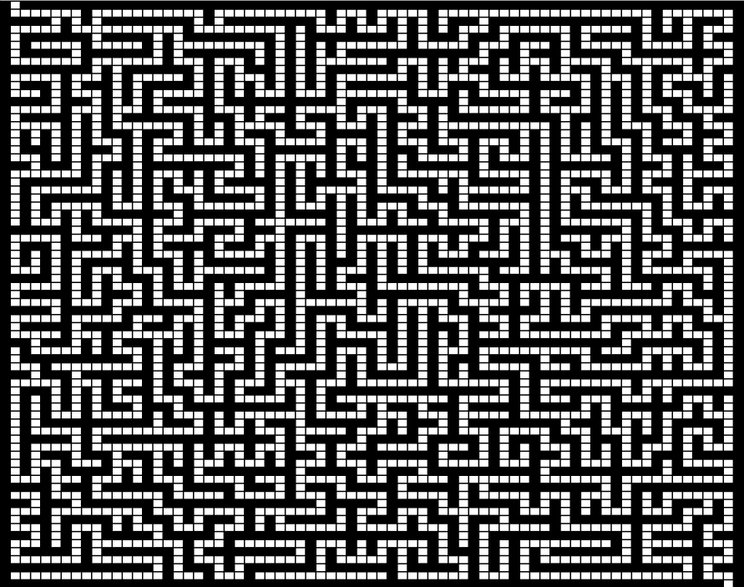
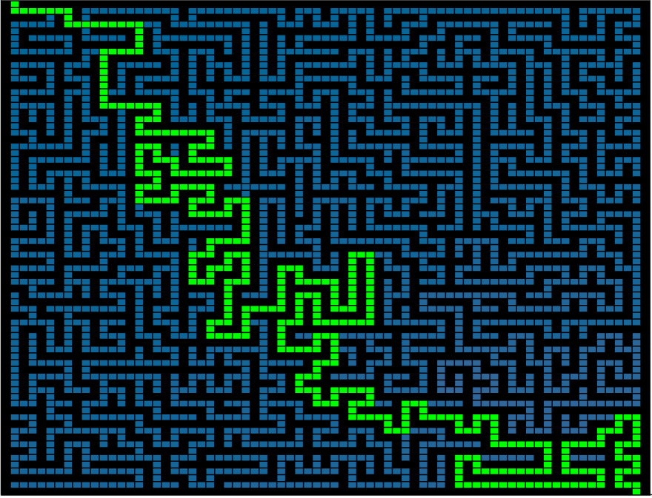
Execution
Generated Maze
Solved Maze

Slide 4
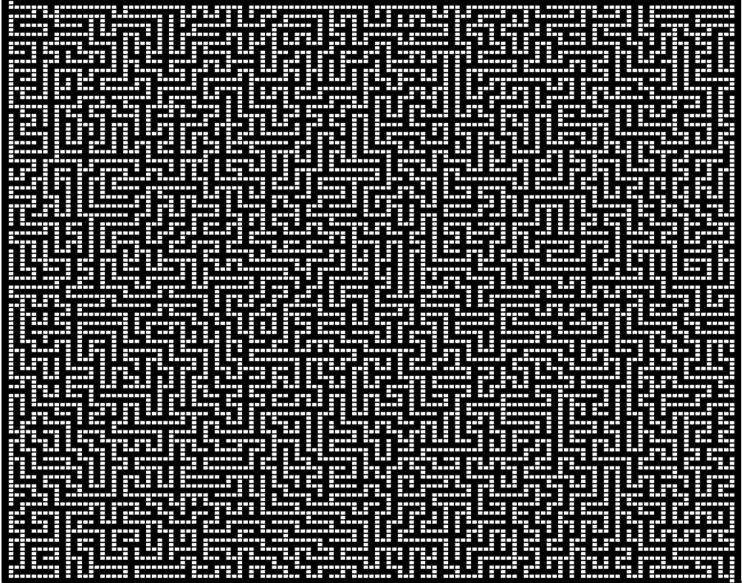
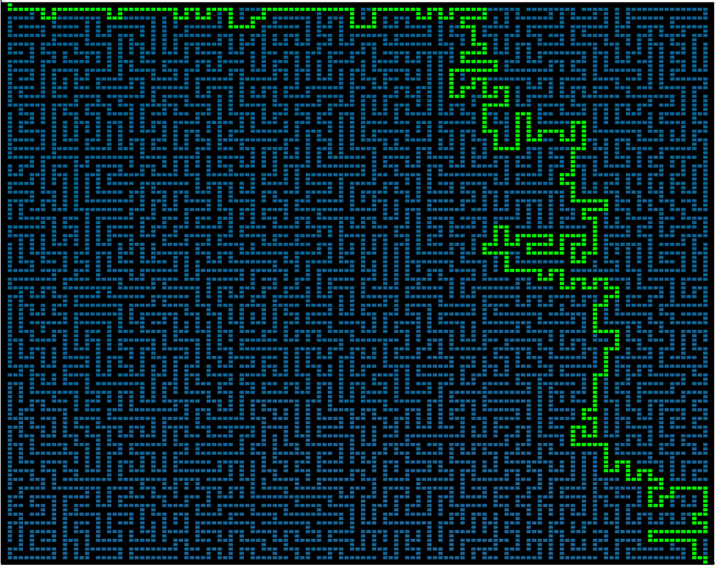
Larger Execution
Generated Maze
Solved Maze

Slide 5
Challenges
MATLAB does not handle recursion variables well
Bitwise math should not be approached lightly
How to store the maze data

