Slide 1
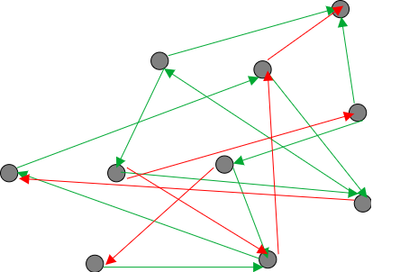
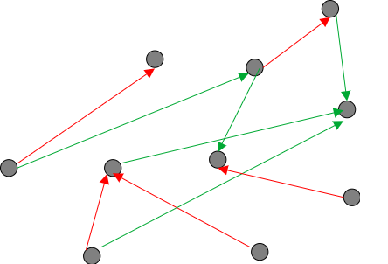
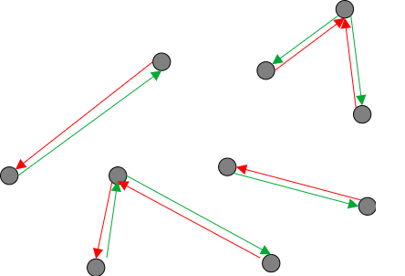
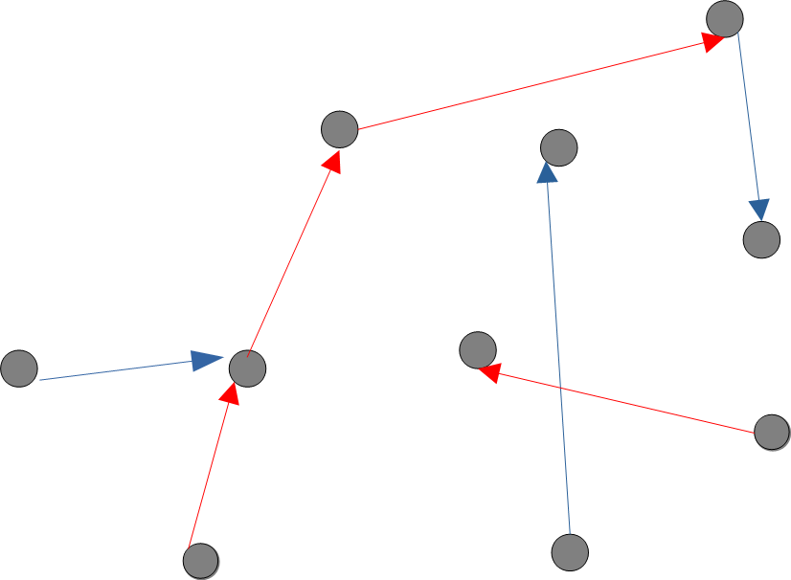
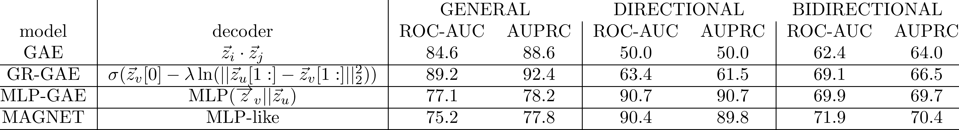
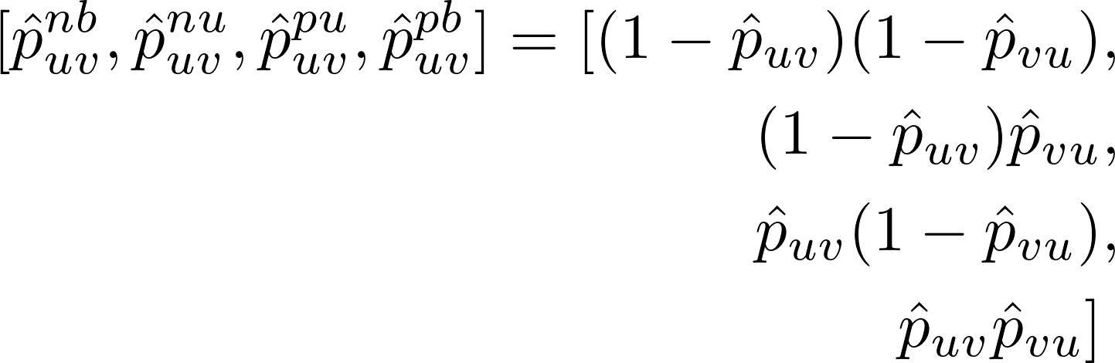
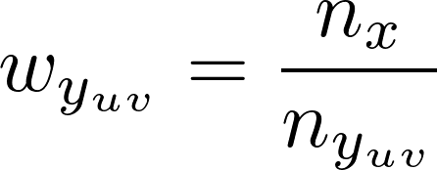



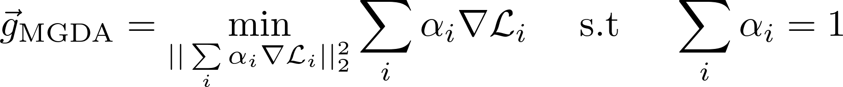
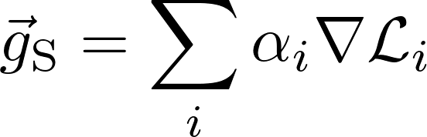


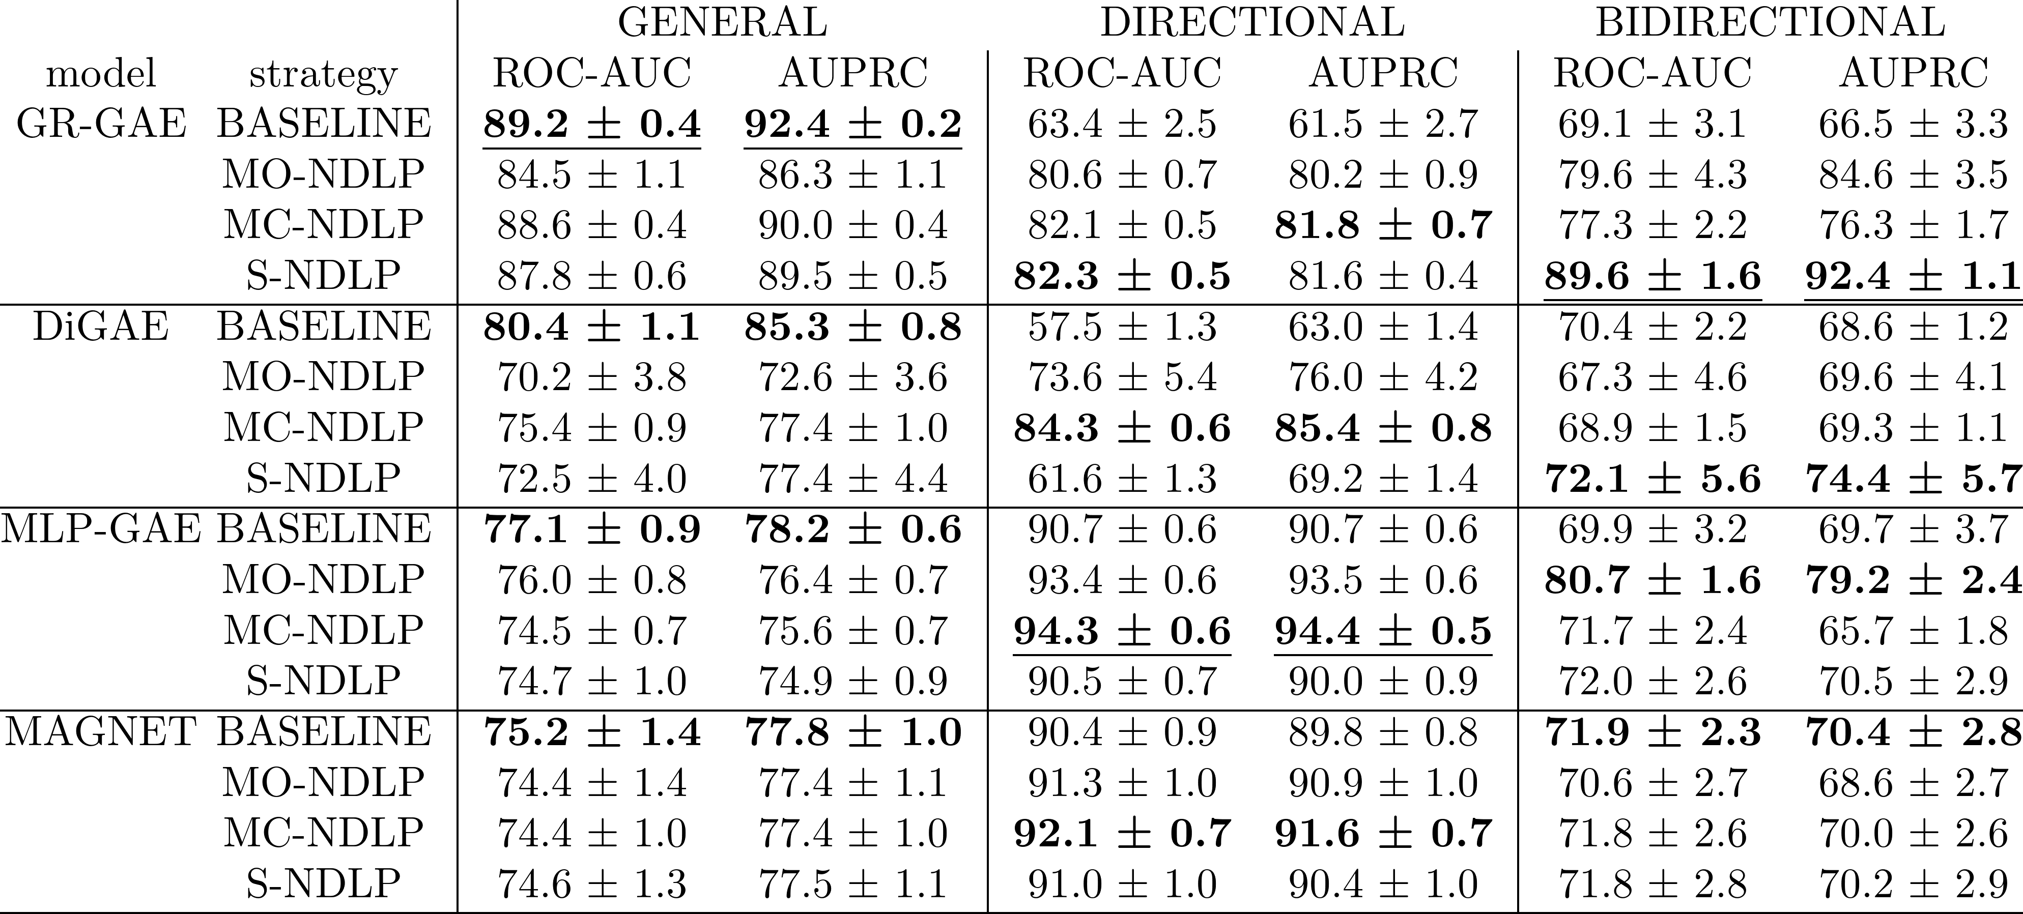
Multi-Class and Multi-Task Strategies for Neural Directed Link Prediction
Claudio Moroni(✉)^{1,2}, Claudio Borile²,Carolina Mattsson², Michele Starnini^{1,3}, André Panisson¹
¹Dedagroup, Torino, Italy, claudio.moroni@dedagroup.it
²CENTAI Institute, Torino, Italy, {name.surname}@centai.eu
³Department of Engineering, Universitat Pompeu Fabra, Barcelona, 08018, Spain
(NAIVE) DIRECTED LINK PREDICTION
Training
Testing
General
Directional
Bidirectional
NEW TRAINING STRATEGIES
Multi Class
MGDA
Scalarization
General Training Set
Directional Training Set
Bidirectional Training Set
Salha, G., Limnios, S., Hennequin, R., Tran, V.A., Vazirgiannis, M.: Gravityinspired graph autoencoders for directed link prediction. In: Proceedings of the 28th ACM International Conference on Information and Knowledge Management. pp. 589–598 (2019)
Zhang, X., He, Y., Brugnone, N., Perlmutter, M., Hirn, M.: Magnet: A neural network for directed graphs. In: Advances in Neural Information Processing Systems (2021)
Kollias, G., Kalantzis, V., Id’e, T., Lozano, A.C., Abe, N.: Directed graph autoencoders. In: AAAI Conference on Artificial Intelligence (2022)
Désidéri, J.A.: Multiple-gradient descent algorithm (mgda) for multiobjective optimization. Comptes Rendus Mathematique 350(5), 313–318 (2012)

