Slide 1


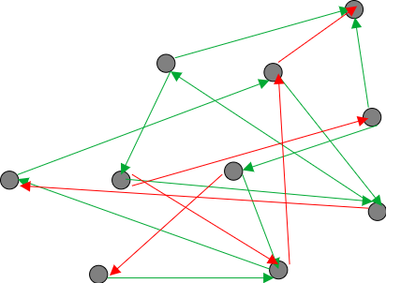
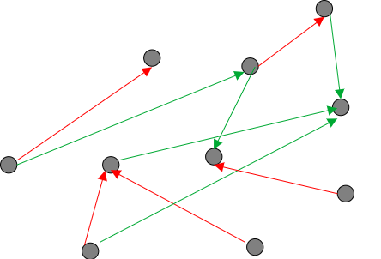
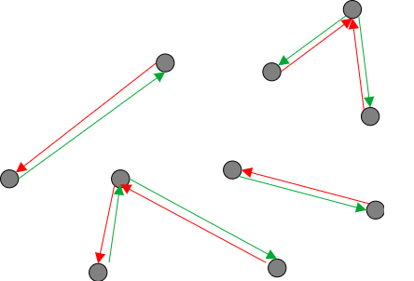
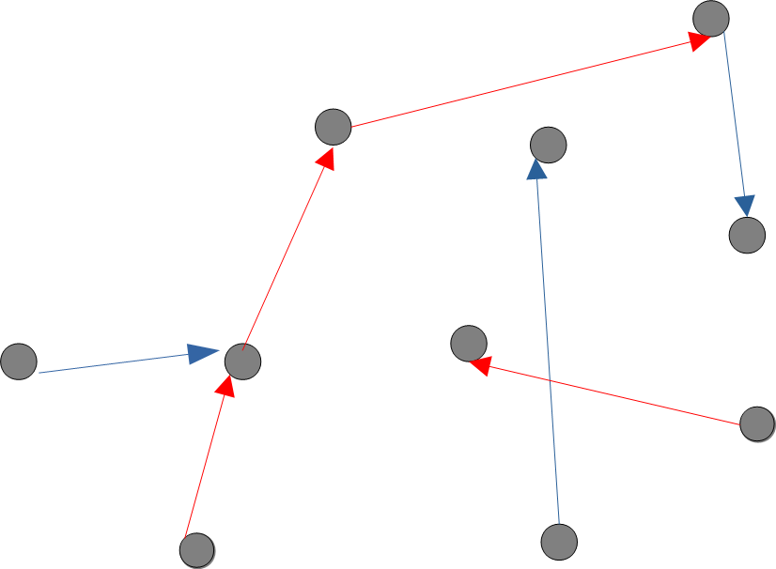
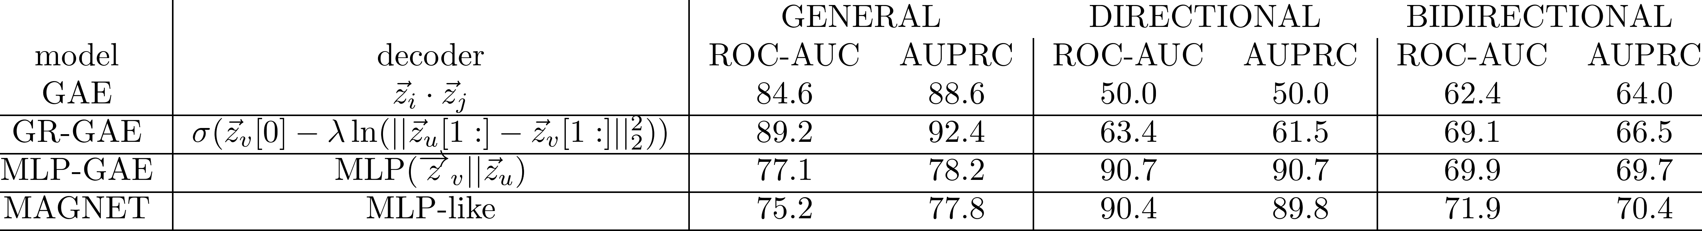
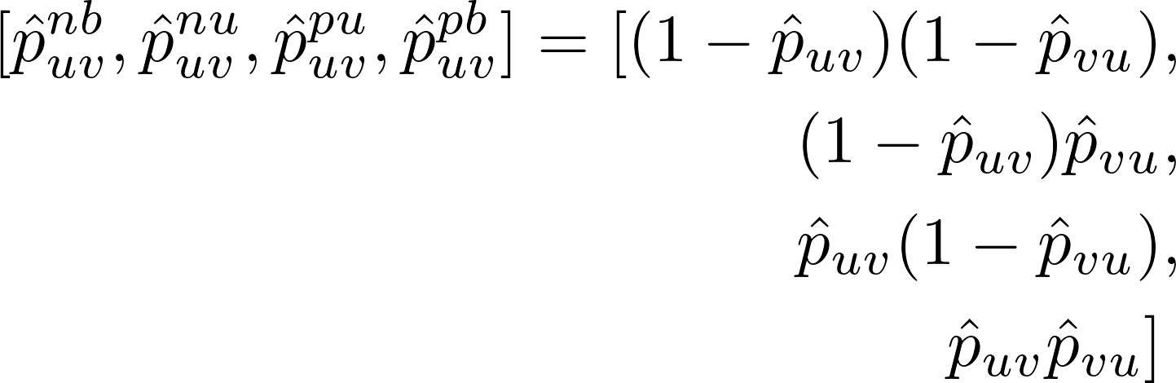
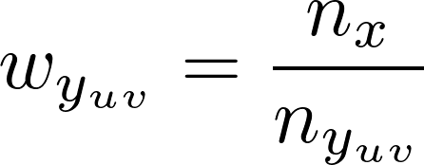



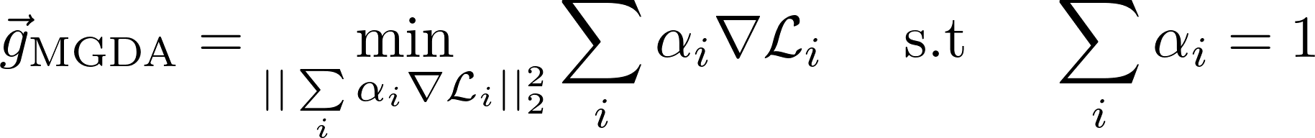
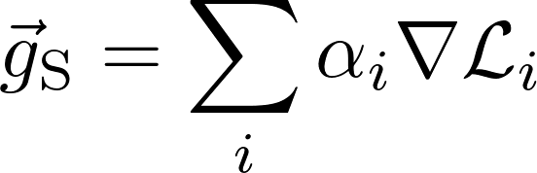


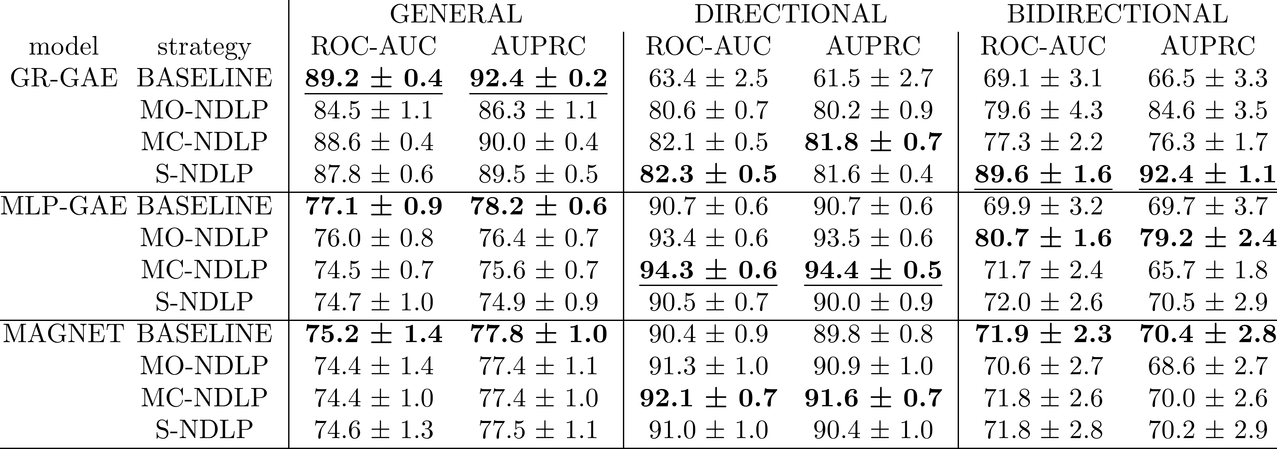
Multi-Class and Multi-Task Strategies for Neural Directed Link Prediction
Claudio Moroni(✉)^{1,2}, Claudio Borile²,Carolina Mattsson², Michele Starnini^{2,3}, André Panisson²
¹Dedagroup, Torino, Italy, claudio.moroni@dedagroup.it
²CENTAI Institute, Torino, Italy, {name.surname}@centai.eu
³Department of Engineering, Universitat Pompeu Fabra, Barcelona, 08018, Spain
(NAIVE) DIRECTED LINK PREDICTION
In the context of Graph Machine Learning, Link Prediction (LP) is a foundational task. Graph Neural Networks (GNN) perform LP by decoding pairs of node embeddings into a probability that an edge between them exists. We find that LP’s directed variant (DLP) has been poorly explored. Infact, evaluating DLP models require a nuanced setup made of three test sets, respectively measuring the model’s ability to predict edge’s existence, direction and bidirectionality. Nevertheless, we find that training general DLP models using the standard contrastive setup as in Undirected Link Prediction (ULP) does not work. A few prior works have, at best, trained specialized models for each test set, leaving the question open on how get good performance across the three test sets out of a general DLP-capable GNN model.
Training
Testing
General
Directional
Bidirectional
NEW TRAINING STRATEGIES
We devise three training strategies that allow a general DLP-capable GNN model to perform well across the three sub tasks simultaneously. The first strategy, Multi-Class NDLP (MC-NDLP) recognizes that the underwhelming performances reported above are due to an imbalance between uni- and bi-directional edges in the naive training set, and makes up for it by mapping NDLP to a four-class classification task where the loss contributions of uni- and bi-directional edges are rebalanced together with that of positives and negatives. The second and third tasks instead split the training set in three sets whose composition mimics that of the three test sets, and apply multi-task learning techniques, respectively MGDA and Scalarization.
Multi Class
MGDA
Scalarization
General Training Set
Directional Training Set
Bidirectional Training Set
Salha, G., Limnios, S., Hennequin, R., Tran, V.A., Vazirgiannis, M.: Gravityinspired graph autoencoders for directed link prediction. In: Proceedings of the 28th ACM International Conference on Information and Knowledge Management. pp. 589–598 (2019)
Zhang, X., He, Y., Brugnone, N., Perlmutter, M., Hirn, M.: Magnet: A neural network for directed graphs. In: Advances in Neural Information Processing Systems (2021)
Kollias, G., Kalantzis, V., Id’e, T., Lozano, A.C., Abe, N.: Directed graph autoencoders. In: AAAI Conference on Artificial Intelligence (2022)
Désidéri, J.A.: Multiple-gradient descent algorithm (mgda) for multiobjective optimization. Comptes Rendus Mathematique 350(5), 313–318 (2012)

