Slide 1
Claude White
  Katrina Butler
Vector Databases
  Advanced Topics 1
  December 6th, 2024

Slide 2
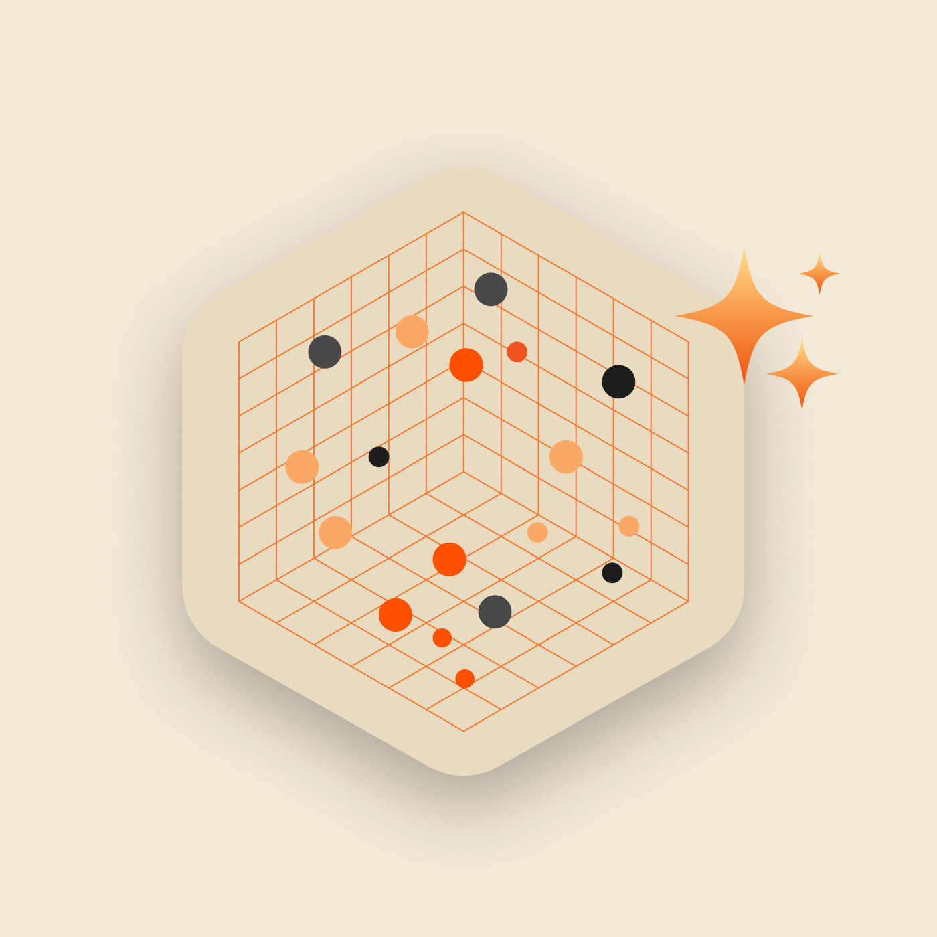
AGENDA
  Main Question
  Indexing
  Vector Database
  Querying Algorithms
  Background
  Current Issues
  Current Uses
  Future of Vector Databases
  How it works
  Summary
  Vector Embeddings
Notes:
Image: https://blog.purestorage.com/purely-technical/vector-database-and-storage/

Slide 3
  Are vector databases going to replace all other databases?

Slide 4
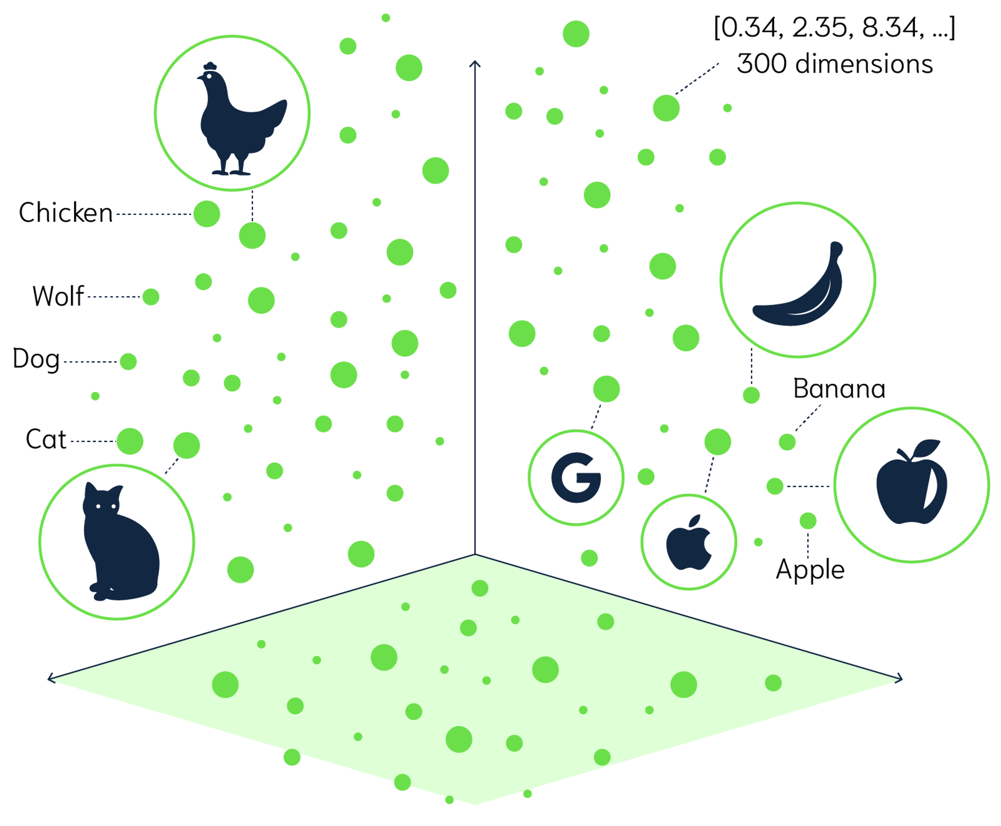
  Vector Database
  Efficient data storage
  Unstructured data
  Information searching
  Compare data of all types
  Data stored as vectors
  N number of dimensions
  Similarity
  Approximate Nearest Neighbor (ANN)
Notes:
Each piece of data is a vector in a grid, but vector databases can have many more dimensions used to search for data
Even unstructured data like images, text, sensor data
Image: https://weaviate.io/blog/distance-metrics-in-vector-search

Slide 5
  Background
  2000s
  University of California, Berkeley
  Designed to store high-dimensional vectors
  Ability to query vectors
  2010
  First commercial Vector DB
  VectorWise
  Research Project: X100
  Integrated in Ingres SQL
  2011
  VectorWise acquired by Actian
  Data analytics company
Notes:
Researchers at university designed db to store high dimensional vectors
With ability to query them
Rename to Actian Vector after aquired

Slide 6


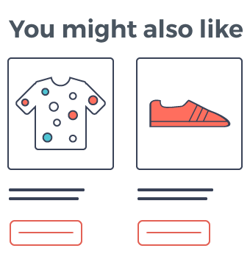
  Current Uses
  Personalized User Experiences
  Customer satisfaction based on preferences
  Netflix show suggestions
  LLMs
  High performance similarity searching
  Product Discovery
  Recommendations based on customer interactions
Notes:
Left Image: https://www.vecteezy.com/free-vector/fingerprint
Middle Image: https://www.grow-force.com/product-recommendation/
Right Image: https://www.eschoolnews.com/files/2024/04/AI-teaching-guide-training-course-teachers.jpeg

Slide 7
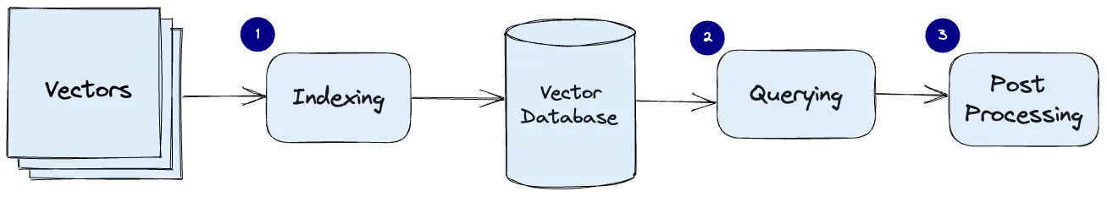
How it Works
Generates Vector Embeddings
Indexes the vectors
Stores vectors
Query with algorithms
Post Processing to refine output
Notes:
Generate vector embeddings before storing
You can make them with an LLM like GPT embeddings (text-embedding-3) or others
Index the vectors to help with later querying speed
Query database using a chosen algorithm
Post processing may apply to refine results
Image: https://www.pinecone.io/learn/vector-database/

Slide 8
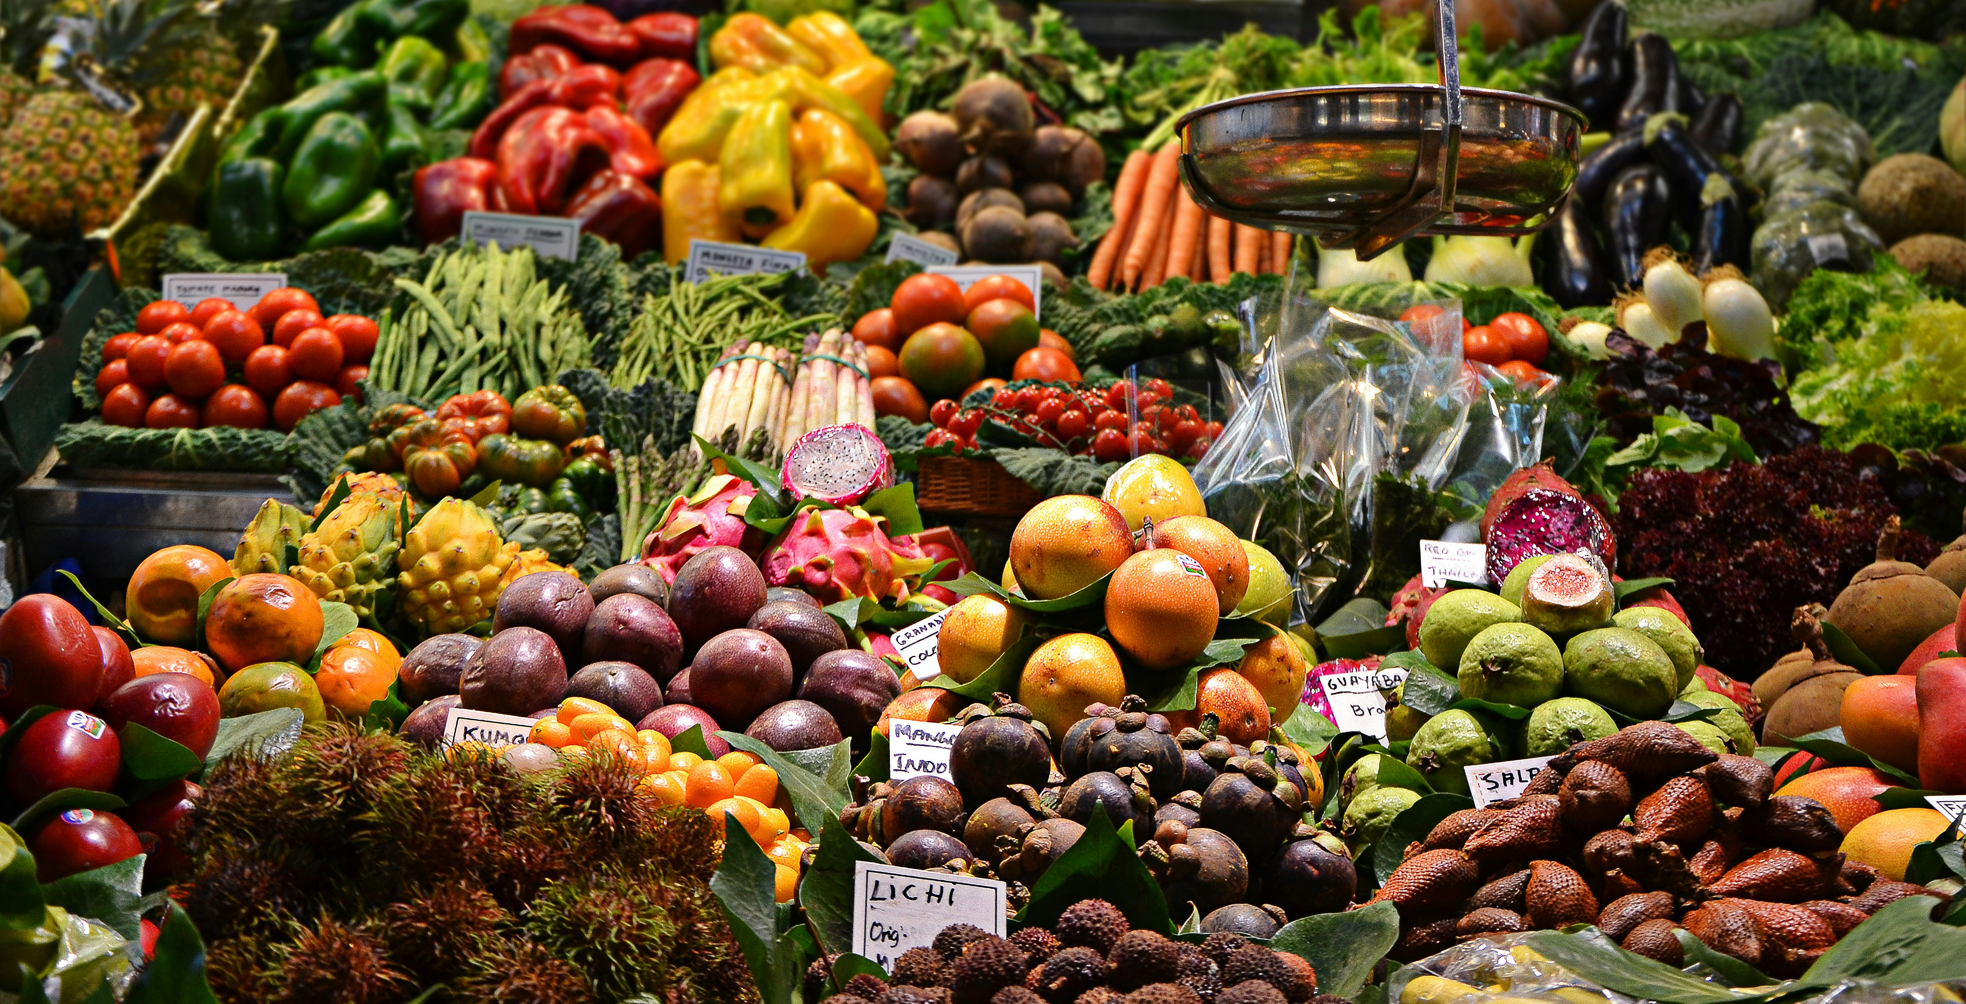
Example
Notes:
You group fruits into sweet ones (apples, grapes, ripe bananas) and sour ones (oranges, unripe bananas).
If you want a fruit like an apple, you check the sweet group.
But for something specific, like a fruit that’s both sweet and tangy, you’d ask an expert, who can suggest a fruit based on their knowledge.
That expert is like a "vector database."
Image: https://unsplash.com/photos/assorted-fruits-at-the-market--gOUx23DNks

Slide 9
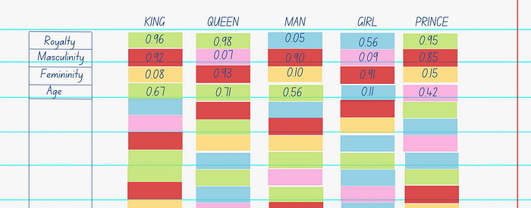
  Vector Embeddings
  Vector representation of data (text, image, video, sound)
Notes:
King, queen, prince have similar scores for royalty and girl, queen have similar scores for femininity
So, with a query where you want something like a king without the man part you get a queen
Prince a king are very similar as we can see, age is the only big difference
Image: https://medium.com/@manansuri/a-dummys-guide-to-word2vec-456444f3c673

Slide 10
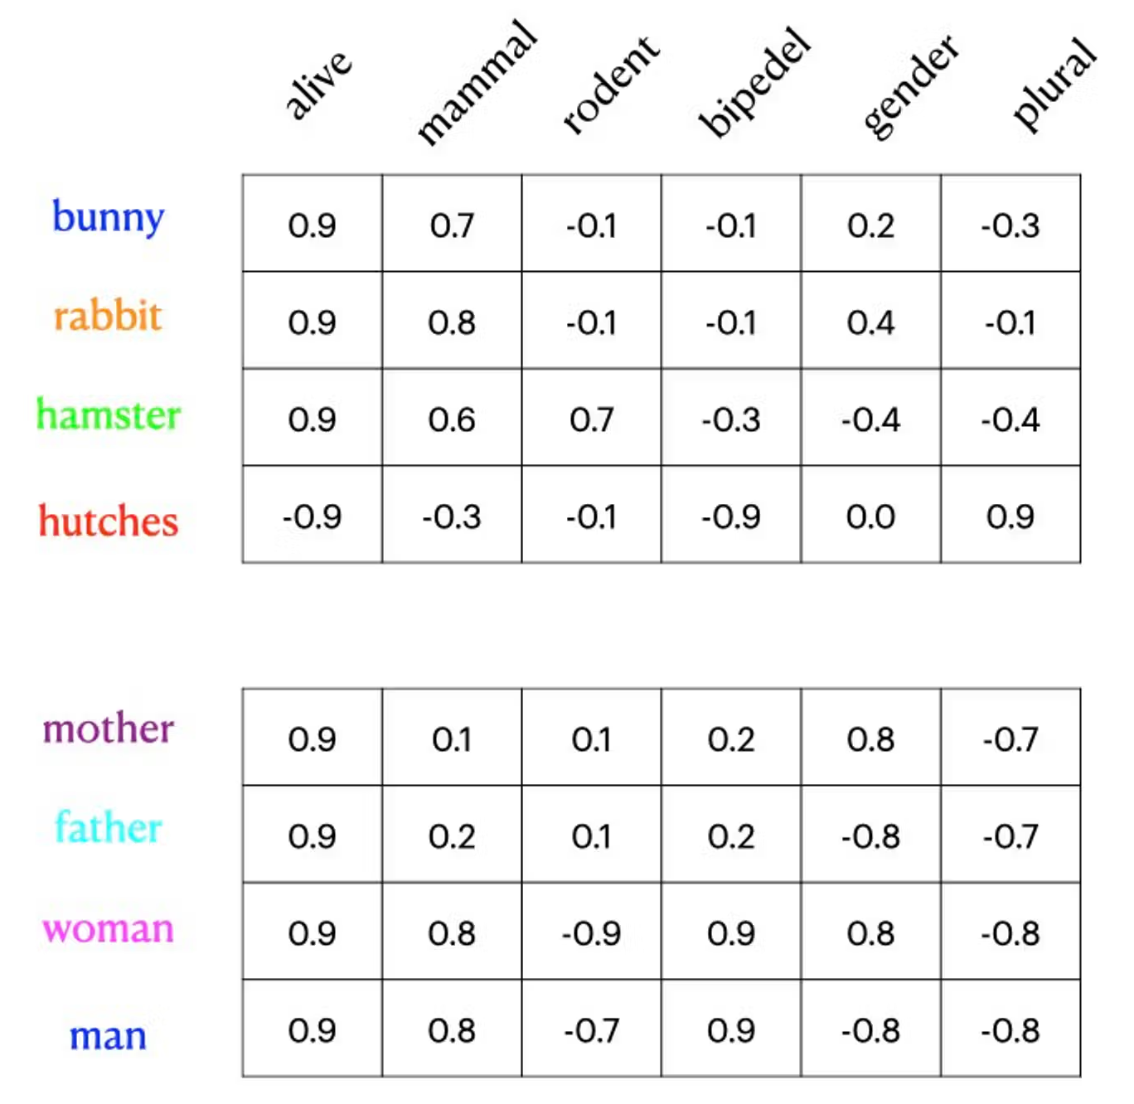
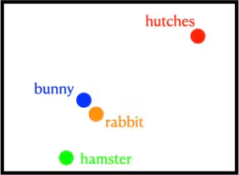
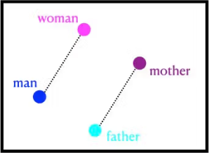
  Vector Embeddings 2
Notes:
Similar example, we see bunnies and rabbits are very similar based on these metrics
but hamster are not too dissimilar
Another example with mother father woman and man can be seen here
Images: https://www.datastax.com/guides/what-is-a-vector-embedding

Slide 11

  Indexing
Notes:
Creating structures to store data more efficiently to help with querying later on
We will talk about 3 but there are many more
Image: https://nanonets.com/blog/document-indexing/

Slide 12
  Flat Indexing
Store Vector as is
Simple and accurate
Very slow
Good for small datasets
Notes:
Simplest one
Just store the vector without any processing
Create a simple structure and can make for somewhat accurate results because all vectors considered
Only good for small datasets because they are extremely slow with lots of data

Slide 13
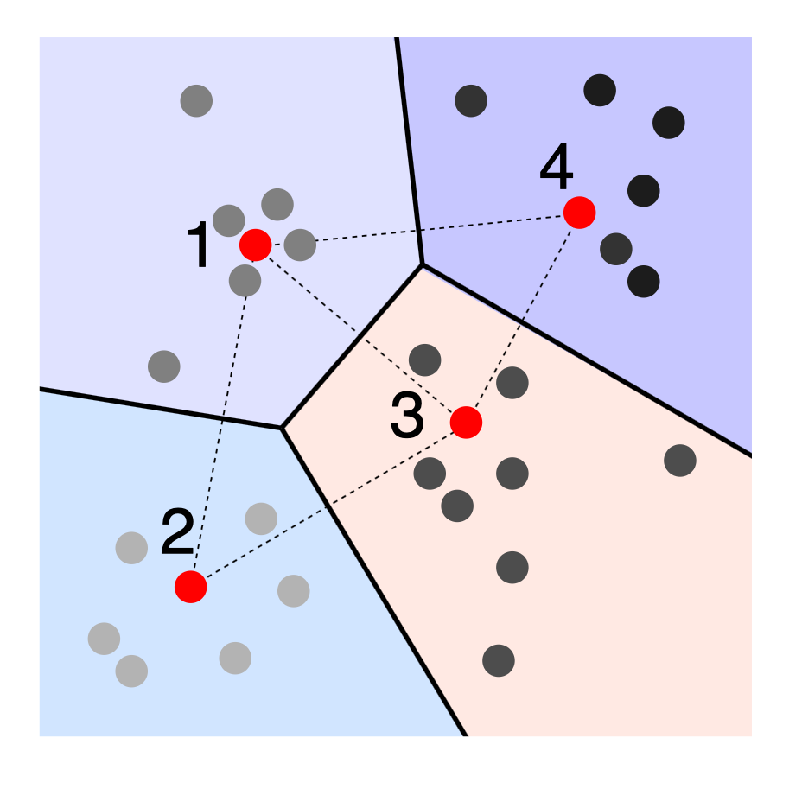
  Locality Sensitive Hashing
Focused on speed
Finds approximates
Sacrifice speed for accuracy
Hashes vectors into buckets
Similar vectors go in the same bucket
Notes:
Locality Sensitive Hashing (LSH)
This is focused on speed and getting answers fast
Less precise because of this
Big trade of in algorithms for indexing and querying
Speed or Accuracy
Hashes vectors and puts them into buckets or sectors
When querying later, once a bucket is found we can narrow search to this sector
Image: https://randorithms.com/2019/09/19/Visual-LSH.html

Slide 14
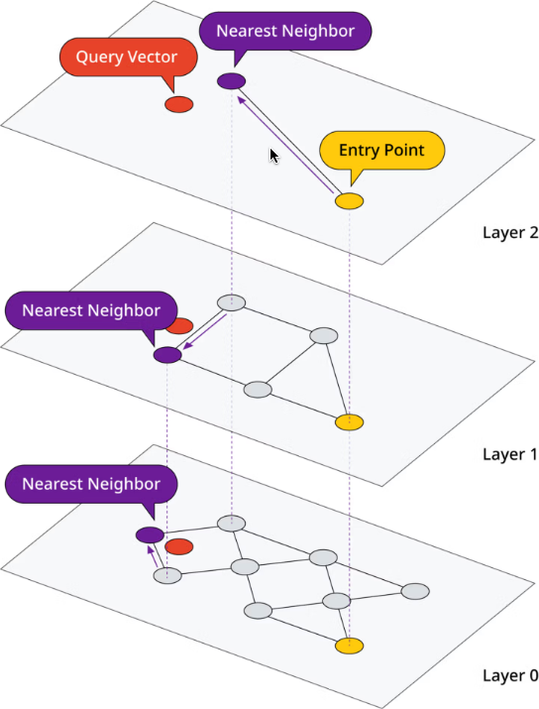
  Hierarchical Navigable Small Worlds
Multi-layered graph
Top level most sparse
Lower layers => more precise
Goal: least hops
Very fast
Popular
Notes:
The structure created is an indexing method and the navigation part is a querying algorithm
So this is a bit of both
But it’s a multi layered structure where the higher layers a sparse a contain different data
As we go down the layers more vectors ”appear” and we get more precise
The goal is to get to what we are looking for in the least about of hops or holes
It is a very fast and popular algorithm
Images: https://www.datastax.com/guides/what-is-a-vector-index

Slide 15
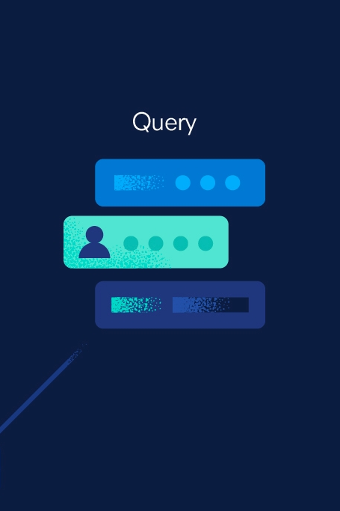
  Querying Algorithms
Notes:
Used to find data with a certain similarity
Image: https://www.elastic.co/what-is/vector-database

Slide 16

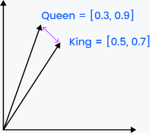
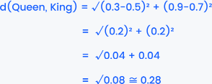
  Euclidean Distance
Measures straight-line distance
Output: 0 to +∞
Notes:
Euclidean = yoo·kli·dee·uhn
This measures the distance between the ends of vectors to determine their similarity
The greater the distance the lower the similarity
Run through example
Images: https://zilliz.com/blog/similarity-metrics-for-vector-search

Slide 17

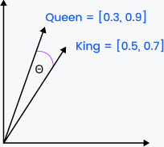
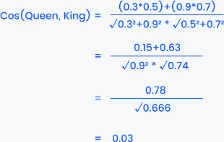
  Cosine Similarity
Measures cosine of angle between vectors
Similar direction = similar data
Notes:
Measures the cosine of the angle between the vectors
The smaller the angle means the vectors are more similar
Run through example
Images: https://zilliz.com/blog/similarity-metrics-for-vector-search

Slide 18
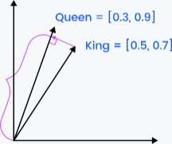


  Dot Product Similarity
Measures how much vectors point in same direction
Higer number = higher similarity
Notes:
Measures how much a vector projects onto another vector
The more they point in the same direction the more similar
The higher the output the more similar
Images: https://zilliz.com/blog/similarity-metrics-for-vector-search

Slide 19
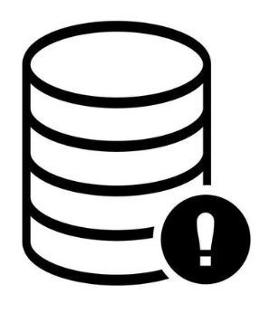
  Current Issues
  Common Risks
  Exact/Precise Results
  Overlooking Metadata
  Inefficient Queries
  Not made for exact searches
  Not a replacement for relational databases
Notes:
There are some mistakes that are easy to make
Like overlooking some of the data’s metadata that could be used to get more accurate results to a query
Like any other database inefficient queries by the user can also result in terrible performance
Another big issue is they aren’t precise in data fetching
You get similar results but not a definitive result, you get hypotheses not answers
To answer my original question
They won’t replace other databases like relational databases or document databases
Each have their strengths and weaknesses and should be used together for best results
Image: https://www.vecteezy.com/vector-art/5011685-database-error-icon-illustration

Slide 20

  Future of Vector Databases
Optimize for weaker hardware
Better querying algorithms
Complex pattern matching
Notes:
Better querying algorithms => especial those that can improve precision
Complex pattern matching => fraud detection or other anomalies where its hard for person to see the pattern or lack of pattern
Image: https://dribbble.com/tags/future-illustration

Slide 21
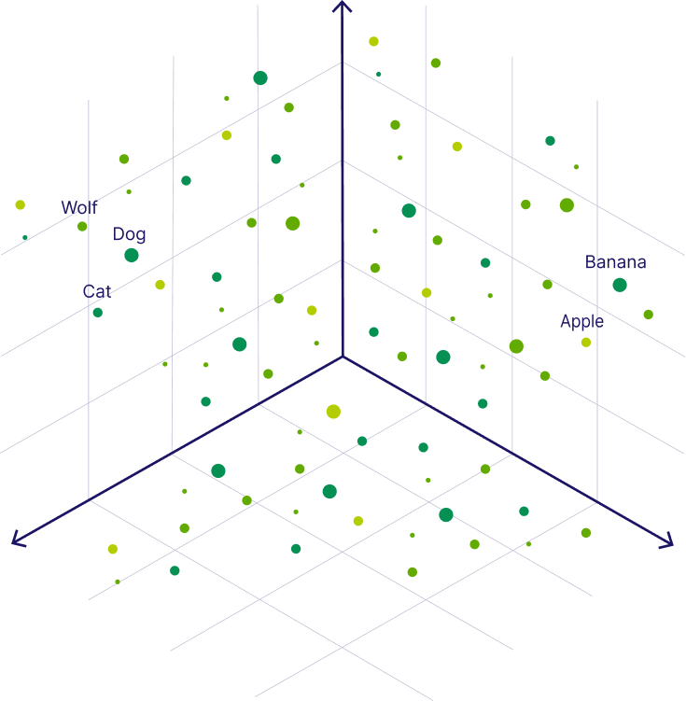
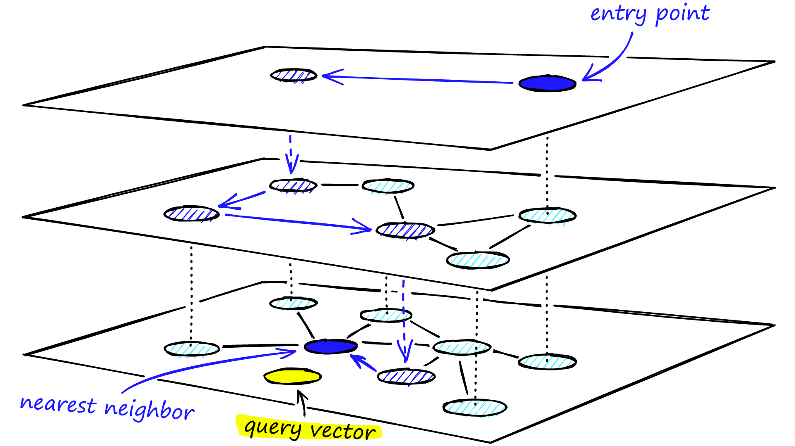
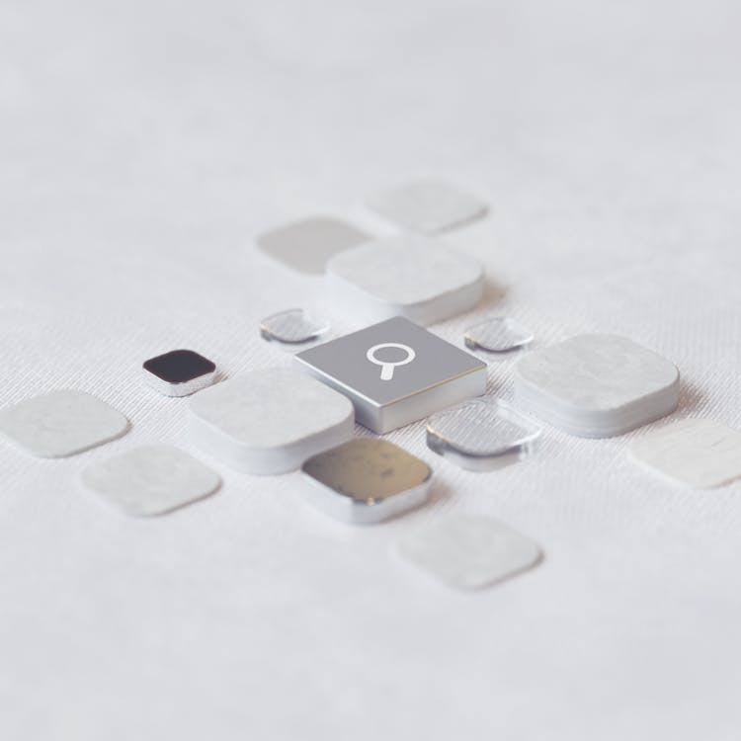

  Summary
  Vector Embeddings
  Indexing
  Querying
  Issues and Future
  Mathematical representation of data
  Efficient Storage
  Help with later queries
  Many algorithms
  Pros and cons
  Determine similarity
  Inefficiencies
  Not precise
  Only getting better
Notes:
Image 1: https://weaviate.io/blog/vector-embeddings-explained
Image 2: https://www.pinecone.io/learn/series/faiss/hnsw/
Image 3: https://www.pexels.com/photo/an-artist-s-illustration-of-artificial-intelligence-ai-this-image-depicts-the-process-used-by-text-to-image-diffusion-models-it-was-created-by-linus-zoll-as-part-of-the-visualising-ai-18069157/
Image 4: https://pixabay.com/vectors/watch-mechanism-time-gears-1277873/

Slide 22
  THANK YOU

Slide 23
  References
Alake, R. (2024, December 4). Common pitfalls to avoid when using vector databases. DagsHub Blog. https://dagshub.com/blog/common-pitfalls-to-avoid-when-using-vector-databases
Belagatti, P. (2023, September 8). WTF is a vector database: A beginner’s guide! DEV Community. https://dev.to/pavanbelagatti/wtf-is-a-vector-database-a-beginners-guide-16p
Chand, M. (2024, September 10). Understanding vector databases: The key to scaling AI and Search. Medium. https://medium.com/@mehar.chand.cloud/understanding-vector-databases-the-key-to-scaling-ai-and-search-692ac2c7f3d3
Manager, E. C. P. (2023, August 15). Distance metrics in vector search: Weaviate. Weaviate RSS. https://weaviate.io/blog/distance-metrics-in-vector-search
McLane, B. (2024, August 22). What are vector embeddings? applications, use cases & more. DataStax. https://www.datastax.com/guides/what-is-a-vector-embedding
Schwaber-Cohen, R. (n.d.). What is a vector database & how does it work? use cases + examples. Pinecone. https://www.pinecone.io/learn/vector-database
Similarity metrics for vector search. Zilliz blog. (n.d.). https://zilliz.com/blog/similarity-metrics-for-vector-search
Soni, A. (2023, October 15). Why are vector databases now A hot topic?. LinkedIn. https://www.linkedin.com/pulse/why-vector-databases-now-hot-topic-abhishek-soni-fvacc
Suri, M. (2022, January 21). A dummy’s guide to word2vec. Medium. https://medium.com/@manansuri/a-dummys-guide-to-word2vec-456444f3c673
Tai, W. (2024, March 2). HNSW indexing in vector databases: Simple explanation and code. Medium. https://medium.com/@wtaisen/hnsw-indexing-in-vector-databases-simple-explanation-and-code-3ef59d9c1920
What is a vector database?: A comprehensive vector database guide. Elastic. (n.d.). https://www.elastic.co/what-is/vector-database

