Slide 1
Module 2, Section 3: AWS Core Services – Amazon Virtual Private Cloud
© 2018, Amazon Web Services, Inc. or its Affiliates. All rights reserved.
Notes:
Welcome to Module 2, Section 3 – AWS Core Services – Amazon Virtual Private Cloud (Amazon VPC).

Slide 2
What’s In This Module
Part 1: Amazon Virtual Private Cloud (Amazon VPC)
Part 2: Amazon VPC Security Groups
Part 3: Amazon CloudFront
Notes:
The Amazon Virtual Private Cloud (or Amazon VPC) is a custom-defined network within the AWS Cloud. It enables you to design and implement an independent network that operates in the cloud.
In this module, we’ll understand the features and benefits of Amazon VPC, review Amazon VPC Security Groups and learn about Amazon CloudFront, a global Content Delivery Network (or CDN) service that securely delivers data, videos, applications, and APIs to your viewers with low latency and high transfer speeds.

Slide 3
Module Objectives
Discuss key concepts related to the AWS Virtual Private Cloud (Amazon VPC) and security groups to better understand:
Virtual networking in the cloud with Amazon VPC.
Creating virtual firewalls with security groups.
Secure delivery of data, videos, applications, and APIs with Amazon CloudFront.
Notes:
Upon completing this module, you’ll understand key concepts related to the AWS Virtual Private Cloud (or Amazon VPC) and security groups including:
Virtual networking in the cloud with Amazon VPC.
Creating virtual firewalls with security groups.
And securing delivery of data, videos, applications, and APIs with Amazon CloudFront

Slide 4
Part 1: Amazon Virtual Private Cloud (Amazon VPC)
Notes:
Introducing Part 1: Amazon Virtual Private Cloud.

Slide 5
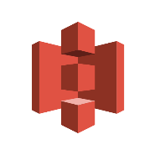

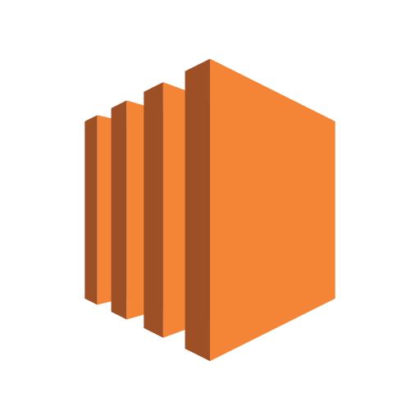
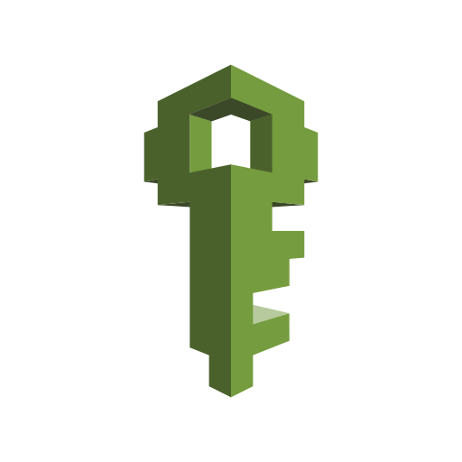
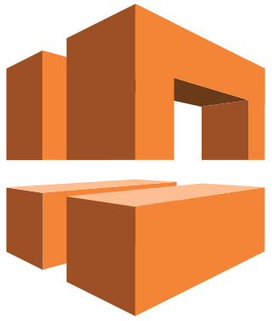
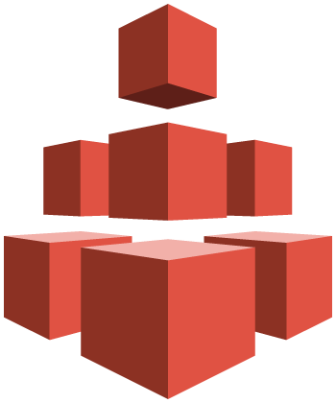


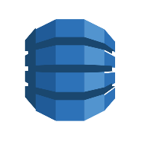
Amazon VPC
Amazon S3
Amazon EBS
Amazon
EFS
Amazon Glacier
Amazon
VPC
Amazon EC2
Storage
AWS IAM
Amazon RDS
Amazon DynamoDB
Database
Notes:
The AWS cloud offers pay-as-you-go, on-demand compute as well as managed services, all accessible via the web. These compute resources and services must be accessible via normal IP protocols implemented with familiar network structures. Customers must adhere to networking best practices, as well as meet regulatory and organizational requirements. Amazon VPC is the AWS service that will meet your networking requirements and enable you to build your own virtual private network in AWS.
Let’s dive a little deeper into Amazon VPC.

Slide 6
Amazon VPC
Amazon Virtual Private Cloud (Amazon VPC) allows you to provision virtual networks hosted on the AWS cloud and dedicated to your AWS account.
A private, virtual network in the AWS Cloud, Amazon VPCs are logically isolated from other virtual networks.
Many AWS resources, such as Amazon Elastic Compute Cloud (Amazon EC2) instances, are launched into Amazon VPCs.
Allows complete control of network configuration, including:
Internet Protocol (IP) address ranges
Subnet creation
Route table creation
Network gateways
Security settings
Notes:
Amazon VPC is your network environment in the cloud. It allows you to create a private network within the AWS cloud that uses many of the same concepts and constructs as an on-premises network, but as we shall see later, much of the complexity of setting up a network has been abstracted without sacrificing control, security, and usability.
Amazon VPC is where you will launch many of your resources, and it's designed to provide greater control over the isolation of your environments and their resources from each other. Within a region, you can create multiple Amazon VPCs, and each Amazon VPC is logically isolated even if it shares its Internet Protocol (IP) address space.
Amazon VPC also gives you complete control of the network configuration. Customers can define normal networking configuration items such as IP address ranges, subnet creation, route table creation, network gateways, and security settings. This allows you to control what you expose to the Internet and what you isolate within the Amazon VPC.

Slide 7
Amazon VPC Deployment
Offers several layers of security controls:
Ability to allow and deny specific internet and internal traffic.
Other AWS services deploy into Amazon VPC:
Service inherits security build into network.
Notes:
You can deploy your Amazon VPC in a way to layer security controls in the network. This includes isolating subnets, defining access control lists, and customizing routing rules. You have complete control to allow and deny both incoming and outgoing traffic.
There are numerous AWS services that deploy into your Amazon VPC that then inherit and take advantage of the security you have built into your cloud network.

Slide 8
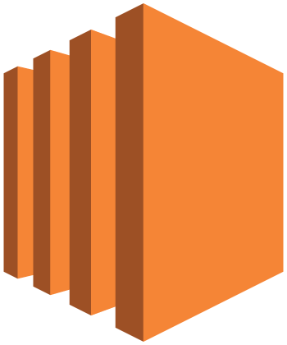
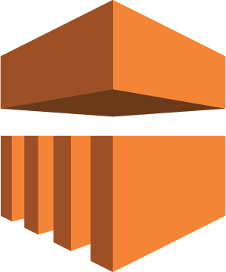

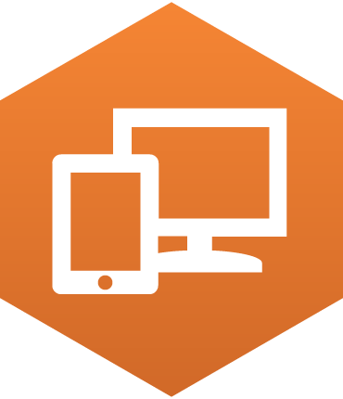
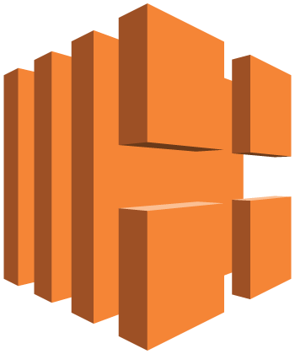
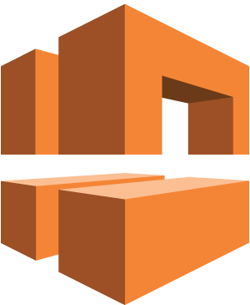
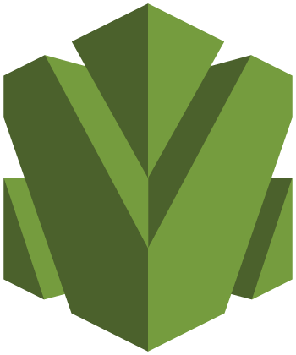
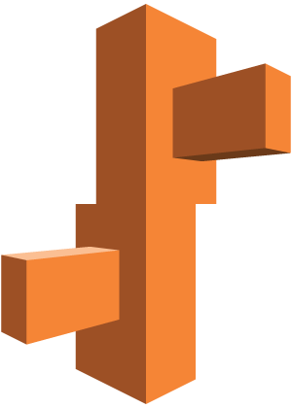

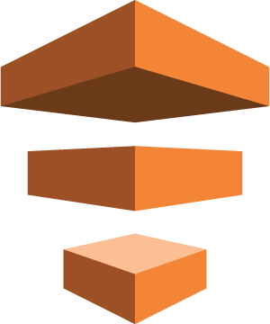
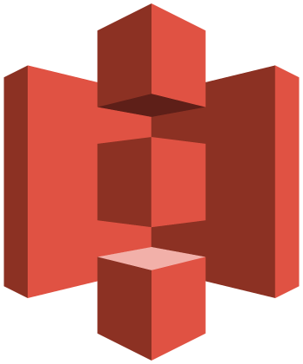
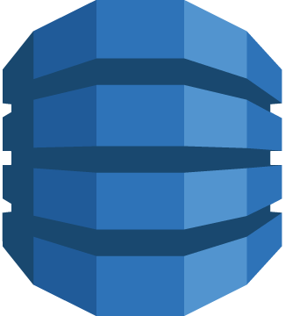
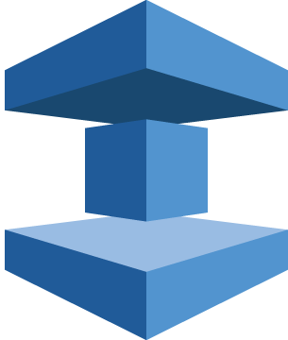

Amazon VPC Integration
Amazon EC2
Amazon EMR
Amazon RDS
Amazon WorkSpaces
Elastic Load Balancing
Amazon VPC
AWS OpsWorks
Amazon EFS
AWS Elastic Beanstalk
Amazon Route 53
AWS Data Pipeline
… and more
Amazon S3
Amazon DynamoDB
Amazon ElastiCache
AWS Directory Service
Notes:
Amazon VPC is an AWS foundational service and integrates with numerous AWS services. For instance, Amazon EC2 instances are deployed into your Amazon VPC. Similarly, Amazon Relational Database Service (Amazon RDS) database instances deploy into your Amazon VPC, where the database is protected by the structure of the network just like your on-premises network. Understanding and implementing Amazon VPC will allow you to fully use other AWS services.

Slide 9

Amazon VPC Features
Builds upon high availability of AWS Regions and Availability Zones (AZ):
Each Amazon VPC lives in a single region
Multiple Amazon VPCs per account
Subnets:
Used to divide Amazon VPC
Allow Amazon VPC to span multiple AZs
AWS Region
Notes:
Let's take a look at the features of Amazon VPC. Amazon VPC builds upon the AWS global infrastructure of Regions and Availability Zones (AZ), and allows you to easily take advantage of the high availability provided by the AWS cloud. It also allows you to provision virtual networks hosted on the AWS cloud and dedicated to your AWS account. Amazon VPCs live within regions, as they can exist only in a single region.
There are ways to connect Amazon VPCs in different regions to each other without going through the public Internet. Each AWS account can create multiple Amazon VPCs that can be used to segregate environments.
An Amazon VPC defines an IP address space that is then divided by subnets. These subnets are deployed within Availability Zones causing the Amazon VPC to span AZs. Amazon VPCs are logically isolated from other virtual networks. You can create many subnets in a Amazon VPC, though fewer is recommended to limit the complexity of the network topology, but this is totally up to you. You can configure route tables for your subnets to control the traffic between subnets and the Internet. By default, all subnets within a Amazon VPC can communicate with each other. It should be noted that while a Amazon VPC can span across multiple AZs, a subnet cannot.
Subnets are generally classified as public or private, with public having direct access to the Internet and private not having direct access to the Internet. For a subnet to be public, we need to attach an Internet gateway to the Amazon VPC and update the route table of the public subnet to send non-local traffic to the Internet gateway. Amazon EC2 instances also need a public IP address to route to an Internet gateway.

Slide 10
Amazon VPC Address
Each Amazon VPC must specify the IPv4 address range by choosing a Classless Inter-Domain Routing (CIDR) block like 10.0.0.0/16:
Address range cannot be changed after the Amazon VPC is created.
Address range can be large as /16 (65,536 available addresses) or as small as /28 (16 available addresses).
Addresses should not overlap addresses of connected networks.
AWS Region
10.0.0.0/16
Notes:
When you create an Amazon VPC, you must specify the IPv4 address range by choosing a Classless Inter-Domain Routing (CIDR) block, such as 10.0.0.0/16.
The address range of the Amazon VPC cannot be changed after the Amazon VPC is created. An Amazon VPC address range may be as large as /16 (65,536 addresses available) or as small as /28 (16 addresses available) and should not overlap any addresses of other networks they are connected to.

Slide 11
Amazon VPC Components
Subnets: Segment of an Amazon VPC’s IP address range where you can launch AWS services.
Subnets within a zone cannot span zones → one subnet equal one availability zone.
Can be classified as public, private, or VPN only.
Default Amazon VPCs contain one public subnet in every Availability Zone within the region with a netmask of /20.
Route Tables: Used to control traffic going out of the subnets.
Dynamic Host Configuration Protocol (DHCP) option sets: Provides a standard for passing configuration information to hosts on a TCP/IP network.
Security Groups: A virtual, stateful firewall.
Network Access Control Lists (ACLs): Control access to subnets; and stateless.
Notes:
You can use the following components to configure networking in your Amazon VPC:
A subnet is a segment of an Amazon IPC address range where you can launch AWS services:
CIDR blocks define subnets.
AWS reserves the first four IP addresses and the last IP address of every subnet for internal networking purposes.
A public subnet is one in which an associated route table direct the subnet’s traffic to the Amazon VPC’s internet gateway. A private subnet is one in which the associated route table does not direct the subnet’s traffic to the internet gateway. A VPN only subnet only directs traffic to the Amazon VPC’s virtual private gateway.
A route table contains a set of rules, called routes, that are used to determine where network traffic is directed. Each subnet in your Amazon VPC must be associated with a route table; the table controls the routing for the subnet. A subnet can only be associated with one route table at a time, but you can associate multiple subnets with the same route table. Select the link to learn more about route tables. https://docs.aws.amazon.com/AmazonVPC/latest/UserGuide/VPC_Route_Tables.html.
AWS automatically create and associates a Dynamic Host Configuration Protocol (DHCP) option set for your Amazon VPC upon creation and sets two options: domain-name-servers and domain-name.
A Security Groups is a virtual stateful firewall that controls inbound and outbound network traffic to AWS resources and Amazon EC2 instances. Select the link to learn more about security groups. https://docs.aws.amazon.com/AmazonVPC/latest/UserGuide/VPC_SecurityGroups.html
A Network Access Control List (NACL) is an optional layer of security for your Amazon VPC that acts as a firewall for controlling traffic in and out of one or more subnets. Select the link to learn more information about NACL. https://docs.aws.amazon.com/AmazonVPC/latest/UserGuide/VPC_ACLs.html.

Slide 12
Optional Amazon VPC Components
Internet Gateway (IGW): Allows access to the Internet from Amazon VPC.
Elastic IP (EIP) Addresses: Static, public IP address that can be pulled from a pool for use on a temporary basis.
Elastic Network Interface (ENI): Virtual network interface.
Endpoints: Direct connection to another AWS service.
Peering: Allows two Amazon VPCs to communicate.
NAT Address Translation (NATs) instances and NAT Gateways: Accepts, translates, and forwards traffic within a private subnet.
Notes:
Let’s review some some optional Amazon VPC components:
An Internet Gateway (IGW) is a horizontally scaled, redundant, and highly available Amazon VPC component that allows communication between instances in your Amazon VPC and the Internet. Select the link to learn more. .https://docs.aws.amazon.com/AmazonVPC/latest/UserGuide/VPC_Internet_Gateway.html.
An Elastic IP (EIP) Address is a static IPv4 address designed for dynamic cloud computing. An Elastic IP address is associated with your AWS account. Select the link to learn more. https://docs.aws.amazon.com/AWSEC2/latest/UserGuide/elastic-ip-addresses-eip.html
Elastic Network Interface (ENI) is a virtual network interface that you can attach to an instance in an Amazon VPC. Select the link to learn more. https://docs.aws.amazon.com/AWSEC2/latest/UserGuide/using-eni.html
An Amazon VPC endpoint enables you to create a private connection between your Amazon VPC and another AWS service without requiring access over the Internet or through a NAT instance, VPN connection, or AWS Direct Connect. Select the link to learn more. https://docs.aws.amazon.com/AmazonVPC/latest/UserGuide/vpc-endpoints.html
An Amazon VPC peering connection is a networking connection between two Amazon VPCs that enables instances in either Amazon VPC to communicate with each other as if they are within the same network. Select the link to learn more. https://docs.aws.amazon.com/AmazonVPC/latest/PeeringGuide/Welcome.html
NAT Address Translation instances is an Amazon Linux AMI designed to keep traffic from instances within a private subnet. A NAT Gateway is an Amazon managed resources designed to operate just like a NAT instance, but is simpler to manage and highly available within an AZ.

Slide 13
Amazon VPC Connections
VPN Connectivity Options | Description
AWS Hardware VPN | You can create an IPsec hardware VPN connection between your Amazon VPC and your remote network.
AWS Direct Connect | AWS Direct Connect provides a dedicated private connection from a remote network to your Amazon VPC.
AWS VPN CloudHub | You can create multiple AWS hardware VPN connections via your VPC to enable communications between various remote networks.
Software VPN | You can create a VPN connection to your remote network by using an Amazon EC2 instance in your Amazon VPC that’s running a software VPN appliance.
Notes:
There are several VPN connectivity options for Amazon VPC. You can connect your Amazon VPC to remote networks using an AWS Hardware VPN, AWS Direct Connect, AWS VPN CloudHub, or a Software VPN.
Select a link to learn more.
Amazon Virtual Private Cloud Connectivity Options whitepaper: https://media.amazonwebservices.com/AWS_Amazon_VPC_Connectivity_Options.pdf
http://docs.aws.amazon.com/AmazonVPC/latest/UserGuide/vpn-connections.html
http://docs.aws.amazon.com/AmazonVPC/latest/UserGuide/VPN_CloudHub.htm

Slide 14
Amazon VPC Review
Amazon VPCs can include resources in more than one Availability Zone.
You can have multiple Amazon VPCs in the same account and region and in multiple regions or accounts.
AWS Region
Availability Zone A
Availability Zone B
Development
Integration
Pre-production
Production
Notes:
To summarize, Amazon VPC allows you to create a private network within the AWS cloud that uses many of the same concepts and constructs as an on-premises network.
Amazon VPC allows you to:
Include resources in more than one Availability Zone.
Have multiple Amazon VPCs in each account or region and VPCs in as many regions as you'd like or in multiple accounts.
You can connect your Amazon VPC to remote networks using a VPN connection.

Slide 15
Amazon VPC Example
us-west-2 (Oregon)
Notes:
Let's design an example Amazon VPC that we can use to start deploying compute resources and AWS services. We will create a network that supports high availability and uses multiple subnets. Since VPC are region based, we need to select a region. In this example, we’ve selected the Oregon region.

Slide 16
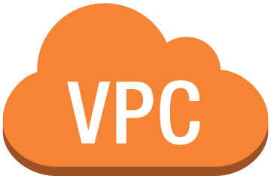
Amazon VPC Example
Test- VPC 10.0.0.0/16
us-west-2 (Oregon)
Notes:
Next, we'll create the Amazon VPC and give it a name, Test VPC, and define the IP address space for the Amazon VPC. The 10.0.0.0/16 is the Classless Inter-Domain Routing (CIDR) format and means that there are over 65,000 IP addresses to use in the Amazon VPC.
CIDR (sometimes called supernetting) is a way to allow more flexible allocation of Internet Protocol (IP) addresses than was possible with the original system of IP address classes. A single IP address can be used to designate many unique IP addresses with CIDR. A CIDR IP address looks like a normal IP address, except that it ends with a slash followed by a number, called the IP network prefix. CIDR addresses reduce the size of routing tables and make more IP addresses available within organizations.
To illustrate, a CIDR network address looks like this: 192.30.250.00/18. The 192.30.250.0 is the network address itself and the “18” says that the first 18 bits are the network part of the address, leaving the last 14 bits for specific host addresses.

Slide 17
Amazon VPC Example
Test- VPC 10.0.0.0/16
10.0.0.0/24
Subnet A1
us-west-2 (Oregon)
Notes:
Next, we create a subnet named Subnet A1 and assign an IP address space that contains 256 IP addresses.

Slide 18
Amazon VPC Example
Test- VPC 10.0.0.0/16
10.0.0.0/24
Subnet A1
Availability Zone A
us-west-2 (Oregon)
Notes:
Also, we specify that this subnet will live in Availability Zone A.

Slide 19
Amazon VPC Example
Test- VPC 10.0.0.0/16
10.0.0.0/24
Subnet A1
10.0.2.0/23
Subnet B1
Availability Zone A
us-west-2 (Oregon)
Notes:
Finally, we create another sub-net called Subnet B1 and assign an IP address space. This subnet contains 512 IP addresses.
Let’s make a few more additions that will make Subnet A1 accessible via the Internet.

Slide 20
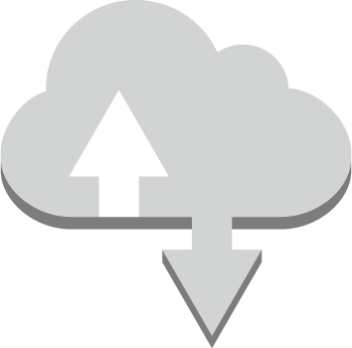
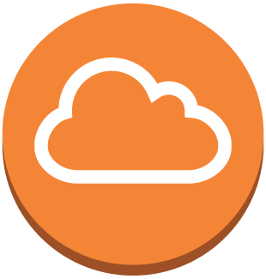
Amazon VPC Example
Test- VPC 10.0.0.0/16
10.0.0.0/24
Test- IGW
Public Subnet A1
10.0.1.0/24
Private Subnet B1
Availability Zone A
us-west-2 (Oregon)
Notes:
To accomplish this, add an internet gateway called Test IGW. Subnet A1 now becomes a public subnet where non-local traffic is routed through the Internet gateway. Subnet B1 will be our private subnet that is isolated from the Internet.

Slide 21
Part 2: AWS Security Groups
Notes:
Introducing Part 2, AWS Security Groups.
Security of the AWS Cloud is one of Amazon Web Services’ highest priorities. This section reviews how AWS Security Groups can be utilized to improve your Amazon VPC security.

Slide 22
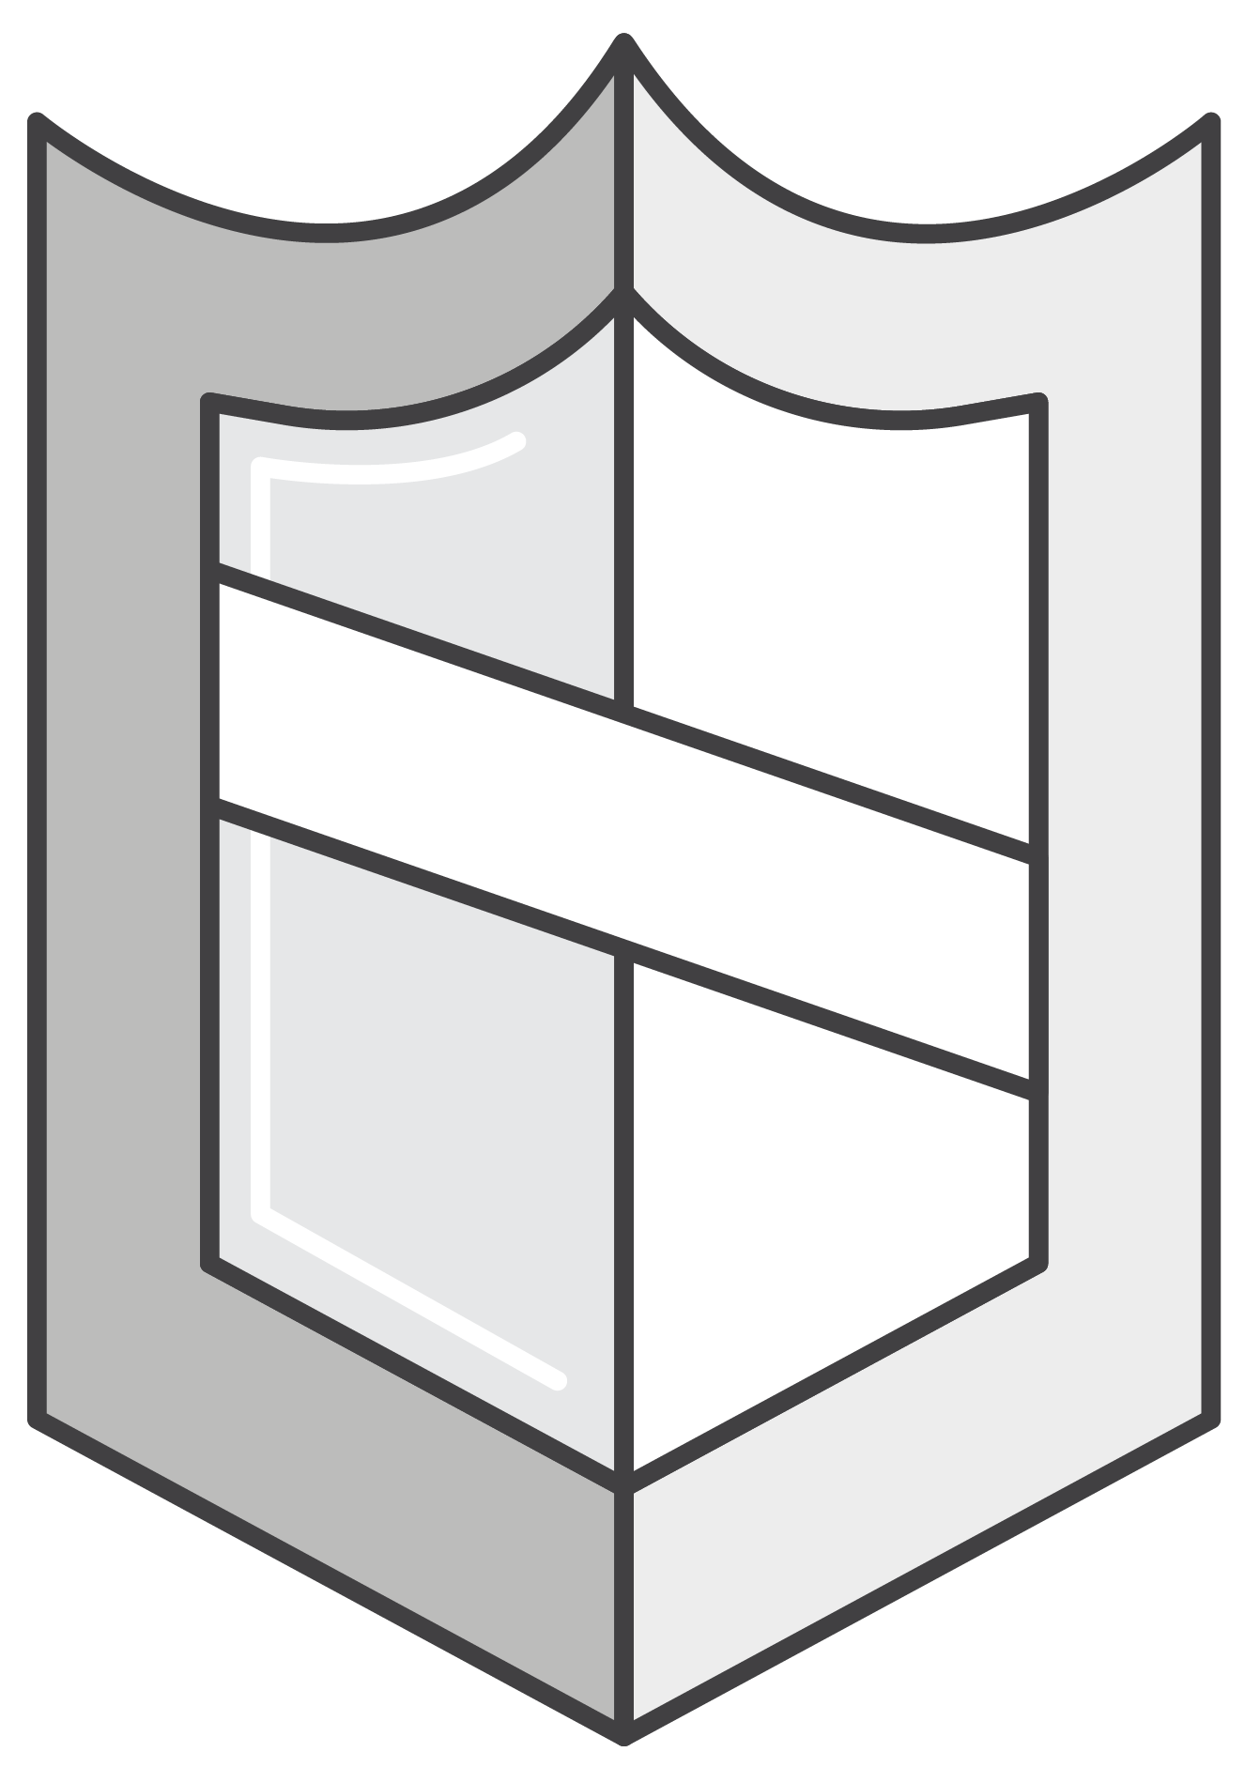
AWS VPC Security Groups
Security groups act like a built-in firewall for your virtual servers.
Security group rules determine who has access to instances.
Security groups are stateful.
Notes:
Let’s take a look at security groups and how they help secure your data. At AWS, security groups will act like a built-in firewall for your virtual servers. With these security groups, you have full control on how accessible your instances are.
At the most basic level, it is just another method to filter traffic to your instances. It provides you control on what traffic to allow or deny. To determine who has access to your instances, you would configure a security group rule. Rules can vary from keeping the instance completely private, totally public, or somewhere in between.

Slide 23




Amazon VPC Security Groups
Security Groups: Firewall for Amazon EC2 instances
Network Access Control Lists (Network ACLs): Firewall for associated subnets
Key Pairs: Cryptography used to encrypt and decrypt login information
instance
instance
instance
instance
Security Group
Security Group
Security Group
Security Group
Subnet
10.0.0.0/24
Subnet
10.0.1.0/24
Network ACL
Network ACL
Routing Table
Routing Table
VPC Router
10.0.0.0/16
Notes:
Amazon VPC provides various features that you can use to increase and monitor the security for your Amazon VPC:
Security Groups act as a firewall for associated Amazon EC2 instances, controlling both inbound and outbound traffic at the instance level.
Network Access Controls Lists (Network ACLs) act as a firewall for associated subnets, controlling both inbound and outbound traffic at the subnet level.
Amazon EC2 uses public-key cryptography to encrypt and decrypt login information. Public-key cryptography uses a public key to encrypt a piece of data, and the recipient uses the private key to decrypt the data. The private and public keys are known as a key pair. To log in to your instance, you must create a key pair, specific the name of the key pair when you launch the instance, and provide the private key when you connect to the instance. Linux instances have no password, and you use a key pair to log in using SSH. Windows instances require a key pair to obtain the administrator password to log in using RDP.
It should be noted that security groups are stateful while NACLs are stateless.
Stateful means the computer keeps track of the state of interaction, usually by setting values in a storage field designated for that purpose.
Stateless means no information is retained by either sender or receiver, and each interaction request has to be handled based entirely on information that comes with it.

Slide 24

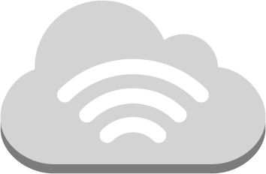
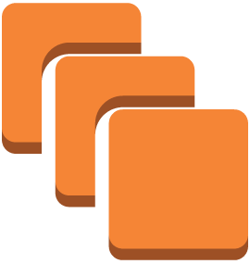
AWS VPC Security Groups
Corporate
Admin Network
ssh/rdp
ssh/rdp
ssh/rdp
www server
app server
db server
www server
app server
db server
Internet
http/https
Source: 0.0.0.0/0
Port 80:443
www server
app server
db server
api
api
Source: Web Tier
Port SSH Port 22
Source: App Tier
Port TCP Port 1521
Web tier
security group
Application tier
security group
Database tier
security group
(All other ports are blocked)
Notes:
Here is an example of a classic AWS multi-tier security group. In this architecture, you will notice that multiple different security group rules have been created to accommodate this multi-tiered web architecture.
If we start at the web tier, you will see that we have set up a rule to accept traffic from anywhere on the internet on port 80/443 by selecting the source 0.0.0.0/0.
Next, moving to the app tier, there is a security group that only accepts traffic from the web tier, and similarly, the database tier can only accept traffic from the app tier.
Finally, you will notice that there has also been a rule created to allow administration remotely from the corporate network over SSH port 22.
To summarize what we have discussed about AWS Security Groups:
AWS provides virtual firewalls that can control traffic for one or more instances, called security groups.
Security groups are stateful.
You can control accessibility to your instances by creating security group rules.
These security groups can be managed on the AWS Management Console.
Select the link to learn more.
https://docs.aws.amazon.com/AmazonVPC/latest/UserGuide/VPC_SecurityGroups.html.

Slide 25










In Review
Internet
Customer Network
Internet Gateway
Virtual Private Gateway
R
Web Server
VPC NAT
Gateway
App Server
DB Server
Web Server
App Server
DB Server
Public Subnet
Private Subnet
VPN Only Subnet
Virtual Private Cloud
AWS Cloud
Notes:
Let’s summarize what we have covered so far. Amazon VPC allows you provision a logically isolated section of the AWS cloud where you can launch AWS resources in a virtual network that you define. With Amazon VPC:
You have complete control over your virtual networking environment, including selection of your own IP address range, creation of subnets, configuration of route tables, network access control lists, and network gateways.
Each subnet must reside entirely within one Availability Zone and cannot span zones.
A subnet defines a range of IP addresses in your Amazon VPC.
You can launch AWS resources into a subnet that you select.
A private subnet should be used for resources that won’t be accessible over the internet.
A public subnet should be used for resources that will be accessed over the internet.
You can easily customize the network and configuration for your Amazon VPC instance. For example, you can create a public-facing subnet for your web servers that require access to the internet and place your back-end systems, such as databases or application servers, in a private-facing subnet with no internet access.
You can create a hardware Virtual Private Network (VPN) connection between your corporate data center and your Amazon VPC, which allows you to use the AWS cloud as an extension of your corporate data center.
You can use multiple layers of security, including security groups and NACLs, to help control access to Amazon EC2 instances in each subnet.

Slide 26
Amazon VPC Demo
Notes:
Please review the Amazon VPC demonstration: Virtual Private Cloud (VPC) Wizard Console Demo.
This video demonstration can be found in the learning management system.

Slide 27

Module 2, Section 3, Lab 3: Build Your Amazon VPC and Launch a Web Server
~ 45 minutes
Notes:
Introducing Section 3, Lab 3: Build Your Amazon VPC and Launch a Web Server.

Slide 28
Lab 3 Scenario
In this lab, you will use Amazon VPC to create your own Amazon VPC and add additional components to it to produce a customized network.
You will create security groups for your Amazon EC2 instance.
You will configure and customize the EC2 instance to run a web server and launch it into the Amazon VPC. These services include:
Amazon VPC
Subnet
Security Group
Amazon EC2
Notes:
Amazon VPC enables you to launch AWS resources into a virtual network that you define. This virtual network closely resembles a traditional network that you operate in your own data center, with the benefits of using the scalable infrastructure of AWS. You can create a Amazon VPC that spans multiple Availability Zones. A security group acts as a virtual firewall that controls the traffic for one or more instances. When you launch an instance, you associate one or more security groups with the instance. You add rules to each security group that allow traffic to or from its associated instances.
An internet gateway is a Amazon VPC component that allows communication between instances in your Amazon VPC and the internet. A route table contains a set of rules, called routes, that are used to determine where network traffic is directed. Each subnet in a Amazon VPC must be associated with a route table; the route table controls routing for the subnet.
After completing this lab, you will be able to:
Create an Amazon VPC.
Create subnets.
Configure a security group.
Launch an Amazon EC2 instance into an Amazon VPC.
This lab should take approximately 45 minutes.

Slide 29

Lab 3: Tasks
Create an Amazon VPC.
Create additional subnets.
Create an Amazon VPC security group.
Launch a web server instance (on Amazon EC2).
VPC subnet
security group
Notes:
In this lab, you will
Create an Amazon VPC.
Create additional subnets.
Create an Amazon VPC security group.
Launch a web server instance (on Amazon EC2).

Slide 30
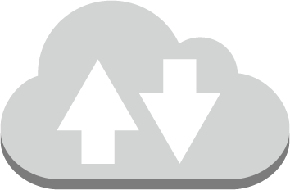

Lab 3: Final Product
Internet Gateway
10.0.0.0/16
NAT Server
Web Server 1
security group
security group
Public Subnet 1 (10.0.1.0/24)
Public Subnet 2 (10.0.2.0/24)
Private Subnet 1 (10.0.3.0/24)
Private Subnet 2 (10.0.4.0/24)
Availability Zone A
Availability Zone B
~ 45 minutes
~ 45 minutes
Notes:
In this lab, you:
Created an Amazon VPC.
Created additional subnets.
Created an Amazon VPC security group.
Launched a web server instance (on Amazon EC2).

Slide 31
Part 3: AWS CloudFront
Notes:
Introducing Part 3: AWS CloudFront.
Amazon CloudFront allows you to scale out, save money and improve application performance. Amazon CloudFront is a global Content Delivery Network (or CDN) service that securely delivers data, videos, applications, and APIs to your viewers with low latency and high transfer speeds.

Slide 32
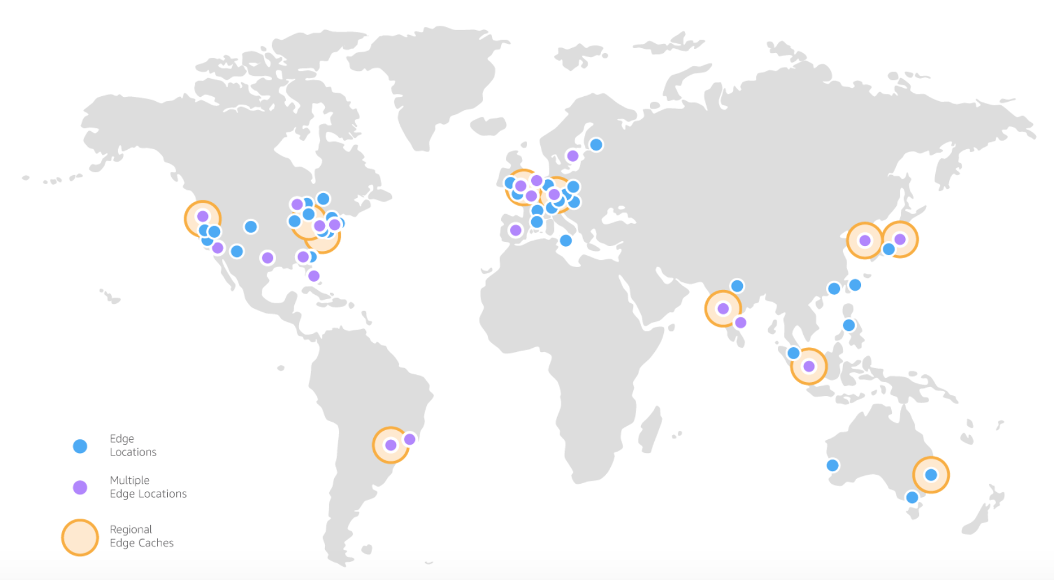
AWS Global Infrastructure: Edge Locations and Regional Edge Caches
Notes:
To deliver content to your users, Amazon CloudFront uses the global network of Edge Locations for content delivery.
By using CloudFront you can leverage multiple locations around the world to deliver your content, allowing your users to interact with your application with lower latency.

Slide 33
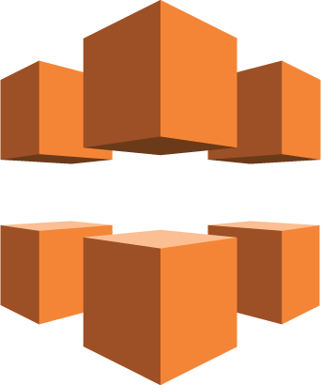
Amazon CloudFront Benefits
Global, Growing Content Delivery Network
Secure Content at the Edge Location
Programmable Content Delivery Network (CDN)
High Performance:
Low latency
High data transfer speeds
Cost Effective:
Pay for data transfer and requests to deliver content to customers
No upfront or minimum commitments
Deep Integration with other AWS services
Notes:
Amazon CloudFront is a web service for content delivery or Content Delivery Network (CDN). Amazon CloudFront provides the following benefits:
A content delivery network built on the expanding global AWS infrastructure with a network of Edge Locations to ensure that applications deliver high availability, scalability, and performance.
A highly-secure Content Delivery Network (CDN) with both network and application level protection.
It is programmable so you can run your code across AWS locations worldwide, allowing you to respond to your end users with the lowest latency.
It is optimized for low latency and high data transfer speeds.
It is cost effective because you pay only for the data transfer and requests used to deliver content to your customers. With CloudFront, there are no upfront payments or fixed platform fees, no long-term commitments, no premiums for dynamic content, and no requirements for professional services to get started. If you use AWS origins such as Amazon S3 or Elastic Load Balancing, you pay only for storage costs, not for any data transferred between these services and CloudFront.
Deep integration with other Amazon Web Services to give you an easy way to distribute content to end users with low latency, high data transfer speeds, and no required minimum commitments.

Slide 34
Amazon CloudFront: Cost Estimation
Traffic Distribution:
Pricing varies across geographic regions
Based on the edge location
Requests:
Number/type of requests
Geographic region
Data Transfer Out:
The amount of data transferred out of Amazon CloudFront edge locations
Notes:
When you begin to estimate the cost of Amazon CloudFront, you need to consider traffic distribution, requests, and data transfer out.
Traffic Distribution – Data transfer and request pricing vary across geographic regions, and pricing is based on the edge location through which your content is served.
Requests – The number and type of requests (HTTP or HTTPS) made and the geographic region in which the requests are made.
Data Transfer Out – The amount of data transferred out of your Amazon CloudFront edge locations.

Slide 35
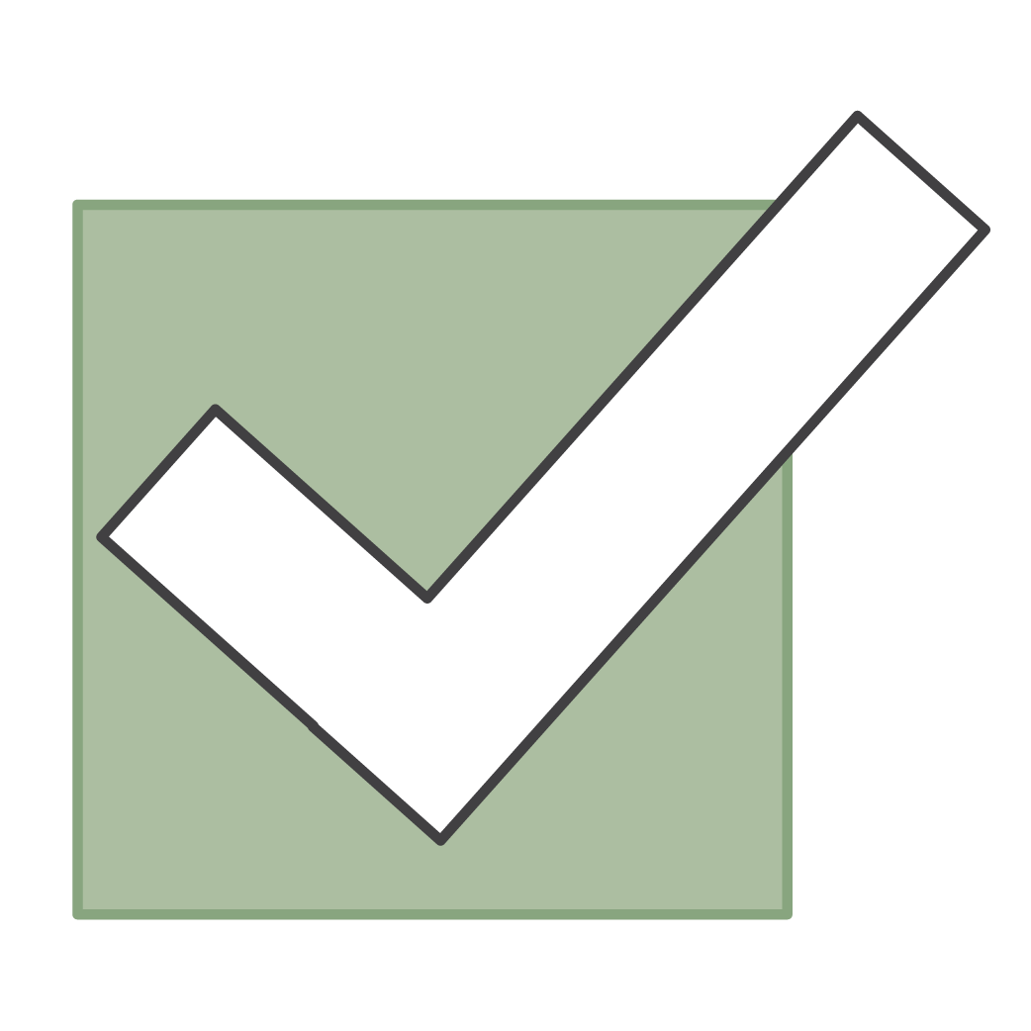

Section 2.0.3 Review:
Explored the features of the Amazon Virtual Private Cloud (Amazon VPC)
Reviewed of Amazon VPC Security Groups
Discussed Amazon CloudFront
To finish this module:
Complete:
Knowledge Assessment
Notes:
In summary, we:
Explored the features of the Amazon Virtual Private Cloud, including its required and optional components that are available.
Reviewed Amazon VPC security groups.
Briefly introduced Amazon CloudFront.
To finish this module, please complete the lab and the corresponding knowledge assessment.

Slide 36
Up Next: Unit 2.04 – AWS Core Services - Database Amazon Relational Database Service (RDS) Amazon DynamoDB Amazon Redshift Amazon Aurora
Notes:
Now that we have a better understanding for some of the compute, storage, and networking services offered by AWS, we will next look at another AWS core service, database services.

Slide 37
Thanks for participating!
© 2018 Amazon Web Services, Inc. or its affiliates. All rights reserved. This work may not be reproduced or redistributed, in whole or in part, without prior written permission from Amazon Web Services, Inc. Commercial copying, lending, or selling is prohibited. Corrections or feedback on the course, please email us at: aws-course-feedback@amazon.com. For all other questions, contact us at: https://aws.amazon.com/contact-us/aws-training/. All trademarks are the property of their owners.
Notes:
Thanks for participating.

