Slide 1


FLOOR PLAN EXTRACTION FROM DIGITAL BUILDING MODELS Helga Tauscher, Subhashini Krishnakumar, Dominik Heigener State of the Map 2022 | University of Florence, Italy, 19 - 21/08/2022.

Slide 2
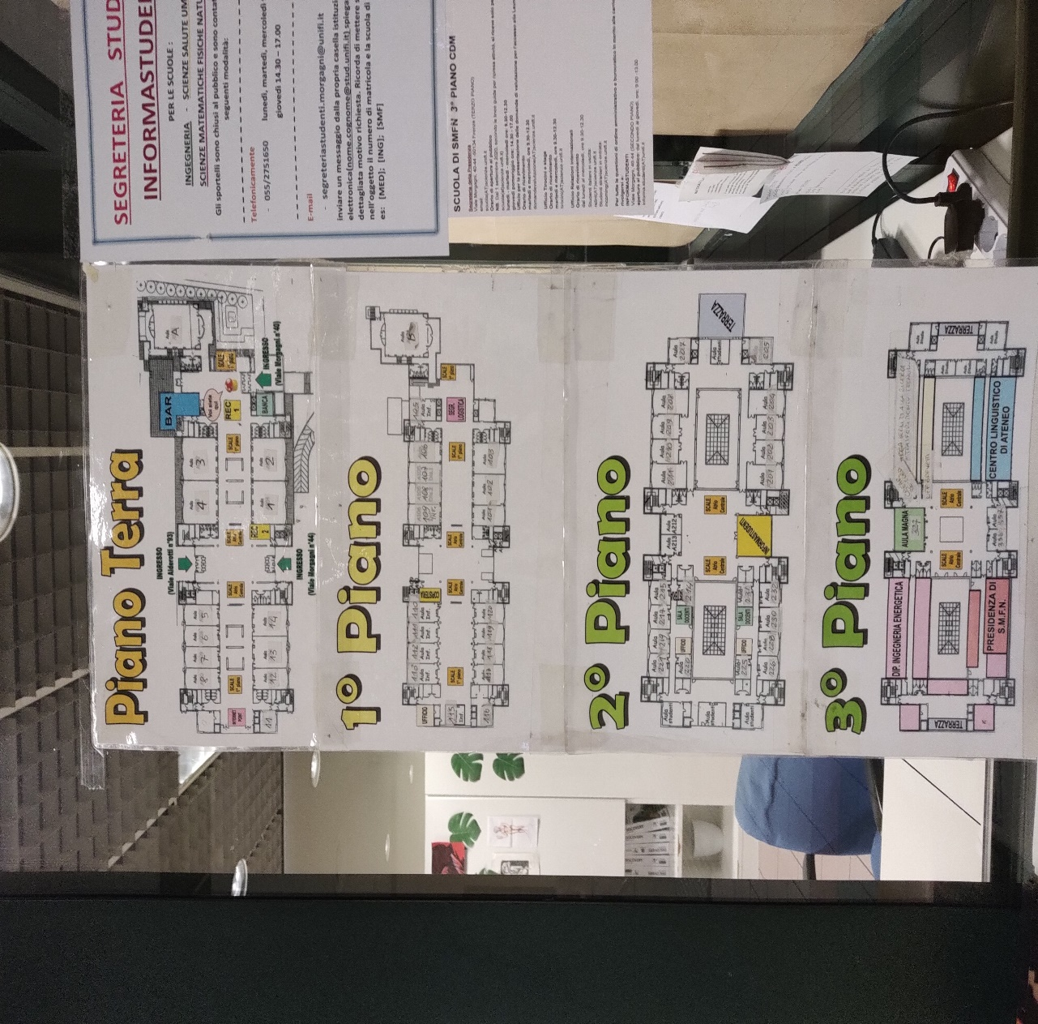
INDOOR MAPPING
Why is indoor mapping necessary?
Profound insights - Building assets and spaces
Enormous outdoor data in comparison
To have information on indoor barriers
Volunteered geodata on the rise
Map of building interior – Morgagni campus

Slide 3
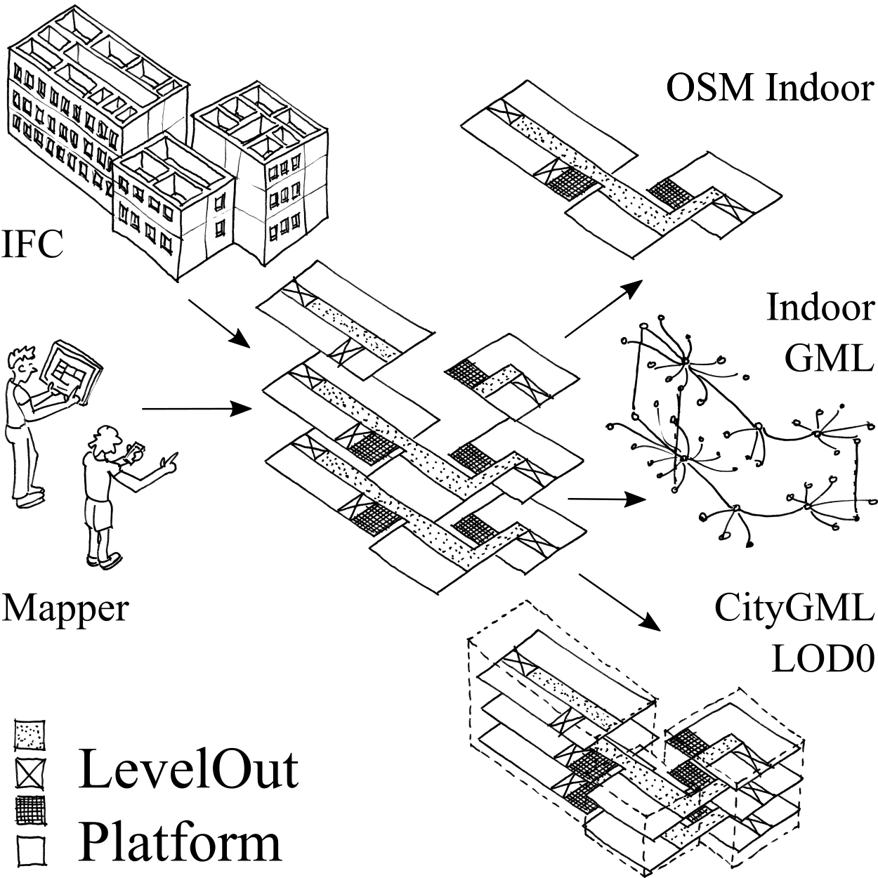
PROJECT LEVELOUT
Extract indoor data from digital building models (IFC format)
Floor plans (2.5D)
Three target formats
OSM
CityGML
IndoorGML
Development of a platform
Enrichment of city models, maps and navigation services
Project LevelOut is funded by the German Federal Ministry for Digital and Transport, program mFUND, grant 19F1095A.
LevelOut platform with input and output data, Graphics : Helga Tauscher

Slide 4



TARGET FORMATS
Open Geospatial Consortium (OGC) GML application schemas
CityGML: storage and exchange format 3D city models
IndoorGML: a standard for indoor spatial modelling, mainly used for navigation and location based services in indoors
Indoor part of OSM:
Simple Indoor Tagging
Simple 3D Buildings

Slide 5
WORKFLOW
Identify relevant entities in IFC
Examine the schema of target formats
Find out the similarities in target format
Establish generic intermediate model
Map from the generic model to target models
Test data: University buildings, public administration centre under construction
Level Out platform, generic intermediate model highlighted

Slide 6
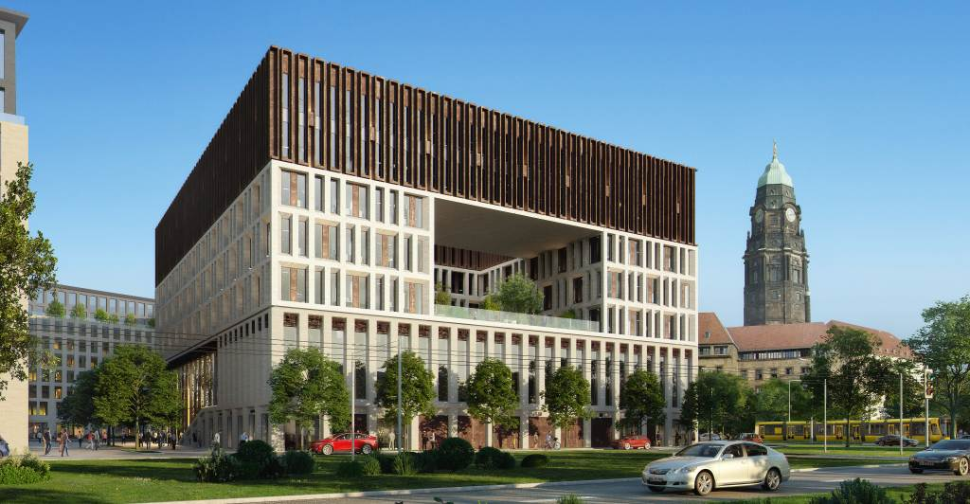
ADMINISTRATION CENTRE
Image source : https://www.dresden.de/de/stadtraum/brennpunkte/ferdinandplatz.php

Slide 7

THANK YOU!
Subhashini Krishnakumar
Contact / Team
Helga Tauscher (project lead)
helga.tauscher@uni-weimar.de
Subhashini Krishnakumar (presenter)
subhashini.krishnakumar@uni-weimar.de
Dominik Heigener
dominik.heigener@uni-weimar.de
References
Open Geospatial Consortium (2021). CityGML 3.0.0. OGC City Geography Markup Language (CityGML) Part 1: Conceptual Model Standard. http://www.opengis.net/doc/IS/CityGML -1/3.0
Li, K.-J. (2016). IndoorGML: A standard for indoor spatial modeling. In: The International Archives of the Photogrammetry, Remote Sensing and Spatial Information Sciences, XLI-B4, 701–704.
International Organization for Standardization (2018) ISO 16739-1:2018 Industry Foundation Cases (IFC) for data sharing in the construction and facility management industries—Part 1: Data schema. https://www.iso.org/standard/70303.html

