Slide 1
maxspeed
Notes:
Introduction: Who am I, what do I do
I want to talk about maxspeed…

Slide 2
What percentage of roads have maxspeed tagged?
Notes:
Not counting tracks, service roads, pedestrian and living streets
MAYBE: (audience question: Best per show of hands - who thinks its less than three quarters,... less then half??, less than…)

Slide 3
What percentage of roads have maxspeed tagged?
15 %
Notes:
Quite underwhelming

Slide 4

Just a matter of time..
Notes:
Maybe it’s just not done yet. Slowly slowly, we will get there…

Slide 5
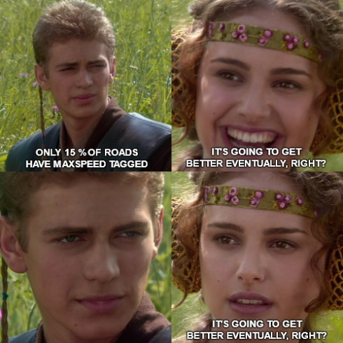
Just a matter of time?
Notes:
Right? Right?? We will get there!

Slide 6
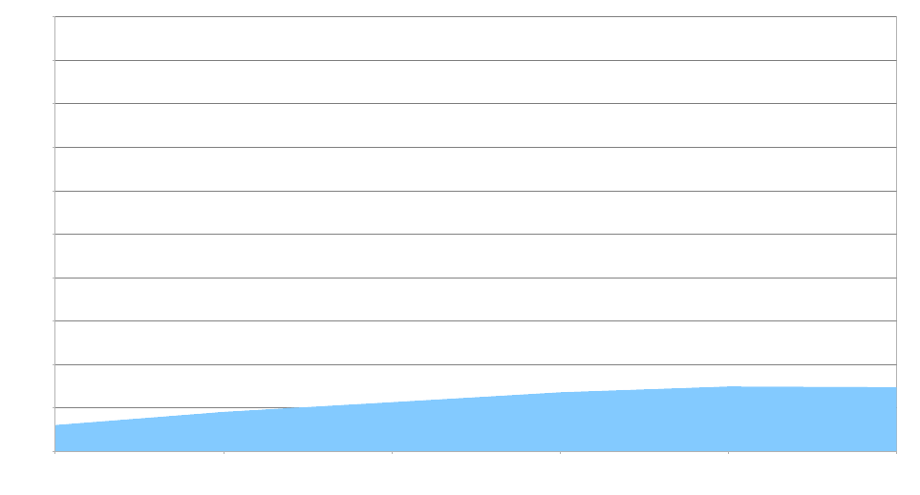
Nope.
Notes:
Because new roads are added too, the % stays the same.

Slide 7
But why?
Notes:
Reasons I can think of ….

Slide 8

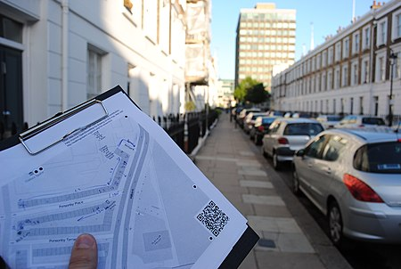
But why?
Adding roads is easier
vs
Images Sources:
https://wiki.openstreetmap.org/wiki/File:Bajrabarahi_Nepal_mapping_training.jpg
https://wiki.openstreetmap.org/wiki/File:Surveying_with_walking_papers.jpg
Notes:
Tracing aerial imagery: Possible remote, even machine-assisted
Speed limits are not visible from space, on-site-survey

Slide 9
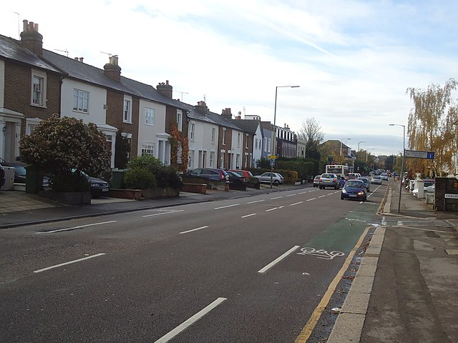
But why?
Adding roads is easier
No sign, what to tag?
Images Source:
https://commons.wikimedia.org/wiki/File:Portsmouth_Road,_Long_Ditton_-_geograph.org.uk_-_2148542.jpg
Notes:
(from illustration…) and then you don’t even find a sign. What to tag?
Mappers may be unsure and rather not tag anything if there is no sign

Slide 10
No sign, what to tag?
Notes:
But let’s say… rural france, have been there on vacation, so you know! …

Slide 11
maxspeed=90
Notes:
It’s 90 km/h. Simple.
(Anyone from France here?)

Slide 12

maxspeed=90 80
When the legislation changed but you mapped all unsigned speed limits with maxspeed
Notes:
Legislation changed in 2018. Without additional tag, was not clear if it should be changed now
This happens all the time. Columbia changed limits end of 2021.

Slide 13
maxspeed=80
source:maxspeed=FR:rural
Notes:
So, some people came up with…. (explain)
To denote “from sign”, use “sign”

Slide 14
maxspeed=80
source:maxspeed=FR:rural
1:1
maxspeed=80
Notes:
…value: idea is to have a 1:1 mapping - some simple table maintained in the wiki - easy to use by data consumers

Slide 15
(maxspeed=80)
source:maxspeed=FR:rural
1:1
maxspeed=80
Notes:
…if it works well: maxspeed is even kind of optional/superfluous (and generates work in case law changes)
Anyway…

Slide 16

maxspeed=80
source:maxspeed
maxspeed:type
Notes:
British Community: what is this, that’s not a `source` tag?! source=bing / mapillary / survey!

Slide 17
maxspeed=80
source:maxspeed
maxspeed:type
zone:maxspeed
Notes:
Other proposal (in use)

Slide 18
maxspeed=80
source:maxspeed
maxspeed:type
zone:maxspeed
zone:traffic
Notes:
Other proposal (in use)

Slide 19


maxspeed=FR:rural
source:maxspeed
maxspeed:type
zone:maxspeed
zone:traffic
Notes:
Romanian / Russian community: Stick it in maxspeed!

Slide 20
maxspeed
source:maxspeed
maxspeed:type
zone:maxspeed
zone:traffic
=FR:rural
}
Notes:
Kind of a mess (Welcome to OpenStreetMap). But: compatible and idea is the same FR:rural -> 1:1 -> maxspeed=80

Slide 21
Sounds good, doesn’t work

Slide 22
Sounds good, doesn’t work
Mappers still need to know in which “road category” they are to make any contribution at all
Notes:
mappers must still know the predefined “road categories” valid for the country/state they are mapping in. It’s more than just urban/rural

Slide 23
Sounds good, doesn’t work
Mappers still need to know in which “road category” they are to make any contribution at all
Those “road categories” need to be defined comprehensively and mappers need to know about them (for each country)
But they aren’t (it’s not always just urban/rural)
Notes:
the road types are not comprehensively documented (thus mappers also don’t know about them + data consumers cannot use them)
(Also: even road categories can change in legislation)
But: Point 2 could be solved, with some research and documentation….

Slide 24
Default Speed Limits
wiki.osm.org/wiki/Default_speed_limits
Notes:
…so I researched it in actual legislation texts - a massive effort 250 legislation texts!!! (US, CA, AU states too)
This is the result. (Explain at example of France that 1:1 mapping doesn’t work - show taginfo; even for Germany it doesn’t work!; US…)
…but this table is part of the solution, it’s comprehensive: many properties can be detected looking at other tags
(explain second table with Lithuania / Phillipines!)
(Your help is appreciated if the legislation for your country is missing)

Slide 25
Findings

Slide 26
Findings
source:maxspeed (etc.) schema is only good to determine if it is signed, urban or rural (But: it is only set if no explicit maxspeed is specified 🙁)
Notes:
There is no other tag to determine if something is urban/rural, but it is important!
Finding it otherwise is very hard for data consumers
But: only set in absence of maxspeed sign -> what about speed limits for other vehicles???

Slide 27
Findings
source:maxspeed (etc.) schema is only good to determine if it is signed, urban or rural (But: it is only set if no explicit maxspeed is specified 🙁)
Many road types can be determined from physical properties or their classification in OSM with certainty. A plethora of more tags are used in different countries
Notes:
E.g. their width, number of lanes, presence of shoulders, highway=-classification, oneway, paved or not, …
-> So, often no extra tag for road categories necessary
Such as “designation” (PH), “HFCS” (US), or just “ref” / network in route relations

Slide 28

Demo!!
westnordost.github.io/osm-legal-default-speeds/
Notes:
Actually implemented as library. With demo page.
Examples to show:
France -
maxspeed:type=FR:rural
+ lanes=4
+ oneway=yes
… others… if time…
Show features:
From maxspeed
Fuzzy

Slide 29

Thank You!
Made possible through grant from
Notes:
… and now: Questions and answers!

