Slide 2
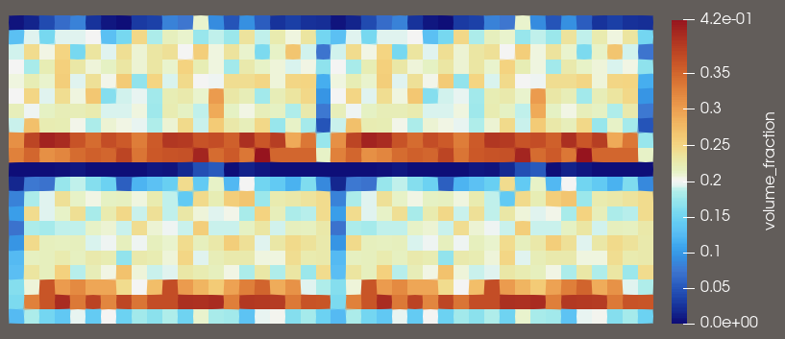
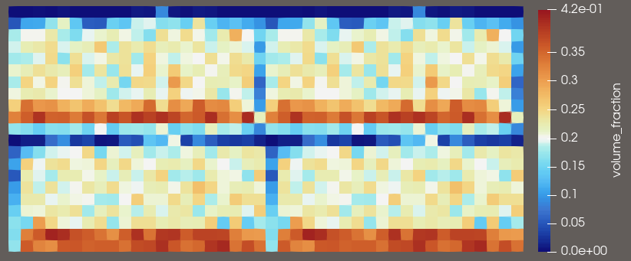
Volume fraction (2D vtkhdf file writer)
Slice 0
Slice 1

Slide 3
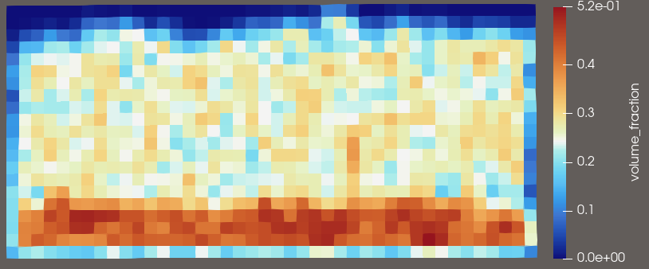
Volume fraction (3D vtkhdf file writer)
Slice 0 (z=0)

Slide 4
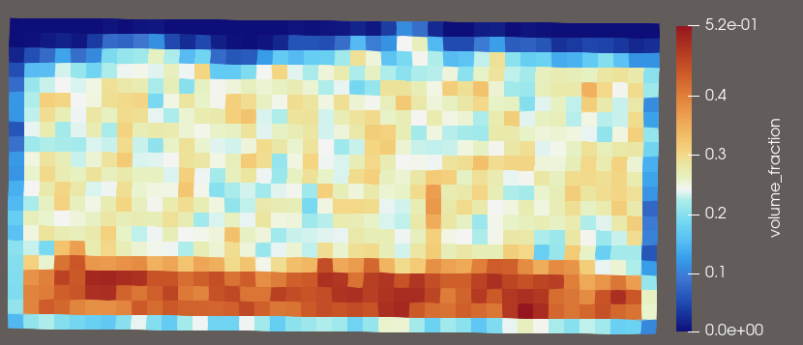
Volume fraction (2D vtkhdf file writer)

