Slide 1
How to register invention report on inventor portal
Click the link:
https://rb-wam.bosch.com/plas-service/plasroute/plas_invention_en

Slide 2
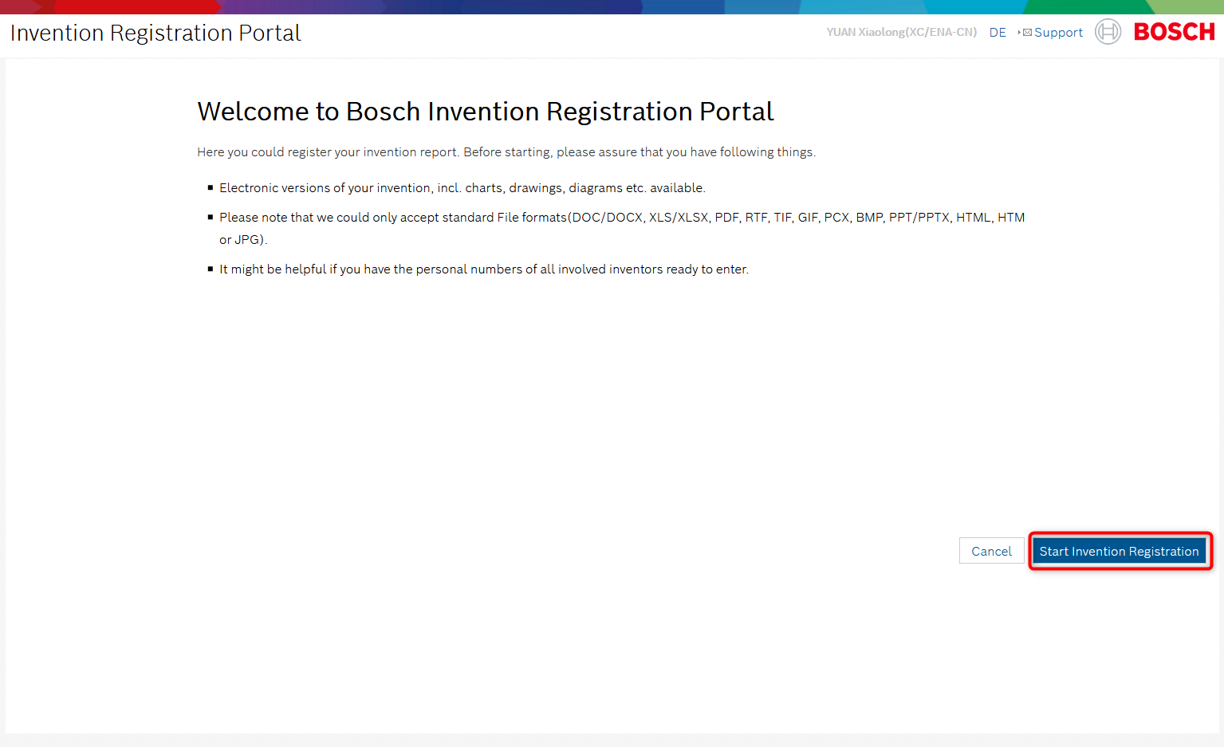
How to register invention report on inventor portal
Then you will go to this page:

Slide 3
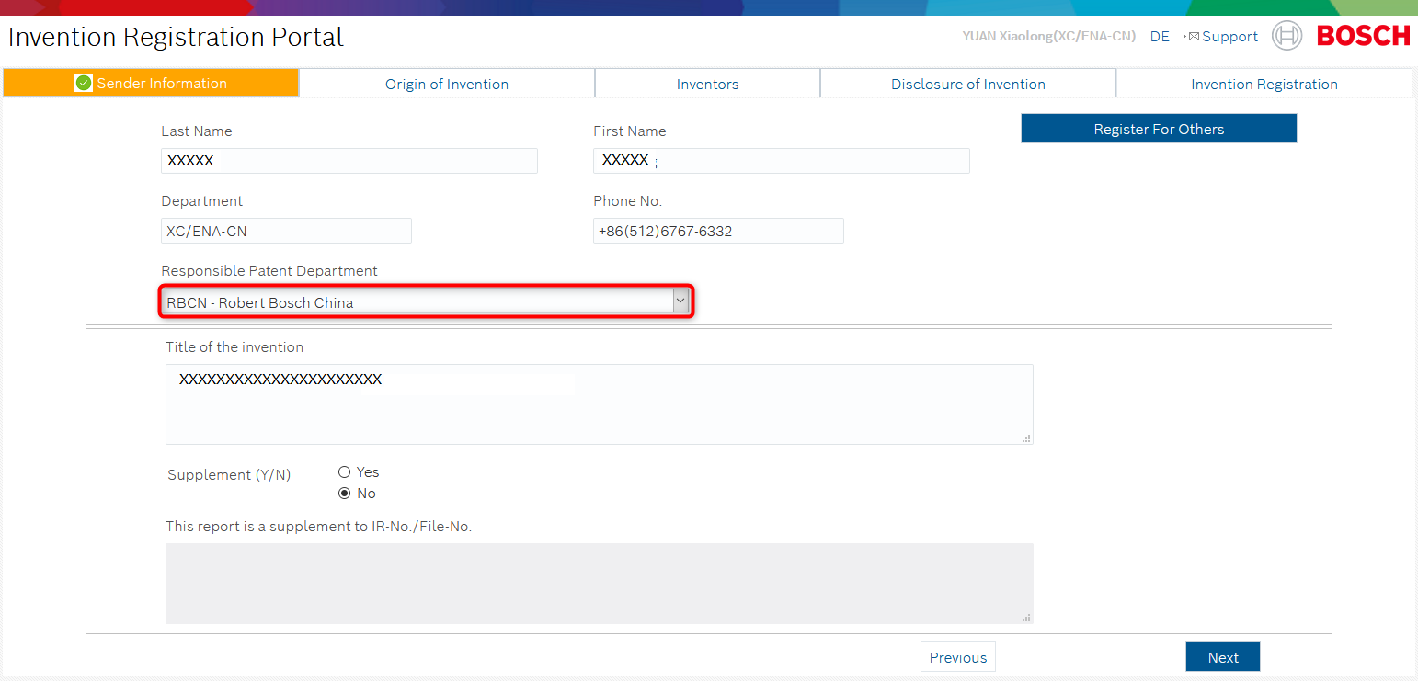
How to register invention report on inventor portal
After clicking the START REGISTRATION REGISTRATION button, following page will be shown
Notice: The Responsible Patent Department must be right.
Fill in the information base on instruction step by step in website, all the mandatory fields which are marked red must be filled in.

Slide 4
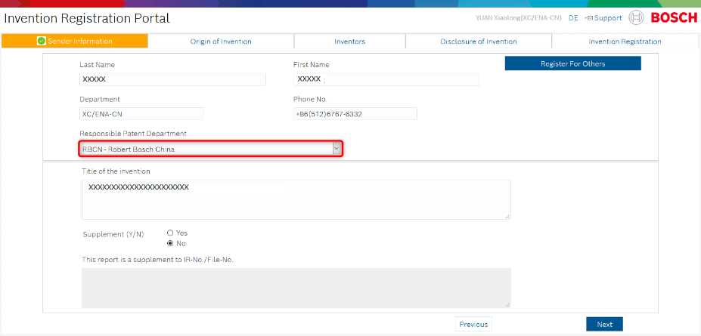
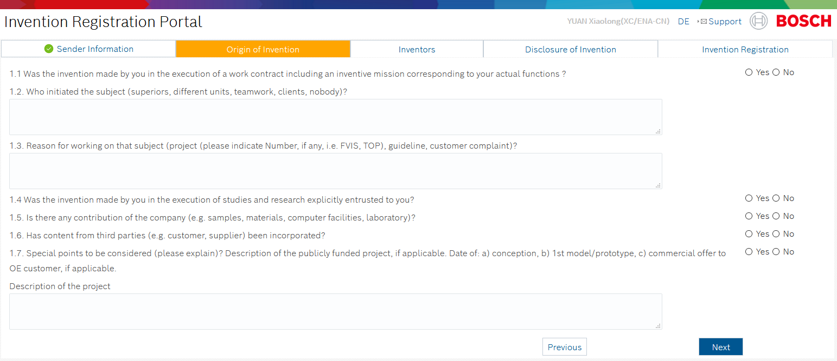
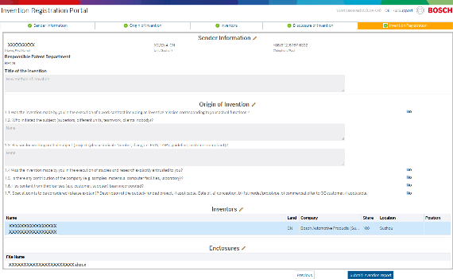
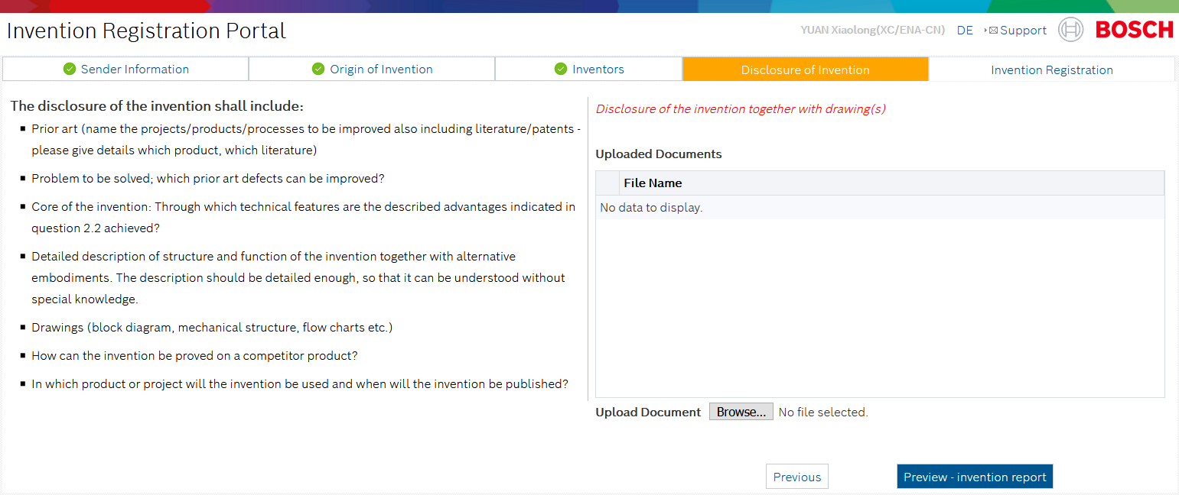
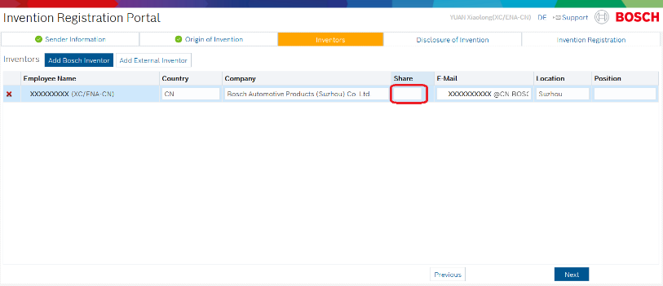
How to register invention report on inventor portal
Step 1: Sender Information
Step 2: Origin of Invention
Step 5: Invention Registration
Step 4: Disclosure of Invention
Step 3: Inventors

Slide 5
How to register invention report on inventor portal
After registration all of information (Step 1: Sender; Step 2 : Origin of Invention; Step3 Inventor,Step4 : Disclosure of Invention), Click the CREATE INVENTION REPORT button, which throws a confirmation before proceeding with registering the invention. A registration number will be created (please keep the registration number carefully).
No more modification is possible after registration！

