Slide 1
Validation of SVS SAT CAMS EOL & OCAL High & Entry

Slide 2
FULL test (SW release)
REDUCED test
Use Case | daylight |  |  |  | dusk
 | city < 30 km/h | city 30 – 60 | industrial | Kopfstein-pflaster | city <60 km/h
OCAL UC1 “Customer” | HIGH 10 ENTRY 10 | HIGH 10 ENTRY 10 | HIGH 10 ENTRY 10 | HIGH 5 ENTRY 5 | HIGH 5 ENTRY 5
OCAL UC1+ “Full Ocal Customer” | ONLY Star2 HIGH 10 - | ONLY Star2 HIGH 10 - | ONLY Star2 HIGH 10 - | ONLY Star2 HIGH 10 - | ONLY Star2 HIGH 10 -
OCAL UC2 “Service” | HIGH 5 ENTRY 5 |  | HIGH 5 ENTRY 5 | HIGH 5 ENTRY 5 | - -
OCAL UC3 “Long run” | HIGH >2h UND >10km ENTRY >2h UND >10km |  |  |  | - -
EOL Calib | ONLY HIGH 3 x 30 -
Markercalib | ONLY HIGH (SW validation) -
Mask Dumps | ONLY HIGH -
SVS Head Unit Dumps | ONLY HIGH -
daylight |  |  |  | dusk
city < 30 km/h | city 30 – 60 | industrial | Kopfstein-pflaster | city <60 km/h
HIGH 10 ENTRY 10 |  |  | - - | - -
ONLY Star2 HIGH 15 -
HIGH 10 ENTRY 10 |  |  | - - | - -
- - |  |  |  | - -
ONLY HIGH 2 x 20 -
- -
ONLY HIGH -
ONLY HIGH -
P.7
P.6
P.8
P.4
P.11
P.11

Slide 3
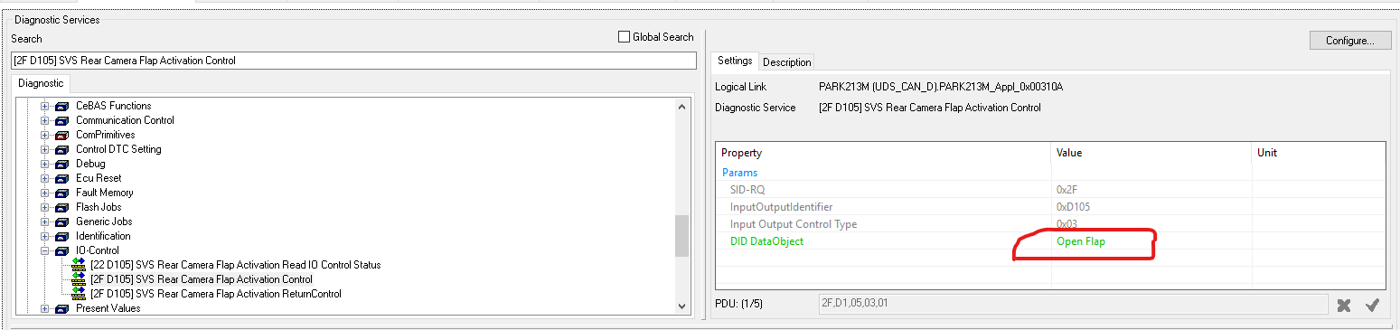
Vehicle preparation
SVS KPI Tests EOL/OCAL
Drive smooth!!! Accelerate, breake and steer softly!!!
Start the test campaign with the EOL CALIB Part!
General Data
Write down the car license plate number, the vehicle variant (e.g. 223_S), the car type, (e.g., MOL, AVA, etc.) and suspension type!
write down the “smr-d” name/number from your Monaco config
Dump the c2w coding string (.aed) via Monaco and add it to test data.
Execute script "rtaos\common_tools\Lauterbach\uscale\c2w\input\plus\RPU_C2W_intrinsic_conti_plus_dump.cmm" on RPU in Lauterbach. The result will be saved in a file "intrinsicSatConti.txt".
Execute script "rtaos\common_tools\Lauterbach\uscale\c2w\input\plus\APU_C2W_valsignals_plus_dump.cmm" on APU in Lauterbach. The result will be saved in two text files "C2W_valsignals_plus.txt".
Execute script "rtaos\common_tools\Lauterbach\uscale\c2w\debug\plus\APU_C2W_intrinsic_c2w_plus_dump.cmm" on APU in Lauterbach. The result will be saved in two text files "intrinsicSatYYYYxZZZZ.txt".
Execute script "rtaos\common_tools\Lauterbach\uscale\c2w\validation\plus\APU_C2W_nominalextrinsic_plus_dump.cmm" on APU in Lauterbach. The result will be saved in a file "nominalExtrinsic.txt".
Ask for correct (up to date) CTC & Correct Coding + Write down the exact name of the C2W string in Monaco which has been used to code the car
Check cameras (mechanically ok, no damage, no dirt on lenses)
Have OBU in your vehicle + booking for EOL/ Immendingen City area
Have Monaco, ECOM (for STAR2) and Lauterbach for Ultrascale
Code the Flaps to stay open: Launch Monaco-routine “rear cam flap activation control” and change its last value to OPEN. (Redo after each ECU Shutdown!!!)
Move front doors, mirrors and trunk as few as possible during entire test procedure, in order to keep the calibration valid
Suspenstion: Check what Suspension the car has (write it down in your diary) and if suitable information from chassis height sensors are available (make a screenshot from the signals). Hint: If you have steel suspension “invalid” is ok.
Execute the script: “rtaos\common_tools\Lauterbach\uscale\c2w\debug\plus\APU_C2W_onlinecalib_plus_watch.cmm"
find the position of the four cameras (the four entries ending with m_camPosW_vf32.m_data). The third number in the position is the height of the camera in meters.
Change the height of the chassis using the air suspension (presse the button).
While doing so, check that the heights values of the four cameras is adapted, i.e., they shall change by roughly 0.01 per cm the chassis changes

Slide 4
EOL CALIBRATION [ONLY High & Premium]
SVS KPI Tests EOL/OCAL
Place the car on the EOL target: straight and parallel as possible between the line markings; center of the front wheel align with the little grey cross hairs
Check (from the inside of the car): All doors are closed, mirrors are unfolded, trunk is closed! Do not open anything during the complete test!
Perform "Static Calibration for SVS Start” with Monaco. After the first EOL, execute “Static Calibration for SVS Request Results EOL” in Monaco. Check if the lines: “Precondition Report”, “Error Report” and “Activity Report” have the value “0”. If not 0: check with “Error code list” or if not available report this Error immediately to a C2W contact person (Markus Klein, Nils Gerhard, Manuel Schenk)
Perform Monaco job: "Reset Extrinsic Online Calibration Start” and set the Parameter [Camera ID = 4] (=all cams).
Perform "Static Calibration for SVS Start” with Monaco. [Check that default parameter are used: LinesGradientSensivity=1, LinesClusterQuality=0.4; RoiOffsetFront = 1.6m, RoiOffsetRear = 1.8m, RoiExpasionSide = 3.0m]
Wait until the indicator sign in top view turned green (=successful finished)
Execute script: "rtaos\common_tools\Lauterbach\uscale\c2w\validation\plus\ APU_C2W_eol_measurements_plus.cmm" on the APU. To write out the results to a excel file. Check if its written properly (all values are available and valid).
Repeat Step d) - g) as often as you needs according to test catalog. The script will append all measurements to "eol_extrinsic_info_measurement_series.xls". After the last measurements in one position is finished, rename the file to "_position_X" X=[straight, slanted]
Dump a Picture from the HeadUnit (of the stitching areas), see the following .ppt sheet “Take Pictures” for more information. Do not move the car away from the target to take the picture!
After this reposition the car for 20 further measurements into the most possible slanted position (possible means: no “Precondition Error” occurs) and repeat steps c) - i) for these position.
After the last successful EOL calibration (~Nr.90) read the results with Monaco "Static Calibration for SVS Get Result” and log/store all in file "eol_calib_monaco.txt“, compared this log with the last entry of the file "eol_extrinsic_info_measurement_series.xls“ you create (step g.)) by LB-script to confirm that both deliver the same data. (Small deviations <0.01 are acceptable) → DON’T SAVE THE FILE, this will change its formation!!
After this test is finished, move the car away from the calibration target (e.g., onto a normal street/parking garage, ...) and trigger the "Static Calibration for SVS Start” again. In that case, the resulting debug screen shall visualize a non-successful calibration (red light), document this in your written statement.
After all, you should have six files: 2x eol_extrinsic_info_measurement_series_position_X.xls (for the 2 different positions, each consisting of 20 measurements) 2x HeadUnit dumps (one from straight, one from slanted Position) 1x eol_calib_monaco.txt 1x Written statement for all cases, if the debug screen signalized success (green) [e.g. step f)], or non-success (red) [e.g. step l)]

Slide 5
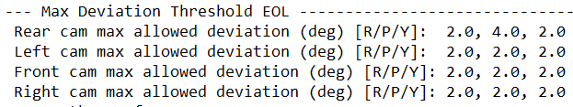
Possible EOL CALIBRATION ERRORs
SVS KPI Tests EOL/OCAL BACKUP
Align the vehicle with the lines on the floor. The front wheel axis should be aligned to the cross on the floor (More or less at 10cm, the cross are grey). Note that the placement of the car is important for the calibration. If the car is not placed correctly, an error can occur during the calibration.
DO NOT TURN THE WEELS ON THE LINES! It degrade the lines on the floor.
Execute the routine “Static Calibration for SVS Request Results EOL” in Monaco. Check if the last line which is “Error Report” have the value “0”
If the error report have a value like 16384 it could be interesting to check the limit deviation values of the cams:
With the lauterbach execute the script on APU: \\rtaos\common_tools\Lauterbach\ uscale\c2w\debug\plus\APU_C2W_onlinecalib_plus_dump.cmm It should create a text file in the same folder. Inside this text file you should find the following lines:
Compare the result values from “Monaco Results” with the maximum allowed value here extracted.
If the value of the angle from manaco is superior to the value of the dump from the lauterbach, it’s mean that the maximal value is too low to calibrate correctly the cameras.
DON’T push or touch the cameras or mirrors under any circumstances!!!
If it still does not calibrate, a camera change could be needed. Report this problem to the C2W contact person (Markus Klein, Nils Gerhard or Manuel Schenk), which will take a decision concerning the situation
If the line “Error Report” have another value, or if the blue dot turn red or orange something during the calibration was wrong.
Check if the car is correctly positioned with the line and the wheels close to the cross. It’s really important for that calibration to place correctly the car between the line with the center of the wheels in front of the grey cross
The Lines have to be completely free of parts or garbage
Try to open close the mirrors, reboot the engine, and recheck if the camera are clean and dry
Try to reboot the ECU

Slide 6
OCAL Case 2 - “Service Calibration” (starts from Reset)
SVS KPI Tests EOL/OCAL
Check: All doors closed, mirrors unfolded, trunk is closed!
[ONLY Star2] Activate ALL CAMS for Calibration with Monaco: “Variant Coding” → C2W → Activation Mode Calibration Start → “all active” = “07”
Restart ECU (hard reset by Monaco) and reconnect the Session with the routine: “StartSecureDiagSession” & Set the Flaps to stay open
Perform "Service Online Calibration Start” with Monaco. The debug screen of Service Calibration should be visible in the Head Unit and has the following behavior: (write down if the system behaves like that or not in your “written statement”)
Drive in different speeds, the shown velocity should adapt
The shown steering angle should adapt to the actual steering angle of the car
When cornering sharply or driving too fast, the debug screen should become red
Drive around how it is specified in the test catalog (e.g. industrial or city). Use the debug screen as help to not violate the steering and velocity conditions. (If not available the following scripts are useful: rtaos\common_tools\Lauterbach\uscale\c2w\ validation\plus\APU_C2W_onlinecalib_plus_validation_watch.cmm or rtaos\common_tools\ Lauterbach\uscale\c2w\debug\plus\APU_C2W_onlinecalib_plus_watch.cmm)
Once the calibration is finished, the debug screen will vanish. (or the calibration status of all four cameras go to "FULLY CALIBRATED" at Lauterbach scripts)
Execute script "rtaos\common_tools\Lauterbach\uscale\c2w\validation\ plus\APU_C2W_ocal_measurements_plus.cmm" on APU.
Repeat Steps c) - g) as often as you needs according to test catalog. The script will append all measurements in a text file "ocal_extrinsic_info_measurement_series.xls". After a series is finished, rename the file by appending the scenario description (e.g., "_industrial_daytime_below_30kmh_UC2").
After the last successful service calibration:
read results with Monaco job: "Service Online Calibration Request Results” and copy the response lines/log from this job to a "service_calib_monaco.txt“, compared this log with the last entry of your xls file “ocal_extrinsic_info_ measurement_series.xls“ you create (step g.)) by LB-script to confirm that both deliver the same data (Small deviations <0.01 are acceptable) → DON’T SAVE THE FILE in Excel, this will change its format/structure!!
[only HIGH & PREMIUM]: Dump a Picture from the HeadUnit of the stitching areas (|| & =) → see the following .ppt sheet “Take Pictures”
Execute the following script once; it will create a text file in the same folder: rtaos\common_tools\Lauterbach\uscale\c2w\debug\plus\APU_C2W_onlinecalib_plus_dump.cmm - This is needed to let the C2W team check the general behavior of the system and to check for issues when the test was failed.
After all, you should have six files: 1x "ocal_extrinsic_info_measurement_series.xls". (consisting of 5 or 10 measurements) 2x HeadUnit dumps (one longitudinal, one crosswise) 1x service_calib_monaco.txt (=Customer diagnosis log) 1x “C2W_onlinecalib_plus.txt” from debug dump 1x Written statement for all cases, if the debug screen was reacting as expected (screen appears; reaction to velocity and steering plausible; progress non-decreasing; screen disappears when finished)

Slide 7

OCAL Case 1 “Customer Calibration” (OCAL starts from Service OCAL results / PDM)
SVS KPI Tests EOL/OCAL
After the last successful calibration:
read results with Monaco job for every camera and copy the response lines/log from this job to a “customer_calib_monaco.txt“, compared this log with the last entry of the file “ocal_extrinsic_info_measurement_series.xls“ you create (step j.)) by LB-script to confirm that both deliver the same data (Small deviations <0.01 are acceptable)
read results with Monaco job: "Service Online Calibration Request Results” and copy the response lines/log from this job to a "service_calib_monaco.txt“, compared this log with the last entry of your xls file “ocal_extrinsic_info_ measurement_series.xls“ you create (step h.)) by LB-script to confirm that both deliver the same data (Small deviations <0.01 are acceptable) → DON’T SAVE THE FILE in Excel, this will change its format/structure!!
[only HIGH & PREMIUM]: Dump a Picture from the HeadUnit of the stitching areas (|| & =) → see the following .ppt sheet “Take Pictures”
Execute the following script once; it will create a text file in the same folder: rtaos\common_tools\Lauterbach\uscale\c2w\debug\plus\APU_C2W_onlinecalib_plus_dump.cmm - This is needed to let the C2W team check the general behavior of the system and to check for issues when the test was failed.
→ After all, you should have five files: 1x "ocal_extrinsic_info_measurement_series_CHECK.xls“ (from step g)) 1x "ocal_extrinsic_info_measurement_series.xls". (consists 10 measurements) 2x HeadUnit dumps (one longitudinal, one crosswise) 1x customer_calib_monaco.txt (=diagnosis log)
Check (from the inside of the car): All doors are closed, mirrors are folded in driving position, trunk is closed! Do not open anything during the test!
[ONLY STAR2] Activate ONLY Front & Rear CAM (with Monaco): “Variant Coding” → C2W → Activation Mode Calibration Start → “camera to world + hight estimation active” (coding pre-fix = 05)
Use a fresh “fully calibrated” (NOT “partially calibrated”), successful “Service Calibration” as the starting point (described in “OCAL Case 2)”. From this point, execute the script "rtaos\common_tools\ Lauterbach\uscale\c2w\validation\plus\ APU_C2W_ocal_measurements_plus.cmm"
Let the car go to sleep in order to persist/save this calibration (= unplug ECOM, and lock the car for some minutes (>5min) till everything is off, check with LB till “system down” occours). After startup execute script "APU_C2W_ocal_measurements_plus.cmm" again. All values must be stay equal, but the status go from "fully calibrated to partially calibrated“ → rename the file “_CHECK”!
From now the ECU must under no circumstances go to sleep mode!
Drive around how it is specified in the test catalog. Use the “OCAL-watch-Screen” ("rtaos\common_tools\Lauterbach\uscale\c2w\validation\plus\APU_C2W_onlinecalib_plus_validation_watch.cmm for regarding the progress. Stop when the cameras have the status GCM_FULLY_CALIBRATED.
After success, stop the car and execute script "rtaos\common_tools\Lauterbach\ uscale\c2w\ validation\plus\APU_C2W_ocal_measurements_plus.cmm" on APU.
Restart ECU (e.g. by pressing "Parken 5.0" button in car) & Set the Flaps to stay open
Repeat Steps f) - k) as often as you needs according to test catalog. The script will append all measurements in a text file "ocal_extrinsic_info_measurement_series.xls".

Slide 8
[ONLY STAR2] OCAL Case 1+ “Full Ocal Customer Calibration” (OCAL starts from Service OCAL results / PDM)
SVS KPI Tests EOL/OCAL
After the last successful calibration:
read results with Monaco job for every camera and copy the response lines/log from this job to a “customer_calib_monaco.txt“, compared this log with the last entry of the file “ocal_extrinsic_info_measurement_series.xls“ you create (step j.)) by LB-script to confirm that both deliver the same data (Small deviations <0.01 are acceptable)
read results with Monaco job: "Service Online Calibration Request Results” and copy the response lines/log from this job to a "service_calib_monaco.txt“, compared this log with the last entry of your xls file “ocal_extrinsic_info_ measurement_series.xls“ you create (step h.)) by LB-script to confirm that both deliver the same data (Small deviations <0.01 are acceptable) → DON’T SAVE THE FILE in Excel, this will change its format/structure!!
Dump a Picture from the HeadUnit of the stitching areas (|| & =) → see the following .ppt sheet “Take Pictures”
Execute the following script once; it will create a text file in the same folder: rtaos\common_tools\Lauterbach\uscale\c2w\debug\plus\APU_C2W_onlinecalib_plus_dump.cmm - This is needed to let the C2W team check the general behavior of the system and to check for issues when the test was failed.
→ After all, you should have five files: 1x "ocal_extrinsic_info_measurement_series_CHECK.xls“ (from step g)) 1x "ocal_extrinsic_info_measurement_series.xls". (consists 10 measurements) 2x HeadUnit dumps (one longitudinal, one crosswise) 1x customer_calib_monaco.txt (=diagnosis log)
Check (from the inside of the car): All doors are closed, mirrors are folded in driving position, trunk is closed! Do not open anything during the test!
Activate ALL CAMS for Calibration with Monaco: “Variant Coding” → C2W → Activation Mode Calibration Start → “all active” = “07”
Use a fresh “fully calibrated” (NOT “partially calibrated”), successful “Service Calibration” as the starting point (described in “OCAL Case 2)”. From this point, execute the script "rtaos\common_tools\ Lauterbach\uscale\c2w\validation\plus\ APU_C2W_ocal_measurements_plus.cmm"
Let the car go to sleep in order to persist/save this calibration (= unplug ECOM, and lock the car for some minutes (>5min) till everything is off, check with LB till “system down” occurs). After startup execute script "APU_C2W_ocal_measurements_plus.cmm" again. All values must stay the same, but the status go from "fully calibrated to partially calibrated“ → rename the file “_CHECK”!
From now the ECU must under no circumstances go to sleep mode!
Drive around how it is specified in the test catalog. Use the “OCAL-watch-Screen” ("rtaos\common_tools\Lauterbach\uscale\c2w\validation\plus\APU_C2W_onlinecalib_plus_validation_watch.cmm for regarding the progress. Stop when the cameras have the status GCM_FULLY_CALIBRATED.
After success, stop the car and execute script "rtaos\common_tools\Lauterbach\ uscale\c2w\ validation\plus\APU_C2W_ocal_measurements_plus.cmm" on APU.
Restart ECU (e.g. by pressing "Parken 5.0" button in car) & Set the Flaps to stay open
Repeat Steps f) - k) as often as you needs according to test catalog. The script will append all measurements in a text file "ocal_extrinsic_info_measurement_series.xls".

Slide 9
OCAL Case 3
SVS KPI Tests EOL/OCAL
“long run” (starts from a persisted Service OCAL)
a) Do all Steps from OCAL Case 1, Step: a) – e) to start from a fresh “Service OCAL” / PDM Data
b) Execute script "rtaos\common_tools\Lauterbach\uscale\c2w\validation\ plus\APU_C2W_onlinecalib_plus_validation_watch.cmm" on APU to start the “OCAL-watch-screen”. Here the Calib-status should be "GCM_PARTIALLY_CALIB". for every camera. Furthermore, check whether a deviations has appeared, i.e., “GCM_CALIB_ERROR_DEVIATION” is not set. ”. Otherwise: report the Error Values immediately to a C2W contact person (Markus Klein, Nils Gerhard or Manuel Schenk).
[ONLY STAR 2]: Activate ONLY Front & Rear CAM (with Monaco): “Variant Coding” → C2W → Activation Mode Calibration Start → “camera to world + hight estimation active”
c) Drive around how it is specified in the test catalog (<50-60 km/h, not too much steering). Use the “OCAL-watch-Screen” for regarding the progress.
h) Execute every 5-10 minutes the script "rtaos\common_tools\Lauterbach\uscale\c2w\validation\plus\ APU_C2W_ocal_measurements_plus.cmm" on APU.
e) Stop driving after the time documented in the test catalog. After that, you should have a file (ocal_extrinsic_info_measurement_series.xls) with measures from every 5-10 minutes.
→ Drive like an end customer would to, also use eg. APC or drive in and out a parking house, have a protocol of your trajectory

Slide 10
Possible OCAL ERRORs
SVS KPI Tests EOL/OCAL
Depending of the error, some action could be needed to fix the problem
For example, “error luminosity check”. Here the problem is that the luminosity is too low to take measurements. In that case
If it’s dark you should find an enlighten place to finish the calibration
If it’s day time an error in the ECU occurs or the camera are too dirty -> try to clean the camera, if the error status disappear continue the calibration
If cleaning the camera doesn’t work, stop the service calibration via Monaco (Service Online Calibration stop), reset the ECU, clear the DTC and try to see if the problem is still here.
A lot of problem can be fixed by the following procedure; stop the service calibration via Monaco (Service Online Calibration stop) if needed, reset the ECU, clear the DTC and try to see if the problem is still here. If it’s a persistent problem, try to completely switch off the car and wait for the timout. Then try again.
To deactivate the rear flap try to change in Monaco: Svs rear Camera flap activation -> DID Data… -> activate
All Status have to be "GCM_PARTIALLY_CALIB". Furthermore, check whether a deviations has appeared, i.e., GCM_CALIB_ERROR_DEVIATION” is not set for all of the cameras. ”. If GCM_CALIB_ERROR_DEVIATION is set for one (or more) cameras: report the Error Values immediately to a C2W contact person (Markus Klein, Nils Gerhard or Manuel Schenk).
If after a few time the calibration do not progress (10 minutes) you need to determine why the calibration is not working
Execute script "rtaos\common_tools\Lauterbach\uscale\c2w\ validation\plus\APU_C2W_onlinecalib_plus_validation_watch.cmm" on APU to start the “OCAL-watch-screen”.
In case of a problem, you can check different lines on that window to determine if there is a problem or not.
The first thing to check is the calibration state; which camera is calibrating and which one stays at 0 (calibration progress by camera). The order is always the same; 1 – rear camera 2 – left camera 3 – front camera 4 – right camera.
If one stay stuck a 0, you should check :
the state of the calibration of the camera (ErrorCalibration state on the calibration status per cam lines)
The error status of each camera
PreCondition Problems

Slide 11
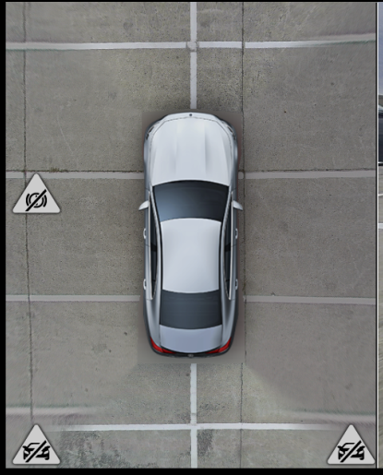
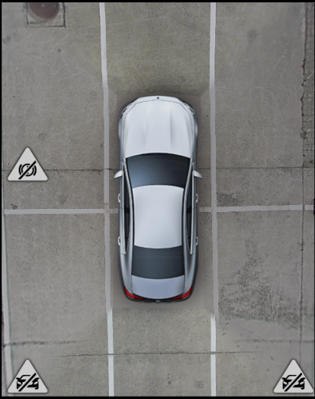
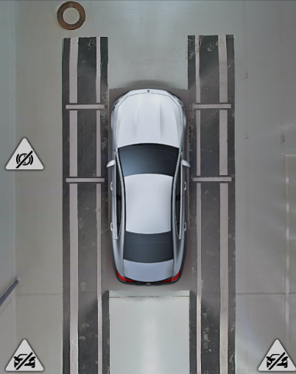
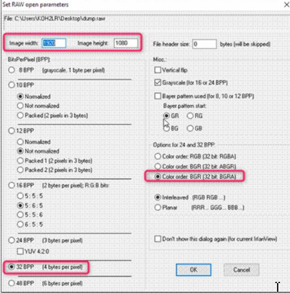
Take Pictures [ONLY High & Premium]
SVS KPI Tests EOL/OCAL
Take HeadUnit dumps from the TOPVIEW via Lauterbach to evaluate the quality of the calibration by the accuracy of the stiching areas. Therefore park the car somewhere on lines or a checkerboard structure on ground. If needed, repeat in a different position (longitudinal AND crosswise).
Important: The ground must be as even as possible!
OCAL: 1Pic on the Lines longitudinal and 1 Pic crosswise
EOL-CAL: 1Pic on the EOL Target
HOWTO dump: Attach with LB to RPU and execute the following command to generate a dump (picture) of the head unit:
data.SAVE.binary *.rgb.raw E:var.value(\lad_vidout_runnable_plus\lad_vidout::pltevidout::g_pixmapAddr_st[0])++7E9000
→ open the raw pictures with „IrfanView“ (DAI Star3 / Star3: 1888x1155) and save as .jpeg

Slide 12
Dump masks and Surroundviews
SVS KPI Tests
MASKS
The car has to be successful calibrated at least one time before this test!
Execute the following scripts from NRC20-Repo: “rtaos\pf\cv\c2w\scripts\mask” (https://sourcecode.socialcoding.bosch.com/projects/NRCSGEN2/repos/nrc2/browse/rtaos/pf/cv/c2w/scripts/mask)
dump_imgData.cmm (on RPU – to dump raw pictures as .bin)
dump_MaskAndImage.cmm (on RPU – to dump the masks)
dump_MaskPoints.cmm (on RPU – to dump the masks)
dump_secondaryMaskPoints.cmm (on RPU – to dump the masks) -> DON’T WORK!!!
Make sure that all gernerated file has an appropriate file size (NOT 0 kB!!!)
doesn‘t work: Execute the Monaco routine „SVS_Perspectiv_Write“ with the parameter „12“ to get an debugview of the masks in the HeadUnit and Dump a Picture from this HeadUnit view → see the following .ppt sheet “Take Pictures”
SURROUNDVIEWS / SVS
The car has to be successful calibrated at least one time before this test!
Take a dump of all available HeadUnit views related to SVS-Views:
Front pano
Rear pano
SideView
SideView with folded Mirrors
Rearview
Rearview with folded Mirrors
Frontview
Hitch
3d View
Dump a Picture from EACH this HeadUnit view:
Attach with LB to RPU and execute the following command:
data.SAVE.binary *.rgb.raw E:var.value(\lad_vidout_runnable_plus\ lad_vidout::pltevidout::g_pixmapAddr_st[0])++7E9000
this generates a dump (picture) of the head unit
Open the raw pictures with „IrfanView““ (DAI Star3 / Star3: 1888x1155) and save as XXX.jpeg (use the names from above)

