Slide 1
Retrieval-Augmented Garment Generation with Diffusion Models
Author: Claudia Cornacchia - 1986434
Course: Neural Networks
Sapienza University of Rome

Slide 2
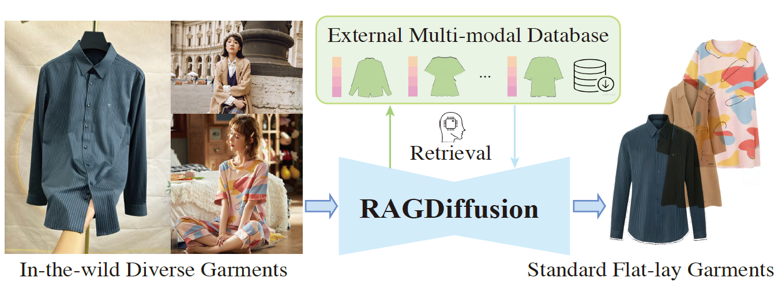
Motivation & Objectives
The problem: Standard diffusion models fail to synthesize standard flat-lay garments from in-the-wild diverse images.
“Structural Hallucinations”: artifacts such as incorrect patterns or shapes, distorted necklines produced by the model in the generation.
The solution: Retrieval Augmented Generation (RAG), augment the model by retrieving a reliable structural guidance from an external database to reduce hallucinations and improve structural accuracy.
Project Goal: investigate the RAG mechanism by replicating the framework proposed in RAGDiffusion [1] and adapting it to settings with limited computational resources

Slide 3
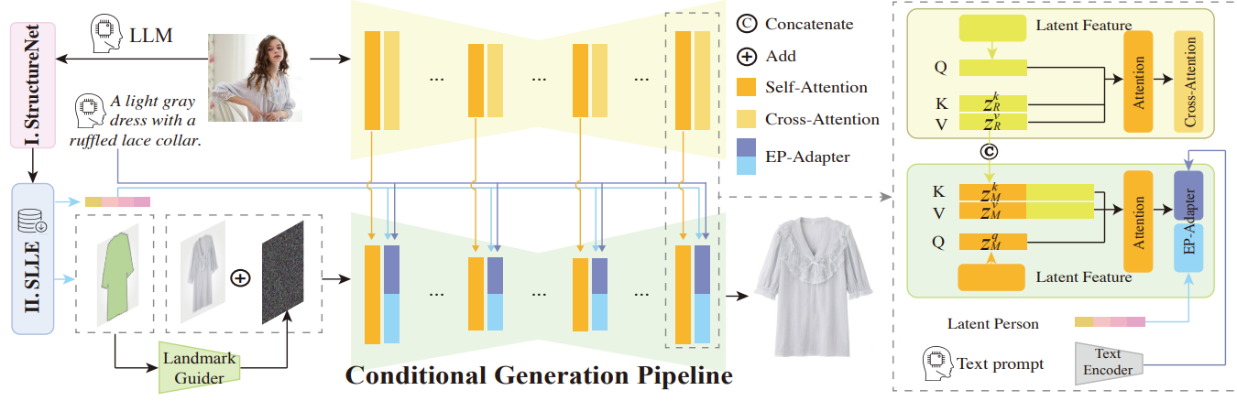
Methodology: The RAG Pipeline
The garment generation is conditioned on 4 inputs:
Structure Embeddings:
Computed by StructureNet from the fusion of visual CLIP features + LLM attributes
Refined via SLLE
Garment silhouette: retrieved from the Retrieval Database, acting as an hard constraint on the final garment shape.
Prompt: generated by a LLM, provides explicit semantic context such as color, pattern, and fabric type.
Reference Latents: the clean latent of the original in-the-wild image produced with the SDXL VAE, serving as the source of high-frequency details.

Slide 4
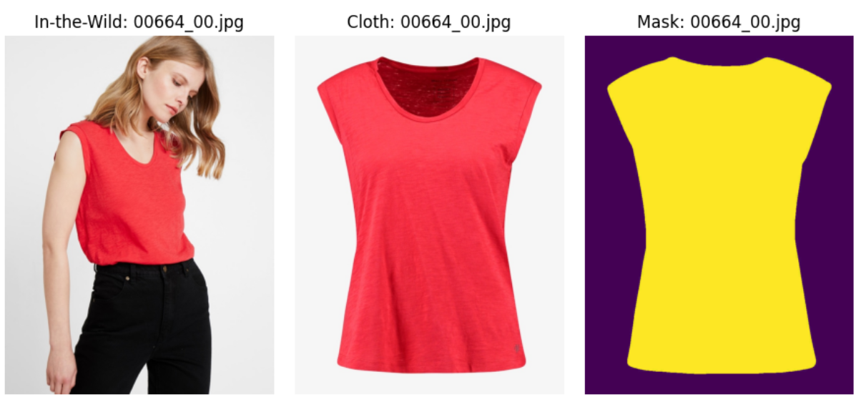
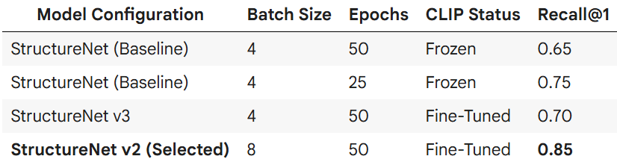
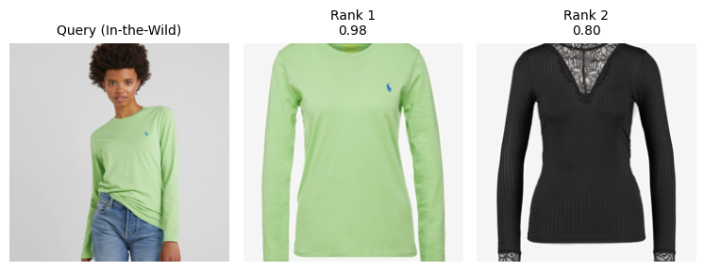
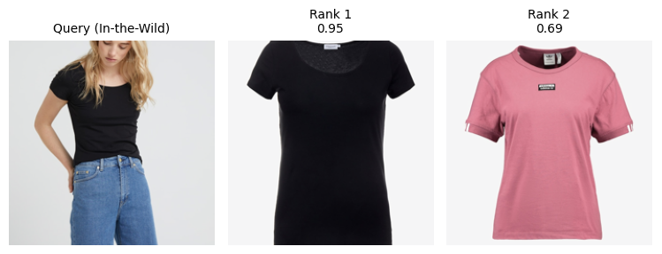
Implementation
StructureNet Training:
Designed to map garment image from 2 distinct domain (In-the-Wild - Flat-Lay) into a shared embedding space.
Trained using Contrastive Loss (InfoNCE) on a representative subset of 100 pairs.
Dataset VITON-HD: ~13k high resolution images (1024x768).
Paired garment and in-the-wild images with associated garment masks
Retrieval database D
Consists of pairs -> (Standard embedding, Mask)
Clustering: DBSCAN (Ɛ=0.4) to group structurally similar items, remove redundancy and outliers.
Downsampling: Cluster-Aware Sampling (proportionally to the cluster size) to obtain a database of 2000 pairs.
This maintains the structural diversity while reducing retrieval latency and memory usage.
Testing the performance on a retrieval task (given the in-the wild image return the k best match in the test set)

Slide 5
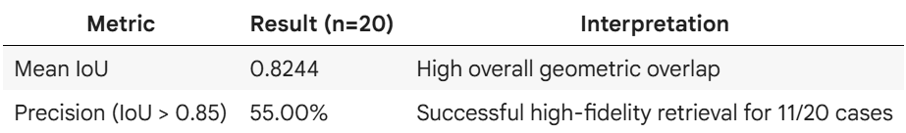
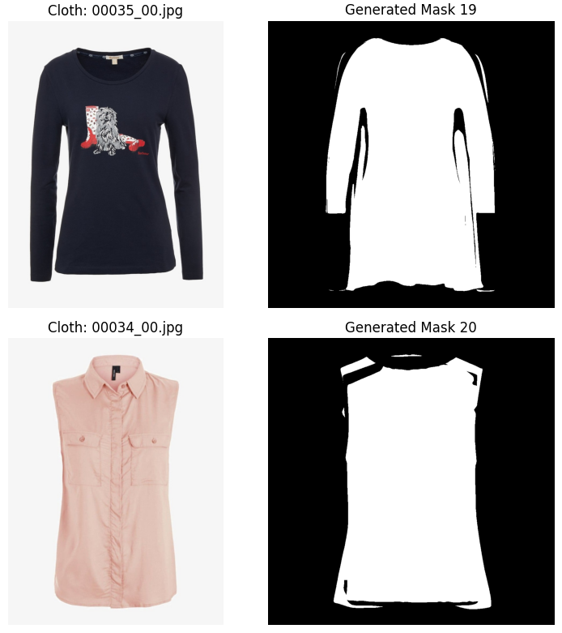
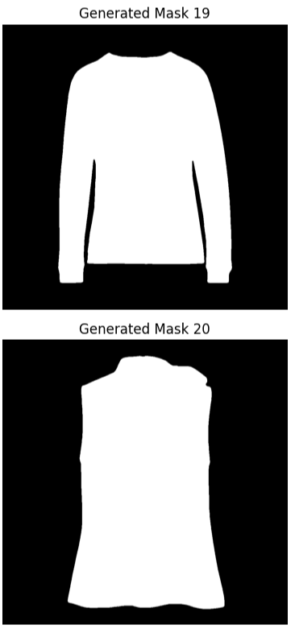
Implementation
Hard constraint (Silhouette mask)
Silhouette retrieval: replaced SLLE which produced blurry masks, with a Cohesion-based selection (choose the single candidate with highest average IoU overlap from the k retrieved neighbors)
Injection: I integrated the pretrained ControlNet-Canny (SDXL 1.0) using the binary silhouette as strong edge map which the Canny model is expert at interpreting.
Soft constraint (Structural embedding)
The EP-Adapter first projects the embeddings into the dimensional space of the SDXL text encoder and then adds a parallel Cross-Attention layer in the U-Net for joint text-structure conditioning.
Adapter weights remain untrained due to computational constraints.
Generation quality is currently mainly driven by the geometric constraint (ControlNet) and semantic control (LLM).

Slide 6
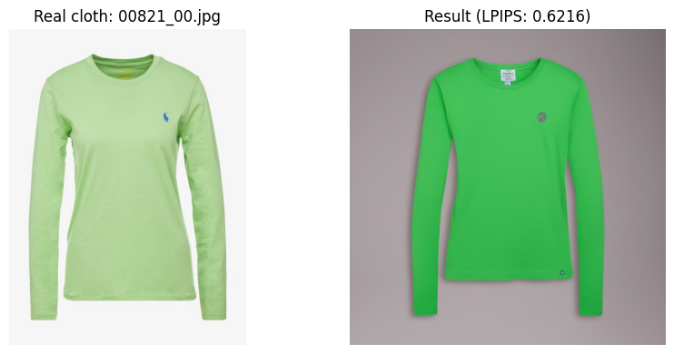
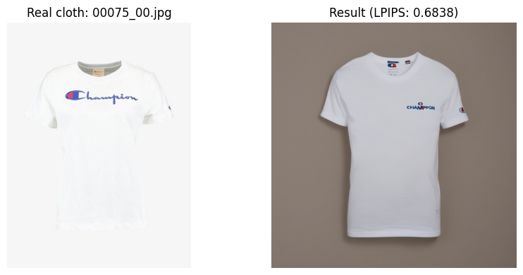
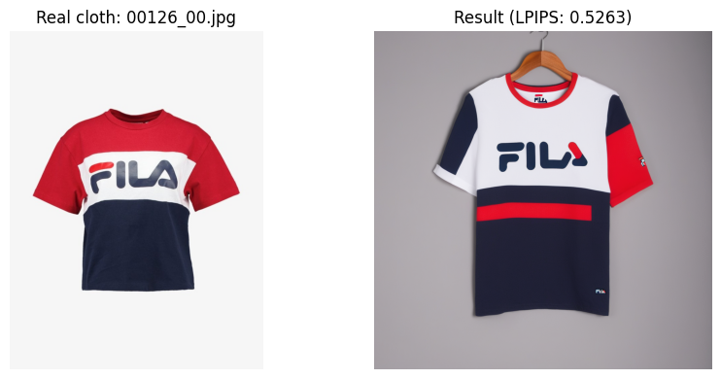
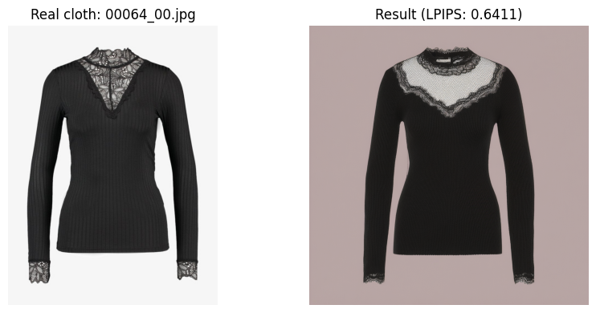
Analysis and Visual results
Due to significant computational constraints, large-scale quantitative benchmarking over thousands of samples was not feasible. Instead, this project focused on component-level validation and perceptual faithfulness, providing insight on the effectiveness of the proposed multi-level conditioning.
Perceptual Faithfulness: computed Learned Perceptual Image Patch Similarity (LPIPS), which measures the perceptual distance between generated output and ground truth, across a test set of 12 samples, achieving a Mean LPIPS of 0.706 (Lower is better).
Observations:
Large logos and macro structures are quite preserved while fine textures and small, repetitive details aren’t well reproduced.
The pipeline functions correctly end-to-end, but the overall fidelity remains limited by computational constraints. .

Slide 7
Conclusion
Future Work
The primary objective of this project was not to achieve state of the art performance, but to understand the mechanisms of Retrieval-Augmented Generation (RAG) within the context of diffusion-based image synthesis.
I successfully validated the multi-level conditioning pipeline, understanding how external knowledge (Retrieval) can effectively mitigate structural hallucinations.
Train EP-Adapter: Unfreeze weights to enable texture transfer from StructureNet.
Implement Decoding Faithfulness: Replace the standard SDXL VAE (which suffers from high compression artifacts) with the 16-channel FLUX VAE and align the 16-channel VAE latent space with the 4-channel SDXL U-Net.
Expand Dataset Diversity: to improve generalization beyond human-worn inputs.

Slide 8
References
Papers:
[1] Yuhan Li, Xianfeng Tan, Wenxiang Shang, Yubo Wu, Jian Wang, Xuanhong Chen, Yi Zhang, Ran Lin, Bingbing Ni. (2025). RAG-Diffusion: Faithful Cloth Generation via External Knowledge Assimilation. arXiv preprint arXiv:2411.19528v2. (Primary architectural framework).
[2] Dustin Podell, Zion English, Kyle Lacey, Andreas Blattmann, Tim Dockhorn, Jonas M¨uller, Joe Penna, and Robin Rombach. (2023). SDXL: Improving Latent Diffusion Models for High-Resolution Image Synthesis. arXiv preprint arXiv:2307.01952. (Backbone generative model).
[3] Jinze Bai, Shuai Bai, Shusheng Yang, Shijie Wang, Sinan Tan, Peng Wang, Junyang Lin, Chang Zhou, and Jingren Zhou. (2023). Qwen-VL: A Versatile Vision-Language Model for Understanding, Localization, Text Reading, and Beyond. arXiv preprint arXiv:2308.12966. (Used for semantic attribute extraction and prompt generation).
[4] Hu Ye, Jun Zhang, Sibo Liu, Xiao Han, Wei Yang. (2023). IP-Adapter: Text Compatible Image Prompt Adapter for Text-to-Image Diffusion Models. arXiv preprint arXiv:2308.06721. (Source for the Perceiver Resampler and the architectural basis of the EP-Adapter).
[5] Li Hu, Xin Gao, Peng Zhang, Ke Sun, Bang Zhang, and Liefeng Bo. (2023). Animate anyone: Consistent and controllable image-to-video synthesis for character animation. arXiv preprint arXiv:2311.17117. (Methodological source for ReferenceNet and spatial feature injection).
[6] Seunghwan Choi, Sunghyun Park, Minsoo Lee, Jaegul Choo. (2021). VITON-HD: High-Resolution Virtual Try-On via Misalignment-Aware Normalization. arXiv preprint arXiv:2103.16874. (Dataset source via Kaggle).
Slides:
https://github.com/pietro-nardelli/sapienza-ppt-template [Attribution-NonCommercial-ShareAlike 4.0 International (CC BY-NC-SA 4.0)]

Slide 9
Thank you for the attention!

