Slide 1
Lab 1: Packet Sniffing and Wireshark
Fengwei Zhang

Slide 2
Packet Sniffer
Packet sniffer is a basic tool for observing network packet exchanges in a computer
Capturing (“sniffs”) packets being sent/received from/by your computer
A packet sniffer itself is passive
Displaying the contents of the various protocol fields in these captured packets, but never sending packets itself

Slide 3
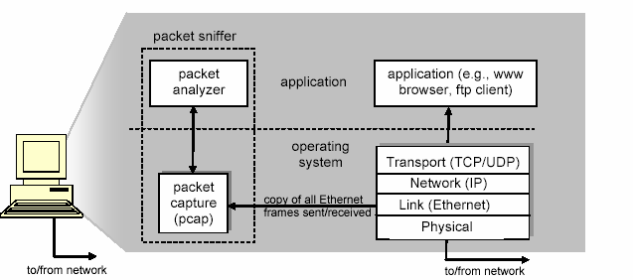
Packet Sniffer Structure

Slide 4
Packet Sniffer (cont’d)
Applications ( web browsers, FTP clients, email clients )
Network protocols (Internet protocol)
Packet capture
The packet capture library receives a copy of every link-layer frame that is sent from or received by your computer
Packet Analyzer
Displaying the contents of all fields within a protocol message
Understanding the structure of all messages exchanged by protocols
IP, TCP, HTTP headers
Wireshark, TCPDump

Slide 5
TCP/IP Network Stack
TCP/IP is the most commonly used network model for Internet services.
Because its most important protocols, the Transmission Control Protocol (TCP) and the Internet Protocol (IP) were the first networking protocols defined in this standard, it is named as TCP/IP.
It contains multiple layers including:
Application layer
Transport layer
Network layer
Data link layer

Slide 6
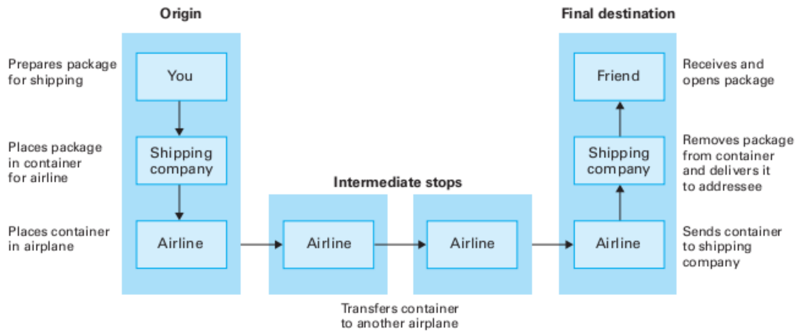
An Example Layered Approach

Slide 7
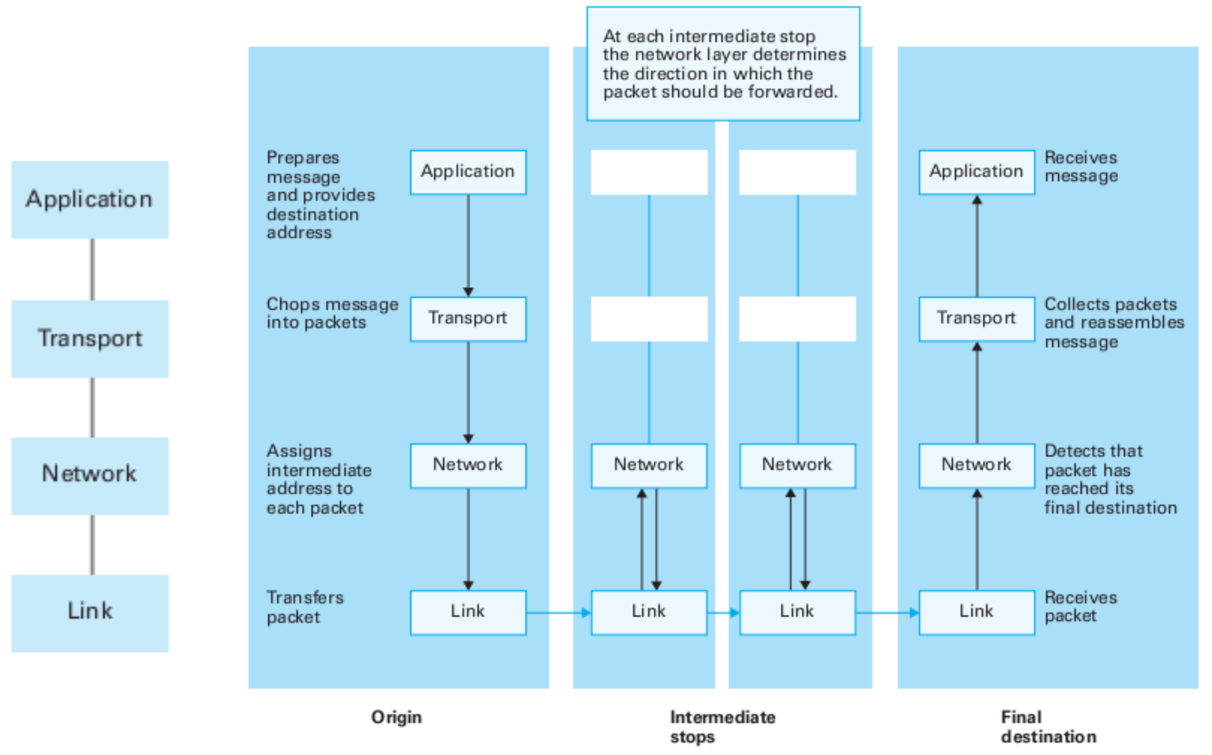
Network Layers

Slide 8
Application Layer
The application layer includes the protocols used by most applications for providing user services
Examples of application layer protocols are Hypertext Transfer Protocol (HTTP), Secure Shell (SSH), File Transfer Protocol (FTP), and Simple Mail Transfer Protocol (SMTP)

Slide 9
Transport Layer
The transport layer establishes process-to-process connectivity, and it provides end-to-end services that are independent of underlying user data.
To implement the process-to-process communication, the protocol introduces a concept of port. The examples of transport layer protocols are Transport Control Protocol (TCP) and User Datagram Protocol (UDP).
The TCP provides flow control, connection establishment, and reliable transmission of data, while the UDP is a connectionless transmission model.

Slide 10
Internet Layer
The Internet layer is responsible for sending packets to across networks.
It has two functions: 1) Host identification by using IP addressing system (IPv4 and IPv6); and 2) packets routing from source to destination.
The examples of Internet layer protocols are Internet Protocol (IP), Internet Control Message Protocol (ICMP), and Address Resolution Protocol (ARP).

Slide 11
Link Layer
The link layer defines the networking methods within the scope of the local network link.
It is used to move the packets between two hosts on the same link. An common example of link layer protocols is Ethernet.

Slide 12
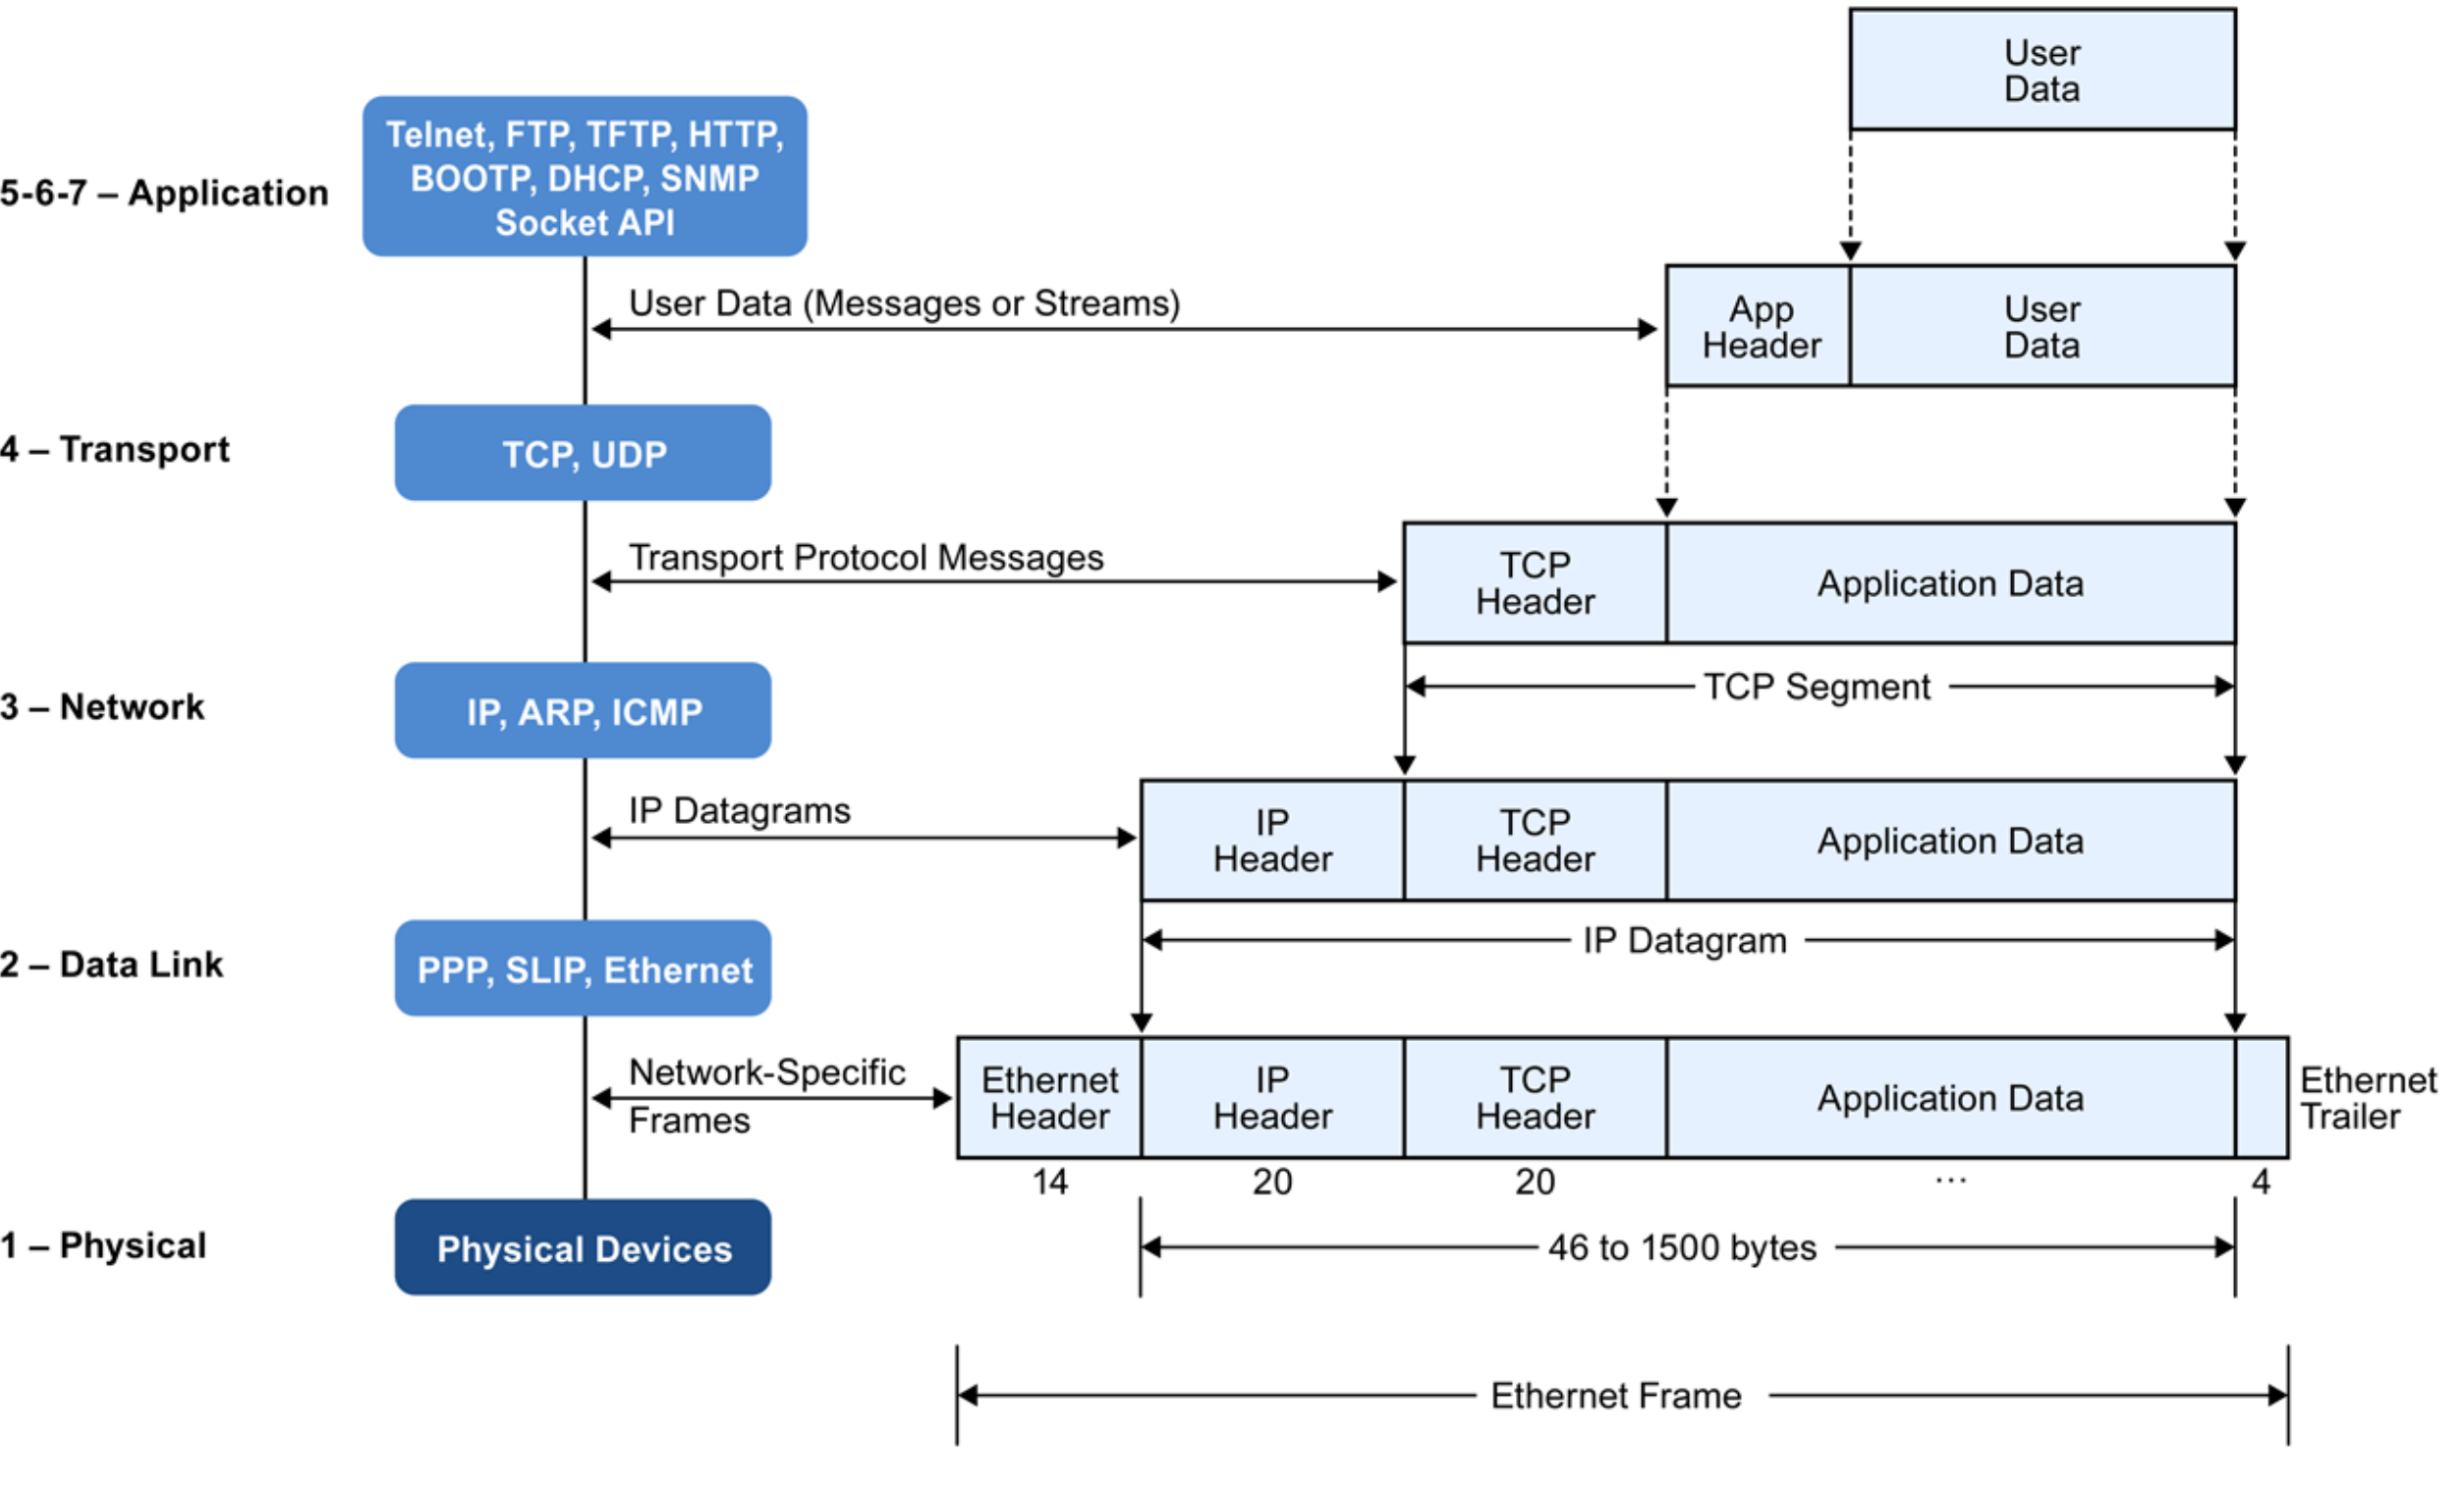
Data Encapsulation in Network Stack

