Slide 1
CS 315 Computer Security (计算机安全)
Instructor: Fengwei Zhang

Slide 2
Who Am I?
Fengwei Zhang
Associate Professor of Computer Science
Office: Room 515, South Tower, Engineering Building
Email: zhangfw@sustech.edu.cn
Website: http://cse.sustech.edu.cn/faculty/~zhangfw/
Course Information
Course website: https://fengweiz.github.io/24fa-cs315/index.html

Slide 3
Why Study Security?

Slide 4
Why Study Security?
It’s cool to be a hacker
It’s a hot topic and media talk about it
It’s useful for finding a job

Slide 5
Course Overview
This course aims help students to learn the principles of computer security and understand how various security attacks and countermeasures work
Providing hands-on experience in playing with security software and network systems in a live laboratory environment, including Capture-the-flag
Taking both offensive and defense methods to help student explore security tools and attacks in practice
Focusing on attacks, hacking fundamentals, defenses.

Slide 6
Course Objectives
Understanding on real-world security vulnerabilities, exploits and defenses
Having hands-on labs in network and system security experiments
Learning knowledge of practical security problems and their solutions

Slide 7
Course Labs
Lab 1: Packet Sniffing and Wireshark
Lab 2: Buffer Overflows and Defense
Lab 3: Secure Coding and Format-String Vulnerability
Lab 4: Scanning, Reconnaissance, and Penetration Testing
Lab 5: Reverse Engineering and Obfuscation
Lab 6: IoT Security and Wireless Exploitation

Slide 8
Course Labs
Lab 7: Nailgun Attack
Lab 8: Nailgun Defense
Lab 9: Dirty COW Attack
Lab 10: RSA Public-Key Encryption and Signature
Lab 11: Web Security
Lab 12: Return-to-libc and Return Oriented Programming

Slide 9
Lab Assignments
12 lab assignments
Source code
Write up PDF

Slide 10
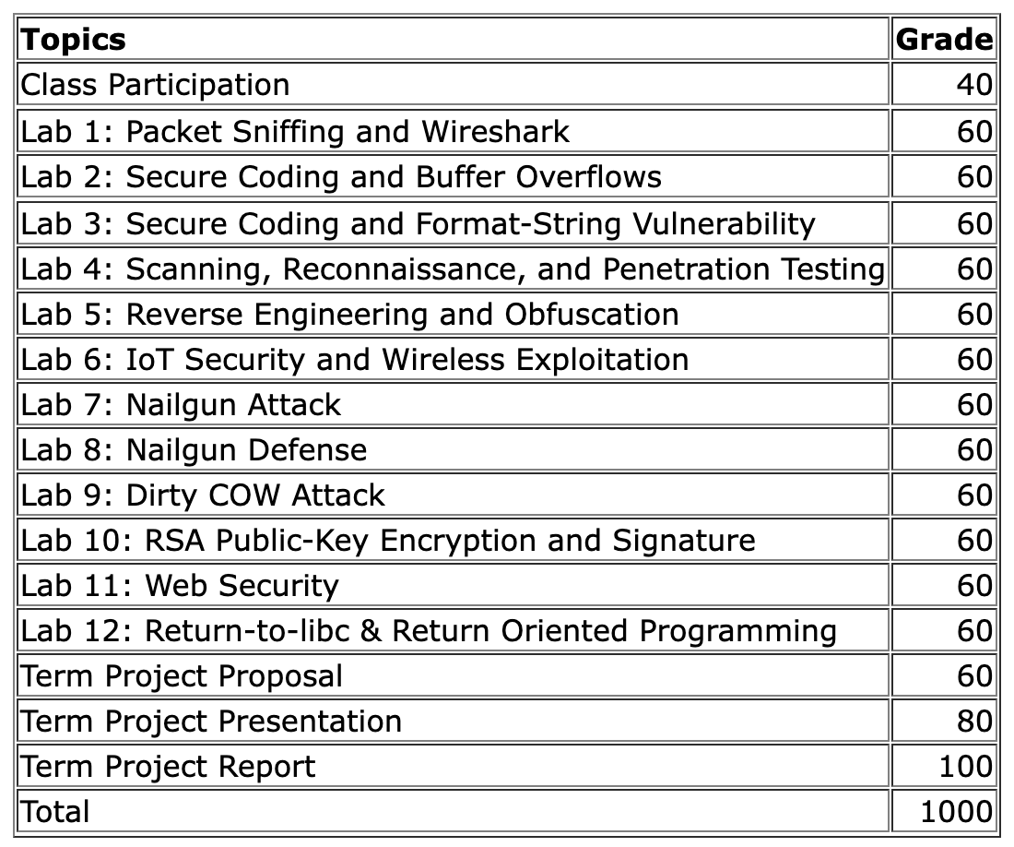
Grading: Labs and Term Project

Slide 11
Course Prerequisites
Familiar with Linux/Unix Commands
It would be better if you know:
Basic C, Java, Assembly, etc.
Operating systems
Computer networks

Slide 12
Policies on Late Submissions
Lab and project deadlines will be firm.
Late homework will be accepted with a 10% reduction in grade for each day they are late by.
Once a homework assignment is discussed in class, submissions will no longer be accepted.

Slide 13
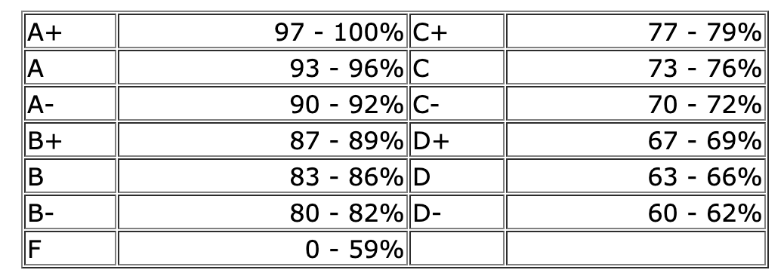
Grading Scale
The grades for the course will be based upon the percentages given by the university

Slide 14
Academic Integrity
Students need to sign the Assignment Declaration Form in your first lecture.
Our department can refuse students to choose the CSE Major if they do not sign the declaration form.
Please read and fill the Undergraduate Students Assignment Delcaration Form in Chinese and English. More details on Regulations.

Slide 15
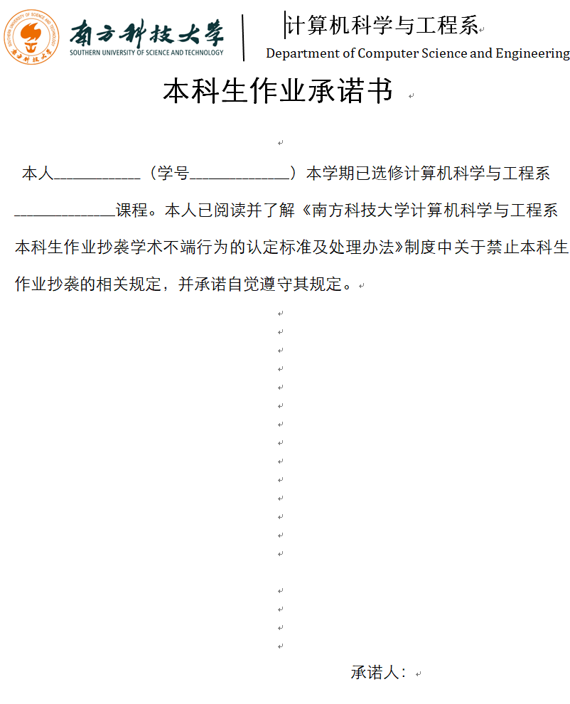
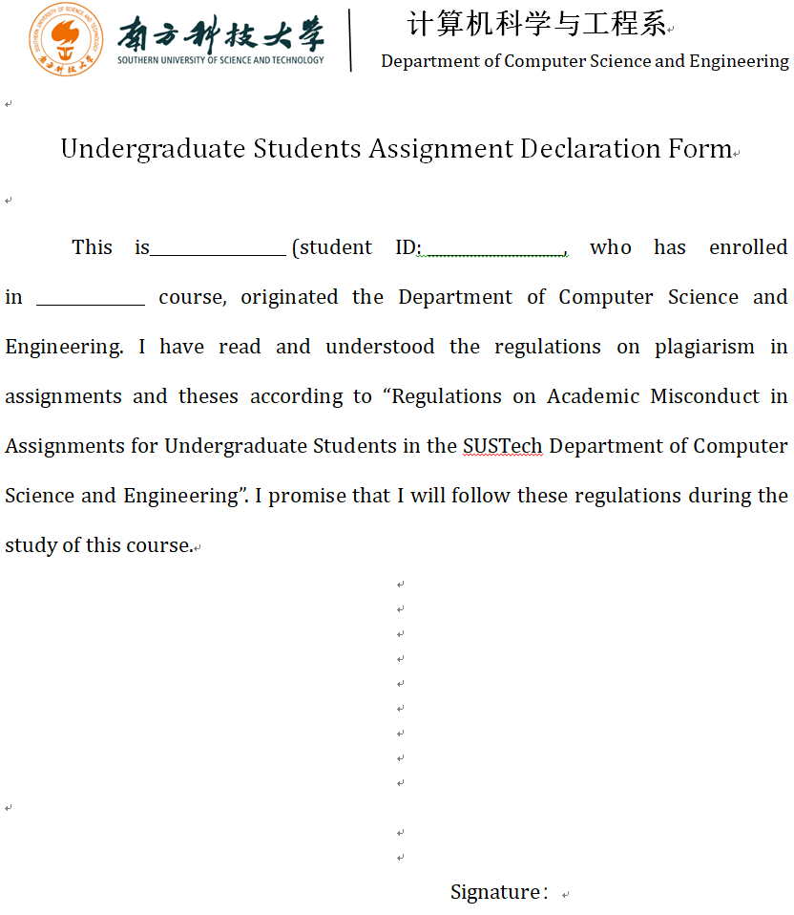
Academic Integrity

Slide 16
Student Disabilities Services
If you have a documented disability that requires accommodations, you will need to register with the University for coordination of your academic accommodations, and let me know.

Slide 17
TAs
Junjie Huang, first year Ph.D. student
Yankai Xu, first year master student
Xingchen Xia, first year master student

Slide 18
Other Resources
Course Website:
https://fengweiz.github.io/24fa-cs315/index.html
Instructor homepage:
http://cse.sustech.edu.cn/faculty/~zhangfw

Slide 19
Lab Session
Lab 1: Packet Sniffing and Wireshark
Be prepared!
Please read and fill the Undergraduate Students Assignment Declaration Form

