Slide 1
CS 315: Computer Security Team/Term Project
Fengwei Zhang

Slide 2
General Information
A research project with 2-4 individuals
Building a new system
Improving/Re-showing an existing technique/attack
Performing a large case study
Deadlines
Project proposals due on Sep 30, 10am
Project discussion on Sep 30
Project presentations are on December 23
Project final reports due on December 23

Slide 3
Grading
Term Project Proposal: 60 points
Term Project Progress Meetings: 60 points
Term Project Presentation: 60 points
Term Project Report: 60 points

Slide 4
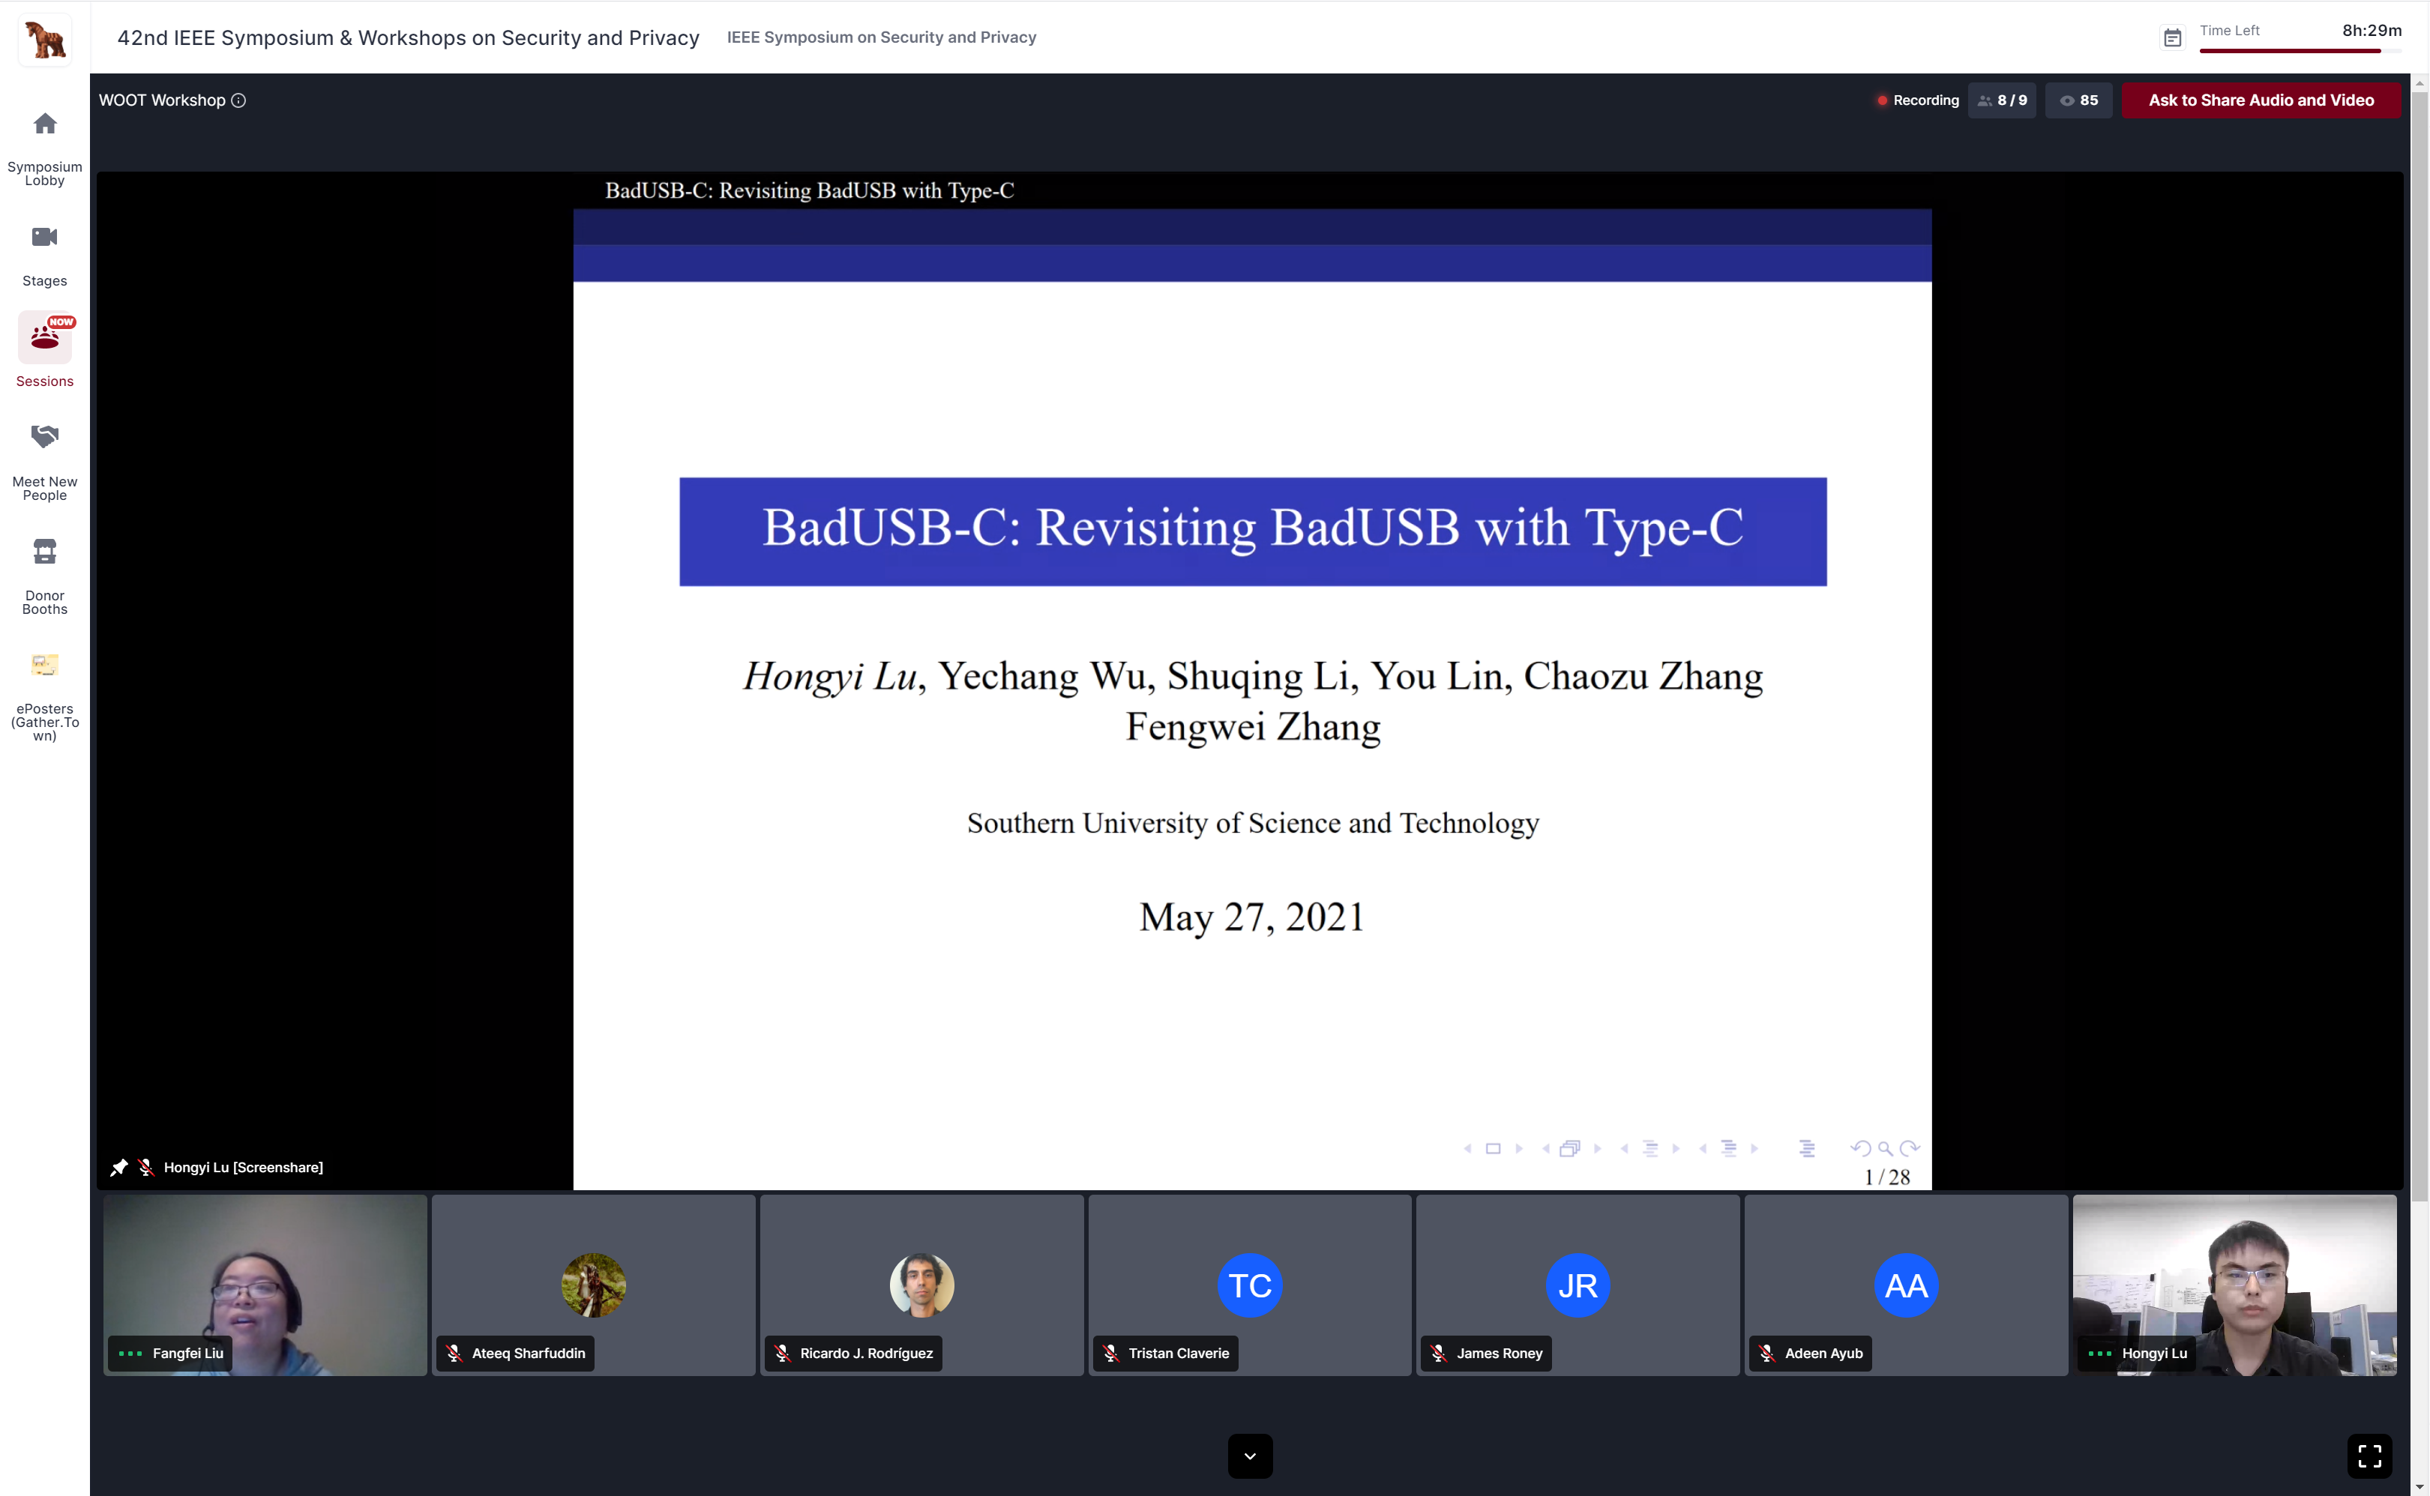
Project Topic Examples
http://cse.sustech.edu.cn/cn/news/view/id/845
华为采用南科大计算机本科生的成果封堵手机漏洞

Slide 5
Project Topic Examples
RISC-V Xiangshan project
https://docs.xiangshan.cc/zh-cn/latest/
COMPASS publications reimplementation
https://compass.sustech.edu.cn/publications_en.html
Joint Project with our Business School
Checking a website if it complies with the privacy policies/laws such as GDPR
Privacy Computing 隐私计算

Slide 6
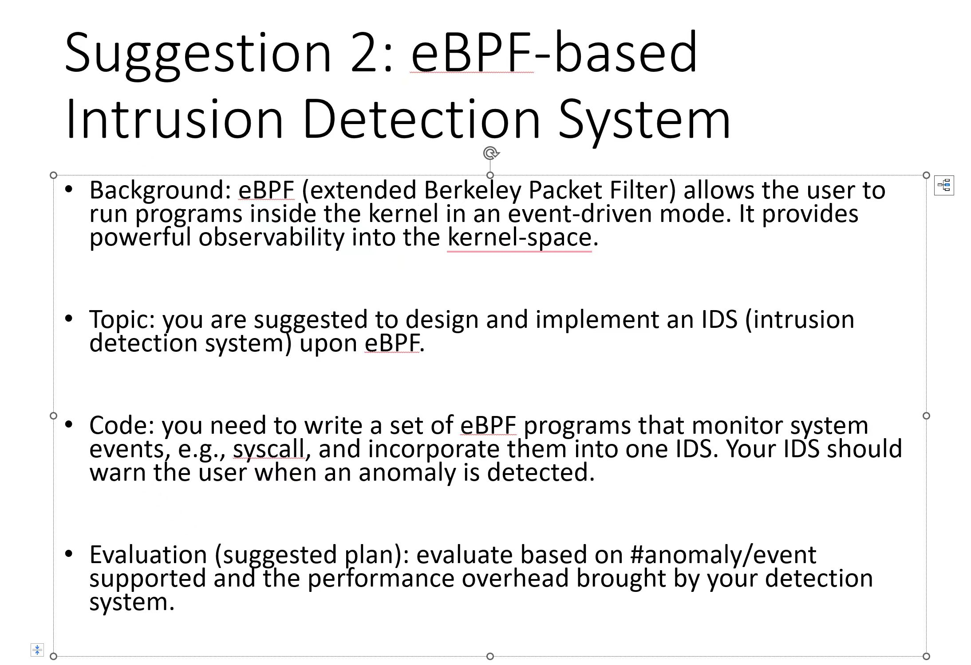
Project Topic Examples

Slide 7
Project Topic Examples
Cold boot attack on Arm architecture (hard)
https://citp.princeton.edu/our-work/memory/
Single-instruction stepping of Ninja (medium+)
- 忍者论文：https://fengweiz.github.io/paper/ninjausenixsecurity17.pdf
- 忍者期刊：https://fengweiz.github.io/paper/ninja-tifs19.pdf
- 复现论文，研究Instruction Skid问题，尝试用LAPIC来缓解。

Slide 8
Project Topic Examples
Building an Encalve in normal world via TZASC and Stage-2 on Arm (hard)
- COMPASS工业界项目，双周会周四上午9点半
Hacking System Management Mode on x86 (medium-)
- 微笑论文：https://cse.sustech.edu.cn/faculty/~zhangfw/paper/smile-sp22.pdf
- Intel DCI-based debugging facility: https://www.ptsecurity.com/ ww-en/analytics/where-theres-a-jtag-theres-a-way
Building a kernel debugging tool in EL1 via Arm CoreSight (hard)
- 钉枪期刊论文：https://cse.sustech.edu.cn/faculty/~zhangfw/paper/nailgun-tdsc22.pdf
- 手册：https://developer.arm.com/documentation/ddi0314/h

Slide 9
Project Topic Examples
RISC-V TEE systematization of knowledge (SoK) paper (medium+)
- Penglai: https://penglai-enclave.systems/
- Cure: https://www.usenix.org/system/files/sec21summer_bahmani.pdf
- Keystone: https://keystone-enclave.org/
- Comparison in terms of performance, security, etc.
Your own idea
- WOOT BadUSB-C: https://fengweiz.github.io/paper/badusbc-woot21.pdf
- Keynote BadUSB-C: https://fengweiz.github.io/paper/badusbc-asss21.pdf

Slide 10
Project Topic
Your own ideas (highly recommended)

Slide 11
Project Proposals
A two-page description
Title and author list
Problem statement
Describe what the problem is and why it is important
Related work
Write about state-of-the-art solutions to the problem
Proposed new solution
Describe the plan of your proposed approach. Use diagrams or figures if needed
Evaluation plan
Describe your evaluation plan. Effectiveness and performance. What tools/benchmarks/attacks/experiments? What deliverables?

Slide 12
Project Presentation
Each project has 30 minutes
Each Project has 10+ minutes Q&A
Presentation format may include slides or demo
Presentation schedule

Slide 13
Project Final Report
8 pages and more, use IEEE Latex format:
https://www.ieee.org/conferences/publishing/templates.html
Download by clicking on Template (ZIP, 700 KB)
http://mirrors.cqu.edu.cn/CTAN/macros/latex/contrib/IEEEtran/IEEEtran_HOWTO.pdf
May contain the following sections
Introduction
Related work
Background
System architecture/System design/Technical approach
Implementation
Evaluation results
Discussion (e.g., limitations)
Conclusion and future works
References

Slide 14
Bonus
If your team can submit a paper
Points: TBA

