Slide 1
Introduction to Python Session 1
TRIADS Training Series, Fall 2024
Instructor: Claudia Carroll

Slide 2
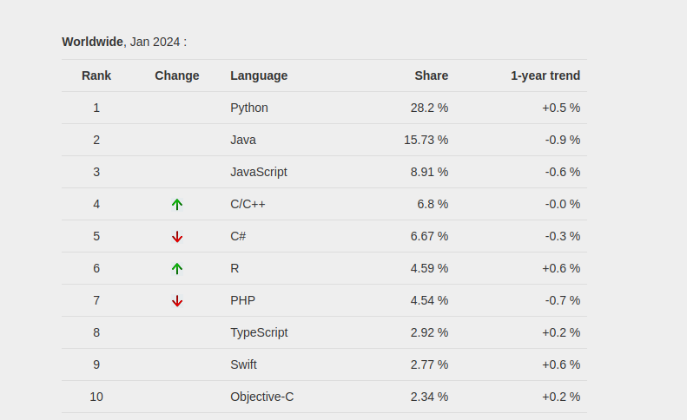
Python: Fastest Growing Programming Language
"PYPL Popularity of Programming Language" is licensed under CC by 3.0

Slide 3
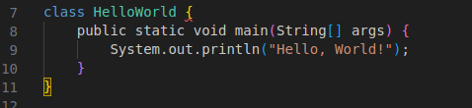

Strengths: Readability and Concision
Java: Python:

Slide 4
Strengths: Flexibility
Natural Language Processing
Machine Learning
Web and game development (back-end)
Data Analysis

Slide 5
Goals of the Class
Learn the basic building blocks of Python programs (lists, loops, functions etc.)
Become familiar with coding logic
Develop basic skills in text and numerical data analysis

Slide 6
Class Plan
1 | Variables, lists, indices and slicing
2 | Comparisons, conditionals and loops
3 | Opening and reading files, file encoding, manipulating dataframes
4 | Creating your own functions

Slide 7
Today's Lesson
Lecture: Basic Python Concepts and Syntax
Data types and variables
Manipulating Variables: Operators, Indices and Slices

Slide 8
Python Syntax
Indentation:
Improves readability
Affects how code is interpreted and executed
Especially crucial for control flow structures (loops and conditionals)
Case sensitive:
Python treats name and Name as two different things
Built-in keywords (like print, True, and if) are also case sensitive
Quotation marks:
used to define and delimit text (strings)
Single ‘ or double “ quotes are both acceptable—choose one and stick with it

Slide 9
Python Syntax cont.
Parentheses ( ):
used to call and define functions and to define tuples
Contain the arguments or parameters of a function
Also used in math expressions to control order of operations
Commas , :
used to separate elements of data structures like lists, tuples, sets, strings, dictionaries, etc., as well as function arguments
Square brackets [ ]:
defining and accessing lists, as well as performing list operations

Slide 10
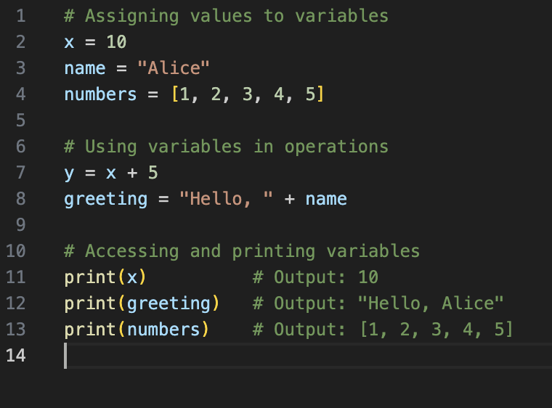
Variables
Used to store data
Different data types can be assigned to variables
Variables are used within code

Slide 11
Python Main Data Types
Strings | "Heuston, we have a problem"
Integers | 35
Floats | 35.6
Lists (data collection type) | ["apple", 12, "computer science", "apple", 13.2] Order is saved Can be rearranged after list is defined Can contain duplicates Elements can be added or removed Indicated by square brackets

Slide 12
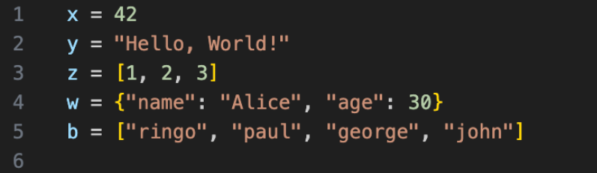

Slide 13
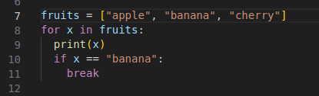
Python for loop containing:
List
Strings—denoted by quotation marks
Indents
function
Square brackets
Variable
Parentheses
argument

Slide 14
Errors
Syntax Error
Name Error
Type Error
Index Error

Slide 15
Syntax Errors
>>> print ("Hello, world!)
File "<stdin>", line 1
print ("Hello, world!)
^
SyntaxError: unterminated string literal (detected at line 1)

Slide 16
Name Error
>>> age = 12
>>> print(age, other)
Traceback (most recent call last):
File "<stdin>", line 1, in <module>
NameError: name 'other' is not defined. Did you mean: 'iter'?

Slide 17
Type Error
>>>x = "10"
>>>y = 5
>>>z = x + y
>>>print(z)
Traceback (most recent call last call):
File "c:\Users\name\OneDrive\Desktop\demo.py", line 3, in <module>
Z = x + y
~~^~~
TypeError: can only concatenate str (not "int") to str

Slide 18
Index Error
>>>my_list = [100, 200, 300, 400, 500]
>>>print(my_list[7])
Traceback (most recent call last):
File "c:\Users\name\OneDrive\Desktop\demo.py", line 2, in <module>
print(my_list[p
~~^~~
IndexError: list index out of range

Slide 19
Google Colab
https://colab.research.google.com/

Slide 20
Demo 1
Getting Started with Python: Data types and variables

Slide 21
Exercise 1
Write the code to ask you how many years you have been at Wash U, and what department you work in. The output should be “Congratulations on working at the X department at Wash U for Y years”.

Slide 22
Solution
years = input("how many years have you worked at WashU? ")
department = input("what department do you work in? ")
print("Congratulations on working at the", department, "department at Wash U for", years, "years")

Slide 23
Demo 2
Manipulating Variables: Operators, Indices and Slices

Slide 24
Exercise 2
Create the following list to track your groceries and prices:
Groceries = [“apples”, “4”, “milk”, “5.9”, “bread”, “3”, “wine”, “15.5”]
Use indices to list out only the food items,
Use mathematical operators to list the number of food items
Write the code to extract the prices from the list, calculate the total, then output the following statement: The total cost of the groceries is $X
**Hint: Watch your parentheses!**

Slide 25
Solution
groceries = [“apples”, “4”, “milk”, “5.9”, “bread”, “3”, “wine”, “15.5”]
print(groceries[0], groceries[2], groceries[4], groceries[6])
len(groceries)/2)
print("The total cost of the groceries is $", int(groceries[1]) + float(groceries[3]) + int( groceries[5]) + float(groceries[7]))
The total cost of the groceries is $28.4

Slide 26
Homework!
For Wednesday's Class:
Complete in-class exercises
Complete Class 1 Homework Exercises
All materials available at:
GitHub Repo:
https://github.com/ClaudiaECarroll/Fall_24_intro_python

