Slide 1
Session 3
Reading Files and Working with Tabular Data

Slide 2
Today's Lesson
Review Exercises
Reading Files
Reading spreadsheet files and analyzing tabular data

Slide 3
Solution Part 3
Problem: Using your humanities and sciences lists (copied below), write a for loop to compare the number of letters in each element of humanities with each word of sciences, printing the two words and the statement “These words have the same number of letters!” when there is a match for the number of letters
Solution:
humanities = ["English", "History", "French", "Art History", "Philosophy"]
sciences = ["Biology", "Chemistry", "Neuroscience", "Physics", "Ecology"]
for x in humanities:
for y in sciences:
if len(x) == len(y):
print(x, y, "These words have the same number of letters!")

Slide 4
Character Encoding
UTF-8 is standard
Other options:
ASCII
UTF-16/UTF-32
You need to know the encoding to read the file correctly
Unicode Error:
The file cannot be read using specified encoding
The file is partially read, with problems

Slide 5
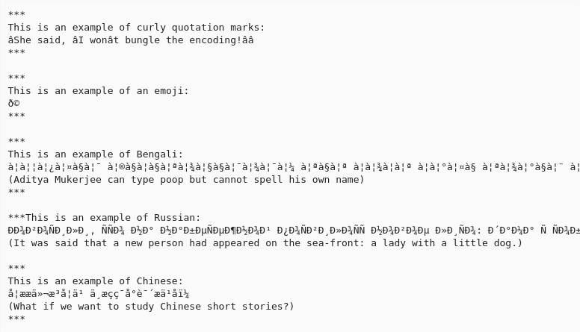
Example of text file opened with incorrect encoding

Slide 6
Text Files: Things to Remember
You have to open a file before you can read and write
You have to specify character encoding (usually UTF-8)
In some versions of python, writing overwrites

Slide 7
Example Data
Download all data files from:
https://github.com/ClaudiaECarroll/Fall_24_intro_python/tree/main/example_data

Slide 8
Demo One
Opening, reading and writing text files

Slide 9
Exercise One
Write the code to count the approximate number of words in the file austen_pride.txt
Create a new text file called “python.txt” that contains the text “I am almost finished my first python class!”)

Slide 10
Exercise One Part One
Write the code to count the approximate number of words in the file austen_pride.txt
file = open("austen_pride.txt", mode="r", encoding="utf-8")
text = file.read()
words = text.split()
print(len(words))

Slide 11
Exercise One Part Two
Create a new text file called “python.txt” that contains the text “I am almost finished my first python class!”)
file = open("python.txt", mode="w", encoding="utf-8")
file.write(“I am almost finished my first python class!”)

Slide 12
Demo Two
Working with Spreadsheets

Slide 13
Exercise Two
Write the code to print each country in the data file gdp_africa.csv and that country’s mean gdp between 1952 and 1982.
Now write the code to print each year (as represented by the column headings) in gdp_africa.csv and the mean GDP in Africa that year. How does your code differ from part one?

Slide 14
Exercise Two Part One
Write the code to print each country in the data file gdp_africa.csv and that country’s mean gdp between 1952 and 1982.
for x in countries:
y = df.loc[x, "gdpPercap_1952": "gdpPercap_1982"].mean()
print(x, y)

Slide 15
Exercise Two Part Two
Now write the code to print each year (as represented by the column headings) in gdp_africa.csv and the mean GDP in Africa that year. How does your code differ from part one?
for x in years:
y = df[x].mean()
print(x, y)

Slide 16
Homework
Complete Exercise Two
Complete Class 3 Homework Exercises (on GitHub repo)

