Slide 1
Introduction to Python Session 1
TRIADS Training Series, Spring 2023
Instructor: Claudia Carroll

Slide 2
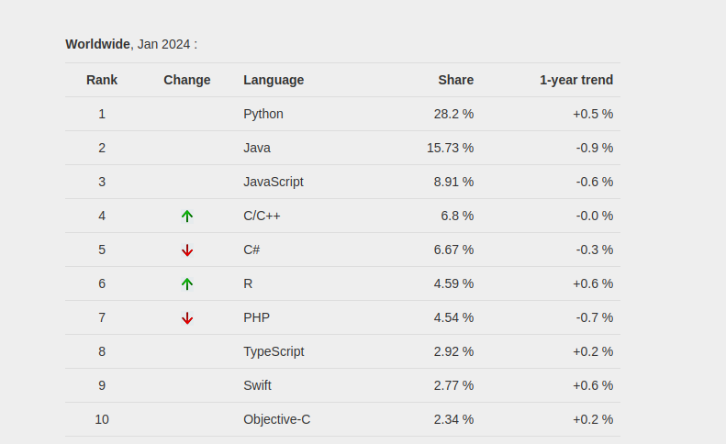
Python: Fastest Growing Programming Language
"PYPL Popularity of Programming Language" is licensed under CC by 3.0

Slide 3
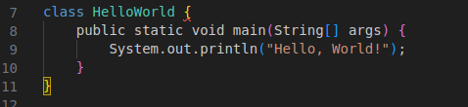

Strengths: Readability and Concision
Java: Python:

Slide 4
Strengths: Flexibility
Natural Language Processing
Machine Learning
Web and game development (back-end)
Data Analysis

Slide 5
Goals of the Class
Learn the basic building blocks of Python programs (lists, loops, functions etc.)
Become familiar with coding logic
Develop basic skills in text and numerical data analysis

Slide 6
Class Plan
1 | The command line and introduction to python
2 | Jupyter Notebooks, commonly used functions for text and data manipulations, lists and dictionaries
3 | Opening and reading files, file encoding, manipulating dataframes
4 | While and for loops, conditionals
5 | Creating your own functions
6 | Introduction to object-oriented programming

Slide 7
Today's Lesson
Command Line Basics
Python installation troubleshooting
Basic programs
https://github.com/ClaudiaECarroll/Intro_to_Python

Slide 8
The Command Line
Text-based way to interface with computer
Other names—the terminal, the Unix Shell (ubuntu/linux), the shell
Uses:
Automating file management
Installing and updating software
Interacting with remote servers
Running programs in Python!

Slide 9
Demo 1
The Command Line

Slide 10
Exercise 1
Create a new directory in your documents folder, create a text file in your desktop, move the new file from the desktop to the documents folder, write a line of text to the text file.
Cheat sheet for commands:
https://github.com/ClaudiaECarroll/Intro_to_Python/

Slide 11
Solution
From root directory:
$ cd Documents (navigate to Documents folder)
$ mkdir new_folder (create a new folder within Documents)
$ cd ../Desktop (navigate to Desktop folder)
$ touch newfile.txt (create a new file within Desktop)
$ mv newfile.txt ../ (move new file to root directory)
$ cd .. (navigate to root directory)
$ mv newfile.txt Documents/new_folder (move new file to new folder in Documents)

Slide 12
Python Installation
Check for python with python --version from the command line
If you do not have python, or only have python2:
Mac or Windows users:
https://www.python.org/downloads/ and
download and install python 3.12 for your OS
Linux users:
Enter on command line in root directory: sudo apt-get install python3.10
If sudo is not installed, enter: apt install sudo, then try the install again
To check the installation, close and reopen your terminal, and enter
python --version again

