Slide 1
Session 5
Reading Files and Working with Tabular Data

Slide 2
Example Data
Download all data files from:
https://github.com/ClaudiaECarroll/Intro_to_Python/tree/main/example_data
Save files to python-workshop folder

Slide 3
Today's Lesson
Review Exercises
Reading Files
Introduction to Jupyter
Installing Pandas
Reading spreadsheet files and analyzing tabular data

Slide 4
Previous Class: Exercise 2
Using your store_shelf list:
Write a for loop to print all the items in the list starting with the letter “a”
Write a for loop to print all the items in your list that are longer than 5 letters

Slide 5
Solution Part 1
Problem:
Write a for loop to print all the items in the list starting with the letter “a”
Solution:
store_shelf = ["apples", "bread", "cookies", "avocados", "eggs", "milk", "carrots"]
for x in store_shelf:
if x[0] == "a":
print(x)

Slide 6
Solution Part 2
Problem:
Write a for loop to print all the items in your list that are longer than 5 letters
Solution:
store_shelf = ["apples", "bread", "cookies", "avocados", "eggs", "milk", "carrots"]
for x in store_shelf:
if len(x) > 5:
print(x)

Slide 7
Solution Part 3
Problem: Using your humanities and sciences lists (copied below), write a for loop to compare the number of letters in each element of humanities with each word of sciences, printing the two words and the statement “These words have the same number of letters!” when there is a match for the number of letters
Solution:
humanities = ["English", "History", "French", "Art History", "Philosophy"]
sciences = ["Biology", "Chemistry", "Neuroscience", "Physics", "Ecology"]
for x in humanities:
for y in sciences:
if len(x) == len(y):
print(x, y, "These words have the same number of letters!")

Slide 8
Demo One
Opening, reading and writing text files

Slide 9
Character Encoding
UTF-8 is standard
Other options:
ASCII
UTF-16/UTF-32
You need to know the encoding to read the file correctly
Unicode Error:
The file cannot be read using specified encoding
The file is partially read, with problems

Slide 10
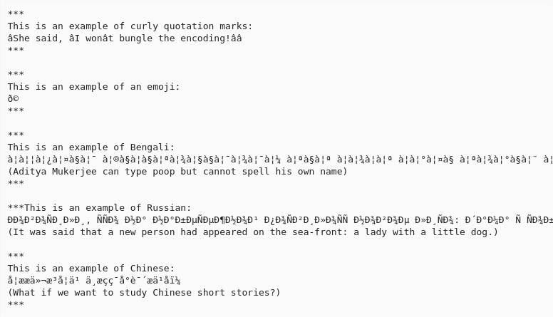
Example of text file opened with incorrect encoding

Slide 11
Text Files: Things to Remember
You have to open a file before you can read and write
You have to specify character encoding (usually UTF-8)
In some versions of python, writing overwrites

Slide 12
Exercise One Part One
Write the code to count the approximate number of words in the file austen_pride.txt
file = open("austen_pride.txt", mode="r", encoding="utf-8")
text = file.read()
words = text.split()
print(len(words))

Slide 13
Exercise One Part Two
Create a new text file called “python.txt” that contains the text “I am almost finished my first python class!”)
file = open("python.txt", mode="w", encoding="utf-8")
file.write(“I am almost finished my first python class!”)

Slide 14
Installing Pandas
Open your terminal (Mac or Linux) or your Command Prompt (Windows) and enter the following:
python -m pip help
pip install pandas==2.0.0

Slide 15
Installing Jupyter Notebook
From the terminal (Mac/Linux) or the Command Prompt (Windows), enter:
jupyter notebook
If there is an error, enter:
pip install jupyter

Slide 16
Demo Two
Working with Spreadsheets

Slide 17
Exercise Two Part One
Write the code to print each country in the data file gdp_africa.csv and that country’s mean gdp between 1952 and 1982.
for x in countries:
y = df.loc[x, "gdpPercap_1952": "gdpPercap_1982"].mean()
print(x, y)

Slide 18
Exercise Two Part Two
Now write the code to print each year (as represented by the column headings) in gdp_africa.csv and the mean GDP in Africa that year. How does your code differ from part one?
for x in years:
y = df[x].mean()
print(x, y)

Slide 19
Homework
Complete Exercise Two
Complete Class 4 Homework Exercises (on GitHub repo)
Look back over exercises from previous sessions!

