Slide 1
Introduction to Python Session 2
TRIADS Training Series, Spring 2023
Instructor: Claudia Carroll

Slide 2
Today's Lesson
Lecture: Basic Python Concepts and Syntax
Data types and variables
Manipulating Variables: Operators, Indices and Slices
https://github.com/ClaudiaECarroll/Intro_to_Python

Slide 3
Python: Basic Terms and Concept

Slide 4
Python Syntax
Indentation:
Improves readability
Affects how code is interpreted and executed
Especially crucial for control flow structures (loops and conditionals)
Case sensitive:
Python treats name and Name as two different things
Built-in keywords (like print, True, and if) are also case sensitive
Quotation marks:
used to define and delimit text (strings)
Single ‘ or double “ quotes are both acceptable—choose one and stick with it

Slide 5
Python Syntax cont.
Parentheses ( ):
used to call and define functions and to define tuples
Contain the arguments or parameters of a function
Also used in math expressions to control order of operations
Commas , :
used to separate elements of data structures like lists, tuples, sets, strings, dictionaries, etc., as well as function arguments
Square brackets [ ]:
defining and accessing lists, as well as performing list operations

Slide 6
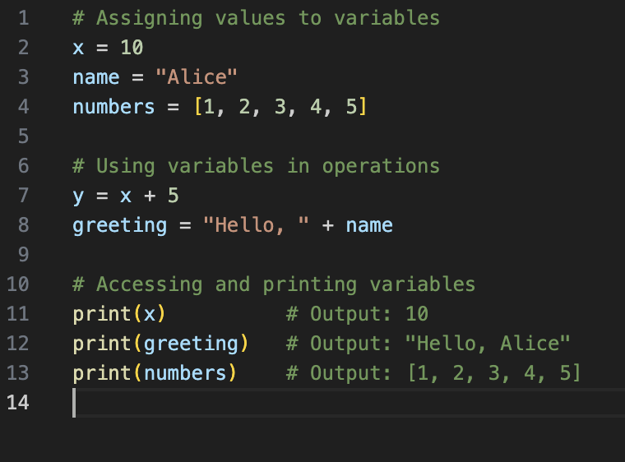
Variables
Used to store data
Different data types can be assigned to variables
Variables are used within code

Slide 7
Python Main Data Types
Strings | "Heuston, we have a problem"
Integers | 35
Floats | 35.6
Lists (data collection type) | ["apple", 12, "computer science", "apple", 13.2] Order is saved Can be rearranged after list is defined Can contain duplicates Elements can be added or removed Indicated by square brackets

Slide 8
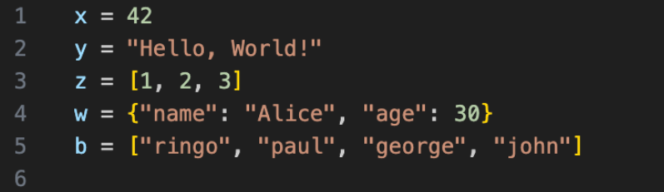

Slide 9
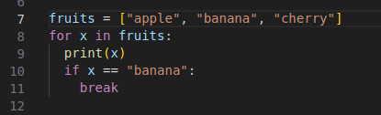
Python for loop containing:
List
Strings—denoted by quotation marks
Indents
function
Square brackets
Variable
Parentheses
argument

Slide 10
Errors
Syntax Error
Name Error
Type Error
Index Error

Slide 11
Syntax Errors
>>> print ("Hello, world!)
File "<stdin>", line 1
print ("Hello, world!)
^
SyntaxError: unterminated string literal (detected at line 1)

Slide 12
Name Error
>>> age = 12
>>> print(age, other)
Traceback (most recent call last):
File "<stdin>", line 1, in <module>
NameError: name 'other' is not defined. Did you mean: 'iter'?

Slide 13
Type Error
>>>x = "10"
>>>y = 5
>>>z = x + y
>>>print(z)
Traceback (most recent call last call):
File "c:\Users\name\OneDrive\Desktop\demo.py", line 3, in <module>
Z = x + y
~~^~~
TypeError: can only concatenate str (not "int") to str

Slide 14
Index Error
>>>my_list = [100, 200, 300, 400, 500]
>>>print(my_list[7])
Traceback (most recent call last):
File "c:\Users\name\OneDrive\Desktop\demo.py", line 2, in <module>
print(my_list[p
~~^~~
IndexError: list index out of range

Slide 15
Demo 1
Getting Started with Python: Data types and variables

Slide 16
Exercise 2
Create a program called dept.py that asks you how many years you have been at Wash U, and what department you work in. Run the program from the command line. The output should be “Congratulations on working at the X department at Wash U for Y years”.

Slide 17
Solution
dept.py:
years = input("how many years have you worked at WashU? ")
department = input("what department do you work in? ")
print("Congratulations on working at the", department, "department at Wash U for", years, "years")
Run from command line:
python dept.py from python-workshop directory

Slide 18
Demo 2
Manipulating Variables: Operators, Indices and Slices

Slide 19
Exercise 2
Create the following list to track your groceries and prices:
Groceries = [“apples”, “4”, “milk”, “5.9”, “bread”, “3”, “wine”, “15.5”]
Write the code to list out only the food items, followed by the number of food items (do not just manually count them!)
Write the code to extract the prices from the list, calculate the total, then output the following statement: The total cost of the groceries is $X
**Hint: Watch your parentheses!**

Slide 20
Solution Part 1
Groceries = [“apples”, “4”, “milk”, “5.9”, “bread”, “3”, “wine”, “15.5”]
Question:
Write the code to list out only the food items, followed by the number of food items (do not just manually count them!)
Solution:
>>>print(groceries[0], groceries[2], groceries[4], groceries[6], (len(groceries)/2))
apples milk bread wine 4.0

Slide 21
Solution Part 2
Groceries = [“apples”, “4”, “milk”, “5.9”, “bread”, “3”, “wine”, “15.5”]
Question:
Write the code to extract the prices from the list, calculate the total, then output the following statement: The total cost of the groceries is $X
Solution:
print("The total cost of the groceries is $", int(groceries[1]) + float(groceries[3]) + int( groceries[5]) + float(groceries[7]))
The total cost of the groceries is $ 28.4

Slide 22
Solution
departments = ["music", "english", "political science", "computer science", "physics", "anthropology"]
departments.sort()
x = departments[0]
y = departments[1]
print(x, "and", y, "are two departments at Wash U")

Slide 23
Homework!
Finish exercises 2/3 (if we did not complete it in class)
Complete the Class One Exercise Sheet
Install anaconda (https://www.anaconda.com/download/)
From the Anaconda Navigator install:
Visual Studio Code
Jupyter Notebook
More details at:
https://github.com/ClaudiaECarroll/Intro_to_Python/blob/main/homework_lesson_1.md

