Slide 1
Session 5
Functions and OOP

Slide 2
Today's Lesson
Review Pandas exercise
Functions Demo and Exercise
Lecture: Object Oriented Programming
Closing Assessment and Survey

Slide 3
Pandas Exercise Part One
Write the code to print each country in the data file gdp_africa.csv and that country’s mean gdp between 1952 and 1982.
for x in countries:
y = df.loc[x, "gdpPercap_1952": "gdpPercap_1982"].mean()
print(x, y)

Slide 4
Pandas Exercise Part Two
Write the code to print each year (as represented by the column headings) in gdp_africa.csv and the mean GDP in Africa that year. How does your code differ from part one?
for x in years:
y = df[x].mean()
print(x, y)

Slide 5
Demo One
Functions

Slide 6
Exercise Part One
Given a list foods = [“eggs”, “bread”, “milk”, “cookies”], create a function to return all words in the list that are longer than 5 letters.

Slide 7
def long_strings(x):
for food in foods:
if len(food) > 5:
print(food)
return(food)
print(long_string(foods))

Slide 8
Exercise Part Two
Create a function that calculates the minimum GDP of each country in Europe based on the gdp_europe.csv file.
Def min_gdp(data):
df = pd.read_csv(data, index_col=0)
countries = df.index.values
for country in countries:
print(country, df.loc[country].min())
return

Slide 9
Object-Oriented Programming
Basic Concepts

Slide 10
Object-Oriented Programming
Almost everything in Python is an object
Objects are instances of classes
A class is a 'bundle' of attributes and methods

Slide 11
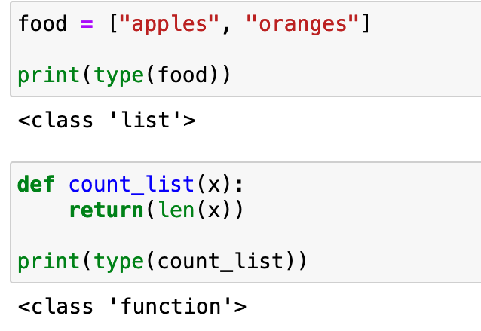

Slide 12
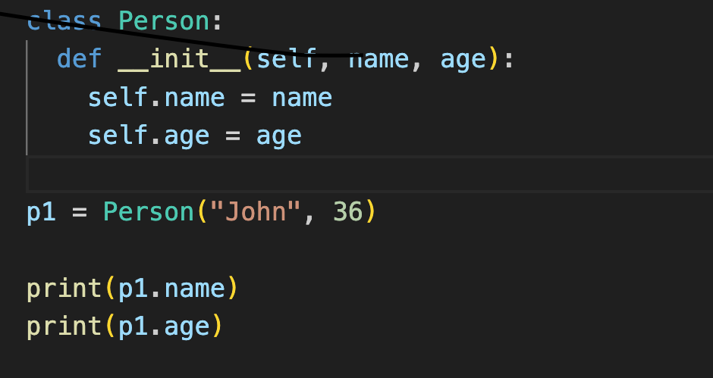
Classes

Slide 13
Methods
Methods are functions created within a class
Methods can only be used on an object of that class

Slide 14
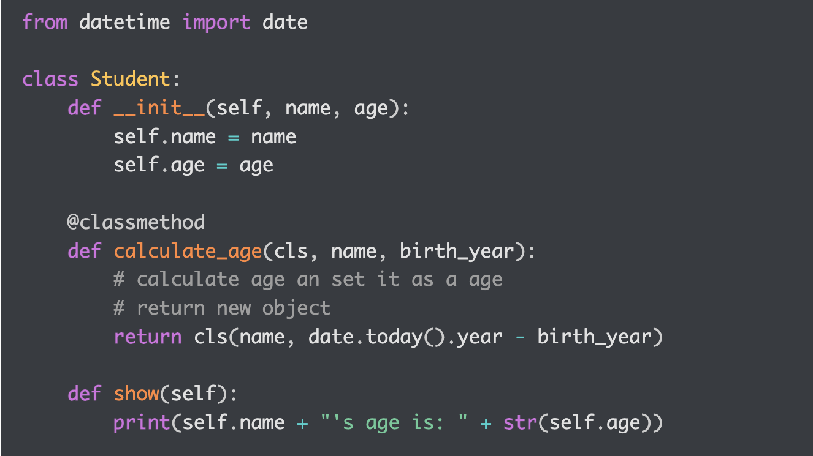
Class with methods

Slide 15
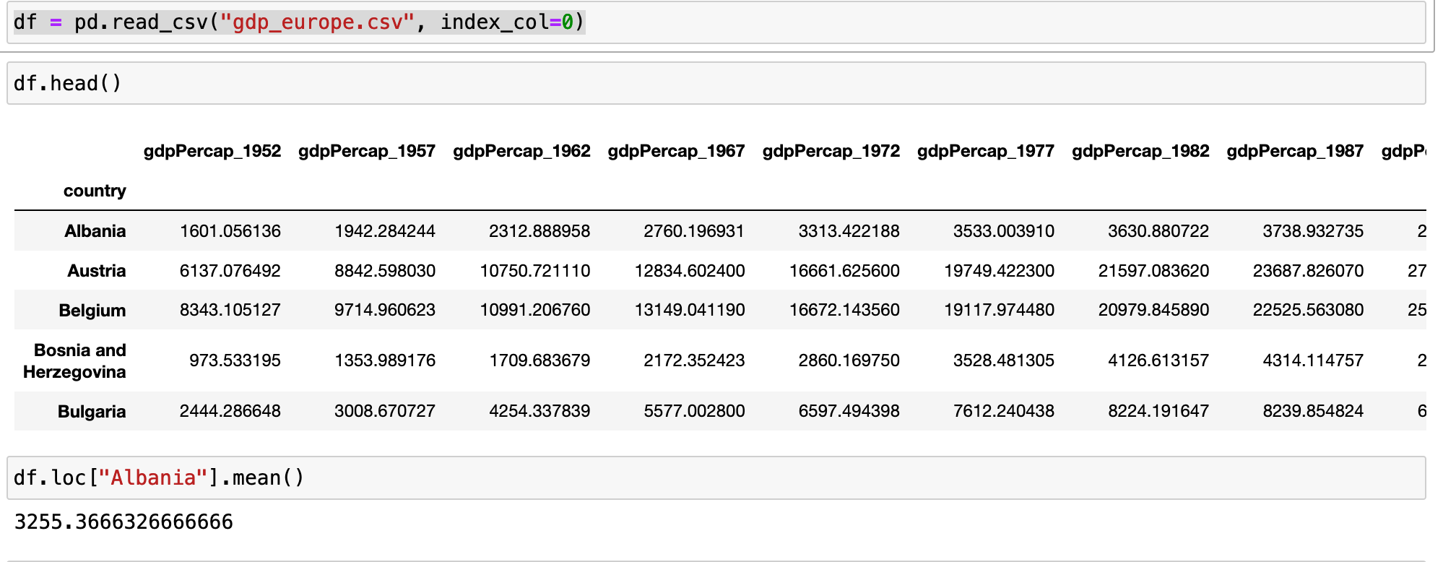
Calling a Method

Slide 16
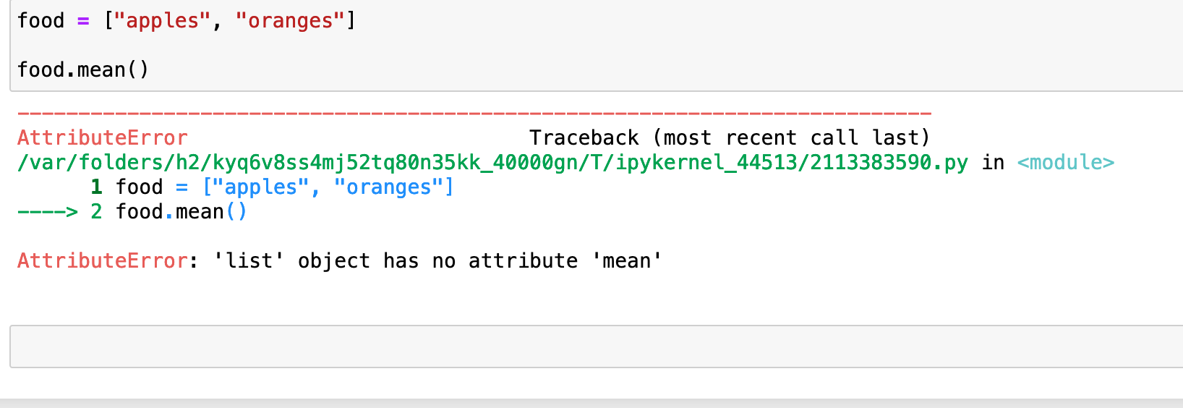
Trying to call a method on an object of the wrong class

Slide 17
Questions?

Slide 18
Resources for Further Learning
In-Person Training at Wash U:
TRIADS Training and Workshops
Olin Library Workshops
Online Resources:
EdX (https://www.edx.org/learn/python)
Codecademy.com
https://github.com/practical-tutorials/project-based-learning

Slide 19
TRIADS Training Offerings
Sign Up: https://triads.wustl.edu/events/
Introduction to Text Analysis with Python
4 sessions
Monday/Wednesday (Feb 12-21)
12.30-2, DUC 233
The Unix Shell
1 session
Wednesday Feb 14
12.30-2, DUC 234
Survey Design
4 sessions
Monday/Wednesday (Feb 12-21)
10.30-12

Slide 20
Courses Schedule
https://triads.wustl.edu/join-triads-mailing-list
Late Feb/March:
Introduction to Machine Learning (4 sessions)
Git Version Control (1 session)
Web Scraping with Python (1 session)
After Spring Break:
Python for Data Analysis and Visualization (6 sessions)
LLMs for Text Analysis (3 sessions)
Machine Learning for Sentiment Analysis (1 session)
Deep Learning (2 sessions)

Slide 21
Participant Survey
Link to participant survey:
https://forms.gle/ao8rMeTZ5AYQKyKX6
We appreciate your feedback!

