Slide 1
Introduction to Python Session 3
TRIADS Training Series, Spring 2023
Instructor: Claudia Carroll

Slide 2
Today's Lesson
VS Code set up
Exercise Solutions
Comparisons and Conditionals
Loops
https://github.com/ClaudiaECarroll/Intro_to_Python

Slide 3
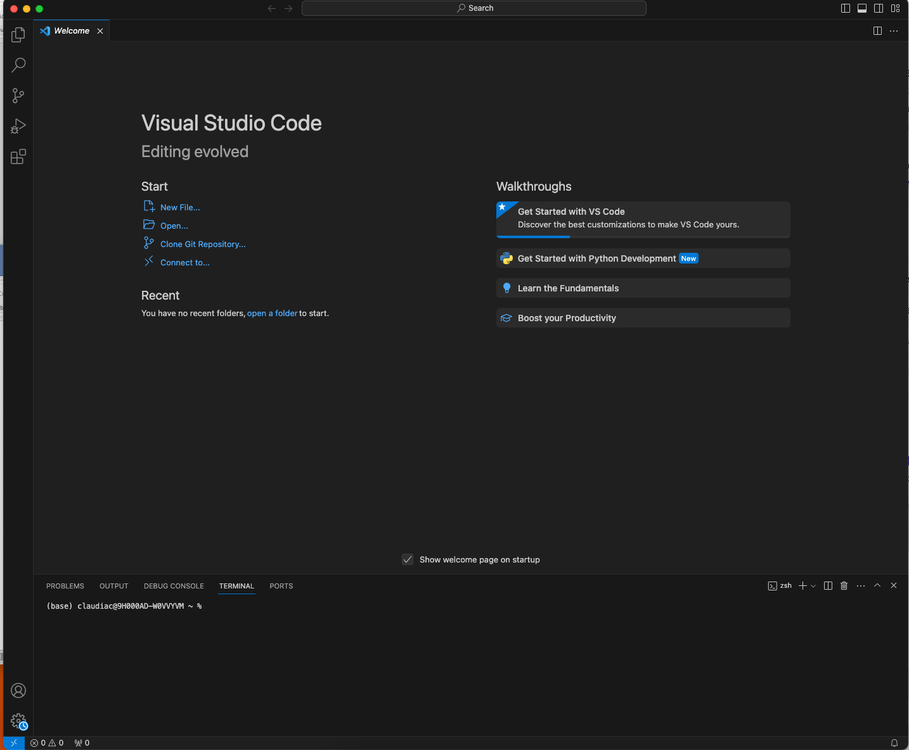
VS Code Set-Up

Slide 4
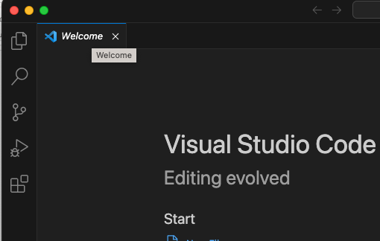

Extension Installer

Slide 5
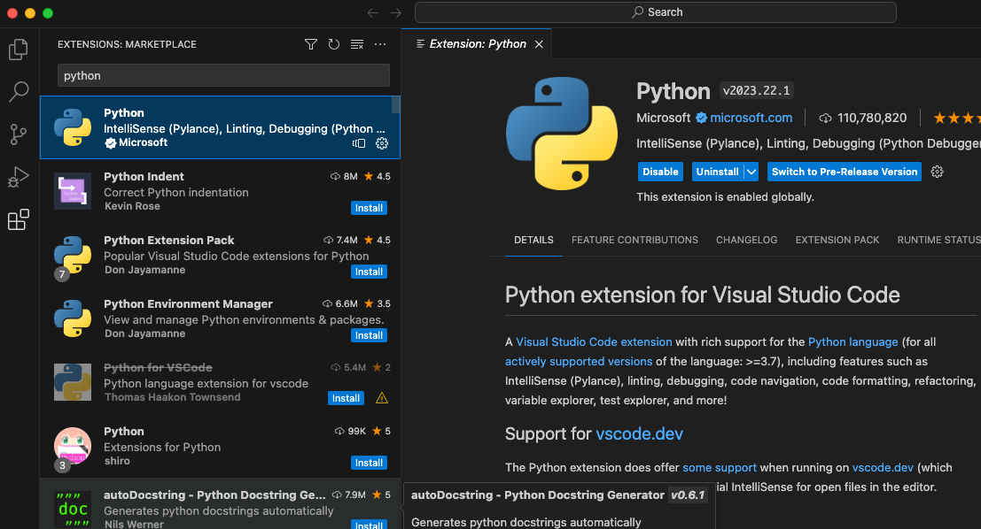

Slide 6
Exercise 2
Create the following list to track your groceries and prices:
Groceries = [“apples”, “4”, “milk”, “5.9”, “bread”, “3”, “wine”, “15.5”]
Write the code to list out only the food items, followed by the number of food items (do not just manually count them!)
Write the code to extract the prices from the list, calculate the total, then output the following statement: The total cost of the groceries is $X
**Hint: Watch your parentheses!**

Slide 7
Solution
Groceries = [“apples”, “4”, “milk”, “5.9”, “bread”, “3”, “wine”, “15.5”]
Question:
Write the code to list out only the food items, followed by the number of food items (do not just manually count them!)
Solution:
>>>print(groceries[0], groceries[2], groceries[4], groceries[6], (len(groceries)/2))
apples milk bread wine 4.0

Slide 8
groceries = [“apples”, “4”, “milk”, “5.9”, “bread”, “3”, “wine”, “15.5”]
Question:
Write the code to extract the prices from the list, calculate the total, then output the following statement: The total cost of the groceries is $X
Solution:
print("The total cost of the groceries is $", int(groceries[1]) + float(groceries[3]) + int( groceries[5]) + float(groceries[7]))
The total cost of the groceries is $ 28.4

Slide 9
Comparisons and Conditionals

Slide 10
Boolean Statements
A Boolean statement is a statement that is either True or False
Boolean statements are primarily used to filter data or methods based on certain conditions
Boolean statements are usually produced using Boolean operators
>>> age = 15
>>> print(age < 12)
False
>>> print (age > 12)
True

Slide 11
Python Comparison Operators
== | Equal to
!= | Not equal to
> | Greater than
< | Less than
>= | Great than or equal to
<= | Less than or equal to

Slide 12
Conditionals
number = 0
if number > 0:
print('Positive number’)
elif number <0:
print('Negative number’)
else:
print('Zero') print('This statement is always executed')

Slide 13
Demo 1
Conditionals

Slide 14
Exercise 1
Create three lists:
humanities = ["English", "History", "French", "Art History", "Philosophy"]
sciences = ["Biology", "Chemistry", "Neuroscience", "Physics", "Ecology"]
social_sciences = ["Political Science", "Sociology", "Anthropology", "Psychology"]
Using conditionals, write the code that prints “You are a philosopher” if the fifth element of humanities is philosophy (hint: remember indices from Monday!)
Now write a program that asks what department you are in, and based on the response, outputs one of the following messages (hint: remember the input() function from Monday!):
You are a humanist!
You are a scientist!
You are a social scientist!
You are probably doing something interesting!

Slide 15
Solution Part 1
if humanities[4] == "Philosophy":
print("You are a philosopher")

Slide 16
Solution Part 2
your_department = input("What department do you work in? ")
if your_department in humanities:
print("You are a humanist")
elif your_department in sciences:
print("You are a scientist")
elif your_department in social_sciences:
print("You are a social scientist")
else:
print("You are probably doing something interesting!")

Slide 17
Demo 2
For loops!

Slide 18
Solution Part 1
Groceries = [“apples”, “4”, “milk”, “5.9”, “bread”, “3”, “wine”, “15.5”]
Question:
Write the code to list out only the food items, followed by the number of food items (do not just manually count them!)
Solution:
>>>print(groceries[0], groceries[2], groceries[4], groceries[6], (len(groceries)/2))
apples milk bread wine 4.0

Slide 19
Solution using for loop
groceries = ["apples", "4", "milk", "5.9", "bread", "3", "wine", "15.5"]
for i in range(len(groceries)):
if i%2 == 0:
print(groceries[i])
print(len(groceries)/2)

Slide 20
Basic For Loop
Form | for variable in collection: #do something with variable
Example code | odds = [1, 3, 5, 7] for num in odds: print(num)
Example output | 1 3 5 7

Slide 21
Exercise 2
Using your store_shelf list:
Write a for loop to print all the items in the list starting with the letter “a”
Write a for loop to print all the items in your list that are longer than 5 letters

Slide 22
Solution Part 1
store_shelf = ["apples", "bread", "cookies", "avocados", "eggs", "milk", "carrots"]
for x in store_shelf:
if x[0] == "a":
print(x)

Slide 23
Solution Part 2
store_shelf = ["apples", "bread", "cookies", "avocados", "eggs", "milk", "carrots"]
for x in store_shelf:
if len(x) > 5:
print(x)

Slide 24
Solution Part 3
humanities = ["English", "History", "French", "Art History", "Philosophy"]
sciences = ["Biology", "Chemistry", "Neuroscience", "Physics", "Ecology"]
for x in humanities:
for y in sciences:
if len(x) == len(y):
print(x, y, "These words have the same number of letters!")

Slide 25
Homework
Finish any in-class exercises
Complete the Class 3 Homework Exercises
https://github.com/ClaudiaECarroll/Intro_to_Python

