Slide 1
Introduction to Python Session 1
TRIADS Training Series, Spring 2023
Instructor: Claudia Carroll

Slide 2
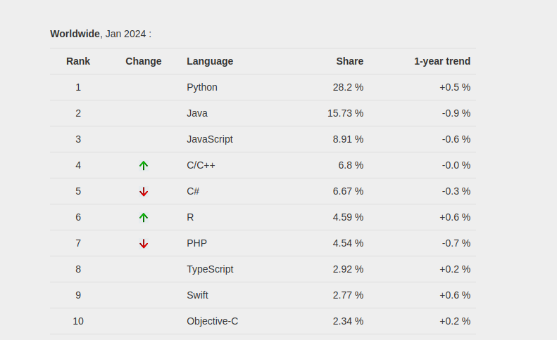
Python: Fastest Growing Programming Language
"PYPL Popularity of Programming Language" is licensed under CC by 3.0

Slide 3
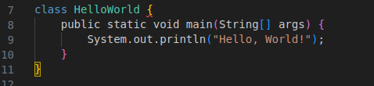

Strengths: Readability and Concision
Java: Python:

Slide 4
Strengths: Flexibility
Natural Language Processing
Machine Learning
Web and game development (back-end)
Data Analysis

Slide 5
Goals of the Class
Learn the basic building blocks of Python programs (lists, loops, functions etc.)
Become familiar with coding logic
Develop basic skills in text and numerical data analysis

Slide 6
Class Plan
1 | The command line and introduction to python
2 | Jupyter Notebooks, commonly used functions for text and data manipulations, lists and dictionaries
3 | Opening and reading files, file encoding, manipulating dataframes
4 | While and for loops, conditionals
5 | Creating your own functions
6 | Introduction to object-oriented programming

Slide 7
Today's Lesson
Command Line Basics
Python installation troubleshooting
Basic programs
https://github.com/ClaudiaECarroll/Intro_to_Python

Slide 8
The Command Line
Text-based way to interface with computer
Other names—the terminal, the Unix Shell (ubuntu/linux), the shell
Uses:
Automating file management
Installing and updating software
Interacting with remote servers
Running programs in Python!

Slide 9
Demo 1
The Command Line

Slide 10
Exercise 1
Create a new directory in your documents folder, create a text file in your desktop, move the new file from the desktop to the documents folder, write a line of text to the text file.
Cheat sheet for commands:
https://github.com/ClaudiaECarroll/Intro_to_Python/

Slide 11
Solution
From root directory:
$ cd Documents (navigate to Documents folder)
$ mkdir new_folder (create a new folder within Documents)
$ cd ../Desktop (navigate to Desktop folder)
$ touch newfile.txt (create a new file within Desktop)
$ mv newfile.txt ../ (move new file to root directory)
$ cd .. (navigate to root directory)
$ mv newfile.txt Documents/new_folder (move new file to new folder in Documents)

Slide 12
Python Installation
Check for python with python --version from the command line
If you do not have python, or only have python2:
Mac or Windows users:
https://www.python.org/downloads/ and
download and install python 3.12 for your OS
Linux users:
Enter on command line in root directory: sudo apt-get install python3.10
If sudo is not installed, enter: apt install sudo, then try the install again
To check the installation, close and reopen your terminal, and enter
python --version again

Slide 13
Python: Basic Terms and Concept

Slide 14
Python Syntax
Indentation:
Improves readability
Affects how code is interpreted and executed
Especially crucial for control flow structures (loops and conditionals)
Case sensitive:
Python treats name and Name as two different things
Built-in keywords (like print, True, and if) are also case sensitive
Quotation marks:
used to define and delimit text (strings)
Single ‘ or double “ quotes are both acceptable—choose one and stick with it

Slide 15
Python Syntax cont.
Parentheses ( ):
used to call and define functions and to define tuples
Contain the arguments or parameters of a function
Also used in math expressions to control order of operations
Commas , :
used to separate elements of data structures like lists, tuples, sets, strings, dictionaries, etc., as well as function arguments
Square brackets [ ]:
defining and accessing lists, as well as performing list operations

Slide 16
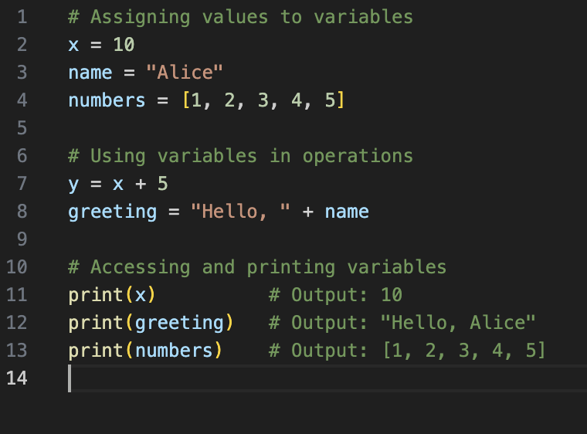
Variables
Used to store data
Different data types can be assigned to variables
Variables are used within code

Slide 17
Python Main Data Types
Strings | "Heuston, we have a problem"
Integers | 35
Floats | 35.6
Lists (data collection type) | ["apple", 12, "computer science", "apple", 13.2] Order is saved Can be rearranged after list is defined Can contain duplicates Elements can be added or removed Indicated by square brackets

Slide 18
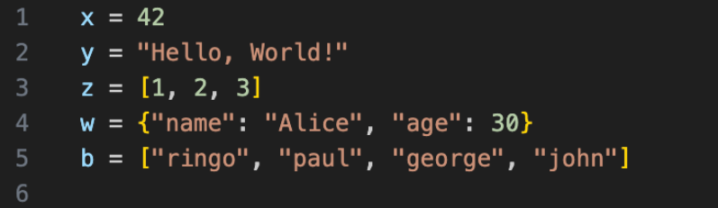

Slide 19
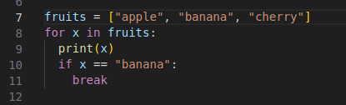
Python for loop containing:
List
Strings—denoted by quotation marks
Indents
function
Square brackets
Variable
Parentheses
argument

Slide 20
Demo 2
Getting Started with Python

Slide 21
Exercise 2
Create a program called dept.py that asks you how many years you have been at Wash U, and what department you work in. Run the program from the command line. The output should be “Congratulations on working at the X department at Wash U for Y years”.

Slide 22
Solution
dept.py:
years = input("how many years have you worked at WashU? ")
department = input("what department do you work in? ")
print("Congratulations on working at the", department, "department at Wash U for", years, "years")
Run from command line:
python dept.py from python-workshop directory

Slide 23
Exercise 3
In your text editor, write a program takes in a list of departments at Wash U, sorts them in alphabetical order and outputs the following statement: “X and Y are two departments at Wash U”, where X and Y are the second and third departments alphabetically. Run the program from the command line.

Slide 24
Solution
departments = ["music", "english", "political science", "computer science", "physics", "anthropology"]
departments.sort()
x = departments[0]
y = departments[1]
print(x, "and", y, "are two departments at Wash U")

Slide 25
Homework!
Finish exercises 2/3 (if we did not complete it in class)
Complete the Class One Exercise Sheet
Install anaconda (https://www.anaconda.com/download/)
From the Anaconda Navigator install:
Visual Studio Code
Jupyter Notebook
More details at:
https://github.com/ClaudiaECarroll/Intro_to_Python/blob/main/homework_lesson_1.md

