Slide 1

TRIADS Workshop: ChatGPT in the Classroom
Friday March 1st, 2024
Dr. Claudia Carroll

Slide 2

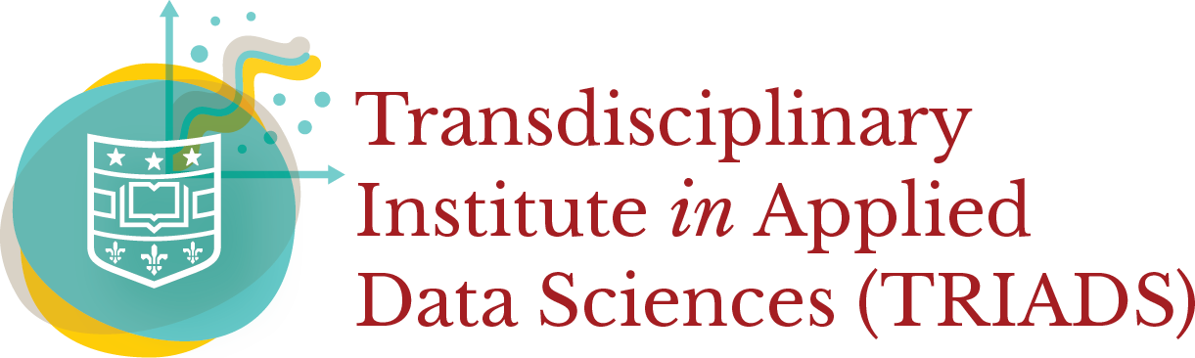
Signature Initiative
Workshop Goals
Understand generally how ChatGPT works, and its strengths and weaknesses for student assignments
Gain experience using ChatGPT for a variety of student assignments
Consider the extent to which you wish to encourage ChatGPT use by your students
Consider options for active engagement with ChatGPT in your class

Slide 3
Signature Initiative
How ChatGPT Works
ChatGPT is based on statistical patterns of words
It generates passages of text by generating the next most likely word
It makes this determination based on the statistical liklihood of a certain word coming next in the training data
ChatGPT's development is a form of supervised machine learning
ChatGPT does not 'know' the answer to questions or prompts. It generates an output by using the words in the prompt to generate a response that is a string of statistically likely words in sequence.

Slide 4
Signature Initiative
Versions of ChatGPT
Public ChatGPT:
ChatGPT 3.5
Free
Not secure
Wash U's ChatGPT Beta:
ChatGPT 3.5
Free for Wash U students, faculty and staff
HIPAA and FERPA protected
ChatGPT Plus:
ChatGPT 4
$20/month
Not secure
Increased accuracy due to more training data and human reinforced learning

Slide 5
Signature Initiative
Strengths of ChatGPT
Topic versatility
Interactive
Speed of information retrieval
Can access uploaded files

Slide 6
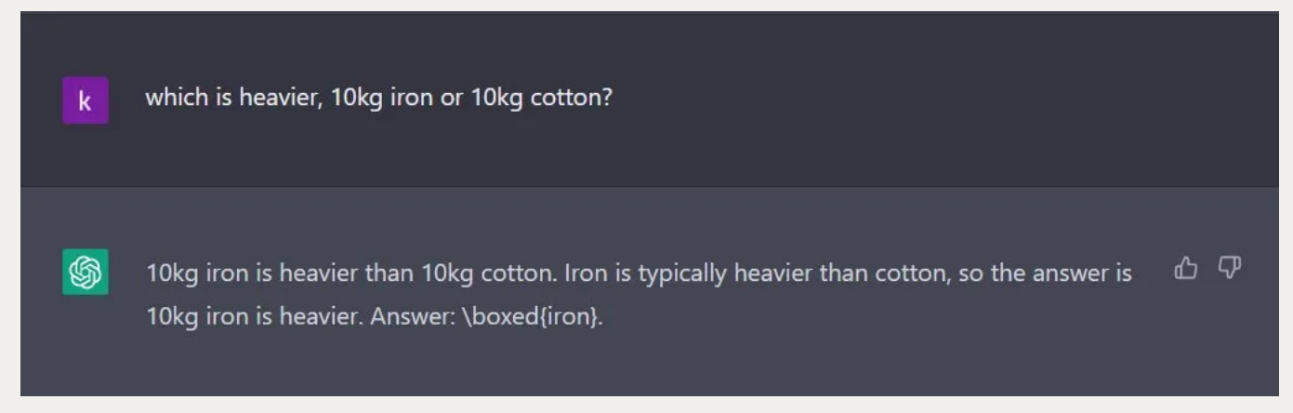
Signature Initiative
Limitations of ChatGPT
Token limit (4000 tokens/ approx. 3000 words)
Training data does not date past September 2021
Can 'hallucinate' sources and facts

Slide 7
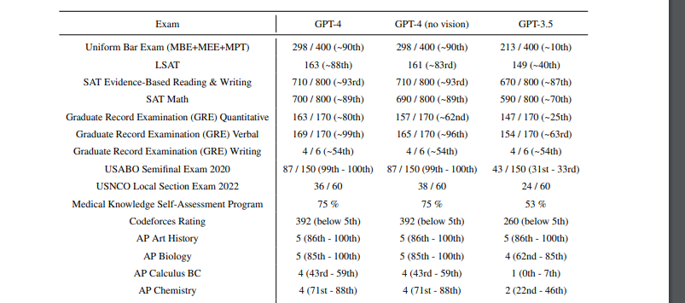
Signature Initiative
ChatGPT: Exams
Source: OpenAI, "GPT4 Technical Report", (March 2023), https://cdn.openai.com/papers/gpt-4.pdf

Slide 8
Signature Initiative
GPT: Exams (cont.)
 | GPT-4 | GPT-3.5
GRE Verbal | 169/170 | 154/170
GRE Quant | 163/170 | 147/170
LSAT | 163/180 | 149/180
UBE* | 297/400 | --
*Source: Katz, Daniel Martin and Bommarito, Michael James and Gao, Shang and Arredondo, Pablo, GPT-4 Passes the Bar Exam (March 15, 2023).

Slide 9
Signature Initiative
ChatGPT and Writing Assignments
Effective for proof-reading and copy-editing
Can offer basic feedback to students
Effective drafting limited length writing assignments
More effective at description/definition writing tasks than analytical writing
BUT:
Requires effective prompt engineering
Requires iterative prompting
First pass output will generally produce mediocre results

Slide 10
Signature Initiative
ChatGPT and Coding Assignments
Can effectively produce modular code
Can effectively offer debugging guidance
BUT:
Requires effective prompt engineering
Longer programs will require iterative prompting
Often leaves out important details, such as input validation
Can include errors

Slide 11
Signature Initiative
ChatGPT and Quantitative Assignments
GPT-3.5 can:
Effectively define and explain mathematical and statistical concepts
Suggest tests and forms of analysis
GPT-4 (Advanced Data Analysis feature) can:
Clean and prepare datasets
Automatically perform basic statistical analysis and querying
Provide data visualizations
BUT:
GPT is a text model, and is therefore of limited reliability for
numerical dataset analysis

Slide 12
Signature Initiative
Exercise: Using ChatGPT
Take 10 minutes to assess how ChatGPT would handle on of your class assignments. You may ask it to answer a question or solve a problem from an exam or homework assignment from your own class, or you may use one of the suggested assignment prompts on the exercise sheet.
Wash U ChatGPT instance: https://gpt.wustl.edu/chat
Public site: https://chat.openai.com/auth/login
Remember, you can upload files to Wash U's ChatGPT instance

Slide 13
Signature Initiative
Discussion

Slide 14

Developing Course Policies

Slide 15
Signature Initiative
Levels of Engagement
Prohibition | ChatGPT and other AI-generation tools are banned from use by students for graded assignments, exams and homework assignments
Acceptance | ChatGPT and other AI-generation tools are permitted for student use for assignments and homework, where specified, and according to certain conditions (such as citation, or discussion with the instructor)
Engagement | ChatGPT and other AI-generation tools are actively used by the instructor during in-class exercises, and guidance for their use is built into assignments guidelines and scaffolding

Slide 16
Signature Initiative
Reasons for Prohibiting Use of ChatGPT
Plagiarism concerns
Reduced material mastery
Reinforcement of training data bias
Others?

Slide 17
Signature Initiative
Options for ChatGPT 'proofing' your assignments
Assignment Design Options:
Tailored assignments
In-class assessment (e.g. exams)
Group assignments
Non-traditional assignments (podcasts, oral exams)
Deterrent Options:
AI detection software
Version history submission

Slide 18
Signature Initiative
Reason for Permitting Use of ChatGPT
Students are already using it!
AI-literacy

Slide 19
Signature Initiative
Options for Minimal ChatGPT Engagement
Ask students to cite AI tools as a source
Ask students to include a brief gloss on their use of AI tools in their assignment
Hold an in-class discussion on student use of ChatGPT to encourage openness
Offer student's guidelines on how you recommend use of ChatGPT for your class, and how you would prefer they did not use it

Slide 20
Signature Initiative
Exercise: ChatGPT Course Policies
Review some of the suggested course policy language provided on the exercise sheet, and begin drafting a paragraph to include in your syllabus on your own ChatGPT policies

Slide 21
Signature Initiative
Discussion

Slide 22
Signature Initiative
Break!

Slide 23
Part 2: Incorporating ChatGPT

Slide 24
Signature Initiative
Example Writing Assignment 1: Revision
Enter the prompt from your class writing assignment into ChatGPT and ask it to generate a submission
Review the rubric for the assignment
Annotated the output noting the strengths and weaknesses of ChatGPT's submission based on the assignment rubric
Revise the submission yourself based on your observation of the weaknesses of the paper

Slide 25
Signature Initiative
Example Writing Assignment 2: Prompt Engineering
Based on the guidelines for your class writing assignment, write a ChatGPT prompt designed to best meet the assignment goals. You may consider specifying the following to the tool:
Role
Task
Requirements (e.g., include at least three examples)
Context
Output format
Revise the output using additional prompts. In your final assignment submission, you should include all prompts and draft outputs generating during the process.
Source: Pamela Bourjaily, https://www.insidehighered.com/news/student-success/academic-life/2023/07/26/teaching-college-students-write-using-chatgpt

Slide 26
Signature Initiative
Critical Coding Assignment 1
Ask ChatGPT to produce an initial version of a program based on an assignment prompt. Then ask students to analyze the code for potential errors or missing elements (for example input constraints or validation conditionals). Students submit a revised version of the code marking their changes/additions and explaining the reasoning behind them.

Slide 27
Signature Initiative
Critical Coding Assignment 2
Train two instances of ChatGPT to answer a short essay question on the history of computer science. You should create two separate sets of training data to use to train each model. Keep records of the sources of you training data, and brief summaries of each text in each training set. Analyze the output of each instance of ChatGPT for how they differ based on what you know about their training set.

Slide 28
Signature Initiative
Summary
Advantages of ChatGPT engagement:
Foregrounds critical thinking
Prepares students for real-world scenarios
Emphasizes review and revision of work
Disadvantages of ChatGPT engagement:
Hinders basic skills mastery
May prevent deeper conceptual understanding

Slide 29
Signature Initiative
Exercise 3: In-class exercise with ChatGPT
Take 15 minutes to brainstorm and begin drafting an in-class exercise in which you and your students use ChatGPT live in the classroom.
Things to consider:
ChatGPT can be used for brainstorming, drafting, or research
The same prompt will result in different outputs each time!
Specify which lesson goal you will use the exercise to meet
Draft brief guidance on what you want the students to do
Consider guidance on how you intend students to use ChatGPT for similar class work outside of class time

Slide 30
Signature Initiative
Discussion

Slide 31
Signature Initiative
Exercise 2: Graded Assignment with ChatGPT
Take 15 minutes to brainstorm and begin drafting a graded assignment in which you direct your students to use ChatGPT.
Things to consider:
How will this assignment contribute to the class learning goals?
How do you envision your students documenting their use of ChatGPT, and differentiating their 'manual' work from the work generated by the tool?
How will you evaluate the assignment when grading? Will effective use of the tool be evaluated? Or just the final product?

Slide 32
Signature Initiative
Discussion

Slide 33
Signature Initiative
Further Resources
The Center for Teaching and Learning
Recommendations for use of AI composition tools: https://ctl.wustl.edu/resources/chatgpt-and-ai-composition-tools/
Resources for ChatGPT assignment ideas: https://ctl.wustl.edu/wp-content/uploads/2023/02/Using-ChatGPT-in-Assignments.pdf
Adapting your class design: https://ctl.wustl.edu/wp-content/uploads/2023/08/Establishing-the-Role-of-AI-in-Your-Classes-Handout.pdf
Workshop schedule: https://ctl.wustl.edu/events/
Consultations: https://ctl.wustl.edu/consultation/

Slide 34

Signature Initiative
TRIADS Guest Lecture
Title: Teaching Responsible AI
Speaker: Julia Stoyanovich (NYU)
Date/Time: Thursday March 7th, 12PM
Location: DUC 276
RSVP: https://triads.wustl.edu/events/triads-speaker-series-teaching-responsible-ai?d=2024-03-07

Slide 35
Thank You!!

