Slide 1

Python for Data Analysis and Visualization
Instructor: Claudia Carroll
Fall 2024
Session 2 (Oct 21)

Slide 2

Today's Lesson Plan
Pandas Basics Review
Dealing with Null Data
Aggregating Data
Merging Dataframes

Slide 3

Demo 1:
Pandas Review &
Dealing with Null Data

Slide 4
Exercise 1: Calculating null cells
Create a new dataframe called SAFI_subset from the SAFI_results.csv that contains the columns C01_respondent_roof_type, C02_respondent_wall_type, C02_respondent_wall_type_other, and C03_respondent_floor_type. Calculate the percentage of cells in the new dataframe that are null.

Slide 5
Exercise 1 (Calculating null cells): Solution
df_SAFI_subset = df_SAFI[["C01_respondent_roof_type", "C02_respondent_wall_type", "C02_respondent_wall_type_other", "C03_respondent_floor_type"]]
col_no = len(df_SAFI_subset.columns)
row_no = len(df_SAFI_subset.index)
total_cells = col_no * row_no
null_cells = 0
for x in df_SAFI_subset.isnull().sum():
null_cells += x
percentage_null = ((null_cells/total_cells) * 100)
print(percentage_null)

Slide 6
Demo 2: Aggregating Data

Slide 7


Joins: Inner and Outer

Slide 8


Joins: Left and Right

Slide 9
Exercise 2:
Read in the SAFI_results.csv dataset.
Get a list of the different C01_respondent_roof_type values.
Groupby C01_respondent_roof_type and describe the results.
Create a new dataframe which is the result of an outer join of the grades and students dataframes using only the student ID column to join on. What do you notice about the column names in the new Dataframe?

Slide 10
Exercise 2 (Part 1): Solution
1. Read in the SAFI_results.csv dataset:
import numpy as np
df_SAFI = pd.read_csv("SAFI_results.csv")
print(df_SAFI.shape)

Slide 11
Exercise 2 (Parts 2&3): Solution
2. Get a list of the different C01_respondent_roof_type values:
print(pd.unique(df_SAFI['C01_respondent_roof_type']))
3. Groupby C01_respondent_roof_type and describe the results:
grouped_data = df_SAFI.groupby('C01_respondent_roof_type') grouped_data.describe()

Slide 12
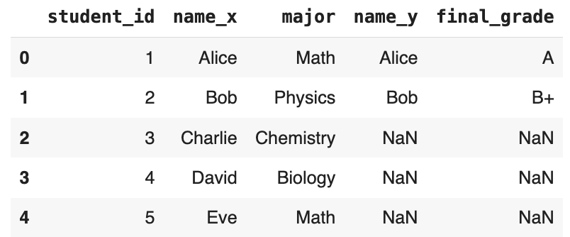
Exercise 2 (Part 4): Solution
merged_df = pd.merge(students_df, grades_df, on='student_id', how='left')
merged_df

