Slide 1
Text Analysis with Python Session 1
Instructor: Claudia Carroll

Slide 2
Goals of the Class
Continue practicing Python basics
Overview some common text-analysis techniques in the humanities and social science
Learn how to implement basic text analysis measures on your own text data

Slide 3
Class Plan
Class 1 | Reading text files and basic word frequency analysis
Class 2 | Bag-of-Word Text analysis (NER, POS-tagging and TF-IDF)
Class 3 | Unsupervised Learning for Text Analysis (Topic Modeling and Clustering)
Class 3 | Supervised Learning for Text Analysis (Traditional Classification and Zero-Shot LLM classification)

Slide 4
Intro to Text Analysis
Bag-of-Words Approaches

Slide 5
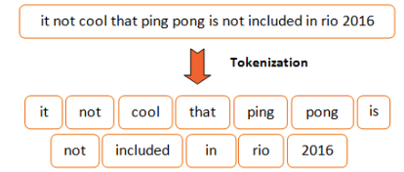
Tokenization
Tokenization is the breaking down of text into components (words, subwords, punctuation etc.)
Tokenization underlies ALL text analysis methods and models

Slide 6
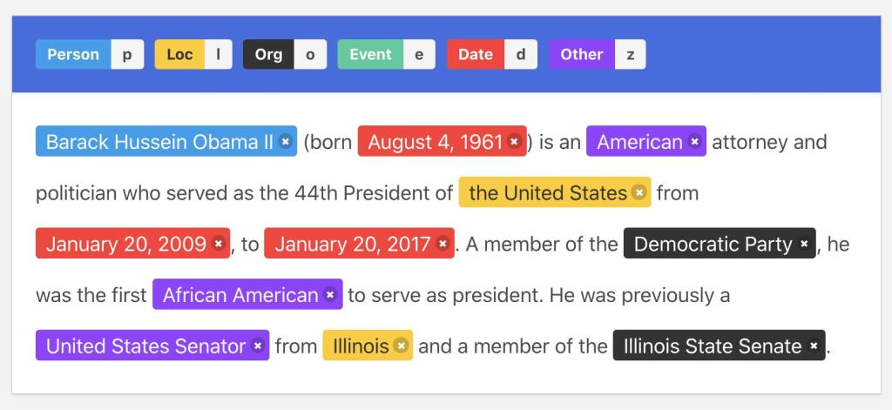
Named Entity Recognition (NER)

Slide 7
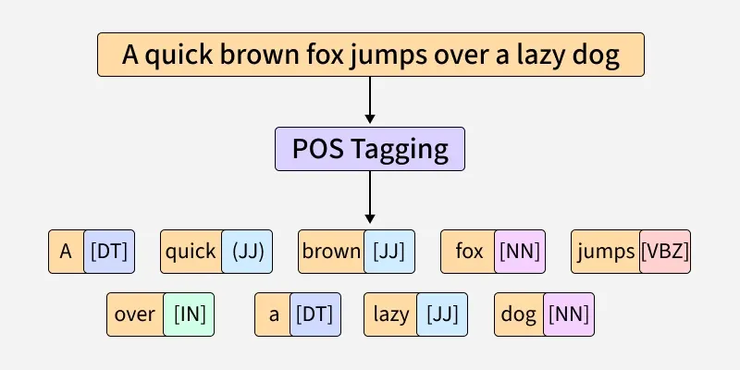
Part-of-Speech Tagging (POS)
Labelling each word in a text with its grammatical part-of-speech (noun, adjective, determiner, verb etc.)

Slide 8
Term-Frequency/Inverse Document Frequency (TF-IDF)
Rapunzel
the
Dwarf
of
Term
Frequency
thje
copyright
pearl
license
Document Frequency

Slide 9
Intro to Text Analysis
Machine Learning

Slide 10
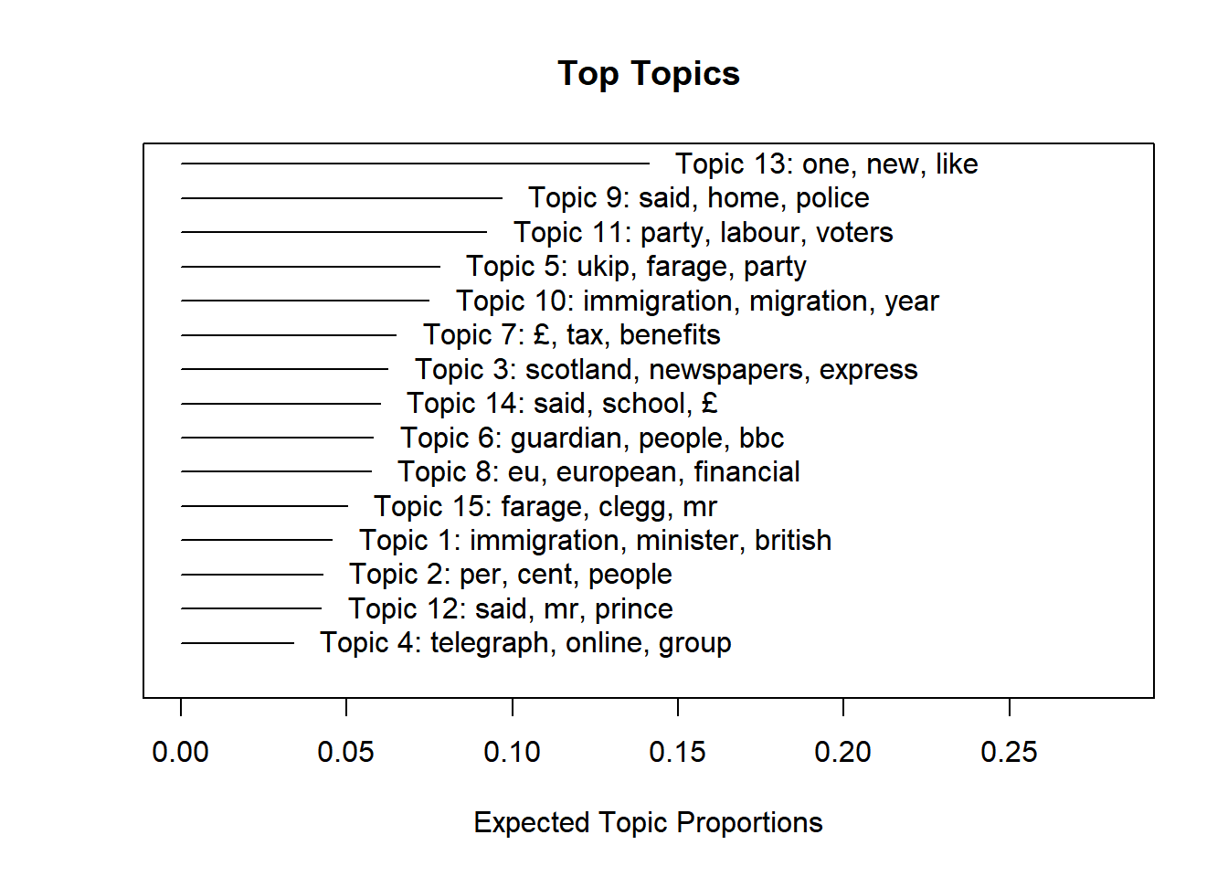
Topic Modelling
Creates lists of words that are likely to appear close to one another in a corpus
These lists can be used to determine ’topics’ or themes in the corpus

Slide 11
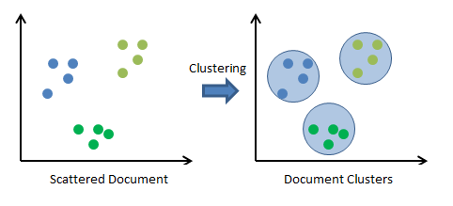
Clustering
Groups texts based on statistical similarities
Similarities can be based on:
user-calculated features
machine-derived features

Slide 12
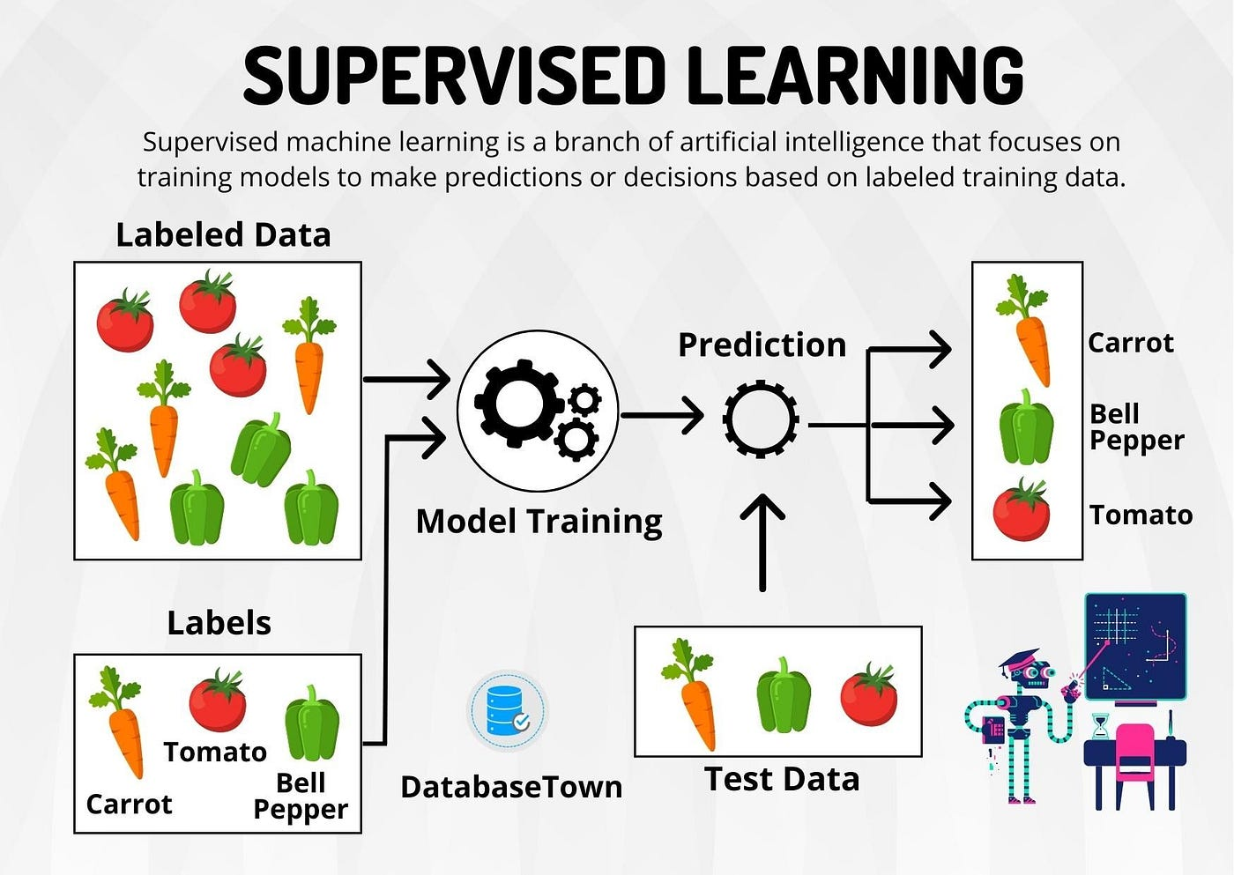
Classification (Traditional Machine Learning)
Predicting text category labels
Predictions are based on ‘training data’
Training data consists of statistics about texts, and the human-assigned text labels
Algorithm determines the features of training texts that best correlate with training labels

Slide 13
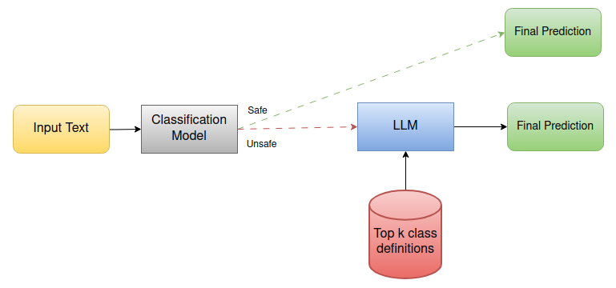
Classification (Large Language Models)
Predicting text category labels
Predictions are based on ‘training data’
Training data consists of texts themselves, and the human-assigned text labels
LLM extracts feature data from texts
Algorithm determines the features of training texts that best correlate with training labels

Slide 14
Today's Lesson
Opening and reading text files
Text processing
Word-frequency analysis

Slide 15
Class Materials
https://github.com/ClaudiaECarroll/intro_text_analysis

Slide 16
Demo 1
Text Processing and Word Frequency Analysis

