Slide 1
Text Analysis with Python Session 1
TRIADS Workshop Fall 2024
Instructor: Claudia Carroll

Slide 2
Goals of the Class
Continue practicing Python basics
Overview some common text-analysis techniques in the humanities and social science
Learn how to implement basic text analysis measures on your own text data

Slide 3
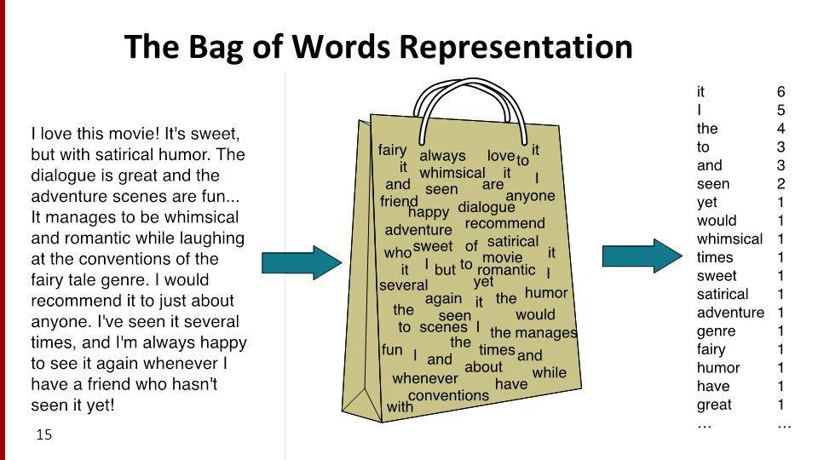
Class Plan
Reading, processing and basic word-frequency analysis
Bag-of-words approaches to text analysis
Part of Speech Tagging
Named Entity Recognition
TF-IDF

Slide 4
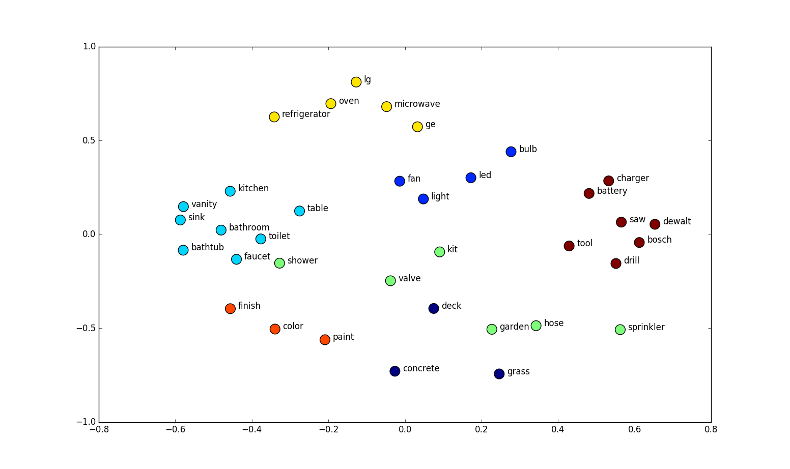
Class Plan
3. Text Vectorization Approaches (Unsupervised Machine Learning)
Topic Modeling
Clustering with Doc2Vec
Text Vectorization Approaches (Supervised Machine Learning)
Classification with Labelled Data
(Time-permitting) Zero-shot classification with BERT

Slide 5
Today's Lesson
Opening and reading text files
Text processing
Word-frequency analysis
https://github.com/ClaudiaECarroll/text_analysis_python

Slide 6
Class Materials
https://github.com/ClaudiaECarroll/text_analysis_python

Slide 7
Demo 1
Text Processing and Word Frequency Analysis

Slide 8
Exercise 1
Calculate and compare the relative frequency of male and female pronouns in rapunzel.txt
Warning: You will have to do a tiny bit of math.

Slide 9
Solution Part 1
# Reading and tokenizing text file
rapunzel = open(os.path.join(grimms_folder, "rapunzel.txt"), encoding="utf-8").read()
tokens = word_tokenize(rapunzel)
# Cleaning tokens of punctuation, and making all lowercase
punctuation = list(string.punctuation)
punctuation.append("‘")
punctuation.append("’")
for token in tokens:
if token in punctuation:
tokens.remove(token)
tokens = [token.lower() for token in tokens]

Slide 10
Solution Part 2
#Checking if pronouns are in the stop word list
if "her" in stopwords:
print("It's a stopword")
else:
print("It's not a stopword")
#Calculating relative frequency
female_pronouns = ["she", "her", "hers", "herself"]
female_pronoun_count = 0
for x in female_pronouns:
for y in tokens:
if x == y:
female_pronoun_count += 1
relative_female_freq = female_pronoun_count / len(tokens)
print("The relative frequency of female pronouns is: " + str(relative_female_freq))

Slide 11
Demo 2 (Bonus)
Sentiment Analysis with VADER

Slide 12
Exercise 2
Calculate the overall sentiment score of all the Grimm's fairytales in our folder, and save them to a csv file (one column for text titles, one for sentiment scores) in order of most positive to most negative.
Notes:
You will have to use os to loop through the directory. Ask google or gemini!
You will have to use pandas to create your csv file

Slide 13
Solution
results = []
for file in os.listdir(grimms_folder):
if file.endswith(".txt"):
file_path = os.path.join(grimms_folder, file)
text = open(file_path, encoding="utf-8").read()
sentiment_scores = sentiment_analyzer.polarity_scores(text)
compound_score = sentiment_scores["compound"]
results.append({"file": file, "sentiment": compound_score})
df_results = pd.DataFrame(results)
df_results.sort_values("sentiment", ascending=False)

