Slide 1
Text Analysis with Python
Session 2
TRIADS Workshop Fall 2024
Instructor: Claudia Carroll

Slide 2
Today's Lesson
Sentiment Analysis
Part of Speech Tagging
Named Entity Recognition
https://github.com/ClaudiaECarroll/intro_text_analysis

Slide 3
Part of Speech Tagging
Part-of-Speech | Tag | Examples
Noun | NN | Paris, Anne, apple
Verb | VB | Run, sit
Adjective | JJ | Red, fast, honest
https://cs.nyu.edu/~grishman/jet/guide/PennPOS.html

Slide 4
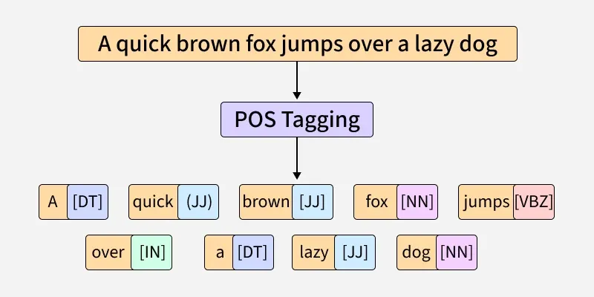
Part of Speech Tagging

Slide 5
Uses of PoS Tagging
Co-reference Resolution
Word Sense Disambiguation (e.g. “reflection”)
Authorship Attribution
Machine Learning
Named Entity Recognition (e.g. “the White House”)

Slide 6
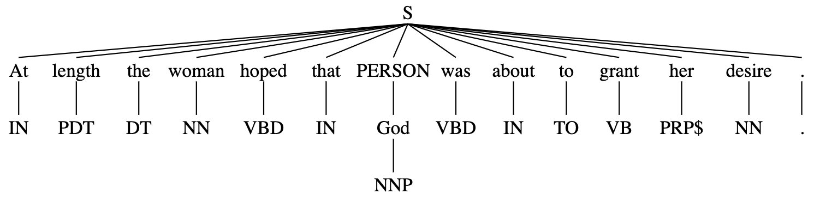
Named Entity Recognition (NER)

Slide 7
Named Entity Recognition (NER)
The extraction of named entities (people, places etc.) from text data
Different from nouns (e.g. the park vs. Central Park)
Based on statistical modeling
Uses:
Character analysis!
Search engines
Disambiguation (e.g. The White House)

Slide 8
NER Models
NLTK
SpaCy
Stanford NER
BookNLP
BERT
GPT
Choosing an NER model
Is the training data similar to your data?
How unusual is your text?
What computational resources do you have available to you?
What accuracy rates do you need?

Slide 9
Demo
Part-of-Speech Tagging and Named Entity Recognition

