Slide 1
Introduction to Python
TRIADS Training Series
Instructor: Claudia Carroll

Slide 2
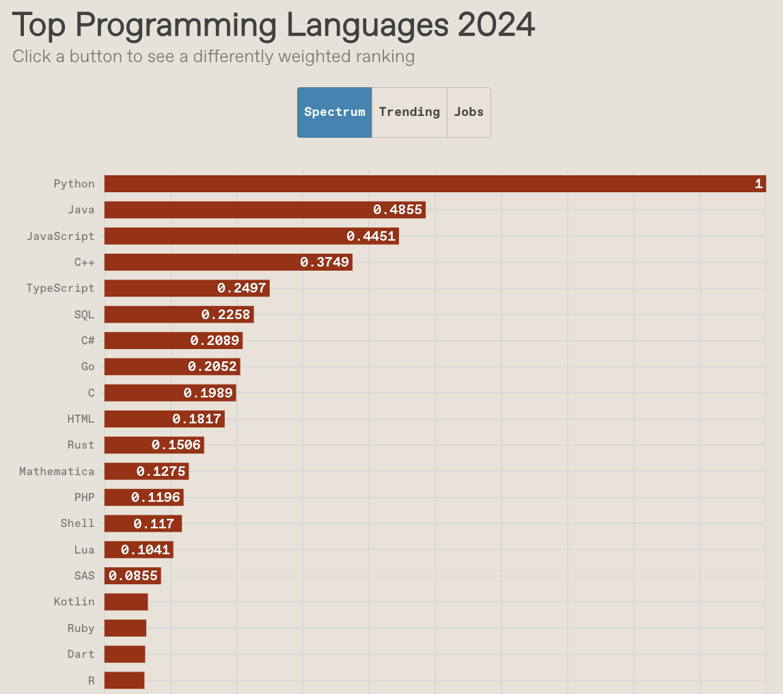
IEEE Developer Survey 2024

Slide 3
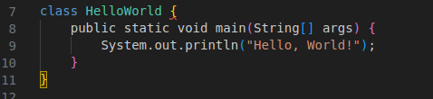

Strengths: Readability and Concision
Java: Python:

Slide 4
Strengths: Flexibility
Natural Language Processing
Machine Learning
Web and game development (back-end)
Data Analysis

Slide 5
Goals of the Class
Learn the basic building blocks of Python programs (lists, loops, functions etc.)
Become familiar with coding logic
Develop basic skills in text and numerical data analysis

Slide 6
Class Plan
Tuesday | Intro Python: variables, operators, comparisons and conditionals)
Wednesday | Building Programs: For loops and Functions
Thursday | Pandas: Data Cleaning and Exploration
Friday | Pandas: Data Summary and Aggregation

Slide 7
Today's Lesson

Slide 8
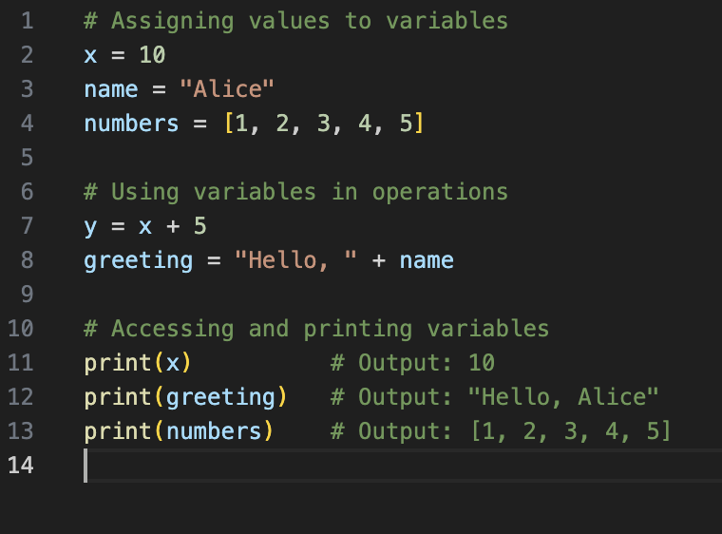
Variables
Used to store data
Different data types can be assigned to variables
Variables are used within code

Slide 9
Python Main Data Types
Strings | "Heuston, we have a problem"
Integers | 35
Floats | 35.6
Lists (data collection type) | ["apple", 12, "computer science", "apple", 13.2] Order is saved Can be rearranged after list is defined Can contain duplicates Elements can be added or removed Indicated by square brackets

Slide 10
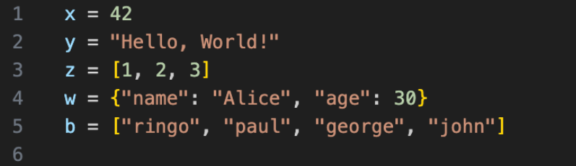

Slide 11
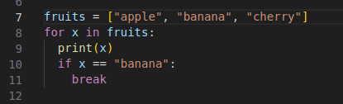
Python Syntax
Indentation
Case sensitive
Quotation marks
Parentheses
Commas

Slide 12
Errors
Syntax Error
Name Error
Type Error
Index Error

Slide 13
Syntax Errors
>>> print ("Hello, world!)
File "<stdin>", line 1
print ("Hello, world!)
^
SyntaxError: unterminated string literal (detected at line 1)

Slide 14
Name Error
>>> age = 12
>>> print(age, other)
Traceback (most recent call last):
File "<stdin>", line 1, in <module>
NameError: name 'other' is not defined. Did you mean: 'iter'?

Slide 15
Type Error
>>>x = "10"
>>>y = 5
>>>z = x + y
>>>print(z)
Traceback (most recent call last call):
File "c:\Users\name\OneDrive\Desktop\demo.py", line 3, in <module>
Z = x + y
~~^~~
TypeError: can only concatenate str (not "int") to str

Slide 16
Index Error
>>>my_list = [100, 200, 300, 400, 500]
>>>print(my_list[7])
Traceback (most recent call last):
File "c:\Users\name\OneDrive\Desktop\demo.py", line 2, in <module>
print(my_list[p
~~^~~
IndexError: list index out of range

Slide 17
GitHub Repo
https://github.com/ClaudiaECarroll/triads_intro_python

Slide 18
Google Colab
https://colab.research.google.com/

Slide 19
Demo 1
Getting Started with Python: Data types and variables

