Slide 1
Introduction to Python
Reading Text Files and Working with Text Data

Slide 2
Character Encoding
UTF-8 is standard
Other options:
ASCII
UTF-16/UTF-32
You need to know the encoding to read the file correctly
Unicode Error:
The file cannot be read using specified encoding
The file is partially read, with problems

Slide 3
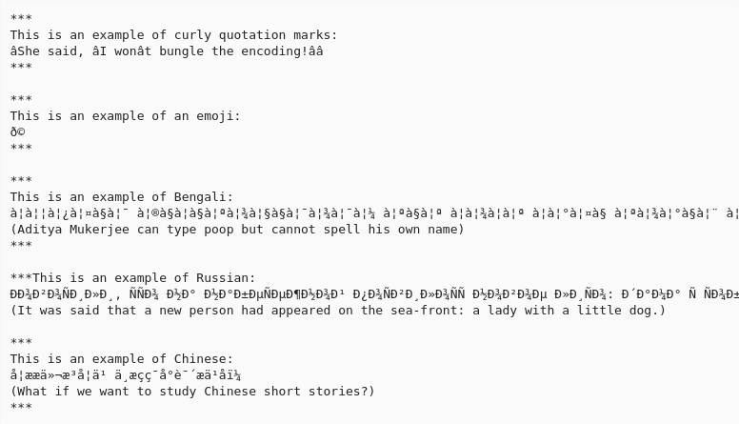
Example of text file opened with incorrect encoding

Slide 4
Text Files: Things to Remember
You have to open a file before you can read and write
You have to specify character encoding (usually UTF-8)
In some versions of python, writing overwrites

